Slide 1
Data 8, Lab 2
Hubert Luo
Fall 2019

Slide 2
Causality
Treatment: Factor of interest
Outcome: What is being measured
Example: Study the effect of capital punishment on a state’s murder rate
Treatment: Whether a state has capital punishment
Outcome: A state’s murder rate

Slide 3
Causality
Association: Any relationship between the treatment and outcome (aka there is a correlation between them)
Causation: The treatment causes the outcome
Correlation does not imply causation!!!!
Example: Study the effect of capital punishment on a state’s murder rate
Association: Most states who have capital punishment also have high murder rate
Outcome: Having capital punishment causes states to have murder rate

Slide 4
Association vs. Causation
Two variables being associated does not mean one causes the other!!
Example: Study the effect of capital punishment on a state’s murder rate
Even if states with capital punishments also have high murder rates, it does not mean having capital punishment causes them to have high murder rates

Slide 5
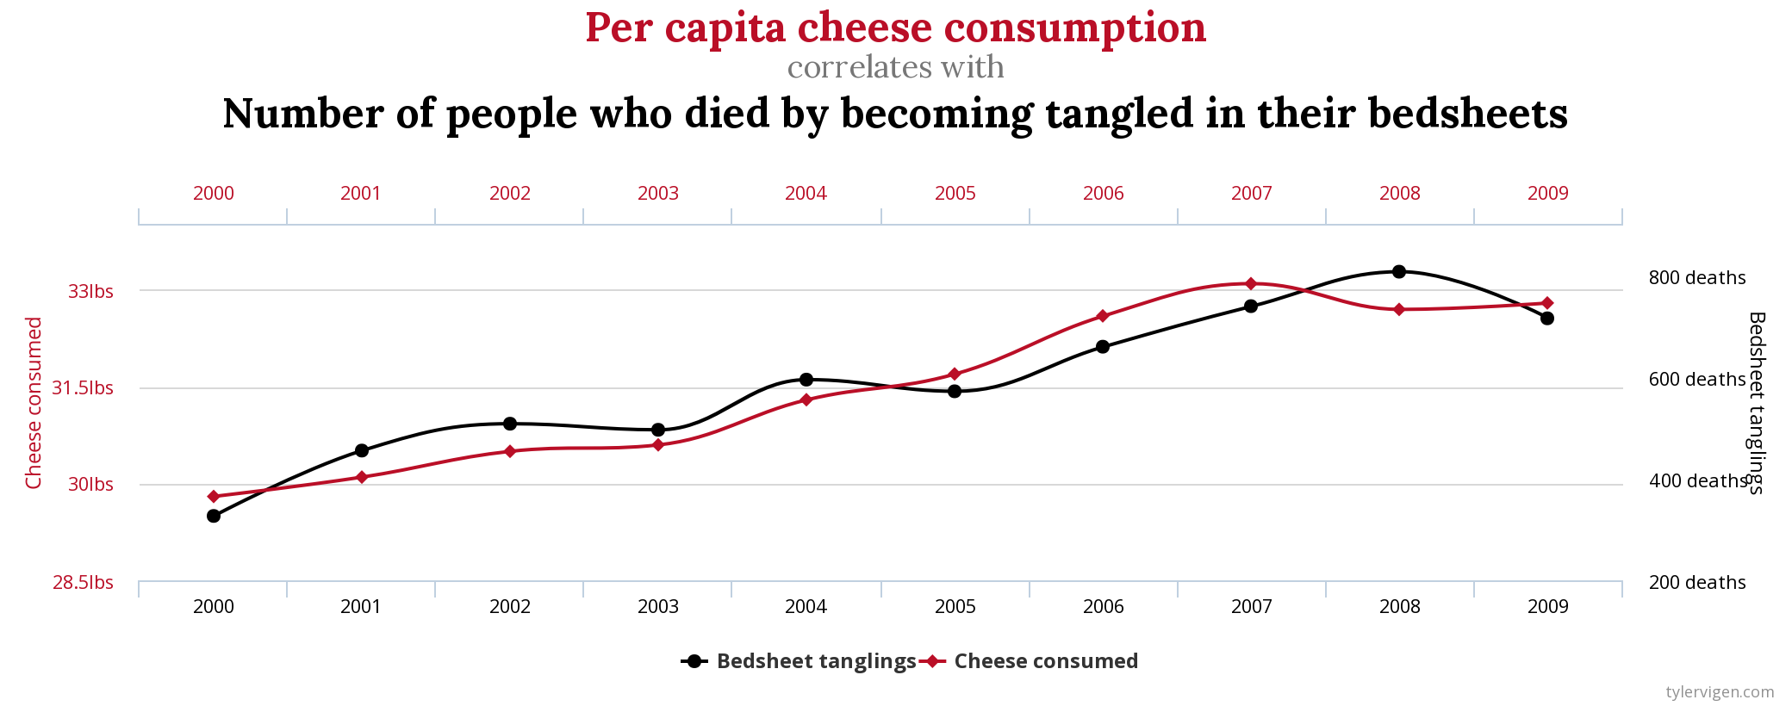
Association vs. Causation

Slide 6
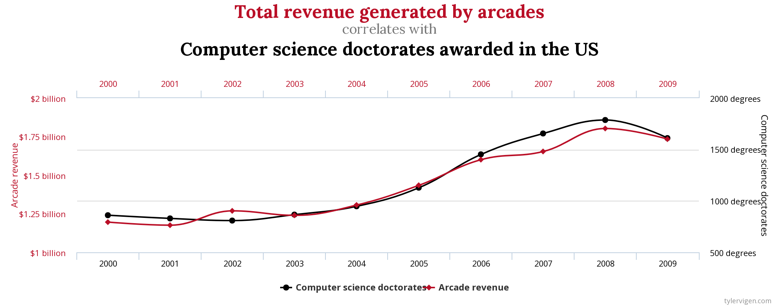
Association vs. Causation

Slide 7
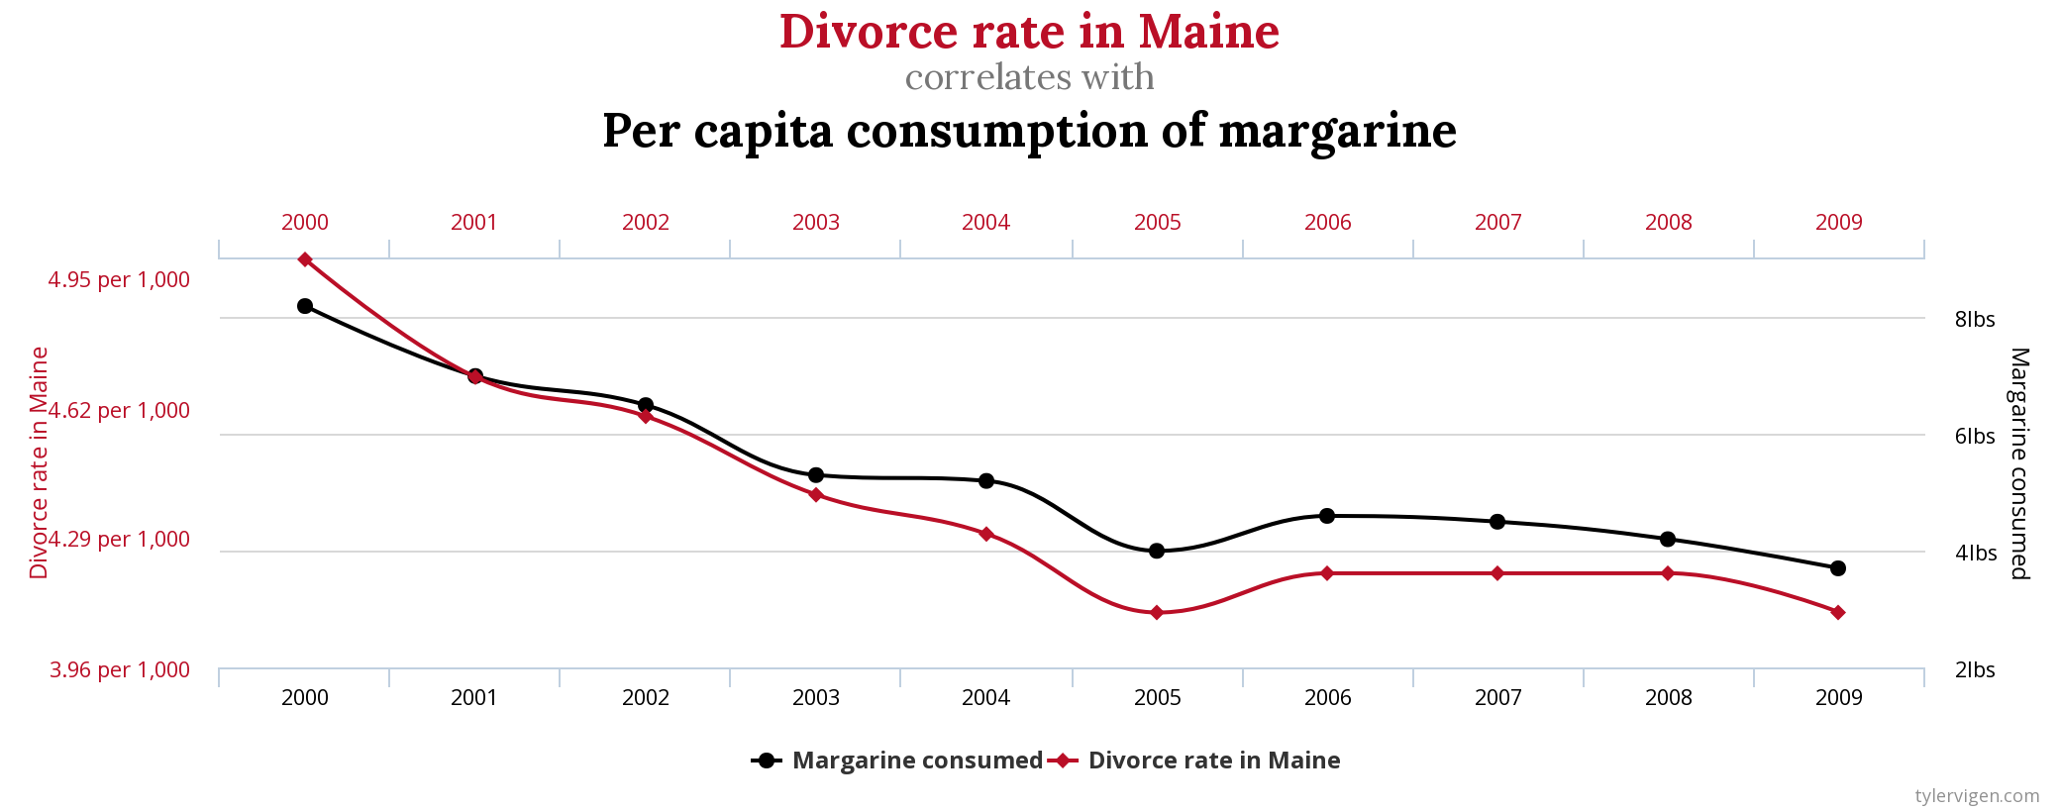
Association vs. Causation

Slide 8
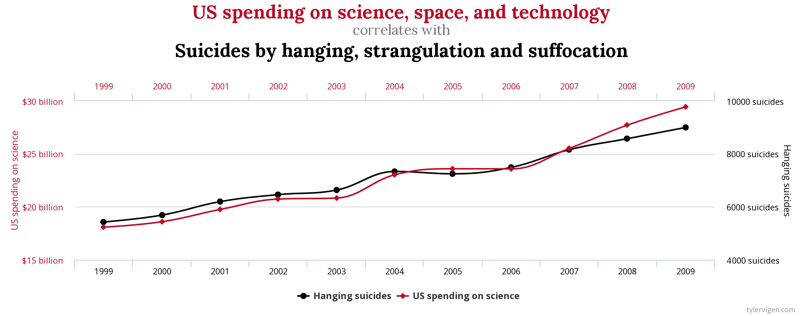
Association vs. Causation

Slide 9
Association vs. Causation
Confounding Factors: Other variables unaccounted for in relationship between treatment and outcome
Example: Study the effect of capital punishment on a state’s murder rate
Lots of other possible explanations: literacy rates, living standards, unemployment, gun control
We do not know which one causes higher murder rates

Slide 10
Establishing Causality
Treatment Group: Treatment applied
Control Group: Treatment not applied
Example: Study the effect of capital punishment on a state’s murder rate
Treatment Group: States with capital punishment
Control Group: States without capital punishment

Slide 11
Establishing Causality
Observational Study: Experimenter has no ability to divide into treatment and control groups
Randomized Control Experiment: Randomly divide into treatment and control group
Example: Study the effect of capital punishment on a state’s murder rate
Observational study since researchers cannot just randomly decide which states have capital punishment or not

Slide 12
Establishing Causality
Example: Researcher test the effect of a new drug on lung cancer by giving the drug to 75% of subjects (randomly selected), and a placebo drug to the other subjects
Randomized control experiment since researcher randomly selected treatment and control groups
Example: Psychologist stood outside an elementary school and asked the first 100 students they saw whether the student played basketball
Observational or randomized study?

Slide 13
Establishing Causality
Observational Study: Cannot prove causation!!
Randomized Control Experiment: Can sometimes prove causation, but also other potential problems:
Selection bias: Study’s subjects don’t represent a typical member of the population
Example: Drug trial subjects are only white males
Measurement error: People don’t answer truthfully
Example: Farmers may underestimate crop numbers to get more aid in a government agriculture survey
Questionnaire design: Leading questions, order of questions
Example: “Do you agree with America’s pointless intervention in Afghanistan?”
Come to OH to hear more or check out Stat 152: Sampling Surveys!

Slide 14
More Resources
http://data8.org/materials-sp18/lec/ch2notes.pdf

Slide 15
Announcements

Slide 16
Lab Notebook
TBD

