Slide 1
Data 8, Lab 3
Hubert Luo
Fall 2019

Slide 2
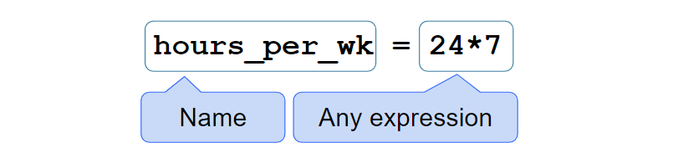
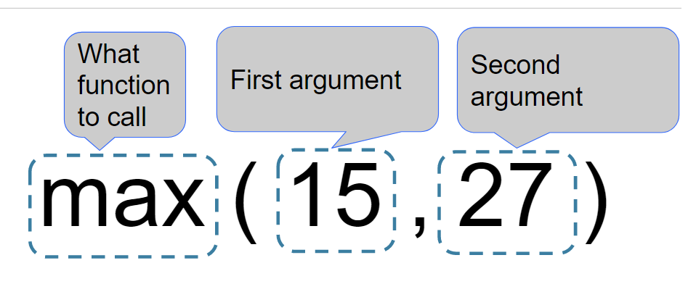
Variables and Function Calls

Slide 3
Expressions: Common Functions
Expression Type | Operator | Example | Value
Addition | + | 2 + 3 | 5
Subtraction | - | 2 - 3 | -1
Multiplication | * | 2 * 3 | 6
Division | / | 7 / 3 | 2.66667
Remainder | % | 7 % 3 | 1
Exponentiation | ** | 2 ** 0.5 | 1.41421

Slide 4
Expressions: Common Functions
Function | Description | Example
abs | Returns the absolute value of its argument | abs(-3) -> 3
max | Returns the maximum of all its arguments | max(1,2) -> 2
min | Returns the minimum of all its arguments | min(1,3) -> 1
pow | Raises its first argument to the power of its second argument | pow(2,0) -> 1
round | Rounds its argument to the nearest integer | round(0.6) -> 1

Slide 5
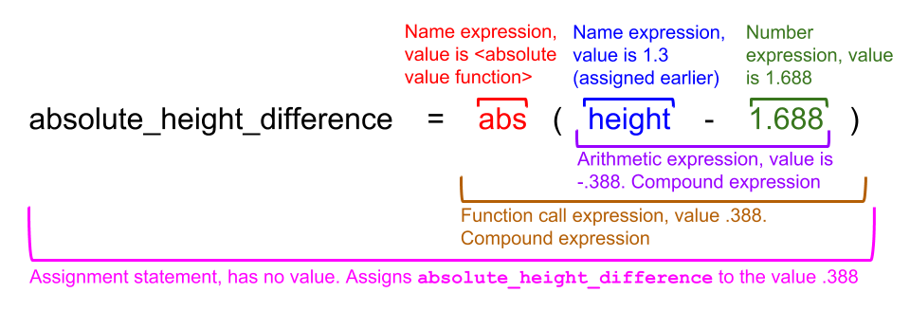
Expressions

Slide 6
Expressions: Demo
(Demo on Notebook)

Slide 7
Selected Table Operations
Name | Purpose | Example
sort | Create a copy of a table sorted by the values in a column | tbl.sort("N")
where | Create a copy of a table with only the rows that match some predicate | tbl.where("N", are.above(2))
num_rows | Compute the number of rows in a table | tbl.num_rows
num_columns | Compute the number of columns in a table | tbl.num_columns
select | Create a copy of a table with only some of the columns | tbl.select("N")
drop | Create a copy of a table without some of the columns | tbl.drop("N")

Slide 8
Selected Where Predicates
Predicate | Result | Example
are.equal_to | Find rows with values equal to 50 | are.equal_to(50)
are.not_equal_to | Find rows with values not equal to 50 | are.not_equal_to(50)
are.above | Find rows with values above (and not equal to) 50 | are.above(50)
are.above_or_equal_to | Find rows with values above 50 or equal to 50 | are.above_or_equal_to(50)
are.below | Find rows with values below 50 | are.below(50)
are.between | Find rows with values above or equal to 2 and below 10 | are.between(2, 10)

Slide 9
Tables: Demo
(Demo on Notebook)

Slide 10
Announcements

Slide 11
Lab Notebook
TBD

