Slide 1
Data 8, Lab 9
Skewness, Normality, and Sample Means
Hubert Luo
Fall 2019
8 November 2019

Slide 2
Agenda
Skewness
Variability
Chebyshev’s Bounds
Standard Units
Normal Distribution
Central Limit Theorem
Distribution of Sample Means

Slide 3
Skewness
Left skew
Long left tail
Mean < Median
Right skew
Long right tail
Mean > Median

Slide 4
Variability
Variance: How spread out is the data?
Standard Deviation: Square root of the variance
Same unit as the data
The larger the SD, the more spread out the data is

Slide 5
Chebyshev’s Bounds
Regardless of the distribution, the proportion of values in the range “average ± z SDs” is at least 1 - 1/z²
Range | Proportion
average ± 2 SDs | at least 1 - 1/4 (75%)
average ± 3 SDs | at least 1 - 1/9 (88.888…%)
average ± 4 SDs | at least 1 - 1/16 (93.75%)
average ± 5 SDs | at least 1 - 1/25 (96%)

Slide 6
Standard Units
Standard Unit: Number of SD’s above or below average
Allows us to easily compare different distributions and units
Z = (value-average)/SD
Average of standard units is always 0
SD of standard units is always 1

Slide 7
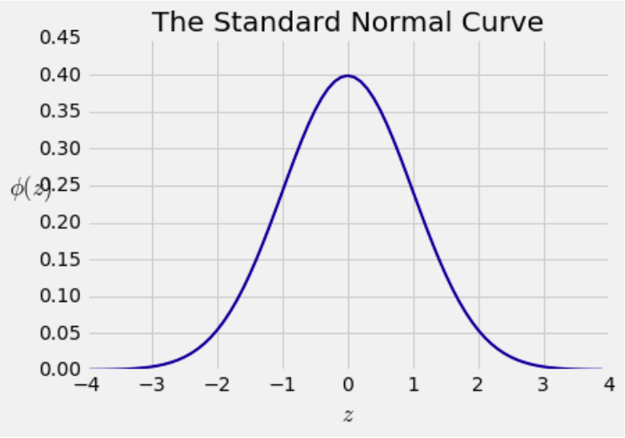
Normal Distribution
An extremely common distribution in statistics, shaped like a bell curve
Most of the data is within a few SD’s of the mean

Slide 8
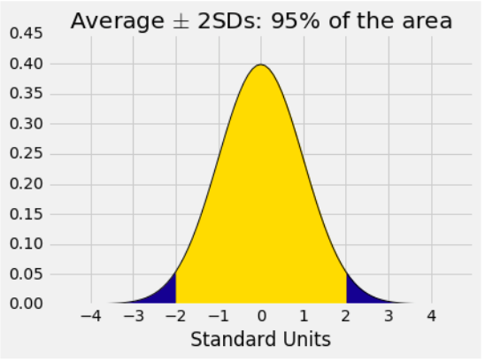
Normal Distribution (cont’d)
Range | All Distributions | Normal
average ± 1 SDs | at least 0% | 68%
average ± 2 SDs | at least 75% | 95%
average ± 3 SDs | at least 88.9% | 99.7%

Slide 9
Central Limit Theorem
If the sample is large and drawn at random with replacement
Regardless of the distribution of the population, the distribution of the sample sum or average is roughly normal
Distribution of the sample sum/average:
Many possible random samples of the same size
Distribution is based on the sum/average of different samples

Slide 10
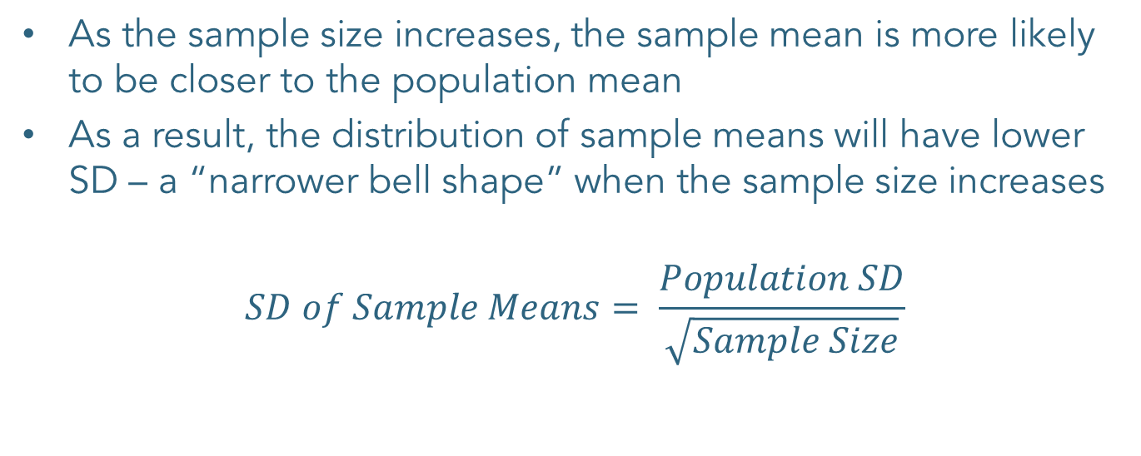
Distribution of Sample Mean
As the sample size increases, the sample mean is more likely to be closer to the population mean
As a result, the distribution of sample means will have lower SD – a “narrower bell shape” when the sample size increases
$$SD of Sample Means= \frac{Population SD}{\sqrt{Sample Size}}$$

Slide 11
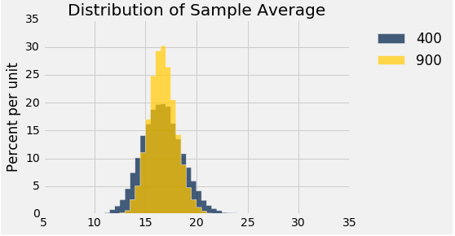
Distribution of Sample Mean

Slide 12
Announcements
Checkpoint 2 of Project 2 due today (11/8)
Homework 10 due next Thursday (11/14)
No class next Monday (11/11)

