Slide 1
Data 8, Lab 12
Residuals
Hubert Luo
Fall 2019
5 December 2019

Slide 2
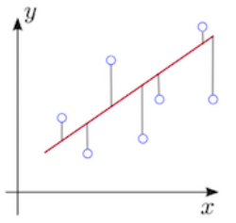
Regression
Predict the value of a continuous random variable
Example: predict the height of a child given the height of a parent
In Data 8, we use an algorithm called Least Squares
This creates a linear prediction

Slide 3
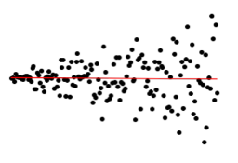
Residuals
Residual = Actual Value – Predicted Value (via Least Squares)
The residual plot of a good regression (a linear model) shows no patterns in the graph of the residuals
Average of residuals is always 0
Heteroscedastic: Uneven variation of residuals around the horizontal line at 0
The regression estimates are not equally accurate
Example:

Slide 4
Standard Deviations
SD of the Residuals = np.sqrt(1-r**2) * SD_of_y
It is also a fraction of the SD of the response variable (y)
The SD tells us how good the linear predictor
The smaller the SD of Residuals, the closer the residuals are to their mean
Mean of Residuals is always 0
Example: If r=1 (perfect correlation), there SD of residuals is 0 since we have a perfect linear relationship between X and y
SD of Predicted Values = |r| * SD of y

Slide 5
Announcements
Topical Review Labs for RRR Week
Leads review on Wed and Fri of RRR Week
Watch the past semesters Wagner Security lecture
Final question might be related
can be found on last semester's calendar: http://data8.org/sp19/ on Friday 4/19
Course evaluations threshold is 80%. If the entire class meets the threshold, everyone gets an extra point on the final.
If you’re interested, apply to be a Lab Assistant next semester!
Application will be posted during winter break on piazza

