Slide 1
Data 8, Lab 2
Causality, Expressions, and Table Operations
Hubert Luo
Fall 2019
6 September 2019

Slide 2
Agenda
Causality
Expressions: Variables and Function Calls
Some Tables Operations
Lab Notebook

Slide 3
Lab Assistants
We have three lab assistants who will be joining us this semester!

Slide 4
Causality
Treatment: Factor of interest
Outcome: What is being measured
Example: Study the effect of capital punishment on a state’s murder rate
Treatment: Whether a state has capital punishment
Outcome: A state’s murder rate

Slide 5
Causality
Association: Any relationship between the treatment and outcome (i.e., there is a correlation between them)
Causation: The treatment causes the outcome
Association does not imply causation!!!!
Example: Study the effect of capital punishment on a state’s murder rate
Association: Most states who have capital punishment also have high murder rate
Outcome: Having capital punishment causes states to have high murder rate

Slide 6
Association vs. Causation
Two variables being associated does not mean one causes the other!!
Example: Study the effect of capital punishment on a state’s murder rate
Even if states with capital punishments also have high murder rates, it does not mean having capital punishment causes them to have high murder rates

Slide 7
Association vs. Causation
Confounding Factors: Other variables unaccounted for in relationship between treatment and outcome
Example: Study the effect of capital punishment on a state’s murder rate
Lots of other possible explanations: literacy rates, living standards, unemployment, gun control
We do not know which one causes higher murder rates

Slide 8
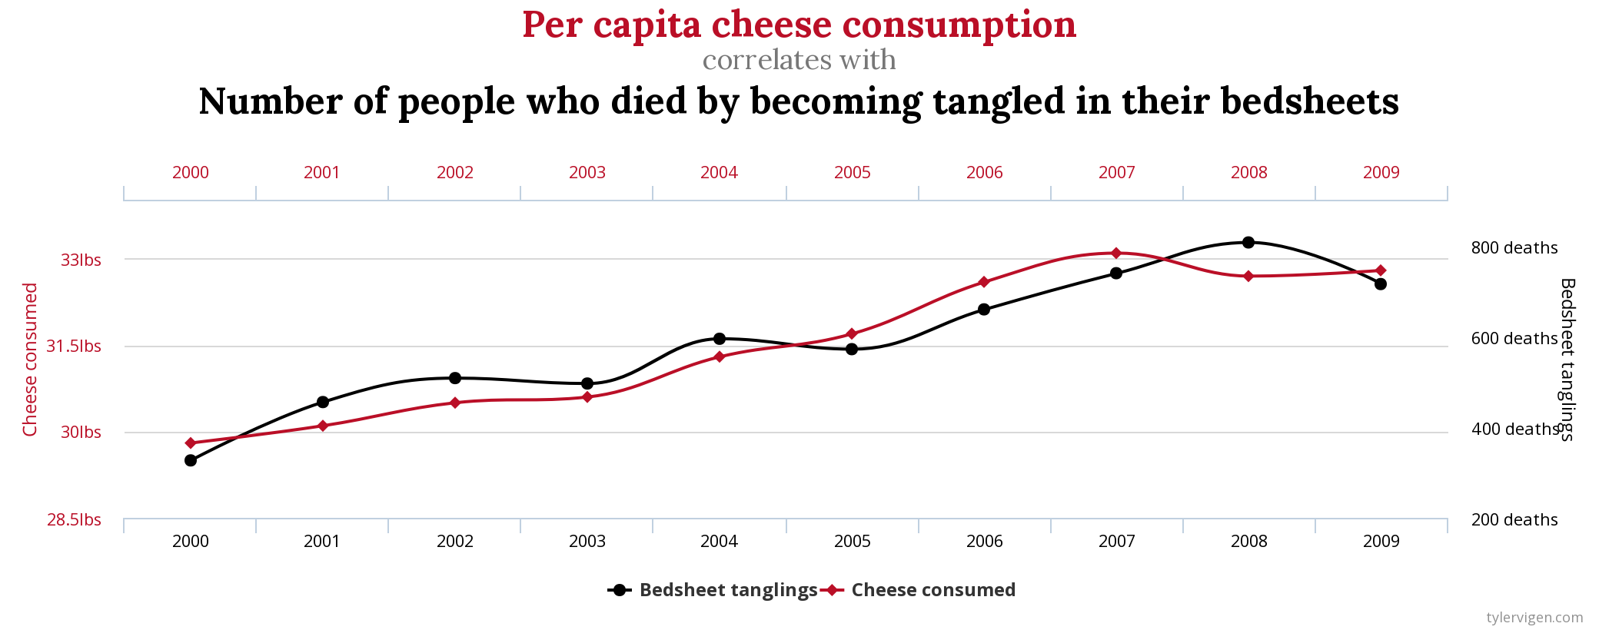
Association vs. Causation

Slide 9
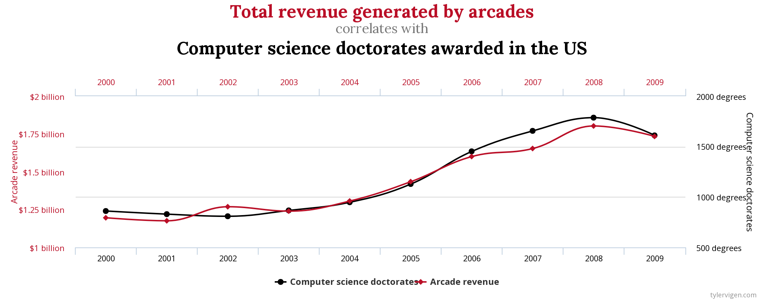
Association vs. Causation

Slide 10
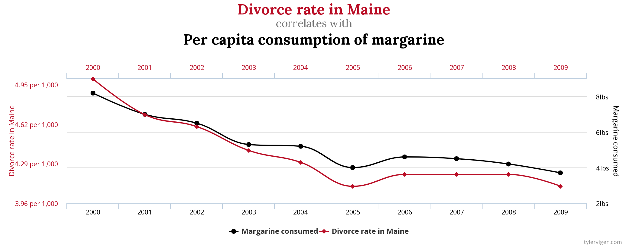
Association vs. Causation

Slide 11
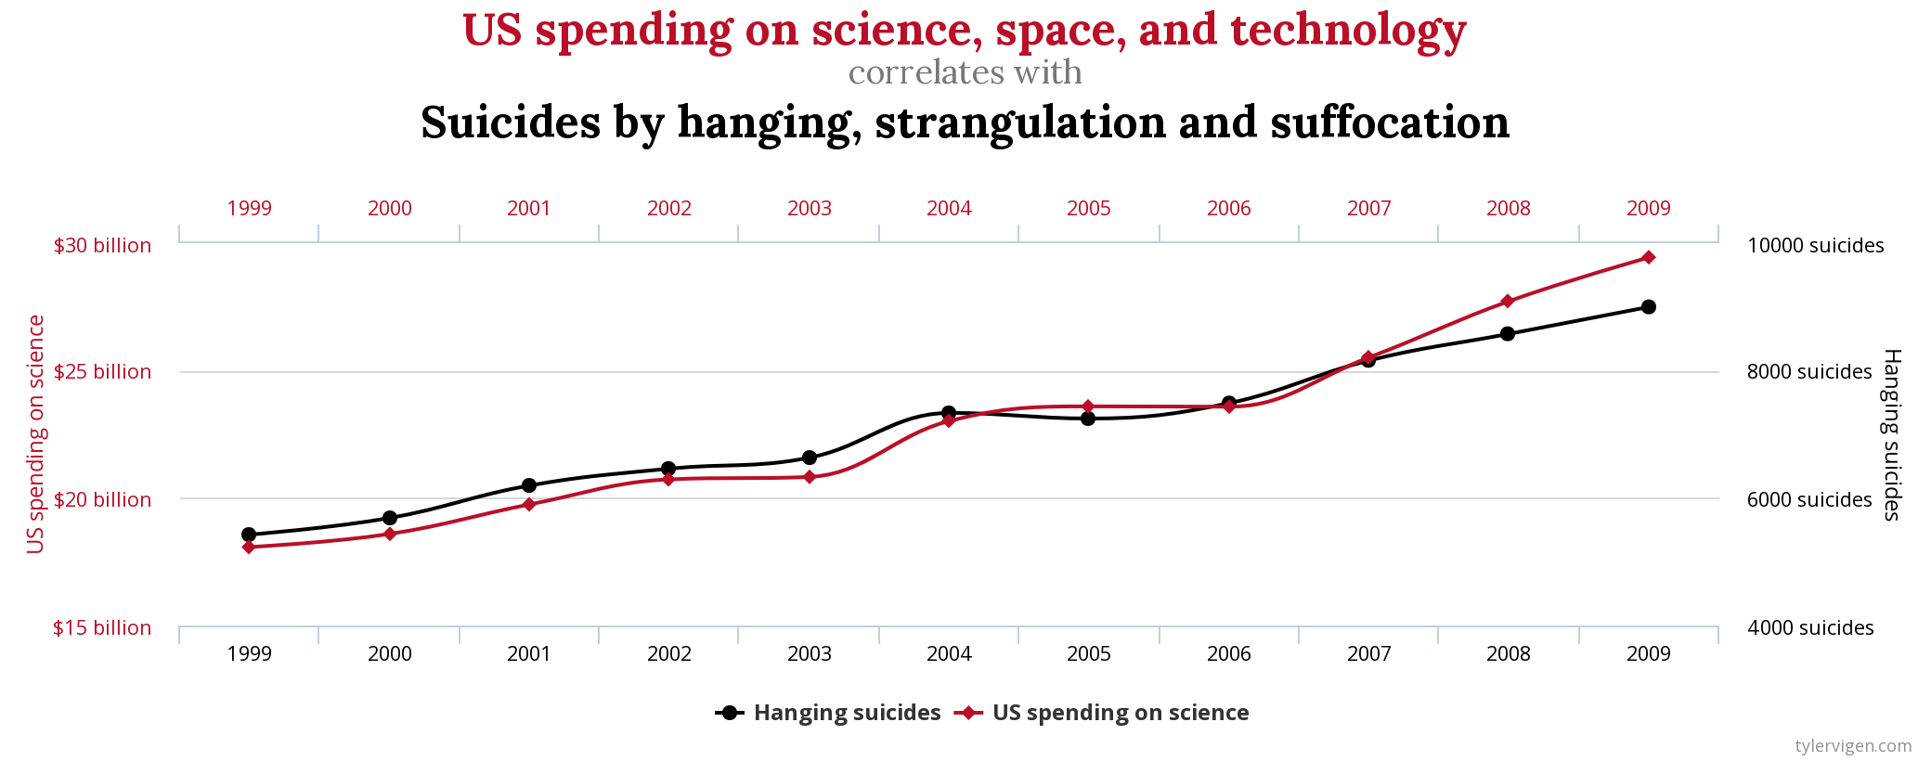
Association vs. Causation

Slide 12
Establishing Causality
Treatment Group: Treatment applied
Control Group: Treatment not applied
Example: Study the effect of capital punishment on a state’s murder rate
Treatment Group: States with capital punishment
Control Group: States without capital punishment

Slide 13
Establishing Causality
Observational Study: Experimenter has no ability to divide study participants into treatment and control groups
Randomized Control Experiment: Randomly divide participants into treatment and control group
Example: Study the effect of capital punishment on a state’s murder rate
Observational study since researchers cannot just randomly decide which states have capital punishment or not

Slide 14
Establishing Causality: Examples
Researcher test the effect of a new drug on lung cancer by giving the drug to 75% of participants selected at random and a placebo drug to the other subjects
Randomized control experiment since researcher randomly selected treatment and control groups
Psychologist stood outside an elementary school and asked the first 100 students they saw whether the student played basketball
Observational study since researcher doesn’t control who gets asked the question

Slide 15
Establishing Causality
Observational Study: Cannot prove causation!!
Randomized Control Experiment: Can sometimes prove causation, but also other potential problems:
Selection bias: Study’s subjects don’t represent a typical member of the population
Example: Drug trial subjects are only white males
Measurement error: People don’t answer truthfully
Example: Farmers may underestimate crop numbers to get more aid in a government agriculture survey
Questionnaire design: Leading questions, order of questions
Example: “Do you agree with America’s pointless intervention in Afghanistan?”
Come to OH to hear more or check out Stat 152: Sampling Surveys!

Slide 16
More Resources
http://data8.org/materials-sp18/lec/ch2notes.pdf

Slide 17
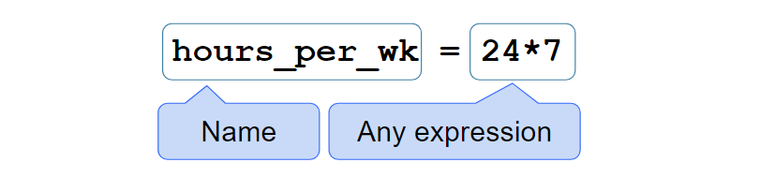
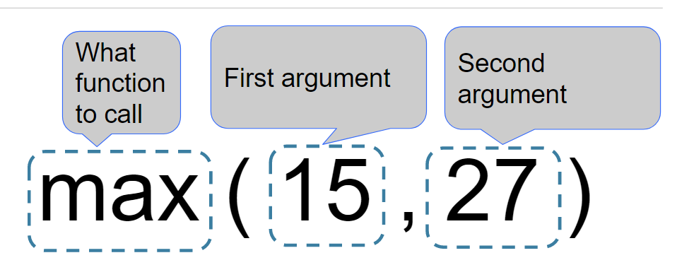
Variables and Function Calls

Slide 18
Expressions: Common Functions
Expression Type | Operator | Example | Value
Addition | + | 2 + 3 | 5
Subtraction | - | 2 - 3 | -1
Multiplication | * | 2 * 3 | 6
Division | / | 7 / 3 | 2.66667
Remainder | % | 7 % 3 | 1
Exponentiation | ** | 2 ** 0.5 | 1.41421

Slide 19
Expressions: Common Functions
Function | Description | Example
abs | Returns the absolute value of its argument | abs(-3) -> 3
max | Returns the maximum of all its arguments | max(1,2) -> 2
min | Returns the minimum of all its arguments | min(1,3) -> 1
pow | Raises its first argument to the power of its second argument | pow(2,0) -> 1
round | Rounds its argument to the nearest integer | round(0.6) -> 1

Slide 20
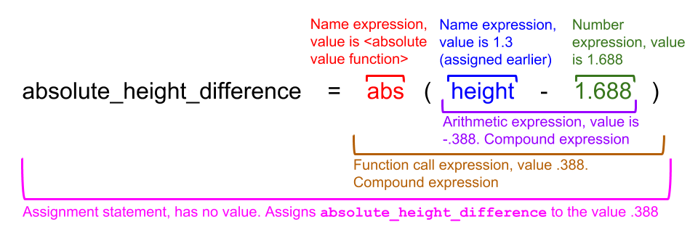
Expressions

Slide 21
Expressions: Demo
(Demo on Notebook)

Slide 22
Some Table Operations
Name | Purpose | Example
sort | Create a copy of a table sorted by the values in a column | tbl.sort("N")
where | Create a copy of a table with only the rows that match some predicate | tbl.where("N", are.above(2))
num_rows | Compute the number of rows in a table | tbl.num_rows
num_columns | Compute the number of columns in a table | tbl.num_columns
select | Create a copy of a table with only some of the columns | tbl.select("N")
drop | Create a copy of a table without some of the columns | tbl.drop("N")

Slide 23
Some Where Predicates
Predicate | Result | Example
are.equal_to | Find rows with values equal to 50 | are.equal_to(50)
are.not_equal_to | Find rows with values not equal to 50 | are.not_equal_to(50)
are.above | Find rows with values above (and not equal to) 50 | are.above(50)
are.above_or_equal_to | Find rows with values above 50 or equal to 50 | are.above_or_equal_to(50)
are.below | Find rows with values below 50 | are.below(50)
are.between | Find rows with values above or equal to 2 and below 10 | are.between(2, 10)

Slide 24
Tables: Demo
(Demo on Notebook)

Slide 25
Announcements
HW2 due Thursday 9/12
Tutoring section sign-ups have been released
Work with a tutor and other students in a small group setting

Slide 26
Lab Notebook
TBD

