Slide 1
Data 8, Lab 11
Classification and k-Nearest Neighbours
Hubert Luo
Fall 2019
22 November 2019

Slide 2
Classification
Goal: Predict categorical data
In this course, we will use known, labelled data points to predict the label of unknown data points
Given a set of attributes for a data point, what label do we predict the data point to have?
Examples:
Predict whether or not a patient has cancer
Predict the year of a student at Cal
Predict if an email is spam

Slide 3
Training vs Testing Data
Training Data: All known, labelled data points
We use our training data to create our model
Test Data: All unknown data points whose labels we are trying to predict
We use our test data to evaluate how well our model does
Allows us to ask how well our model generalizes to unknown data our model hasn’t seen yet

Slide 4
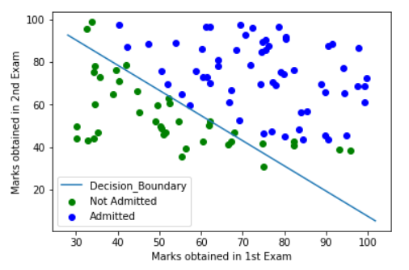
Decision Boundary
Decision Boundary: The curve that divides all the data based on the predicted label
May have points on the wrong side if the predictions are wrong!

Slide 5
K-Nearest Neighbours
Idea: Use the labels of the known data points (training set) closest to an unknown data point (test set) to predict its label
Find the distance between the unknown data point and each known data point in the training set
Sort all the data points based on the calculated distance
Take the k closest data points (“neighbours”) and find their labels
The predicted label for the unknown data point is the majority of the labels of the k closest neighbours

Slide 6
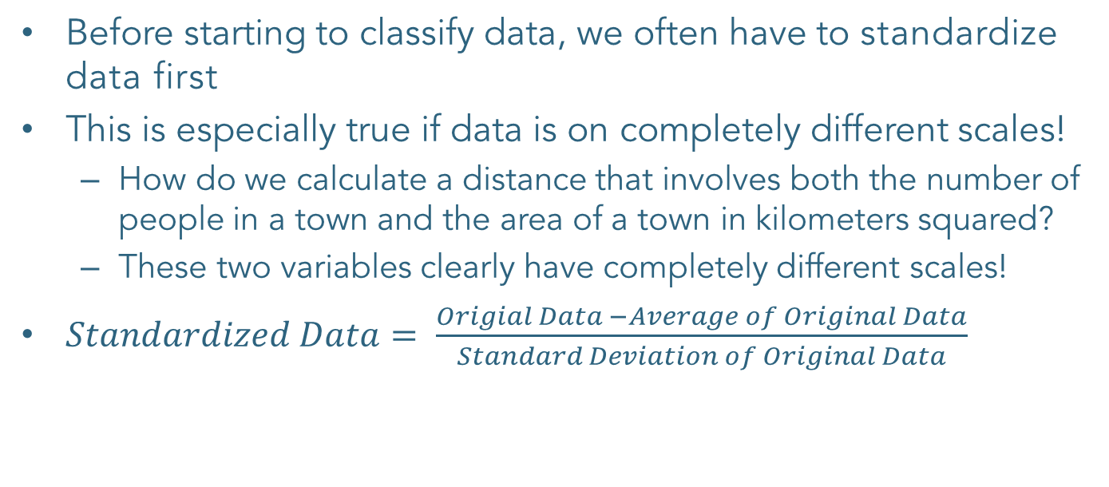
Standardizing Data
Before starting to classify data, we often have to standardize data first
This is especially true if data is on completely different scales!
How do we calculate a distance that involves both the number of people in a town and the area of a town in kilometers squared?
These two variables clearly have completely different scales!
$Standardized Data= \frac{Origial Data −Average of Original Data}{Standard Deviation of Original Data}$

Slide 7
Announcements
Project 3 checkpoint 1 is due today (11/22)
Final project deadline is 12/6.
HW12 will be released today and due on 12/6.
Next week is American Thanksgiving:
Monday lecture will be held as normal
No lecture on Wednesday-Friday, and no lab, office hours, tutoring sections, or assignment deadlines

