Slide 1
Data 8, Lab 9
Linear Regression and Residuals
Hubert Luo
Spring 2020
17 April 2020

Slide 2
Overview
Predict the value of a continuous random variable
Example: predict the number of students attending lab (dependent variable) using the air quality (independent variable)
Dependent variable on the x axis, independent variable on the y axis
Fit a regression line to represent the points on the graph
Can use regression line to predict the y value for points on the x axis

Slide 3

Linear Regression Equation
estimate of y = slope * x + intercept
Slope =$r ∗ \frac{Standard Deviation of y}{Standard Deviation of x}$
Intercept = Average of y – Slope * Average of x

Slide 4
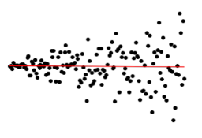
Residuals
Residual = Actual Value of y – Predicted Value of y
The residual plot of a good regression (a linear model) shows no patterns in the graph of the residuals
Average of residuals is always 0
Heteroscedastic: Uneven variation of residuals around the horizontal line at 0
This means that the regression estimates are not equally accurate! For example, this model is better at predicting when x values are small than when x values are large:

Slide 5
Standard Deviation of Residuals
SD of the Residuals = np.sqrt(1-r**2) * SD_of_y
The SD tells us how good the linear predictor is
The smaller the SD of Residuals, the closer the residuals are to their mean
Mean of Residuals is always 0
Example: If r=1 (perfect correlation), there SD of residuals is 0 since we have a perfect linear relationship between X and y
SD of Predicted Values = |r| * SD of y

Slide 6
Announcements
Project 2 is due today (4/17)
Watch year's lecture on privacy here
Material will be on the final!
For labs 7 through 12, we'll be adding one extra lab drop, and changing the policy for how to get credit: you only need to pass at least 80% of public tests to get full credit, and anything extra will be bonus points. See this Piazza post for more details.

Slide 7
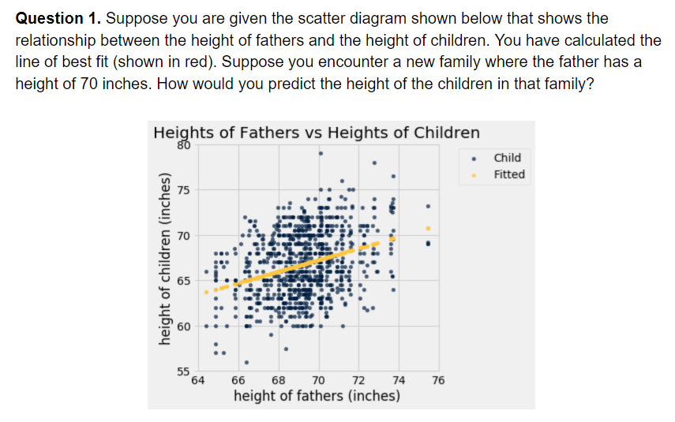
Worksheet Question 1

Slide 8
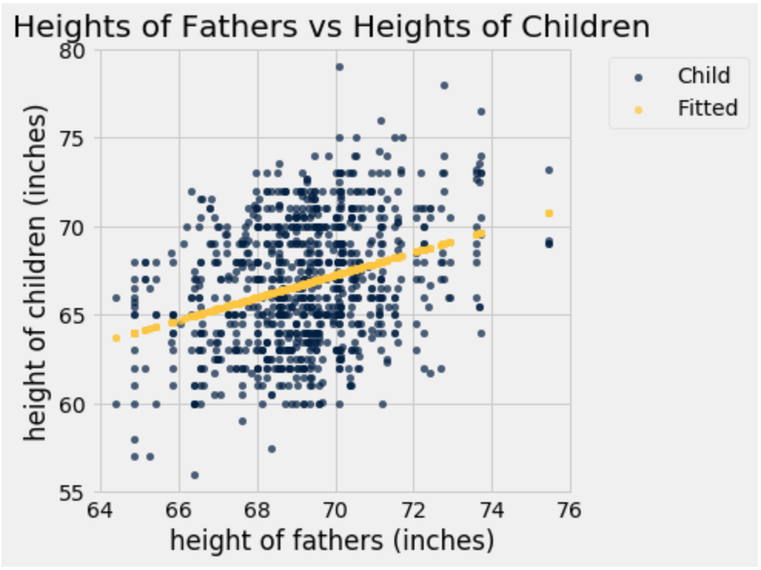
Worksheet Question 1 (Soln)
Use the yellow regression line on the graph to the right
Father’s height is 70 inches so we are given that x=70
At x=70, the corresponding y value on the regression line is about 67
Therefore, predicted child height is around 67 inches

Slide 9
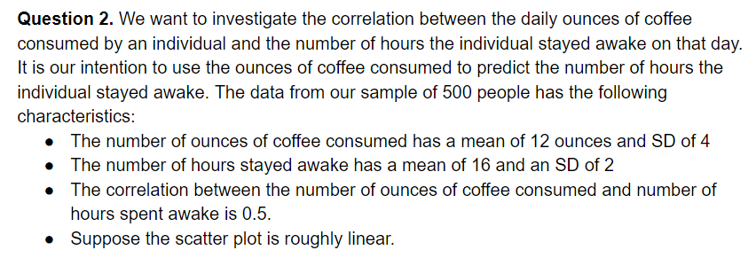
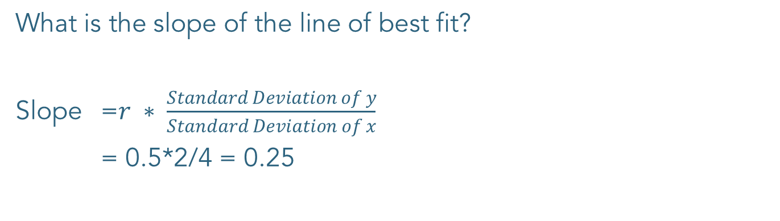
Worksheet Q2a
What is the slope of the line of best fit?
Slope =$r ∗ \frac{Standard Deviation of y}{Standard Deviation of x}$
= 0.5*2/4 = 0.25

Slide 10
Worksheet Q2b
What is the intercept of the line of best fit?
Intercept = Average of y – Slope * Average of x
= 16 – 0.25*12 = 13

Slide 11
Worksheet Q2c
Suppose your friend is in this population. She told you that she consumed 24 ounces of coffee that morning. Use your line of best fit to predict how many hours she will stay awake today.
Predicted y value = Slope * x + Intercept
= 0.25*24 + 13 = 19

