Slide 1
Data 8, Lab 8
The Bootstrap and Confidence Intervals
Hubert Luo
Fall 2019
1 November 2019
Notes:
Motivation: Most of the time we don’t have access to the whole population

Slide 2
Agenda
The Bootstrap
Confidence Intervals

Slide 3
The Bootstrap
If the original sample is large and selected at random, it likely resembles the population
Instead of getting entirely new samples from the population, we resample from the original sample
Resample same number of individuals with replacement
If we sample without replacement, we will always get the sample original sample back!

Slide 4
Confidence Interval
Interval of estimates of a population parameter
A 95% confidence interval means if we create 100 confidence intervals from different samples, we expect 95 of them to contain the true population parameter
It does NOT mean that there is a 95% probability the true population parameter is in a confidence interval!!
The population parameter is a constant. Once an interval is created, it either has the parameter or not

Slide 5
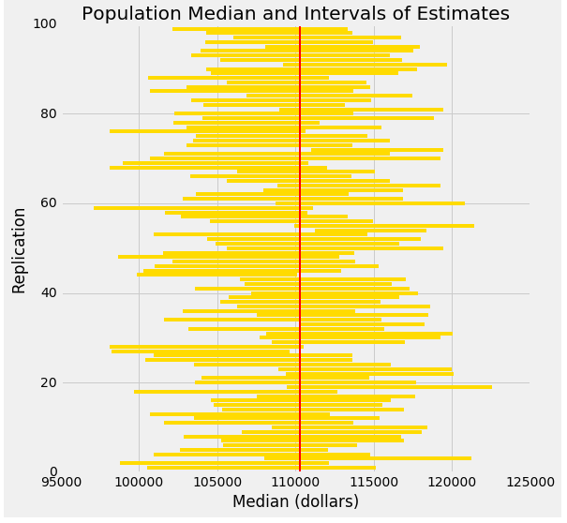
Confidence Interval

Slide 6
Announcements

Slide 7
Lab Notebook
TBD

