Slide 1
Data 8, Lab 8
The Central Limit Theorem, Sample Means, and Correlation
Hubert Luo
Spring 2020
10 April 2020

Slide 2
Agenda
Skewness
Variability
Chebyshev’s Bounds
Standard Units
Normal Distribution
Central Limit Theorem
Distribution of Sample Means
Correlation

Slide 3
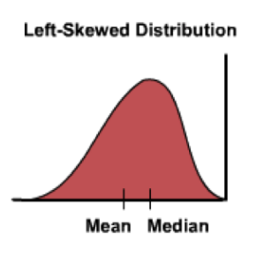
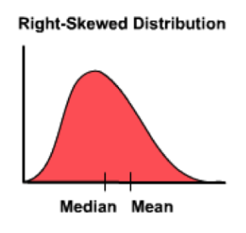
Skewness
Left skew
Long left tail
Mean < Median
Right skew
Long right tail
Mean > Median

Slide 4
Variability
Variance: How spread out is the data?
Standard Deviation: Square root of the variance
Same unit as the data
The larger the SD, the more spread out the data is

Slide 5
Chebyshev’s Bounds
Regardless of the distribution, the proportion of values in the range “average ± z SDs” is at least 1 - 1/z²
Range | Proportion
average ± 2 SDs | at least 1 - 1/4 (75%)
average ± 3 SDs | at least 1 - 1/9 (88.888…%)
average ± 4 SDs | at least 1 - 1/16 (93.75%)
average ± 5 SDs | at least 1 - 1/25 (96%)

Slide 6
Standard Units
Standard Unit: Number of SD’s above or below average
Allows us to easily compare different distributions and units
Z = (value-average)/SD
Average of standard units is always 0
SD of standard units is always 1

Slide 7
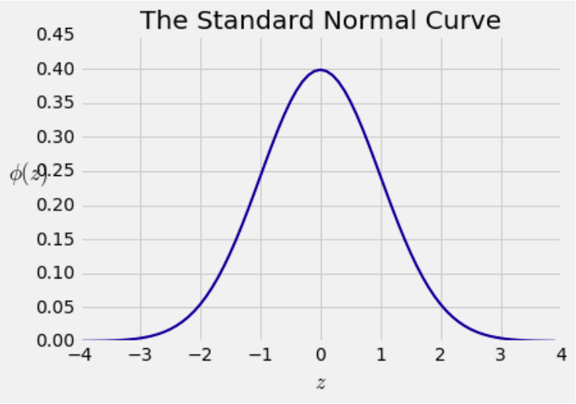
Normal Distribution
An extremely common distribution in statistics, shaped like a bell curve
Most of the data is within a few SD’s of the mean

Slide 8
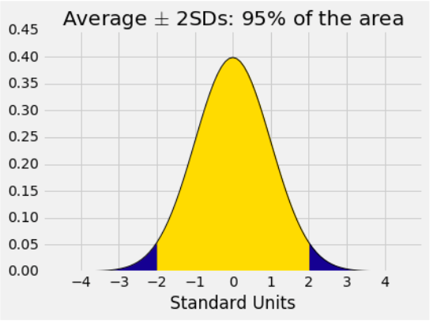
Normal Distribution (cont’d)
Range | All Distributions | Normal
average ± 1 SDs | at least 0% | 68%
average ± 2 SDs | at least 75% | 95%
average ± 3 SDs | at least 88.9% | 99.7%

Slide 9
Central Limit Theorem
If the sample is large and drawn at random with replacement
Regardless of the distribution of the population, the distribution of the sample sum or average is roughly normal
Distribution of the sample sum/average:
Many possible random samples of the same size
Distribution is based on the sum/average of different samples

Slide 10
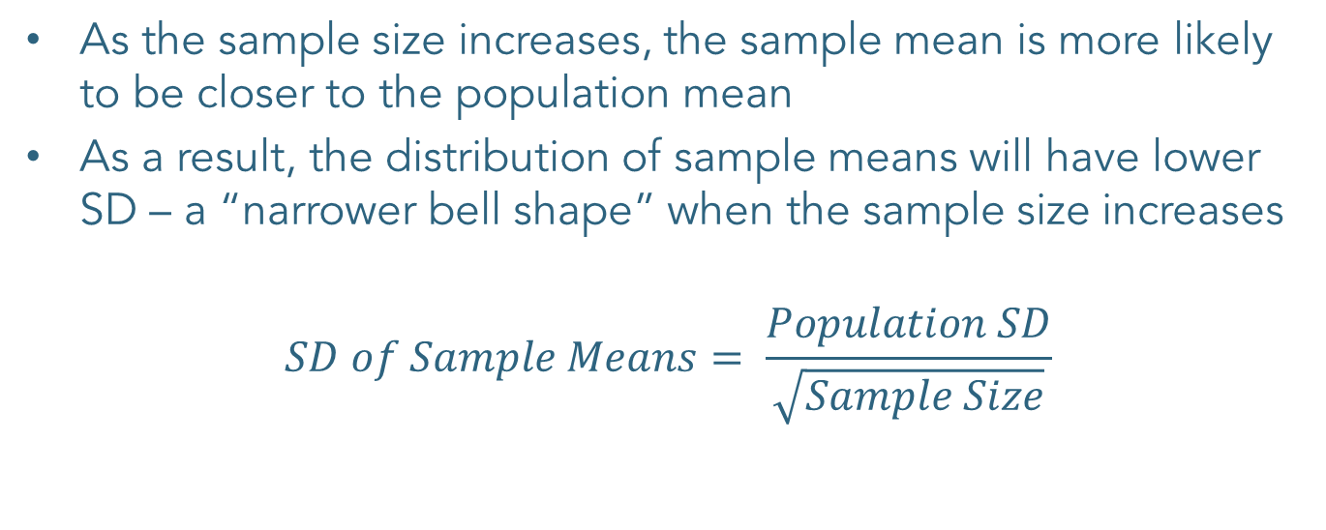
Distribution of Sample Mean
As the sample size increases, the sample mean is more likely to be closer to the population mean
As a result, the distribution of sample means will have lower SD – a “narrower bell shape” when the sample size increases
$$SD of Sample Means= \frac{Population SD}{\sqrt{Sample Size}}$$

Slide 11
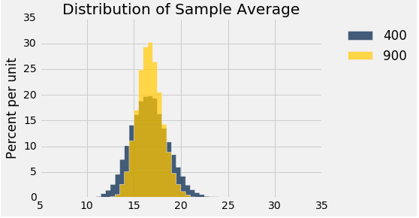
Distribution of Sample Mean

Slide 12
Correlation
Measure the strength of the linear relationship between two variables
Correlation must be between -1 and 1 (inclusive)
When r is positive, there is a positive linear association between the two variables
When r is negative, there is a negative linear association between the two variables
Correlation of x and y is the same as correlation of y and x

Slide 13
Calculating Correlation
Calculated as r = average of element-wise product of two variables in standard units
Algorithm:
Given two numeric arrays x and y of the same length
Convert both x and y into standard units x_su and y_su
Calculate array of the product of the arrays in standard units xy_product = x_su*y_su
The ith element in this product array is the product of the ith element in the x_su array and the ith element in the y_su array
Correlation is the mean of this array np.mean(xy_product)

Slide 14
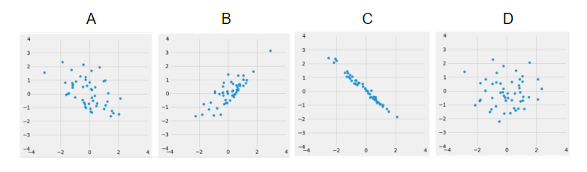
Correlation Example: Worksheet Q6
Small negative correlation: Weak negative linear association since the points are not clustered tightly around a line
Positive correlation: Positive linear association since the points are clustered somewhat tightly around a line
Strong negative correlation: Strong negative linear association since the points are clustered tightly around a line
No correlation: No visible trend since the points are just a blob

Slide 15
Announcements
Project 2 Checkpoint 2 is due today 4/10
Entire project is due next Friday 4/17, bonus point for early submission by 4/16
If you’re working with a partner make sure you add their email onto Okpy so you both receive credit
HW10 due on 4/16. Bonus point for early submission by 4/15
Lab 8 extension by one day to Saturday 4/11 at 11:59PM for this week only
This semester's lecture on privacy has been cancelled, but you can watch last year's version here. The material covered in that lecture will be on the final.

