Slide 1
Data 8, Lab 10
Classification, k-Nearest Neighbours, and Conditional Probability
Hubert Luo
Spring 2020
1 May 2020

Slide 2
Classification
Goal: Predict labels of categorical data
In Data 8: Use known, labelled data points to predict the label of unknown data points in a supervised manner
Given a set of attributes for a data point, what label do we predict the data point to have?
Examples:
Predict whether or not a patient has cancer
Predict the year of a student at Cal
Predict if an email is spam

Slide 3
Training vs Testing Data
Training Data: All known, labelled data points
We use our training data to create our model
Test Data: All unknown data points whose labels we are trying to predict
We use our test data to evaluate how well our model does
Allows us to ask how well our model generalizes to unknown data our model hasn’t seen yet

Slide 4
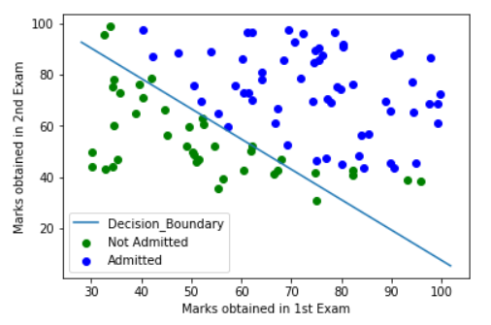
Decision Boundary
Decision Boundary: The curve that divides all the data based on the predicted label
May have points on the wrong side if the predictions are wrong!

Slide 5
K-Nearest Neighbours
Idea: Use the labels of the known data points (training set) closest to an unknown data point (test set) to predict its label
Find the distance between the unknown data point and each known data point in the training set
Sort all the data points based on the calculated distance
From closest (smallest distance) to farthest (largest distance)
Take k closest data points (“neighbours”) and get their labels
The predicted label for the unknown data point is the majority of the labels of the k closest neighbours

Slide 6
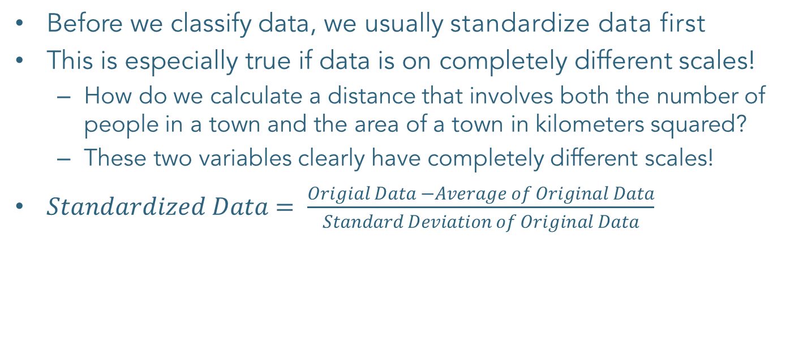
Standardizing Data
Before we classify data, we usually standardize data first
This is especially true if data is on completely different scales!
How do we calculate a distance that involves both the number of people in a town and the area of a town in kilometers squared?
These two variables clearly have completely different scales!
$Standardized Data= \frac{Origial Data −Average of Original Data}{Standard Deviation of Original Data}$

Slide 7
Confusion Matrix Example
 | True Label: Positive | True Label: Negative
Predicted Label: Positive | True Positive | False Positive
Predicted Label: Negative | False Negative | True Negative
The above is an example of a confusion matrix used for classification with two labels, Positive and Negative.
Example: A medical screening is conducted to predict whether or not a patient has cancer
True Positive: Patient has cancer and screening says they do
False Negative: Patient has cancer but screening says they don’t
False Positive: Patient doesn’t have cancer but screening says they do
True Negative: Patient doesn’t have cancer and screening says they don’t

Slide 8
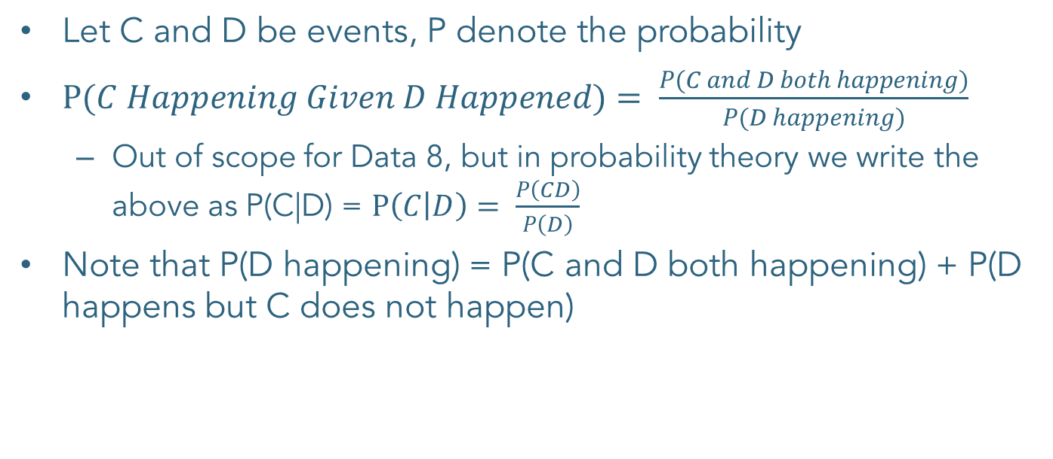
Conditional Probability
Let C and D be events, P denote the probability
$P(C Happening Given D Happened)= \frac{P(C and D both happening)}{P(D happening)}$
Out of scope for Data 8, but in probability theory we write the above as P(C|D) = $P\left(C | D\right)= \frac{P\left(CD\right)}{P\left(D\right)}$
Note that P(D happening) = P(C and D both happening) + P(D happens but C does not happen)

Slide 9
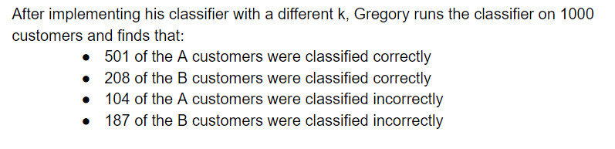
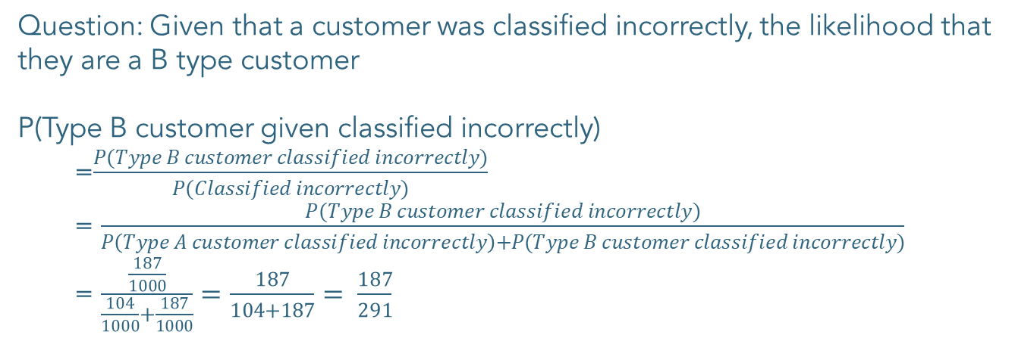
Conditional Probability Example (Q2b)
Question: Given that a customer was classified incorrectly, the likelihood that they are a B type customer
P(Type B customer given classified incorrectly)
=$\frac{P(Type B customer classified incorrectly)}{P(Classified incorrectly)}$
= $\frac{P(Type B customer classified incorrectly)}{P\left(Type A customer classified incorrectly\right)+P(Type B customer classified incorrectly)}$
= $\frac{\frac{187}{1000}}{\frac{104}{1000}+\frac{187}{1000}}=\frac{187}{104+187}= \frac{187}{291}$

Slide 10
Announcements
Project 3 due Friday 5/1
Final Topical Review Labs Next Week! See Piazza for schedule, slides, and topics

