Slide 1
Data 8, Lab 1
Hubert Luo
Fall 2019

Slide 2
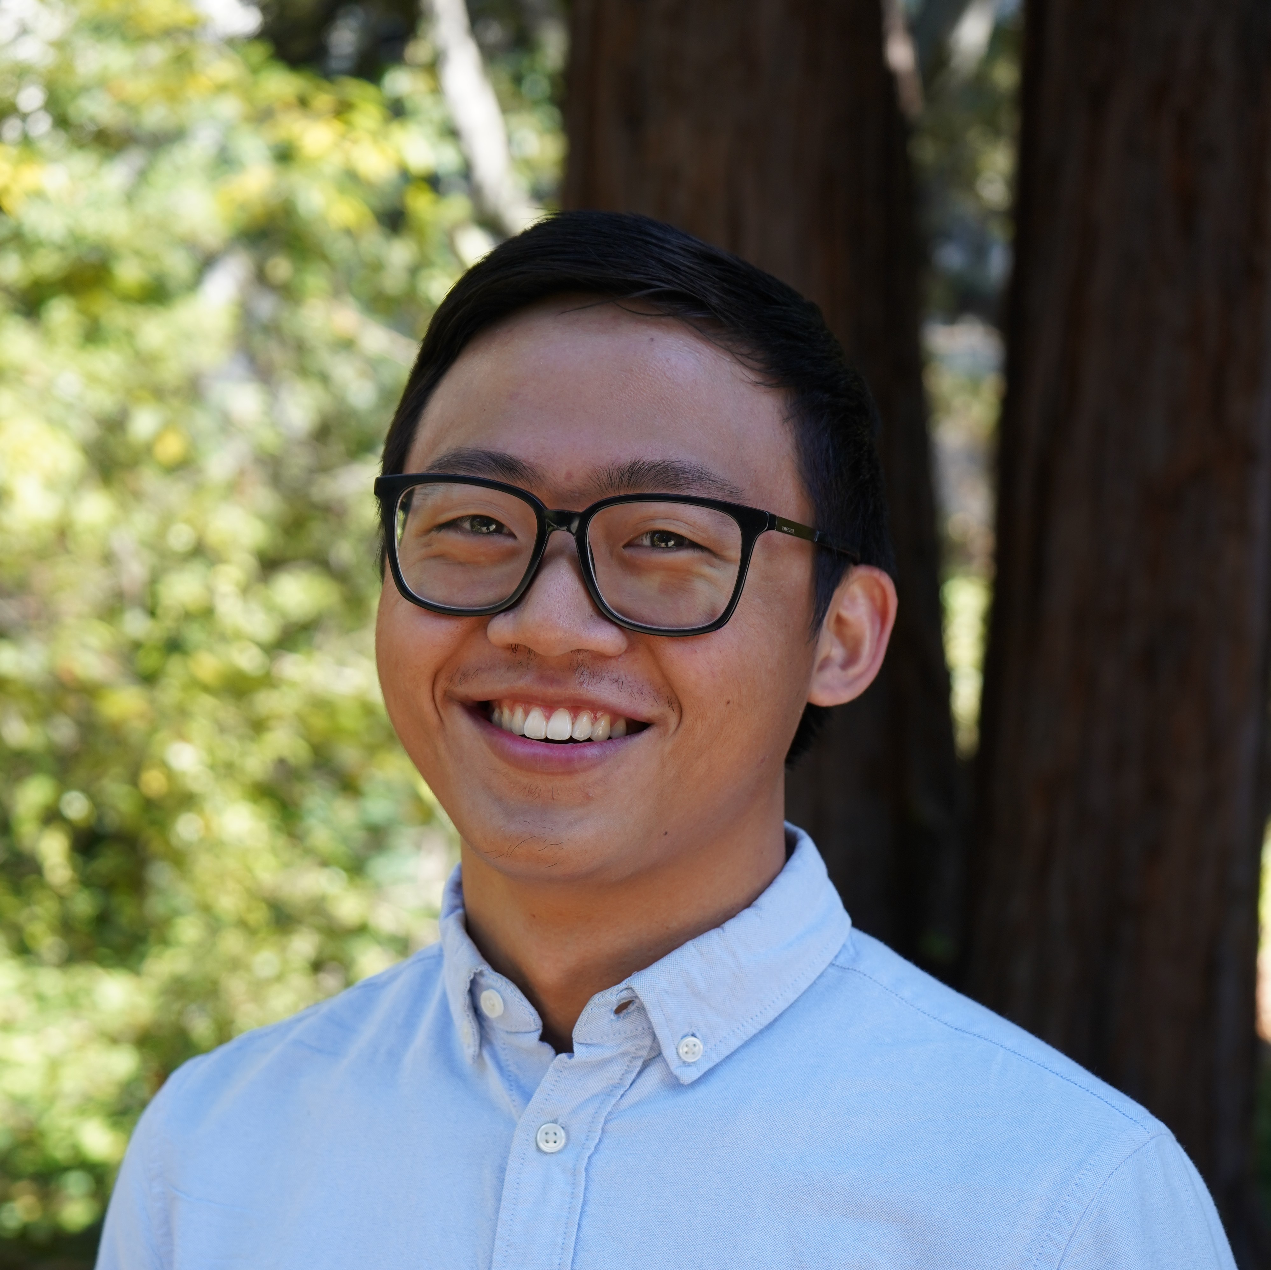
I’m a senior from Toronto, Canada studying stats and applied math, and this is my seventh semester teaching at Cal.
Email: hubertluo@berkeley.edu
Lab Website: https://hluo27.github.io/data8
Lab: TBD
Office Hours: TBD

Slide 3
Lab Policies
TBD

Slide 4
Introductions
Name
Year
Major
Hometown
A fun fact!

Slide 5
Discussion Worksheet
Introduce yourself to the people sitting around you and work in teams!

Slide 6
Discussion: Solutions
TBD

Slide 7
Discussion: Recap
How did your team do?
How did your group come up with an estimated number?

Slide 8
Class Survey
Please fill out this form before starting the lab notebook:
TBD

Slide 9
Lab Notebook
TBD

