Slide 1
Data 8, Lab 1
Hubert Luo
Fall 2019
30 August 2019

Slide 2
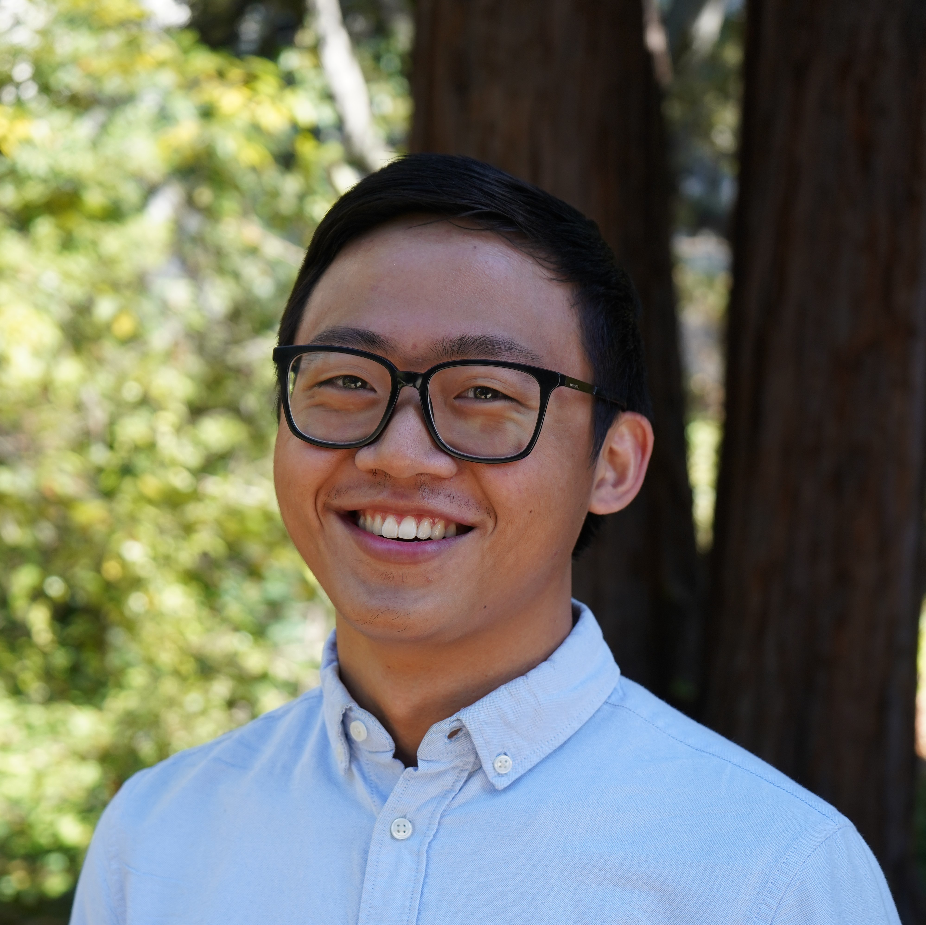
I’m a senior from Toronto, Canada studying stats and applied math. This is my third semester on Data 8 staff and seventh semester teaching at Cal!
Email: hubertluo@berkeley.edu
Lab Website: https://hluo27.github.io/data8
Lab: Friday 9-11am in Evans B6
Office Hours: Friday 2-3pm

Slide 3
Lab Policies
Students can only attend the lab they are enrolled in
Lab assignments released on Monday. Two ways to get credit:
1. Attend lab and discussion section; make substantial progress
2. Finish and pass all autograder tests by Wednesday at 8:59 AM
Waitlisted Students
Enrolled once there is an open seat in lecture + lab section
GSIs do not know what position students are at on the waitlist and cannot manually switch students (must be done by student on CalCentral)
See http://data8.org/fa19/policies.html for more details (screenshot on next slide)

Slide 4
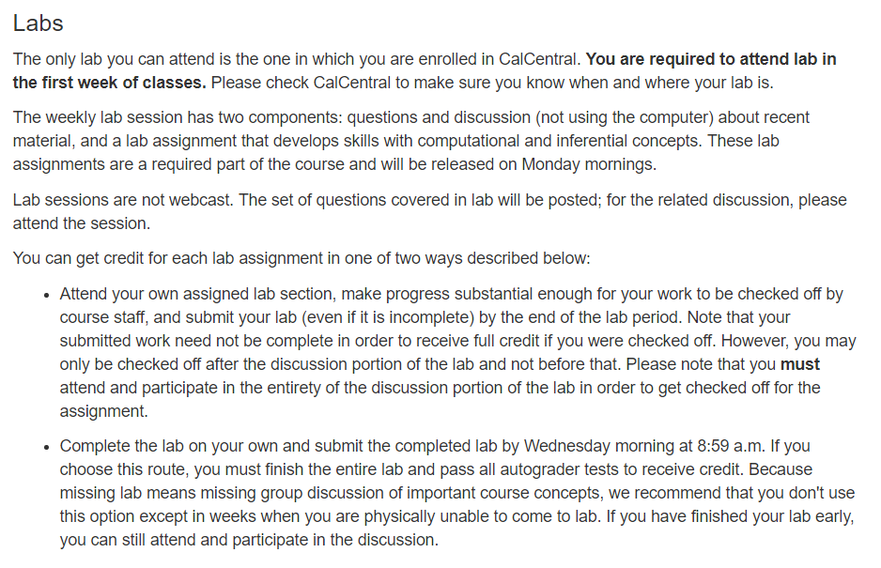
Lab Policies (Detailed)

Slide 5
Grading Logistics
Each student should have Gradescope and Okpy accounts
All labs, homework, and projects will be submitted to Okpy
Code is auto-graded and marks posted on Okpy
Written answers graded by course staff on Gradescope
Let me know if you don’t yet have an account on either!

Slide 6
Introductions
Form groups of at least 4 and find the most obscure thing you have in common.
Example: During a previous semester, a group of 5 all had a sister with the same name!

Slide 7
Discussion Worksheet
Introduce yourself to the people sitting around you and work in pairs
Don’t use online resources!

Slide 8
Discussion: Solutions
50
Cog Sci, English, Media Studies, Sociology, and Psychology
Hawaii and California
America: 78, World: 72

Slide 9
Class Survey
Please fill out this form before starting the lab notebook:
http://tinyurl.com/data8-hubert

Slide 10
Lab Notebook

