Slide 1
Data 8, Project 2 Lab
The Bootstrap and Confidence Intervals
Hubert Luo
Spring 2020
3 April 2020

Slide 2
Agenda
The Bootstrap
Confidence Intervals

Slide 3
Parameters and Statistics
Population Parameter: A metric about a population
Fixed and not random!
Example: Average GPA of all Cal students
Sample Statistic: A metric about a sample of that population
Different for each sample of the population!
Example: Average GPA of Cal students who are taking Data 8

Slide 4
Why Bootstrap?
We need a sample to estimate a population parameter!
In order to evaluate the variability of the statistic, we need multiple samples
If the original sample is large and selected at random, it is close enough to the population that we can resample from our original sample instead of from the population
This is extremely helpful in real life: it saves us time and money!

Slide 5
The Bootstrap
If the original sample is large and selected at random, it likely resembles the population
Instead of getting entirely new samples from the population, we resample from the original sample
Resample same number of individuals with replacement
If we sample without replacement, we will always get the sample original sample back!

Slide 6
Confidence Interval
Interval of estimates of a population parameter
A 95% confidence interval means if we create 100 confidence intervals from different samples, we expect 95 of them to contain the true population parameter
It does NOT mean that there is a 95% probability the true population parameter is in a confidence interval!!
The population parameter is a constant – it’s either in an interval, or it isn’t so there’s nothing we can conclude about probability

Slide 7
Confidence Interval Facts
For a 95% confidence interval, it is true that:
Out of 100 confidence intervals, we expect 95 of them to contain the true population parameter
There is a 95% probability the confidence interval contains the population parameter
Note that the confidence interval is random here so we can make this statement
It is not true that there is a 95% probability a population parameter is in a confidence interval.
This is because the population parameter is fixed so we can't so anything probabilistic about it.

Slide 8
Confidence Interval Facts (Cont’d)
Given a fixed confidence interval, statement #2 from the previous slide no longer applies
The confidence interval is fixed so we can't make any probabilistic conclusions about it
Example: It is not true that there is a 95% probability the confidence interval [2, 5] contains the population parameter
The population parameter fixed AND
The confidence interval [0.439, 0.5] is fixed
Therefore, there is no probability involved here

Slide 9
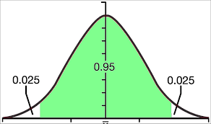
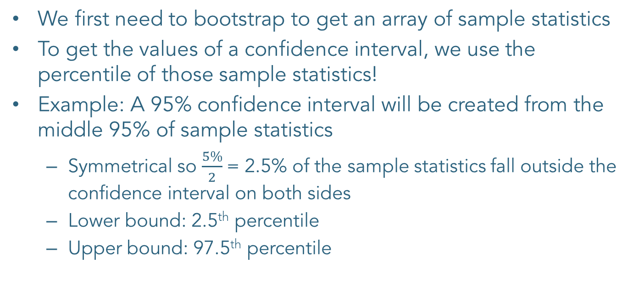
Creating Confidence Intervals
We first need to bootstrap to get an array of sample statistics
To get the values of a confidence interval, we use the percentile of those sample statistics!
Example: A 95% confidence interval will be created from the middle 95% of sample statistics
Symmetrical so $\frac{5\%}{2}$= 2.5% of the sample statistics fall outside the confidence interval on both sides
Lower bound: 2.5th percentile
Upper bound: 97.5th percentile

Slide 10
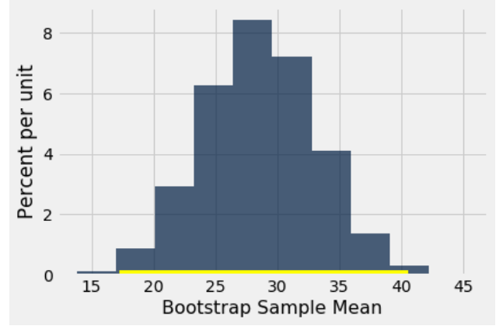
Visualizing Confidence Intervals

Slide 11
Visualizing Confidence Intervals
https://rpsychologist.com/d3/CI/

Slide 12
Announcements
HW8 is due Thursday 4/2
Project 2:
Checkpoint 1 is due this Friday 4/3
Checkpoint 2 is due next Friday 4/10
Entire project is due a week after that, on 4/17.

