Slide 1
Data 8, Lab 2
Causality and Table Operations
Hubert Luo
Spring 2020
31 January 2020

Slide 2
Lab Assistants
We have lab assistants who will be joining us this semester!

Slide 3
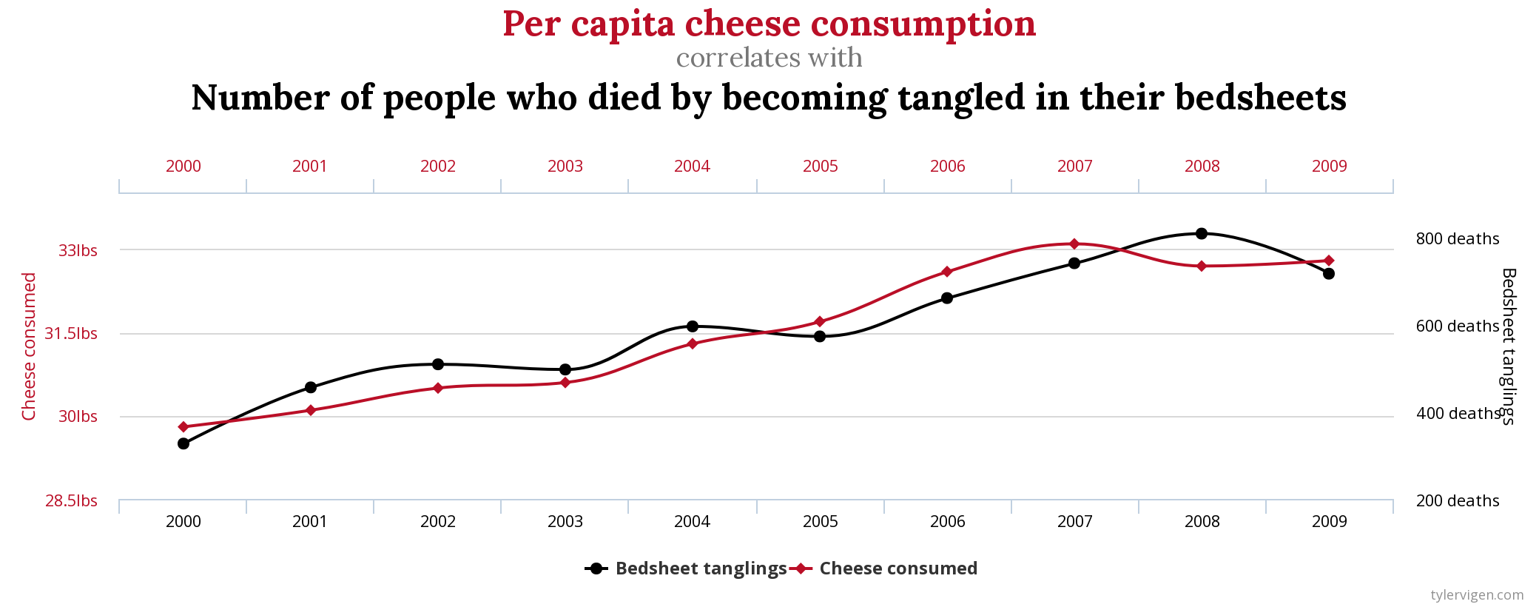
Correlation vs. Causation

Slide 4
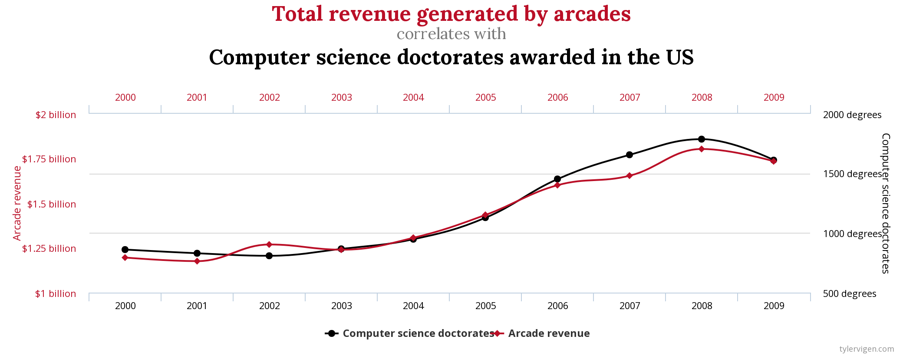
Correlation vs. Causation

Slide 5
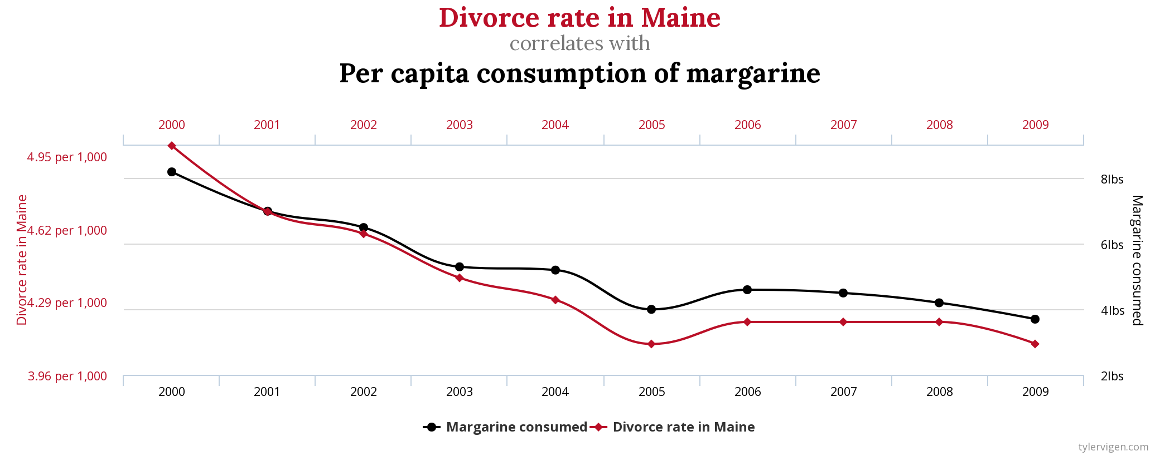
Correlation vs. Causation

Slide 6
Correlation does not imply Causation!!

Slide 7
Establishing Causality
Observational Study: Experimenter has no ability to divide study participants into treatment and control groups
Randomized Control Experiment: Randomly divide participants into treatment and control group
Example: Study the effect of capital punishment on a state’s murder rate
Observational study since researchers cannot just randomly decide which states have capital punishment or not

Slide 8
Announcements
HW1 due 1/30
Early submission bonus point on 1/29
Tutoring section sign-ups have been released, will start in week 3
Highly recommended: Opportunity to work with a tutor and other students in a small group setting
DSP students: Please talk to your advisor about submitting letters of accommodation to SCARAB
Office Hours start this week! 12-5pm Monday-Friday in 581 Barrows
Hubert’s Office Hours are 4-5pm on Fridays

Slide 9
Announcements Contd.
Gradescope vs. Okpy Regrade Requests
Gradescope: Directly request on Gradescope (written answer for homework or projects)
Okpy: Email Hubert (autograder error only)
Make sure to submit before the regrade request deadline! Regrade requests after the deadline will not be considered
Lab Credit Policy Reminder. Credit in two possible ways:
Attend entire lab section and make substantial progress
Finish and pass all autograder tests by Wednesday at 8:59 AM

