Slide 1
Data 8, Lab 4
Plots and Functions
Hubert Luo
Fall 2019
20 September 2019

Slide 2
Agenda
Plots
Histograms
Functions

Slide 3
Plots
Scatter plots:
Relationship between two numerical variables
Line plot:
Sequence of one numerical variable (i.e., over time)
Bar chart:
Distribution of categorical data
Histogram:
Distribution of numerical data

Slide 4
Plots: Demo
(Demo on Notebook)

Slide 5
Histograms
Visualize the distribution of a numerical variable
Bin one of the variables to get bars on the x axis
Area of each bar corresponds the percentage of individuals in that bin
% in bin = Height of bin x Width of bin
Therefore, the y axis is the density (“Percent per unit on the x axis”)
How “clustered” together the data is in a bin?
Warning: Bins include the left endpoint, but not the right endpoint!

Slide 6
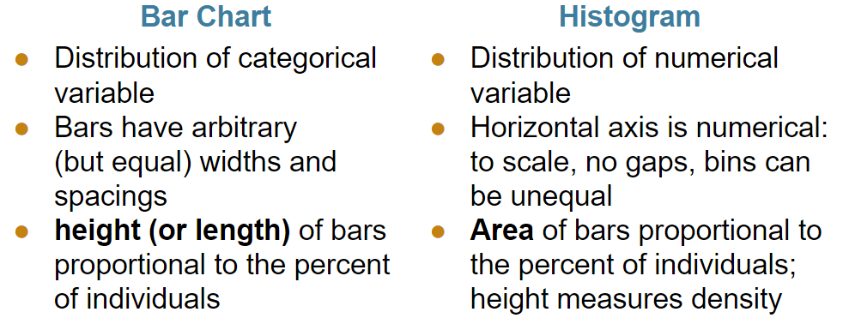
Bar Chart vs Histogram
From lecture:

Slide 7
Histogram: Demo
(Demo on Notebook)

Slide 8
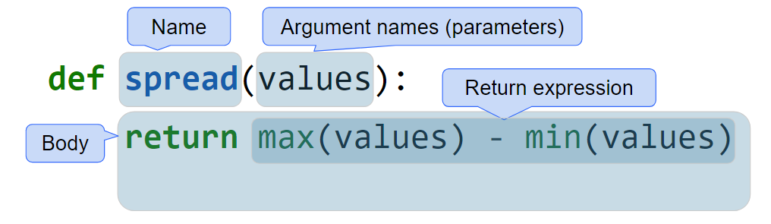
Functions

Slide 9
Functions: Apply
Can apply a function to a column in a table
Need name of function to call and column label
table_name.apply(function_name, 'column_label')

Slide 10
Functions: Demo
(Demo on Notebook)

Slide 11
Lab Worksheet

Slide 12
Announcements
Project 1 and HW4 getting released today
HW4 is pretty short!
Everyone needs to fill out this form for partners:
Link: https://tinyurl.com/data8-proj1-partners
We only have a set number of spots for tutoring sections –check the sign-up sheet periodically for availability
Don’t email course staff!

Slide 13
Lab Notebook

