Slide 1


Github webpage in 1 hour
HARUG!
2021-06-30

Slide 2
Today
-look at folder structure, markdown template
(working in Rstudio)
-Set up Github Desktop to "serve" files to you Github account
-Look at finished webpage

Slide 3
Some things that might be mysterious, but it is OK
-Github
-Markdown language, .md (not .Rmd, .R, .HTML...)

Slide 4
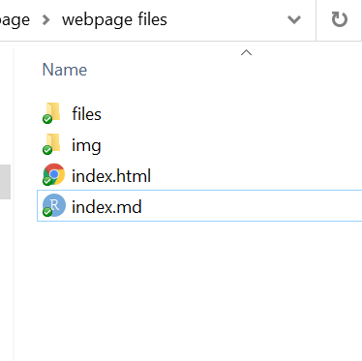

download template files
unzip to a folder on your computer, any folder

Slide 5
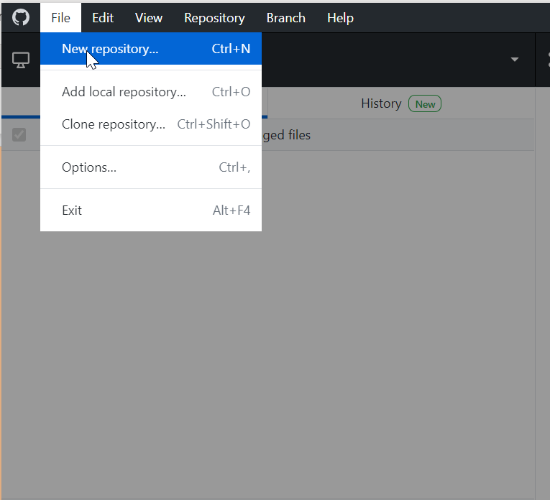
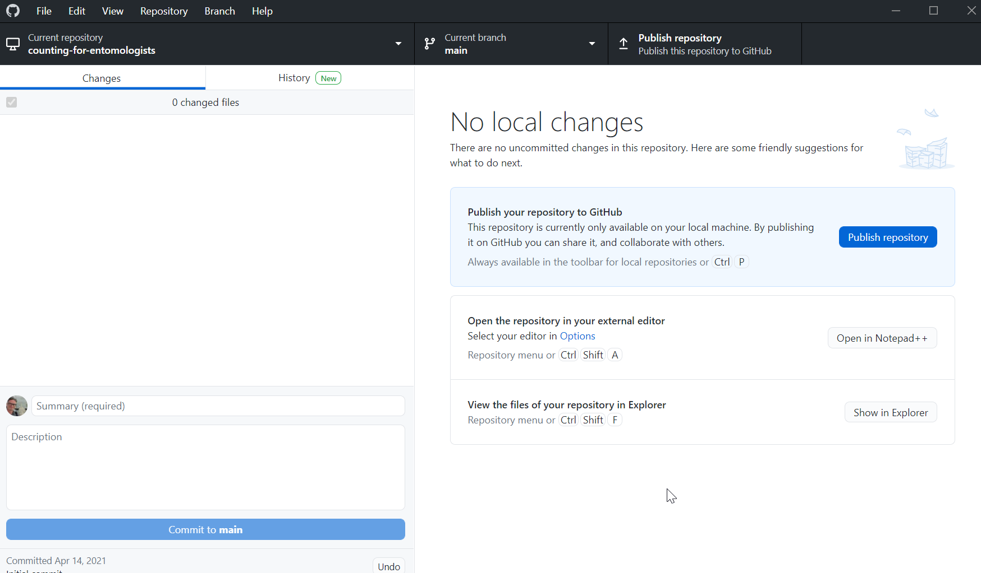
github desktop

Slide 6
github desktop
Create new repository

Slide 7
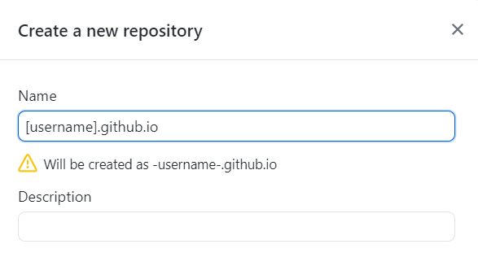
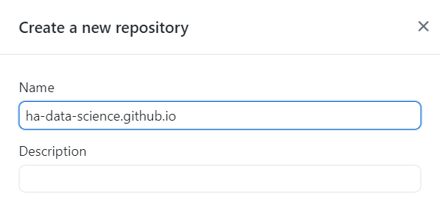




github desktop
REPLACE [username] with YOUR Github account username
This will be your website address!

Slide 8
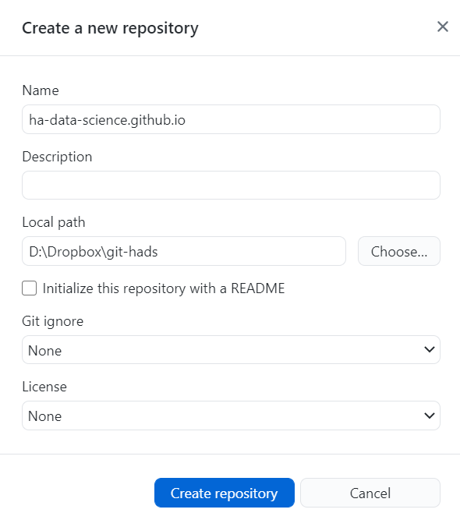
github desktop
Existing path and folders
Smash it >> Create repository

Slide 9
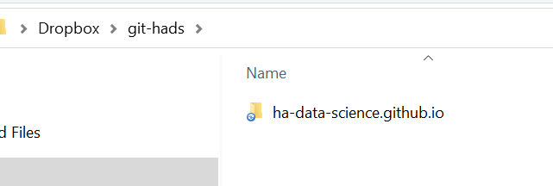



github desktop
Your folders should look similar to this
You made it
Github Desktop made it

Slide 10
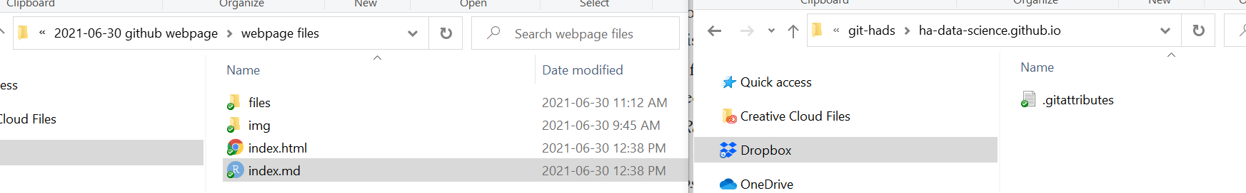

copy edited files from your project local directory, to your active github local repository directory
folder names here do not matter

Slide 11
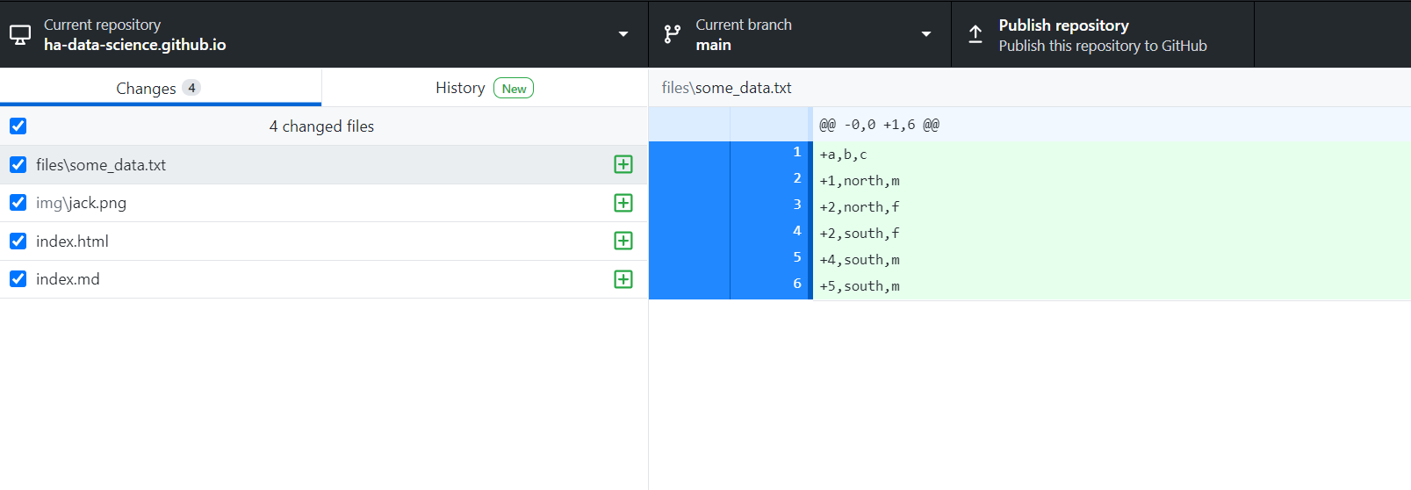




All being well, your Github Desktop should now look like this!

Slide 12
Are you "commit" -ed
When you commit in Git, you are freezing a "snapshot" of all your files in a repository
When you do this, you are required to provide a reason or explanation of the commit in the Summary field
Further info in the Description field is optional

Slide 13
Are you "commit" -ed
When you commit in Git, you are freezing a "snapshot" of all your files in a repository
When you do this, you are required to provide a reason or explanation of the commit in the Summary field
Further info in the Description field is optional

Slide 14
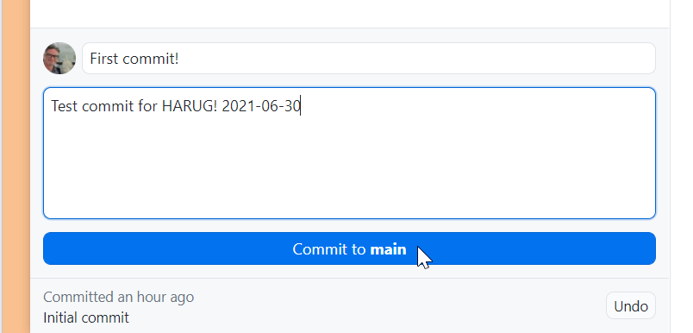
Are you "commit" -ed
Smash it >> Commit to main

Slide 15
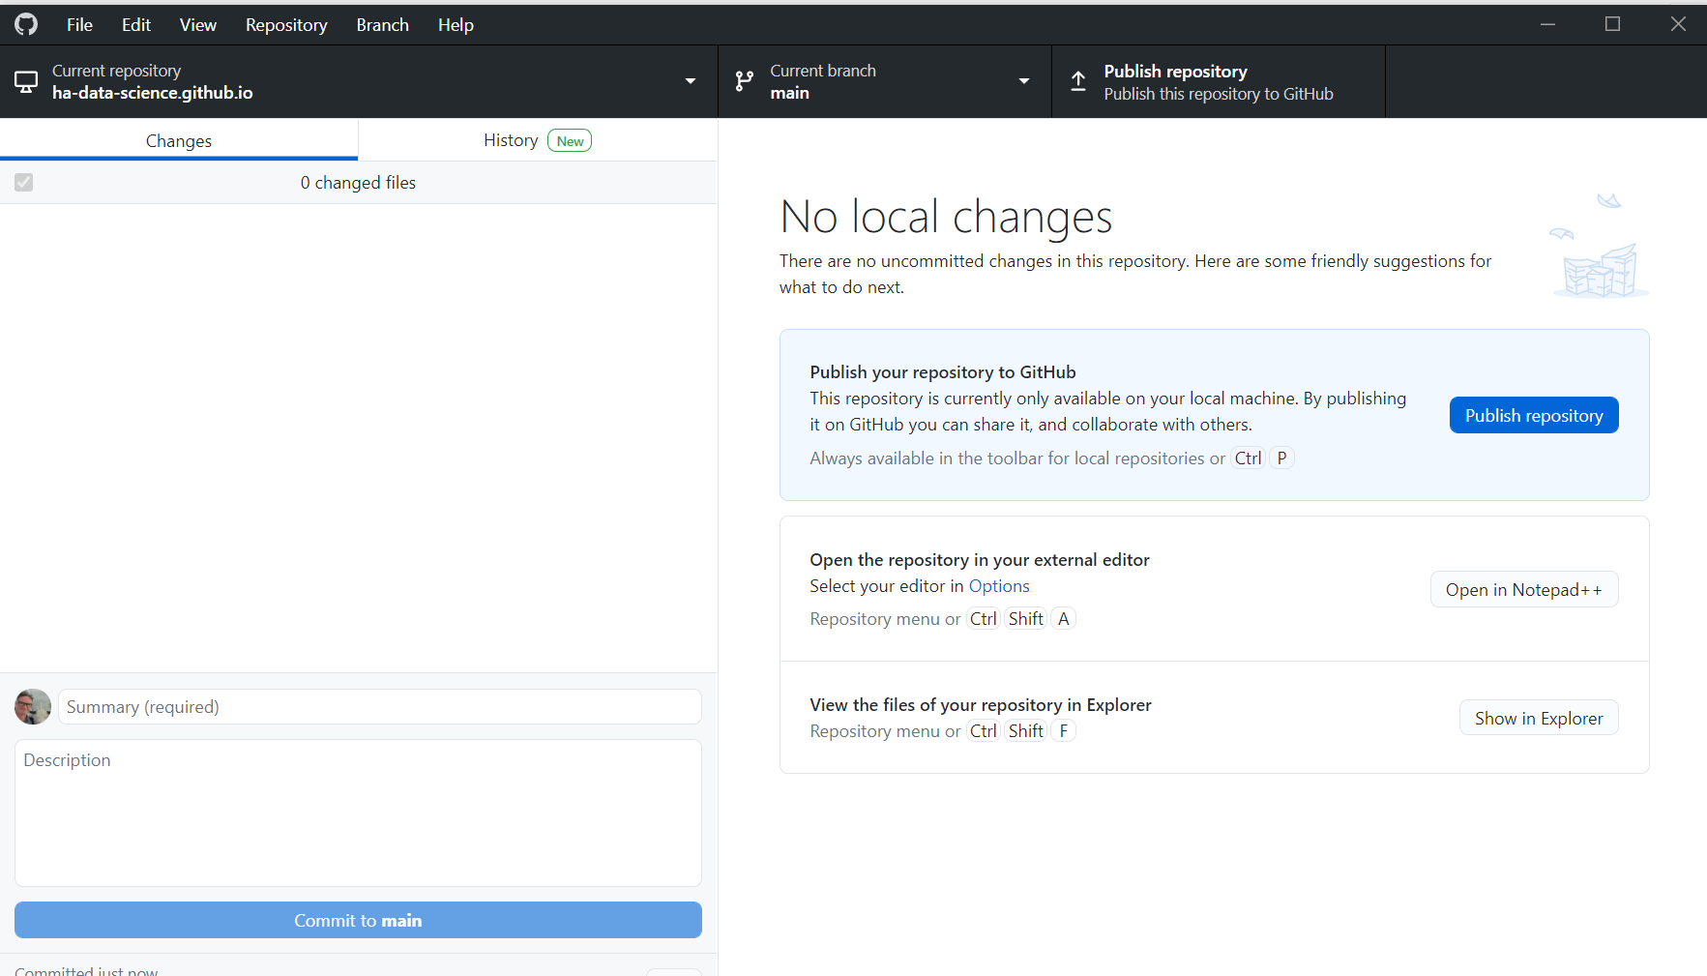






"push" your files onto Github, by using Publish repository
Smash it >> Publish repository

Slide 16
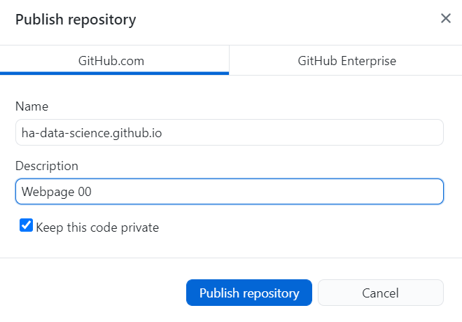




"push" your files onto Github, by using Publish repository
UNtick this!!
(You can change it later, but it takes a little more effort)
Smash it >> Publish repository

Slide 17
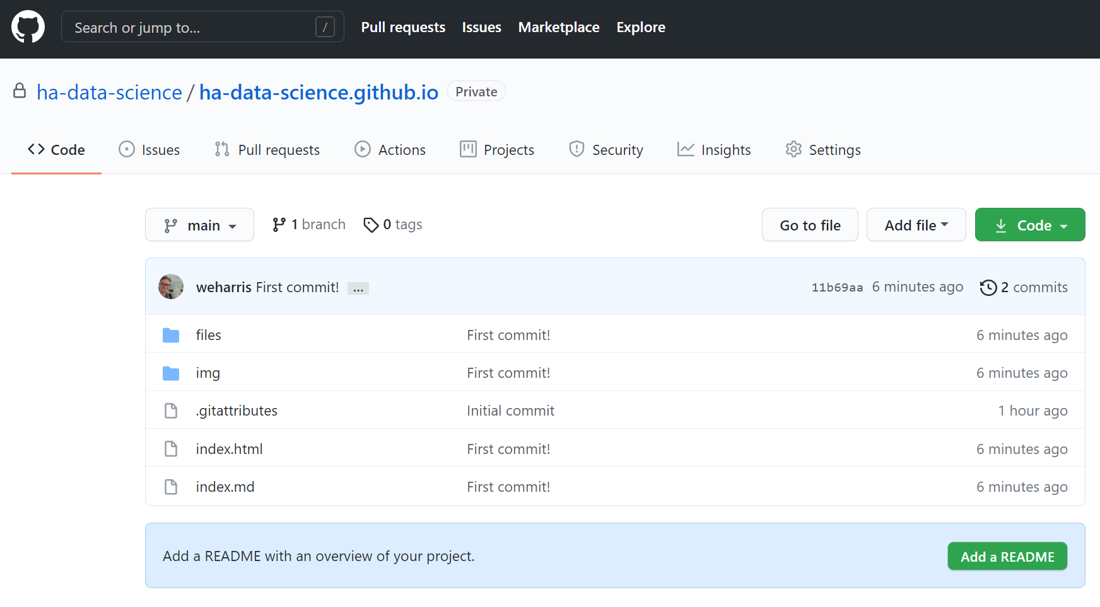


Slide 18
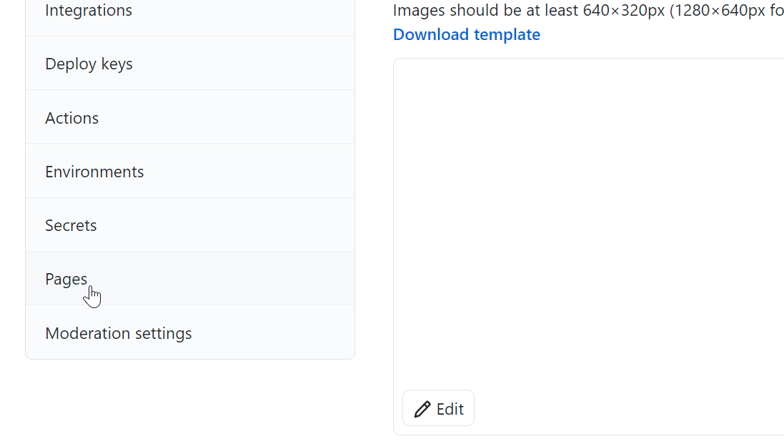


Slide 19
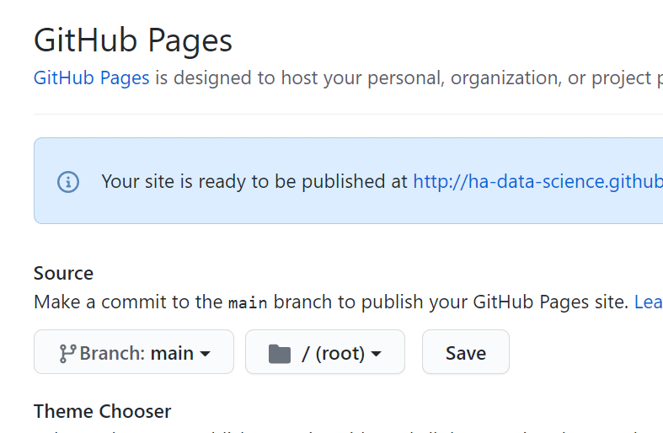

Set Source to main and smash the Save button

Slide 20
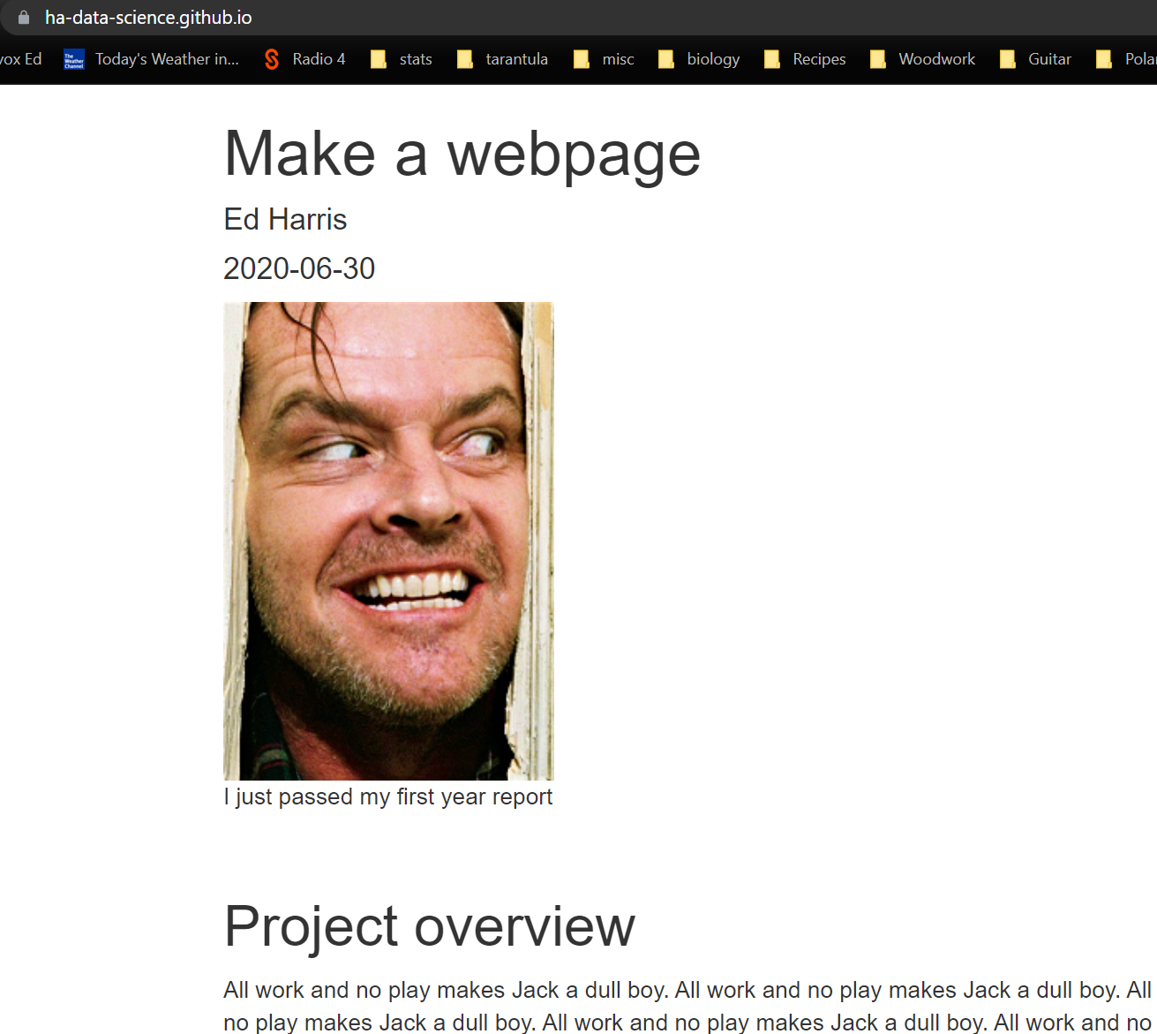

Give it a minute to propagate the change and visit your new website!!
NB the URL
Don't forget https://

Slide 21
Edit and add pages
Do this directly from your local Github folder now
I would choose RStudio and plain .md

Slide 22

Moar resources
Official "Github pages" info
https://docs.github.com/en/pages

