Slide 1
HARUG
2022-03-23 (meeting #86) George Wager - Reading and activity from 'Advanced R' Ch 02
Chapter 02: Names and values
“Behind the scenes in R”
Notes:
Book by Hadley Wickham
Establishes how to interpret the basics to understand what is going on behind the scenes in R

Slide 2
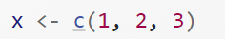
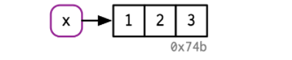
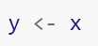

Chapter 02
Binding Basics: How to distinguish between a name and a value in R?
Single binding
Binding Basics: shared binding
Unique identifier that is similar to the object’s memory address

Slide 3
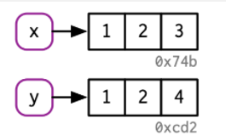
Chapter 02
Copy-on-modify where by R objects are unchangeable and instead a new object is created
Base::tracemem() will tell you the address of the current object- untracemem() is the opposite of tracemem()

Slide 4
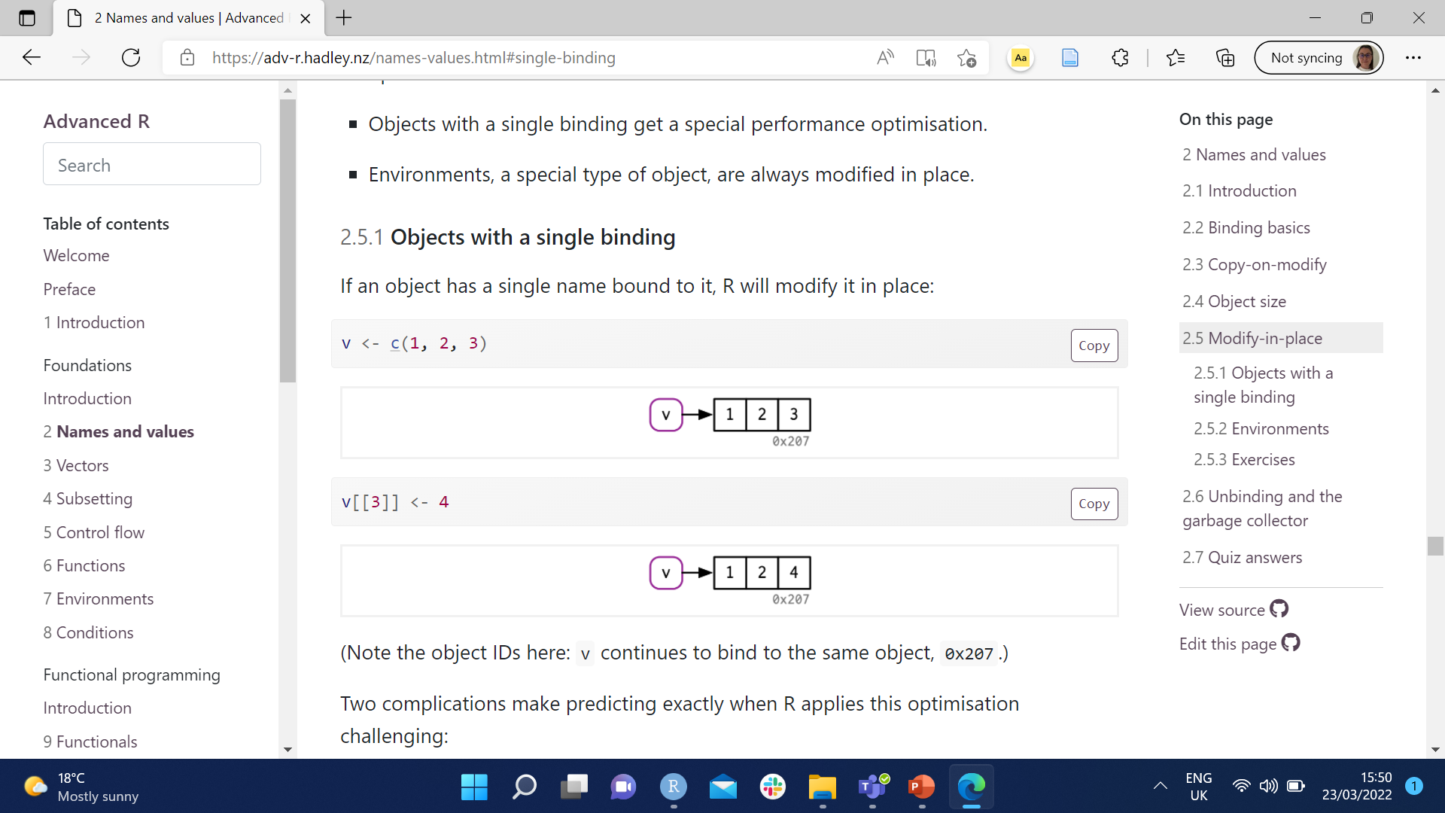
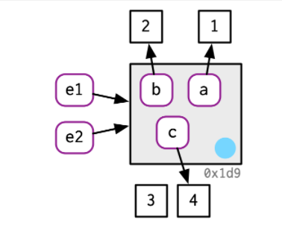
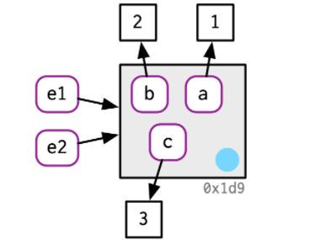
Chapter 02
The exceptions to the “copy-on-modify” whereby we see “modify-in-place” are objects with a single binding and environments
Notes:
Here one of the vectors of a single binding was replaced with a 3 - this is called modify in place

Slide 5
Exercise – Quiz Qs
10 mins for everyone to have a go

