Slide 1



Data Science Garage Bootcamp launch
HARUG!
2021-07-07
Ed Harris

Slide 2
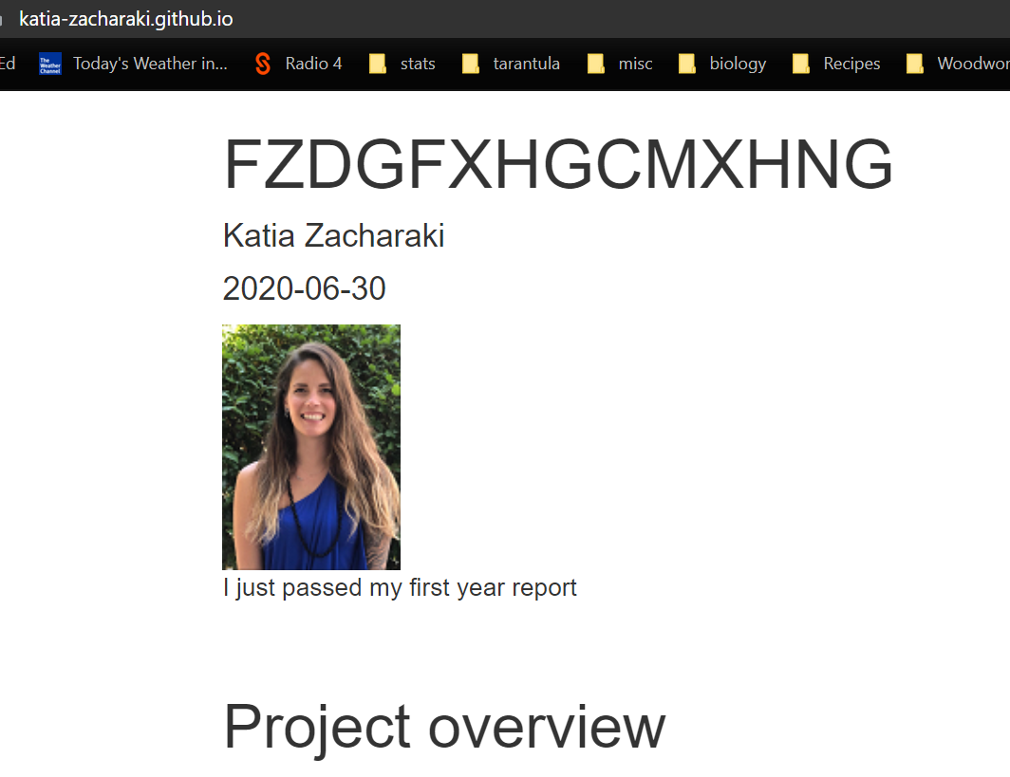
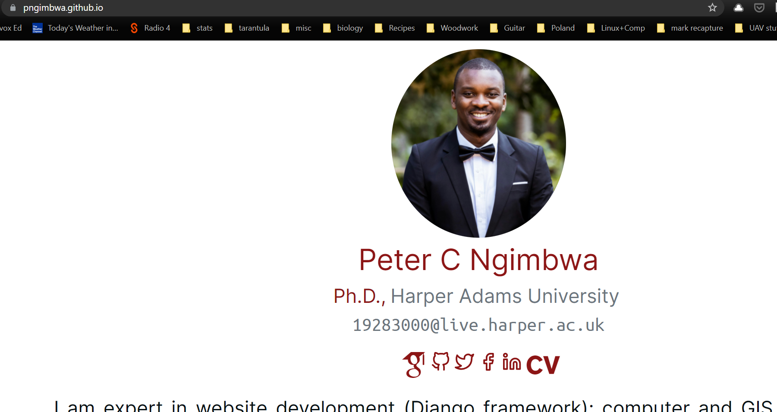
Last time

Slide 3

HAP-E Group
(Harper Adams Python Enthusiasts Group)
First meeting Friday July 9th 1pm
Lunchtime tutorials
(email Ed if you would like to be added to the mailing list)

Slide 4
Last time
Github webpage
Did anybody make one?
Post successes, comic fails, in Slack, ask for help in Slack

Slide 5
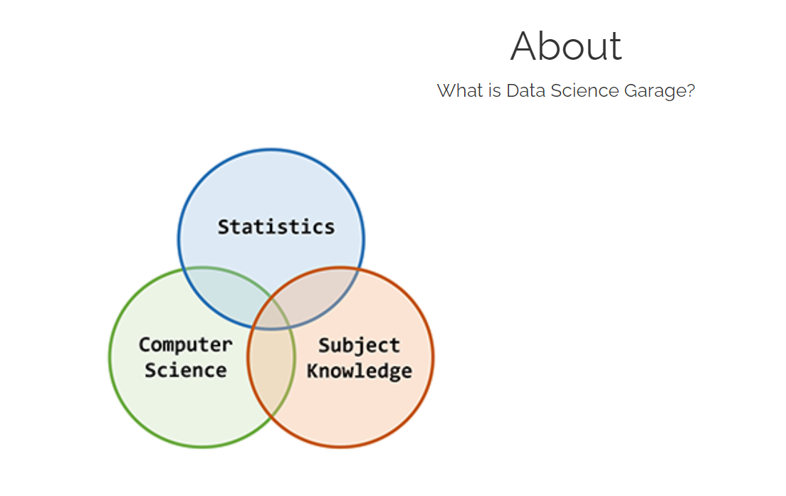
Today
https://dsgarage.netlify.app/
Bootcamp Launch

Slide 6
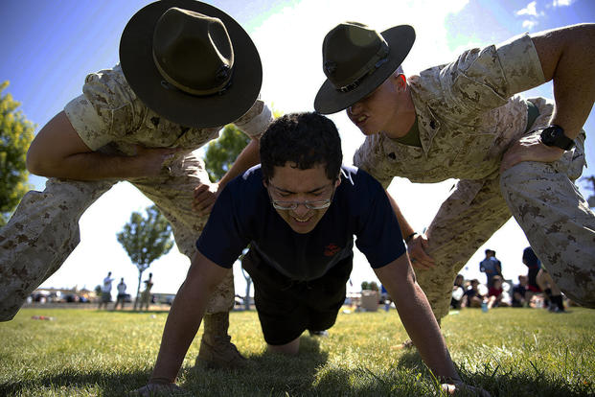

Today
Traditional bootcamp
Ed's R and stats Bootcamp

Slide 7
Why?
The purpose of the bootcamp is a SELF-GUIDED resources to learn basic R programming and basic statistics with no prior knowledge

Slide 8
Who is it for?
- PhD students with data
- Academic colleagues who want to learn R
- Postgraduate students (mixed MSc)
- Learning data scientists
- Other interesting people

Slide 9
What will you learn?
- Intro R programming language
- Best practice for reproducible scripts
- Tidy data
- Review of simple statistics (just enough...)

Slide 10
How is it organised?
https://dsgarage.netlify.app/bootcamp/0.0-bootcamp-overview/
Module 1 (pages 1.x): A bare-bones introduction to R and Rstudio for beginners
Module 2 (pages 2.x): A bare-bones introduction to using R for traditional data analysis
Moduel 3 (pages 3.x): An introduction to reproducible code, R Markdown, and Github

Slide 11
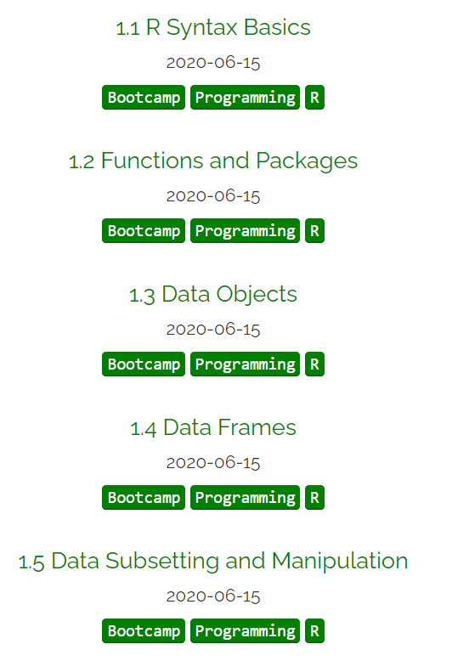
How is it organised?
https://dsgarage.netlify.app/bootcamp/
Module 1 (pages 1.x): A bare-bones introduction to R and Rstudio for beginners

Slide 12
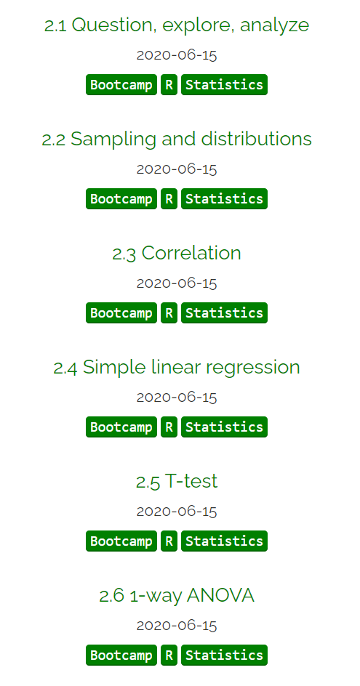
How is it organised?
https://dsgarage.netlify.app/bootcamp/
Module 2 (pages 2.x): A bare-bones introduction to using R for traditional data analysis

Slide 13
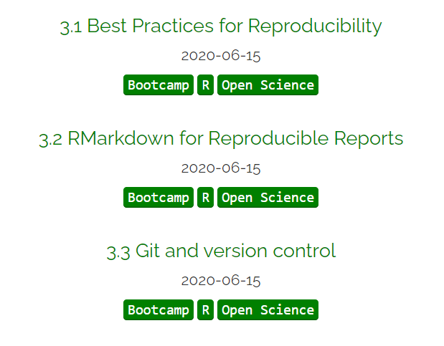
How is it organised?
https://dsgarage.netlify.app/bootcamp/
Moduel 3 (pages 3.x): An introduction to reproducible code, R Markdown, and Github

Slide 14
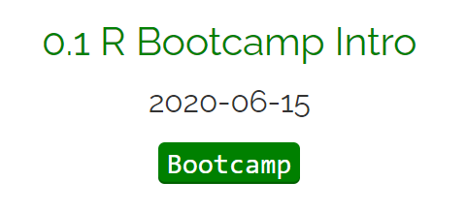
Day 1 with R and how it is intended to work

Slide 15
Day 1 with R and how it is intended to work
- Install R and RStudio
- Read the pages and type and run all code
- Practice good Reproducible scripting

Slide 16
Day 1 with R and how it is intended to work
Real tour of RStudio
(mention RStudio Cloud...)
https://dsgarage.netlify.app/bootcamp/0.1-bootcamp-intro/#anchor-4

Slide 17
Day 1 with R and how it is intended to work
Parts of a reproducible script and workflow
https://dsgarage.netlify.app/bootcamp/0.1-bootcamp-intro/#anchor-5
(Look at example script)
Header
Contents
Section for each item of contents
NB how to submit commands (demonstrate)

Slide 18
Day 1 with R and how it is intended to work
Exercises
Let's do the first one together
(demonstrate)
https://dsgarage.netlify.app/bootcamp/0.1-bootcamp-intro/#anchor-4

Slide 19
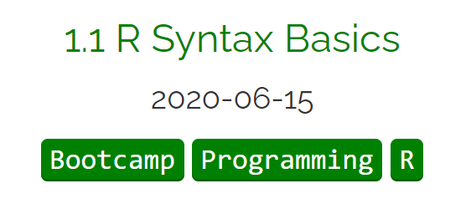

Let's start the next page together!
Meet the Passive aggressive butler, R
https://dsgarage.netlify.app/bootcamp/1.1-m1-r-syntax-basics/

Slide 20
In coming weeks we will use the meeting time to complete bootcamp pages together in real time
1-2 module pages per week?
Problem sessions at beginning and end

