Slide 1
HARUG
2022-04-13 (meeting #89) George Wager- Reading and activity from 'Advanced R' Ch 03
Chapter 03: Vectors
“The vector family in R”
Notes:
Book by Hadley Wickham
How the vectors integrate throughout R

Slide 2
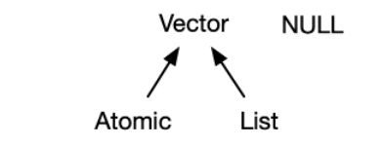
Chapter 03
Two types of vectors “atomic” and “list”. NULL (not a vector) is closely related to vectors and often serves the role of a generic zero length vector.
NULL is special because it has a unique type, is always length zero, and can’t have any attributes
Understanding attributes and their link to vectors
Vectors can have them
Considered as a named list of arbitrary meta data
VIPs of attributes are “dimensions” and “class”
Dimension attribute converts a vector into matrices and arrays
Class attribute powers the S3 object system (more details of this in Chapter 13 – here we are just interested in the S3 vectors)

Slide 3
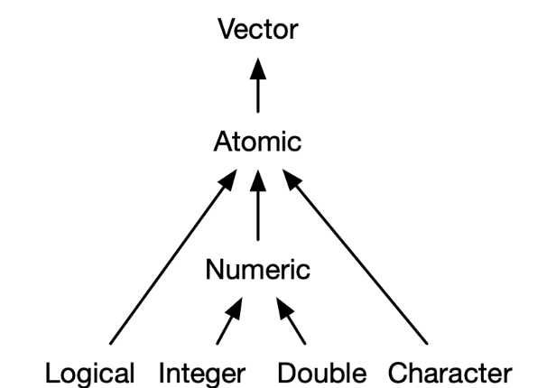
Chapter 03
In total there is 4 primary atomic vectors (see above) and two rare types: complex and raw
Each atomic vector has an individual value, referred to as a scalar
The scalar for each atomic vector is different:
Logical – TRUE or FALSE
Integer – written similarly to doubles but must be followed by L23 (1234L, 1e4L, or 0xcafeL)
Double – decimal (0.1234), scientific (1.23e4), or hexadecimal (0xcafe) form
Character – Strings are surrounded by " ("hi") or ' ('bye')

Slide 4
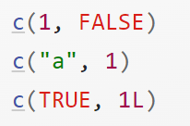
Chapter 03
FUNCTIONS
You can make long vectors using the c()
Use typeof() to get the vector type and length() to get the vector length
Use is.na() to identify missing values within a vector
THE VECTOR HIERARCHY
For atomic vectors, type is a property of the entire vector: all elements must be the same type. When you attempt to combine different types they will be coerced in a fixed order: character → double → integer → logical.
EXERCISE
DOUBLE
LOGICAL
CHARACTER
DOUBLE
LOGICAL
INTERGER
Notes:
Which atomic vector are they, then what would the output be according to coercion

Slide 5
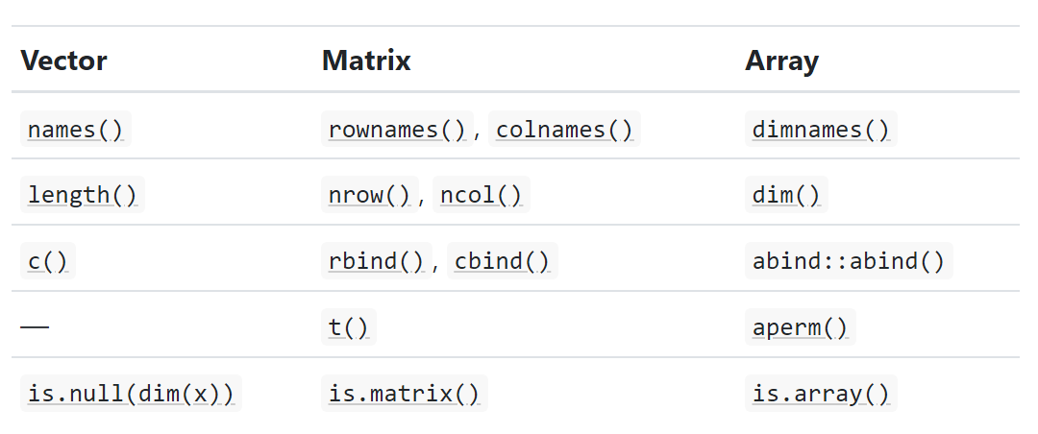
Chapter 03
To get the data structures such as matrices, arrays, factors, or date-times an attribute is added to the atomic vectors.
Attributes can be considered as name-value pairs that attach metadata to an object
Adding a dim attribute to a vector allows it to behave like a 2-dimensional matrix or a multi-dimensional array.

Slide 6
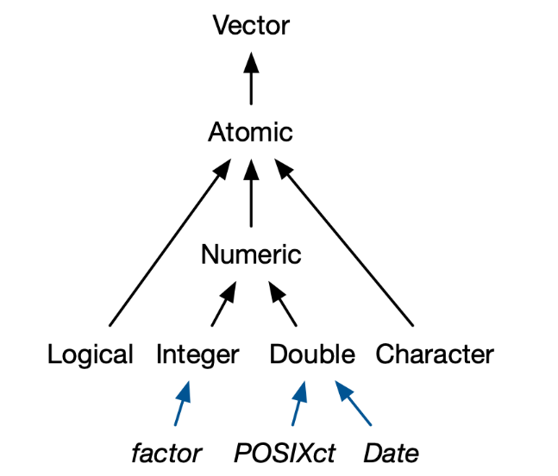
Chapter 03
S3 atomic vectors – importance of class
Class is a vector attribute, which underlies the S3 object system, the class attribute transforms an object into an S3 object, this changes the way it behaves when passed to a generic function.
Four important S3 vectors
- Categorical data, where values come from a
fixed set of levels recorded in factor vectors.
Dates (with day resolution), which are
recorded in Date vectors.
Date-times (with second or sub-second
resolution), which are stored in
POSIXct vectors.
Durations, which are stored in
difftime vectors.

Slide 7
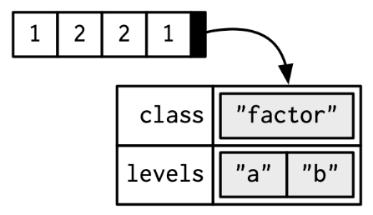
Chapter 03
Factors
when you tabulate a factor, you’ll get
counts of all categories, even unobserved
Ones
Base R automatically converts character
Vectors to factors
Factors can be ordered, ordered factors they behave like regular factors, but the order of the levels is meaningful (low, medium, high)
Dates
Date vectors are built on top of double vectors. They have class “Date” and no other attributes
Date-time
POSIXct vectors are built on top of double vectors, where the value represents the number of seconds since 1970-01-01
Durations
Durations, which represent the amount of time between pairs of dates or date-times, are stored in difftimes. Difftimes are built on top of doubles, and have a units attribute that determines how the integer should be interpreted.

Slide 8
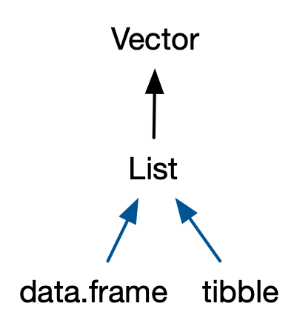
Chapter 03- Lists, df & tribbles
LISTS
- Each element of a list can be any type and is not restricted to just a vector
- A list can be made using the function list()
- Occasionally called recursive vectors because a list can contain other lists
DF & TRIBBLES
Df and tribbles built on top of lists
data frames automatically transform
non-syntactic names tibbles do not
Notes:
Non-syntactic names – covered in chapter 2 - A syntactic name must consist of letters¹⁰, digits, . and _ but can’t begin with _ or a digit. Additionally, you can’t use any of the reserved words like TRUE, NULL, if, and function (see the complete list in ?Reserved). A name that doesn’t follow these rules is a non-syntactic name; if you try to use them, you’ll get an error

Slide 9
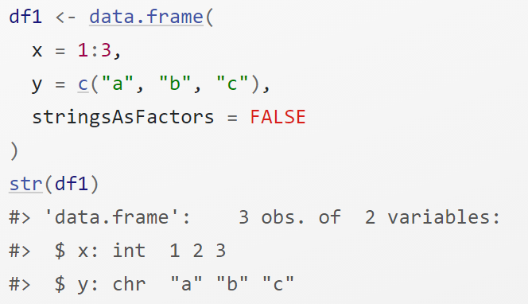
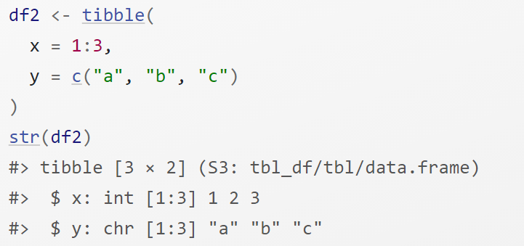
df
tibble
Notes:
Tribbles made to be easier (lazy version of df)

Slide 10
Exercise – Quiz Qs
10 mins for everyone to have a go
What are the four common types of atomic vectors? What are the two rare types?
What are attributes? How do you get them and set them?
How is a list different from an atomic vector? How is a matrix different from a data frame?
Can you have a list that is a matrix? Can a data frame have a column that is a matrix?
How do tibbles behave differently from data frames?

Slide 11
Solutions – Quiz Qs
The four common types of atomic vector are logical, integer, double and character. The two rarer types are complex and raw.
Attributes allow you to associate arbitrary additional metadata to any object. You can get and set individual attributes with attr(x, "y") and attr(x, "y") <- value; or you can get and set all attributes at once with attributes().
The elements of a list can be any type (even a list); the elements of an atomic vector are all of the same type. Similarly, every element of a matrix must be the same type; in a data frame, different columns can have different types.
You can make a list-array by assigning dimensions to a list. You can make a matrix a column of a data frame with df$x <- matrix(), or by using I() when creating a new data frame data.frame(x = I(matrix())).
Tibbles have an enhanced print method, never coerce strings to factors, and provide stricter subsetting methods.

