Slide 1
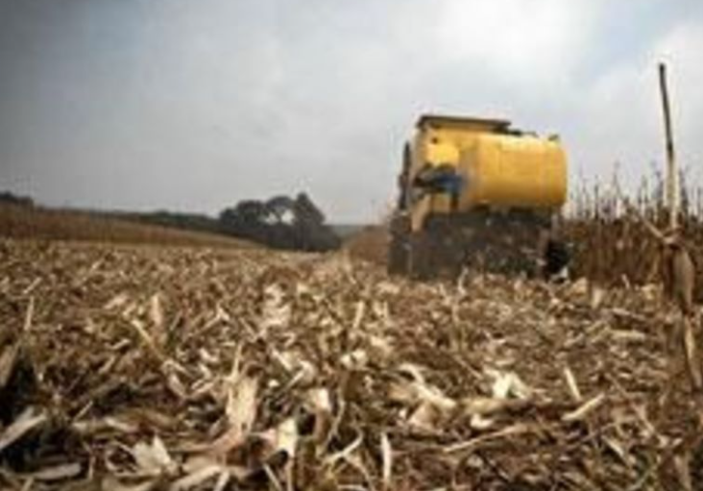

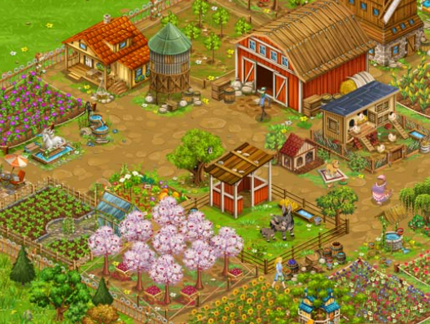
Poor
Machine learning
model
Incoming data
(farm inputs & biodiversity)
Good

