Slide 1
SCED Gastric cancer
04/2025 – Ho Vo
Clinical features |  | Discovery | N= | 480 |  |  |  | Unseen | N= | 468
 |  | Gastric |  | Gastric_benign |  | Healthy |  | Gastric |  | Gastric_benign |  | Healthy
 |  | N= | 100 | N= | 60 | N= | 320 | N= | 38 | N= | 23 | N= | 381
 |  | N | Percentage | N | Percentage | N | Percentage | N | Percentage | N | Percentage | N | Percentage
Gender | Female | 37 | 37.00% | 28 | 46.67% | 130 | 40.63% | 15 | 39.47% | 11 | 47.83% | 205 | 53.81%
 | Male | 63 | 63.00% | 32 | 53.33% | 190 | 59.38% | 23 | 60.53% | 12 | 52.17% | 176 | 46.19%
Age | Median | 61 |  | 51 |  | 55.5 |  | 62.5 |  | 51 |  | 48
 | Min | 34 |  | 26 |  | 21 |  | 35 |  | 31 |  | 19
 | Max | 86 |  | 74 |  | 96 |  | 80 |  | 77 |  | 91
Stage | I | 35 | 35.00% |  |  |  |  | 12 | 31.58%
 | II | 20 | 20.00% |  |  |  |  | 8 | 21.05%
 | IIIA | 25 | 25.00% |  |  |  |  | 8 | 21.05%
 | IIIB | 13 | 13.00% |  |  |  |  | 4 | 10.53%
 | IIIC | 4 | 4.00% |  |  |  |  | 4 | 10.53%
 | IV | 1 | 1.00% |  |  |  |  | 0 | 0.00%
 | NA | 2 | 2.00% |  |  |  |  | 2 | 5.26%

Slide 2
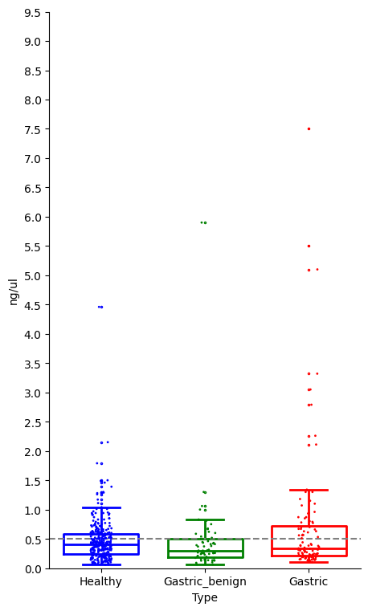
cfDNA conc.

Slide 3
STATS
 | EM | FLEN | NFP | CNA | SCNA | RATIOSL | RATIOST
Total features | 256 | 301 | 601 | 1942 | 1942 | 2872 | 2874
Number of Normal distribution (Shapiro-Wilk Test, p-value>0.05) | 3 | 1 | 212 | 168 | 499 | 0 | 0
Wilcoxon rank sum test, Benjamini–Hochberg correction
Total | EM | FLEN | NFP | CNA | SCNA | RATIOSL | RATIOST
Healthy vs Gastric | 126 | 109 | 135 | 0 | 0 | 0 | 0
Gastric_benign vs Gastric | 120 | 33 | 118 | 0 | 0 | 0 | 0
Nongastric vs Gastric | 137 | 100 | 171 | 0 | 0 | 0 | 0
Decrease in cancer | EM | FLEN | NFP | CNA | SCNA | RATIOSL | RATIOST
Healthy vs Gastric | 75 | 71 | 27 | 0 | 0 | 0 | 0
Gastric_benign vs Gastric | 64 | 26 | 5 | 0 | 0 | 0 | 0
Nongastric vs Gastric | 81 | 68 | 28 | 0 | 0 | 0 | 0
Increase in cancer | EM | FLEN | NFP | CNA | SCNA | RATIOSL | RATIOST
Healthy vs Gastric | 51 | 38 | 108 | 0 | 0 | 0 | 0
Gastric_benign vs Gastric | 56 | 7 | 113 | 0 | 0 | 0 | 0
Nongastric vs Gastric | 56 | 32 | 143 | 0 | 0 | 0 | 0

Slide 4
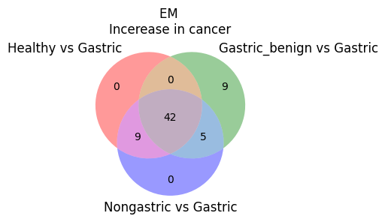

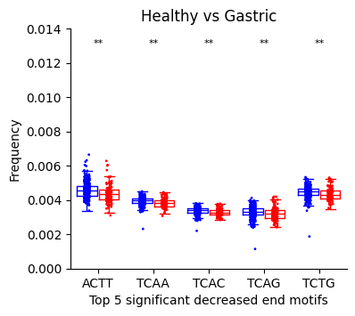
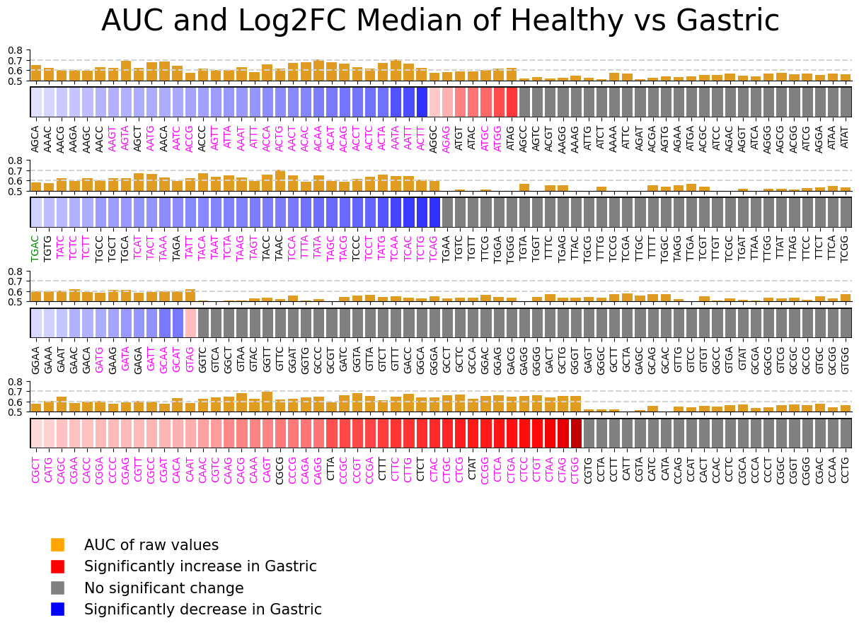
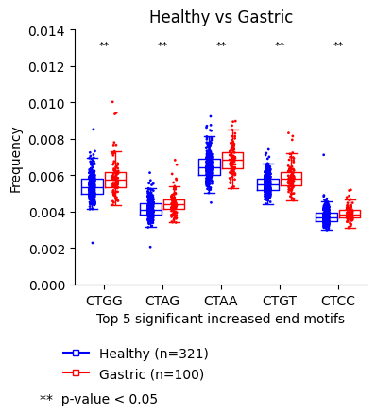
EM
Overlap features

Slide 5
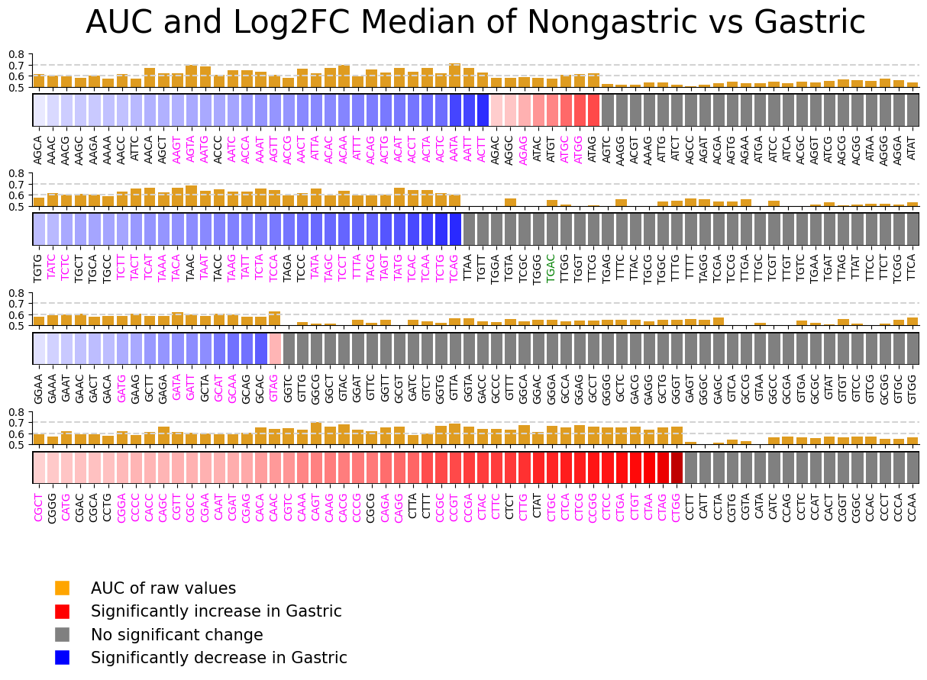
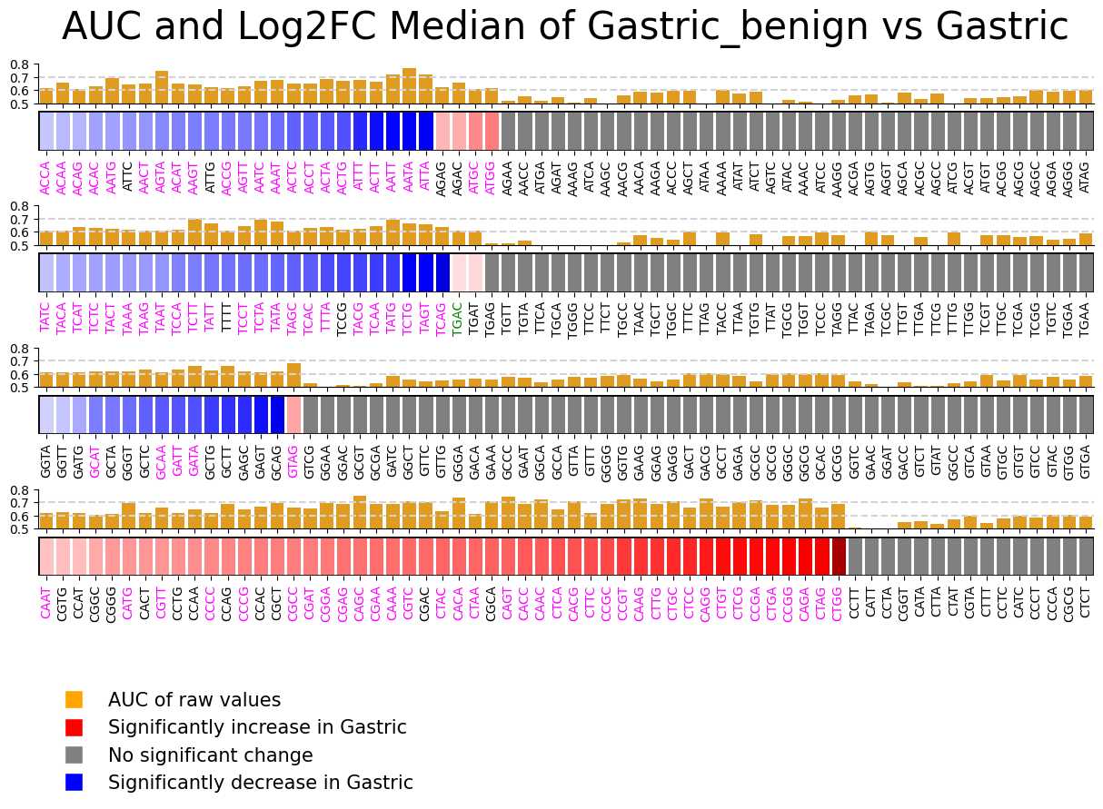
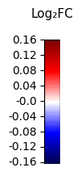
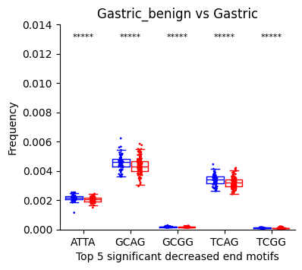
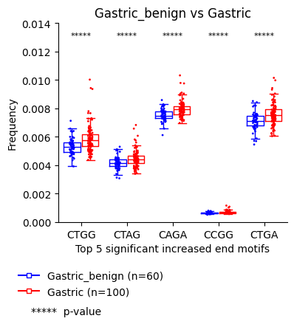
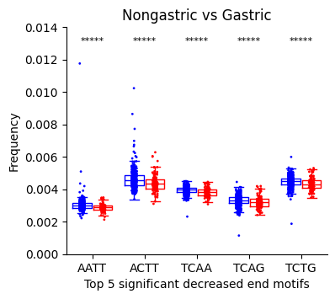
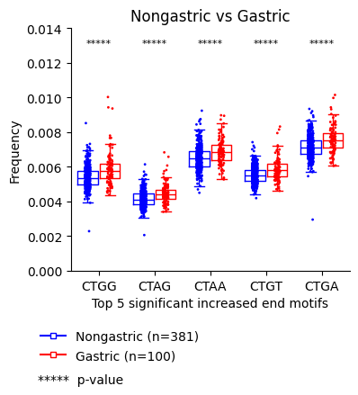
EM
Overlap features
Overlap features

Slide 6
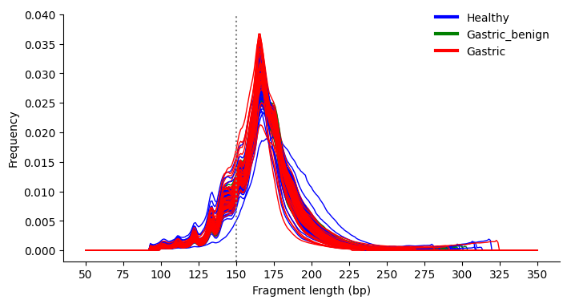
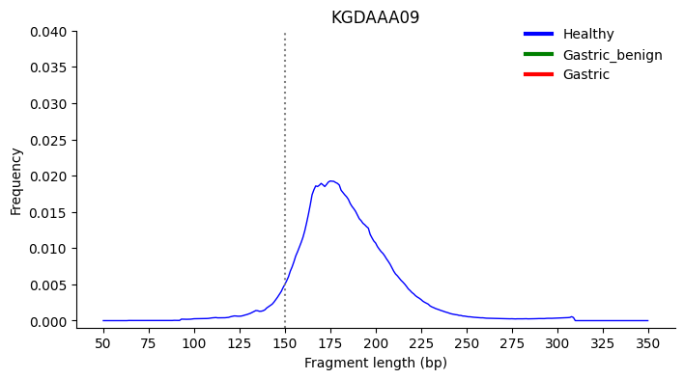
FLEN
Lib prep: Input = 145 ng

Slide 7
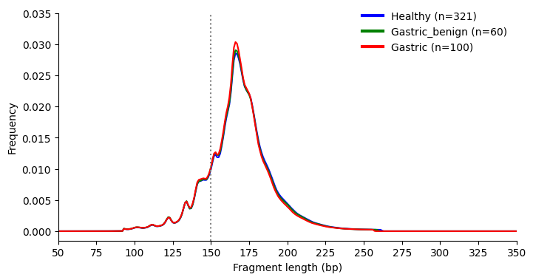
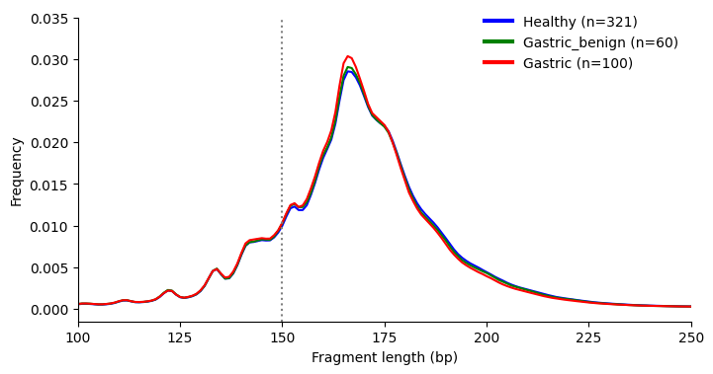
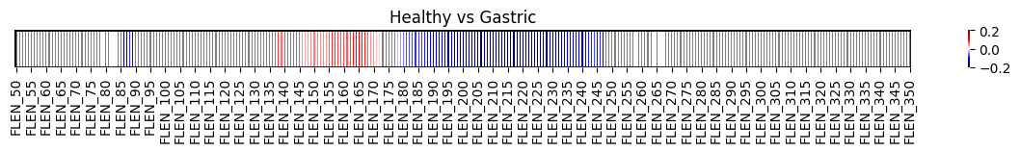


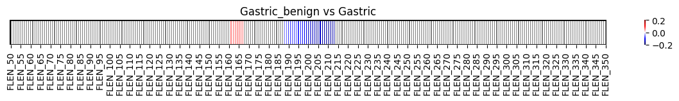
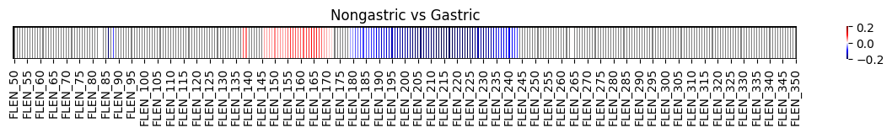
FLEN

Slide 8
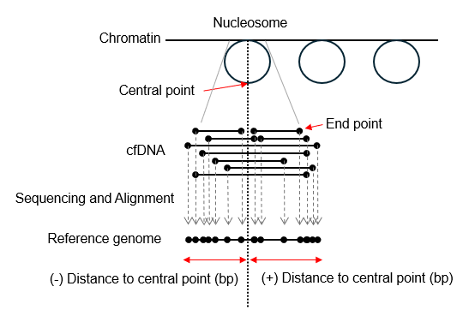


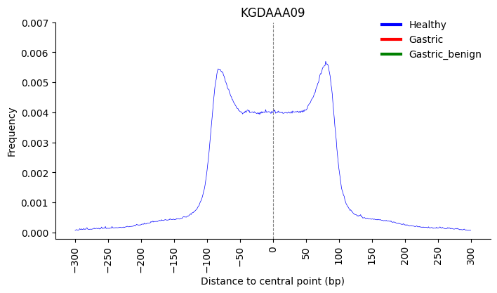
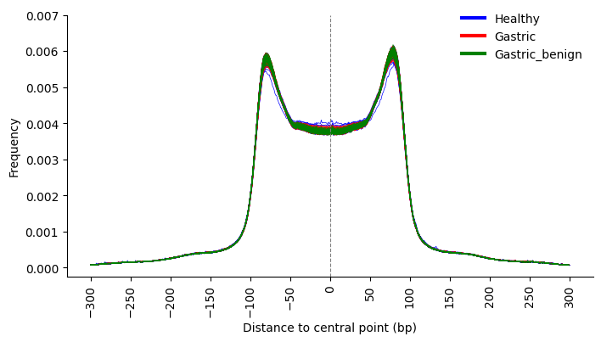
NFP

Slide 9
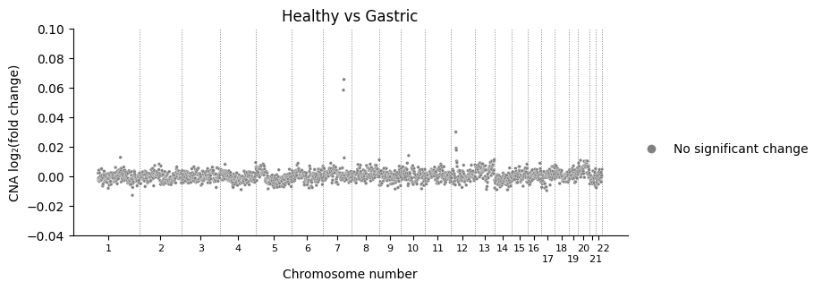
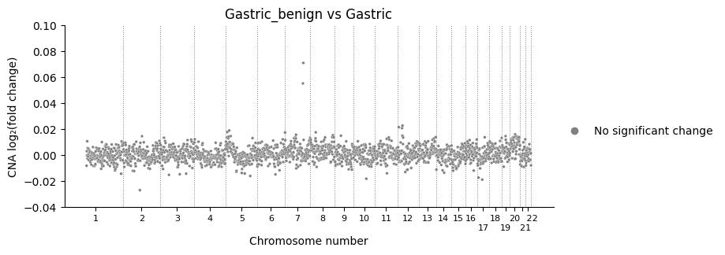

CNA

Slide 10
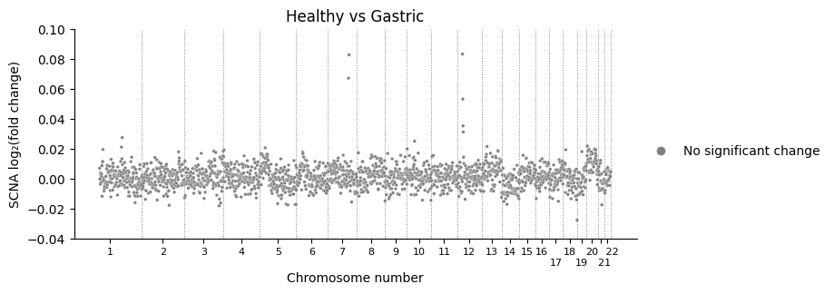
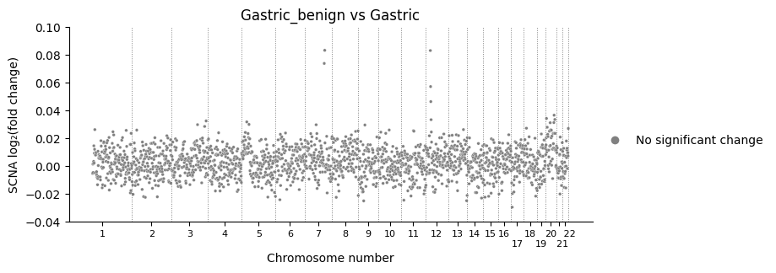
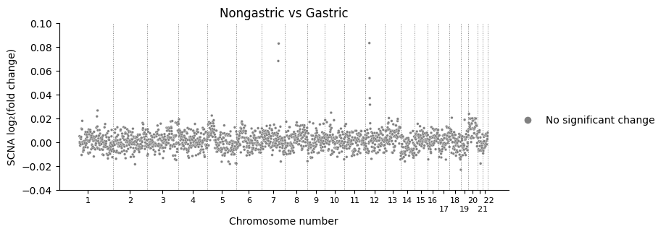
SCNA

Slide 11
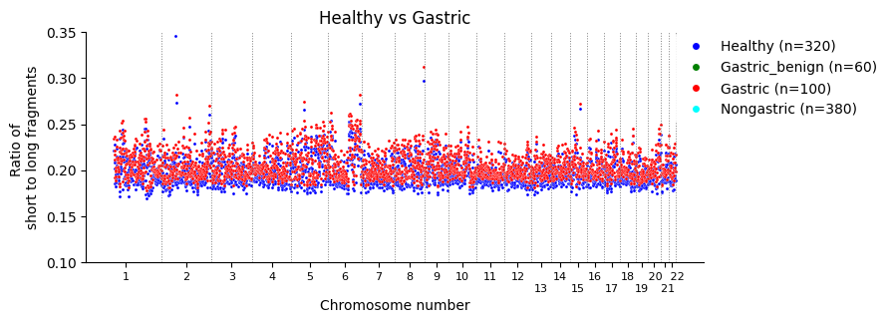
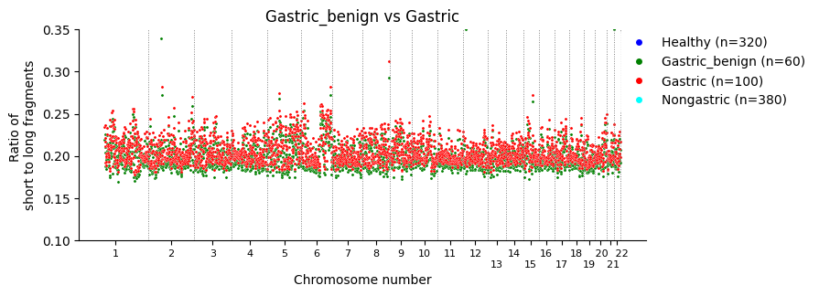
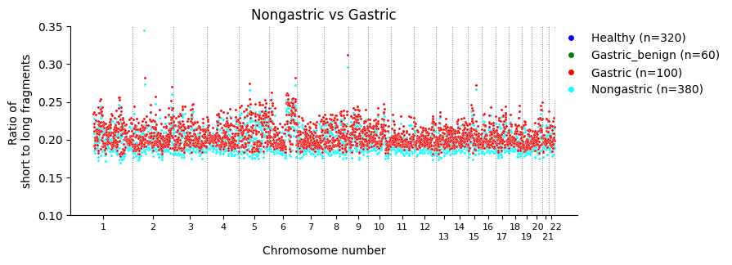
RATIOSL

Slide 12
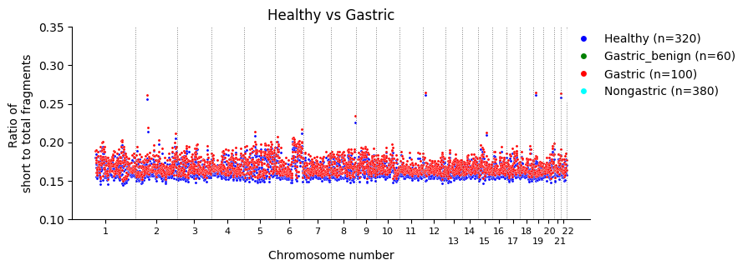
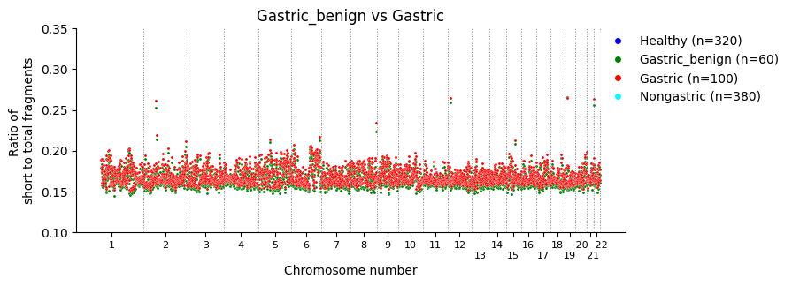
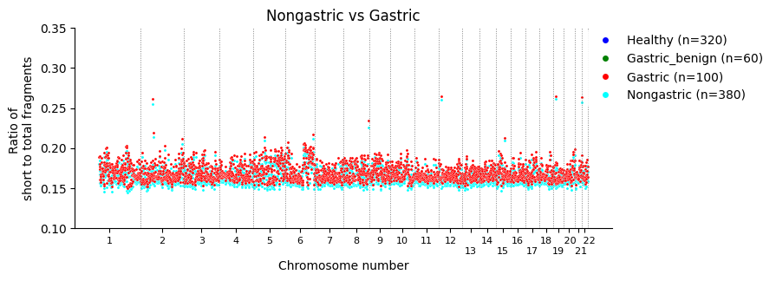
RATIOST

