Slide 1
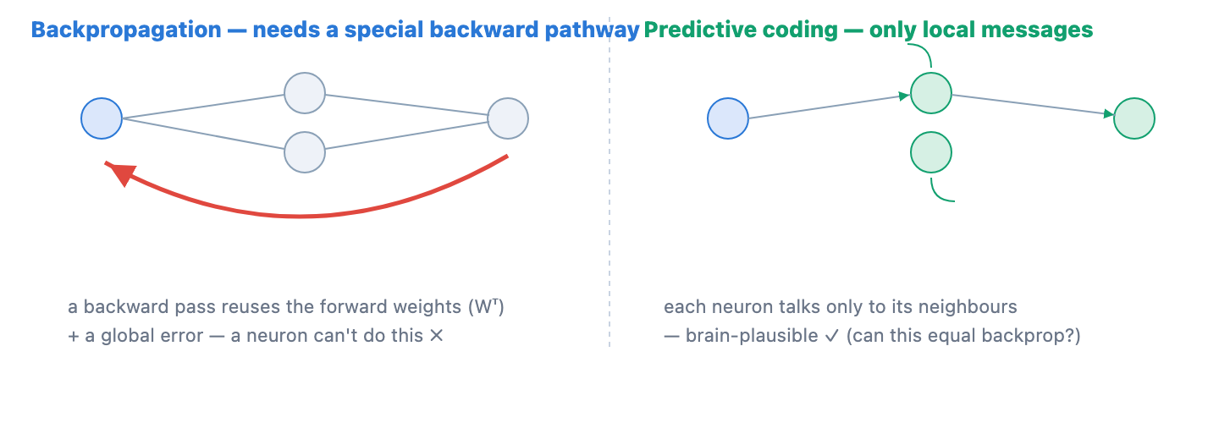
① THE PROBLEM
1 / 9
Backpropagation — powerful, but not brain-like
• Neural nets learn by backpropagation: predict, then send the output error backward through every layer to update the weights.
• A brain can't run it — it needs weight transport (the exact transpose weights, in reverse), a global non-local error, and a separate backward phase.
• And it forgets: learning new tasks overwrites the old ones (catastrophic interference).
✗ × 3
things a brain can't do

Slide 2
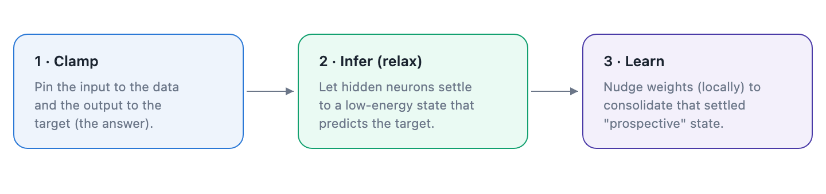
② THE IDEA
2 / 9
Predictive coding — learning with only local signals
• PC gives each layer value neurons (activity) and error neurons (local mismatch); it settles activity first, then makes a local Hebbian update.
• That removes all three blockers — no global error, no weight transport, no separate backward pass: everything is local.
• We test it on an identical MLP (swap only the rule) with three questions — Q1 parity, Q2 forgetting, Q3 budget.
100% local
only neighbour signals

Slide 3
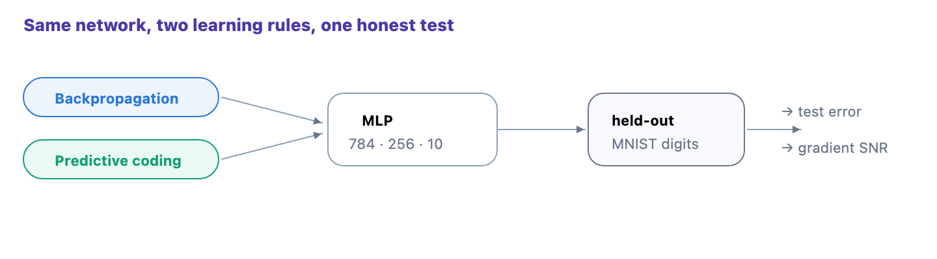
Q1 · THE QUESTION
3 / 9
Does PC match backprop on the basics?
• On plain static MNIST, is predictive coding as accurate as backprop on the same network?
• Test error — % wrong on held-out data; the generalisation number that matters.
• Gradient SNR — how consistent the per-example updates are; high = a clean, reliable signal.
same net
two rules · one test

Slide 4
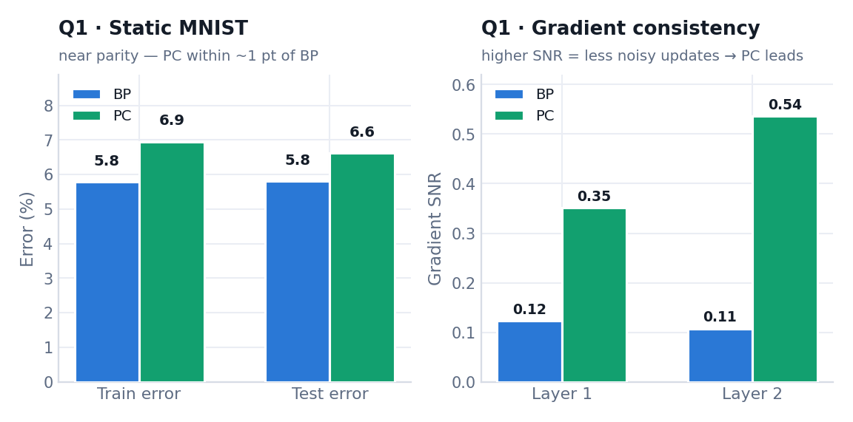
Q1 · RESULTS
4 / 9
Predictive coding matches backprop
• PC reaches backprop-level test error (~6%, either rule).
• Its per-example gradients are more consistent — higher SNR, a cleaner signal.
• So PC is a fully viable learning rule; its real advantage is in continual learning.
PC ≈ BP
static accuracy — on par

Slide 5
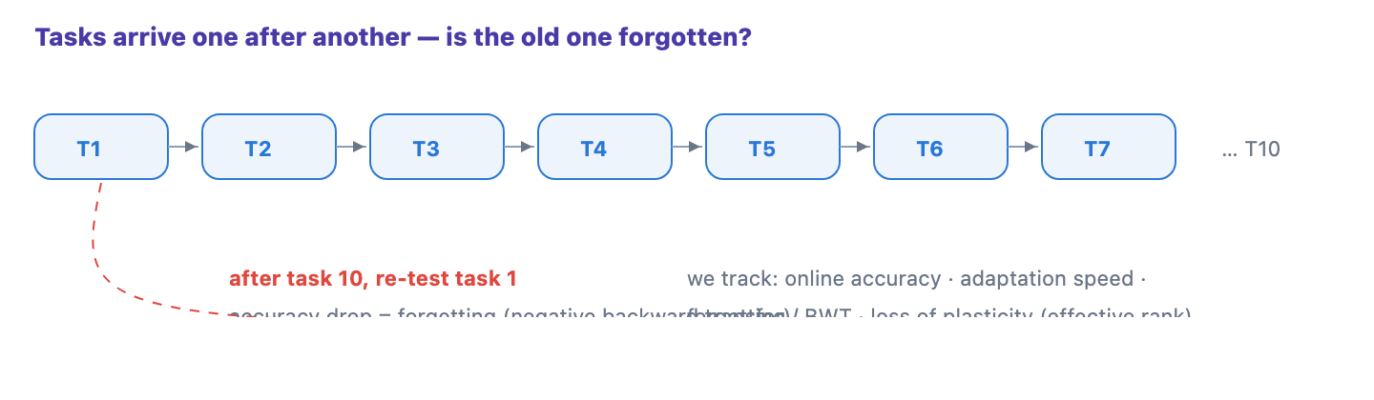
Q2 · THE QUESTION
5 / 9
Can it keep learning without forgetting?
• Train on a stream of tasks (Permuted & Split MNIST), one pass each — does new learning erase the old?
• Forgetting / backward transfer — the drop in an earlier task's accuracy after later training.
• Loss of plasticity — whether the net keeps enough active hidden units to keep learning (effective rank).
task 10 → task 1
still remembered?

Slide 6
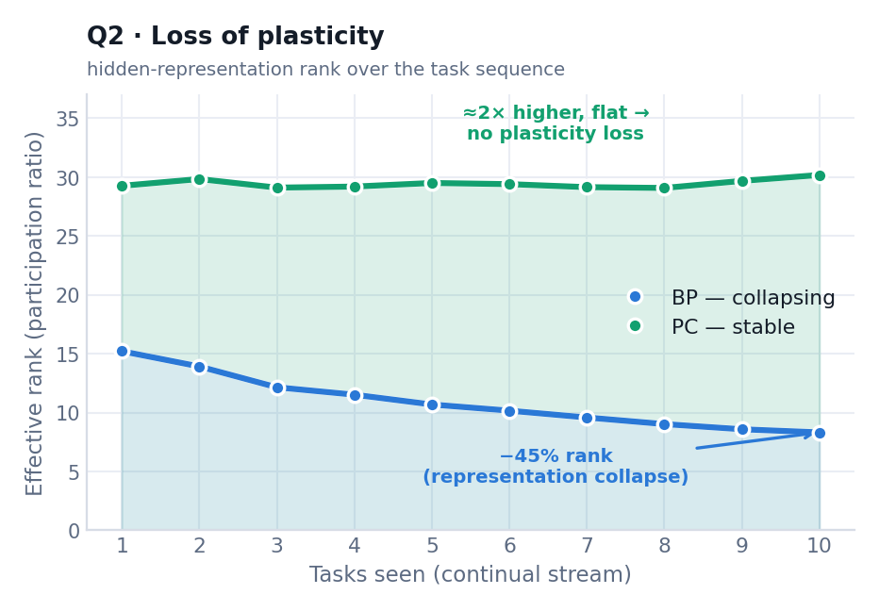
Q2 · RESULTS
6 / 9
PC forgets far less than backprop
• On Permuted-MNIST, PC roughly halves forgetting vs backprop.
• Backprop's hidden representation collapses (effective rank falls); PC's stays high and flat.
• Preserved capacity → less forgetting — the core beyond-backprop result.
3.6% vs 8.4%
forgetting: PC vs backprop

Slide 7
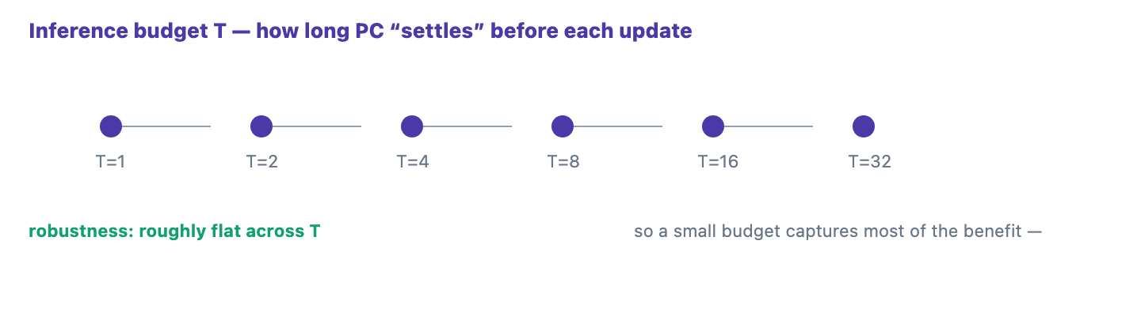
Q3 · THE QUESTION
7 / 9
How much thinking before it learns?
• PC settles its activity for T steps before each weight update — how much T is worth it?
• Inference budget T — the number of settling steps per batch.
• Stability–plasticity vs compute — more T may buy robustness, but costs linearly more.
how long?
to think before learning

Slide 8
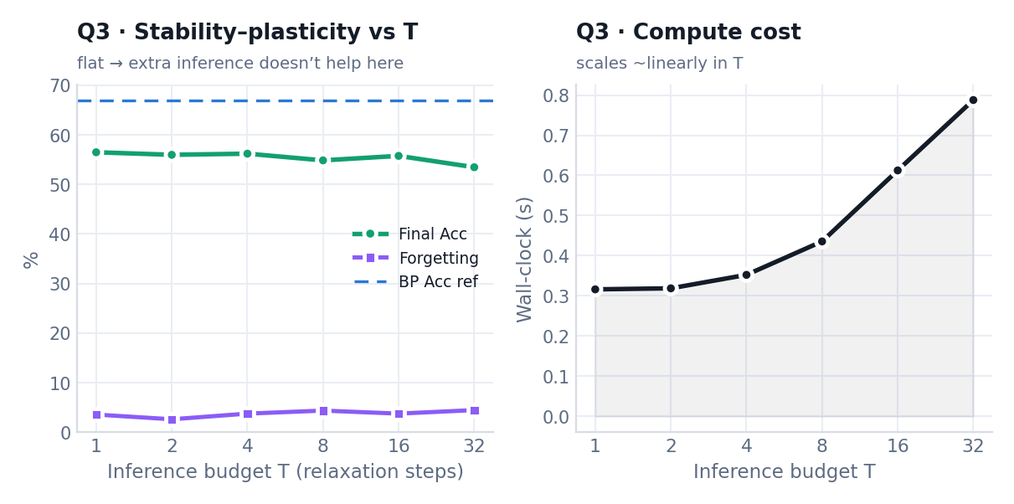
Q3 · RESULTS
8 / 9
A little thinking goes a long way
• Accuracy and forgetting stay roughly flat across T = 1 … 32.
• Compute cost grows ~linearly with T.
• A small inference budget captures most of the benefit.
small T wins
robustness flat · cost linear

Slide 9
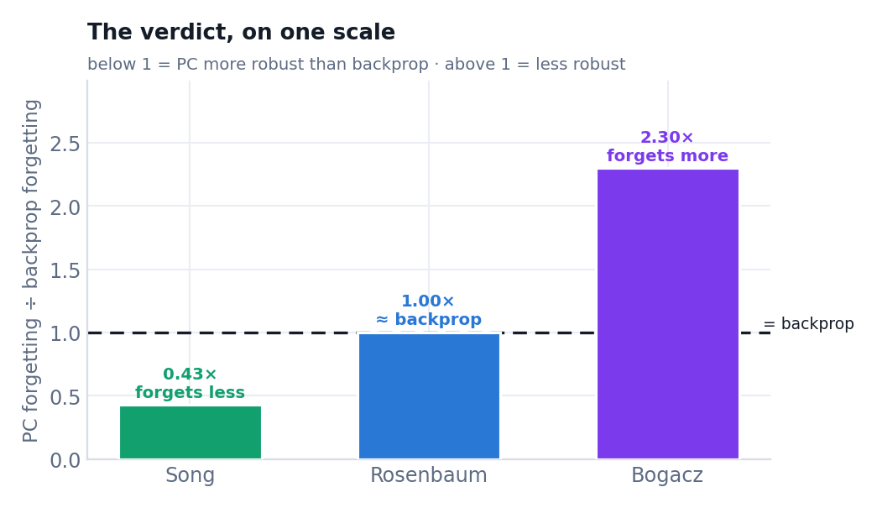
THE VERDICT
9 / 9
Three views of predictive coding
• Song settle then learn · Rosenbaum equals backprop under the FPA · Bogacz weight errors by reliability.
• Forgetting vs backprop — Song 0.43× (better) · Rosenbaum 1.0× (same) · Bogacz 2.3× (worse).
• Conclusion: activity-first PC (Song) beats backprop at continual learning. Next: deeper nets, more seeds, CIFAR.
0.43×
Song forgetting vs backprop

