Slide 1
Reducing Chinook Salmon Bycatch with Individual Tradable Encounter Credits (ITEC) and The Legacy Market-Incentive Program
How Legacy Allocations and Trading of ITEC satisfy the C-2 Motion PPA requirements for an Inter-Cooperative Agreement
George Sugihara and Hao Ye

Slide 2
ICA requirements to participate in the 68,392 hard cap scenario (as specified in the PPA)
An ICA must provide incentive(s) for each vessel to avoid salmon bycatch under any condition of pollock and salmon abundance in all years.
Incentive measures must include rewards for salmon bycatch avoidance and/or penalties for failure to avoid salmon bycatch at the individual vessel level.
Notes:
Note: PPA= preliminary preferred alternative, ICA= inter-cooperative agreement

Slide 3
ICA requirements to participate in the 68,392 hard cap scenario (as specified in the PPA)
The ICA must specify how those incentives are expected to promote reductions in actual individual vessel bycatch rates relative to what would have occurred in the absence of the incentive program. Incentive measures must promote salmon savings in any condition of pollock and salmon abundance, and influence operational decisions at bycatch levels below the hard cap.
Notes:
Bycatch encounters are taken as a proxy for chinook abundance

Slide 4
Summary of the C-2 Motion PPA Incentive Requirements
Provide incentives at the individual vessel level.
Reward vessels that successfully avoid Chinook and/or penalize vessels that fail to avoid chinook.
Incentivize vessels to avoid Chinook bycatch at all levels of abundance in all years.
Incentives must influence fishing decisions at levels below the hard cap.
Notes:
Note: PPA= preliminary preferred alternative, ICA= inter-cooperative agreement

Slide 5
Background: Why Hardcaps Need C-2 Are fixed hardcaps alone sufficient for managing bycatch?
The key problem is that chinook encounters are highly variable from year to year.
A fixed hardcap penalizes the Pollock industry most when the Chinook populations are likely to be most abundant. It does not protect Chinook when they are least abundant (i.e., when Chinook salmon populations are most vulnerable). Thus a hardcap alone without an incentive plan is a bad solution for everyone.
Thus, an incentive plan as in C-2 is required
Notes:
Bycatch encounter rates are taken as a proxy for underlying chinook abundance.
HC only limits high encounter years, not low encounter years.

Slide 6
Background: How Big Should Incentives be?
Q: How to scale Incentives?
A: By the real costs of bycatch to the industry

Slide 7
Background: Cost of bycatch to the Pollock Industry
What is the TRUE COST of chinook bycatch to the pollock industry under the PPA hardcap of 68,392?
These costs should be reflected in the penalties and rewards of the incentive system

Slide 8
Without additional incentives or ITEC trading the cost to industry of the PPA hardcap (68,392) is high
Notes:
Hard cap would have resulted in a ~$200,000,000 loss over 6 years for the inshore sector alone. (Inshore represents 1 of 4 sectors comprising the Bearing Sea Fleet).
Individual vessels run out of credits

Slide 9
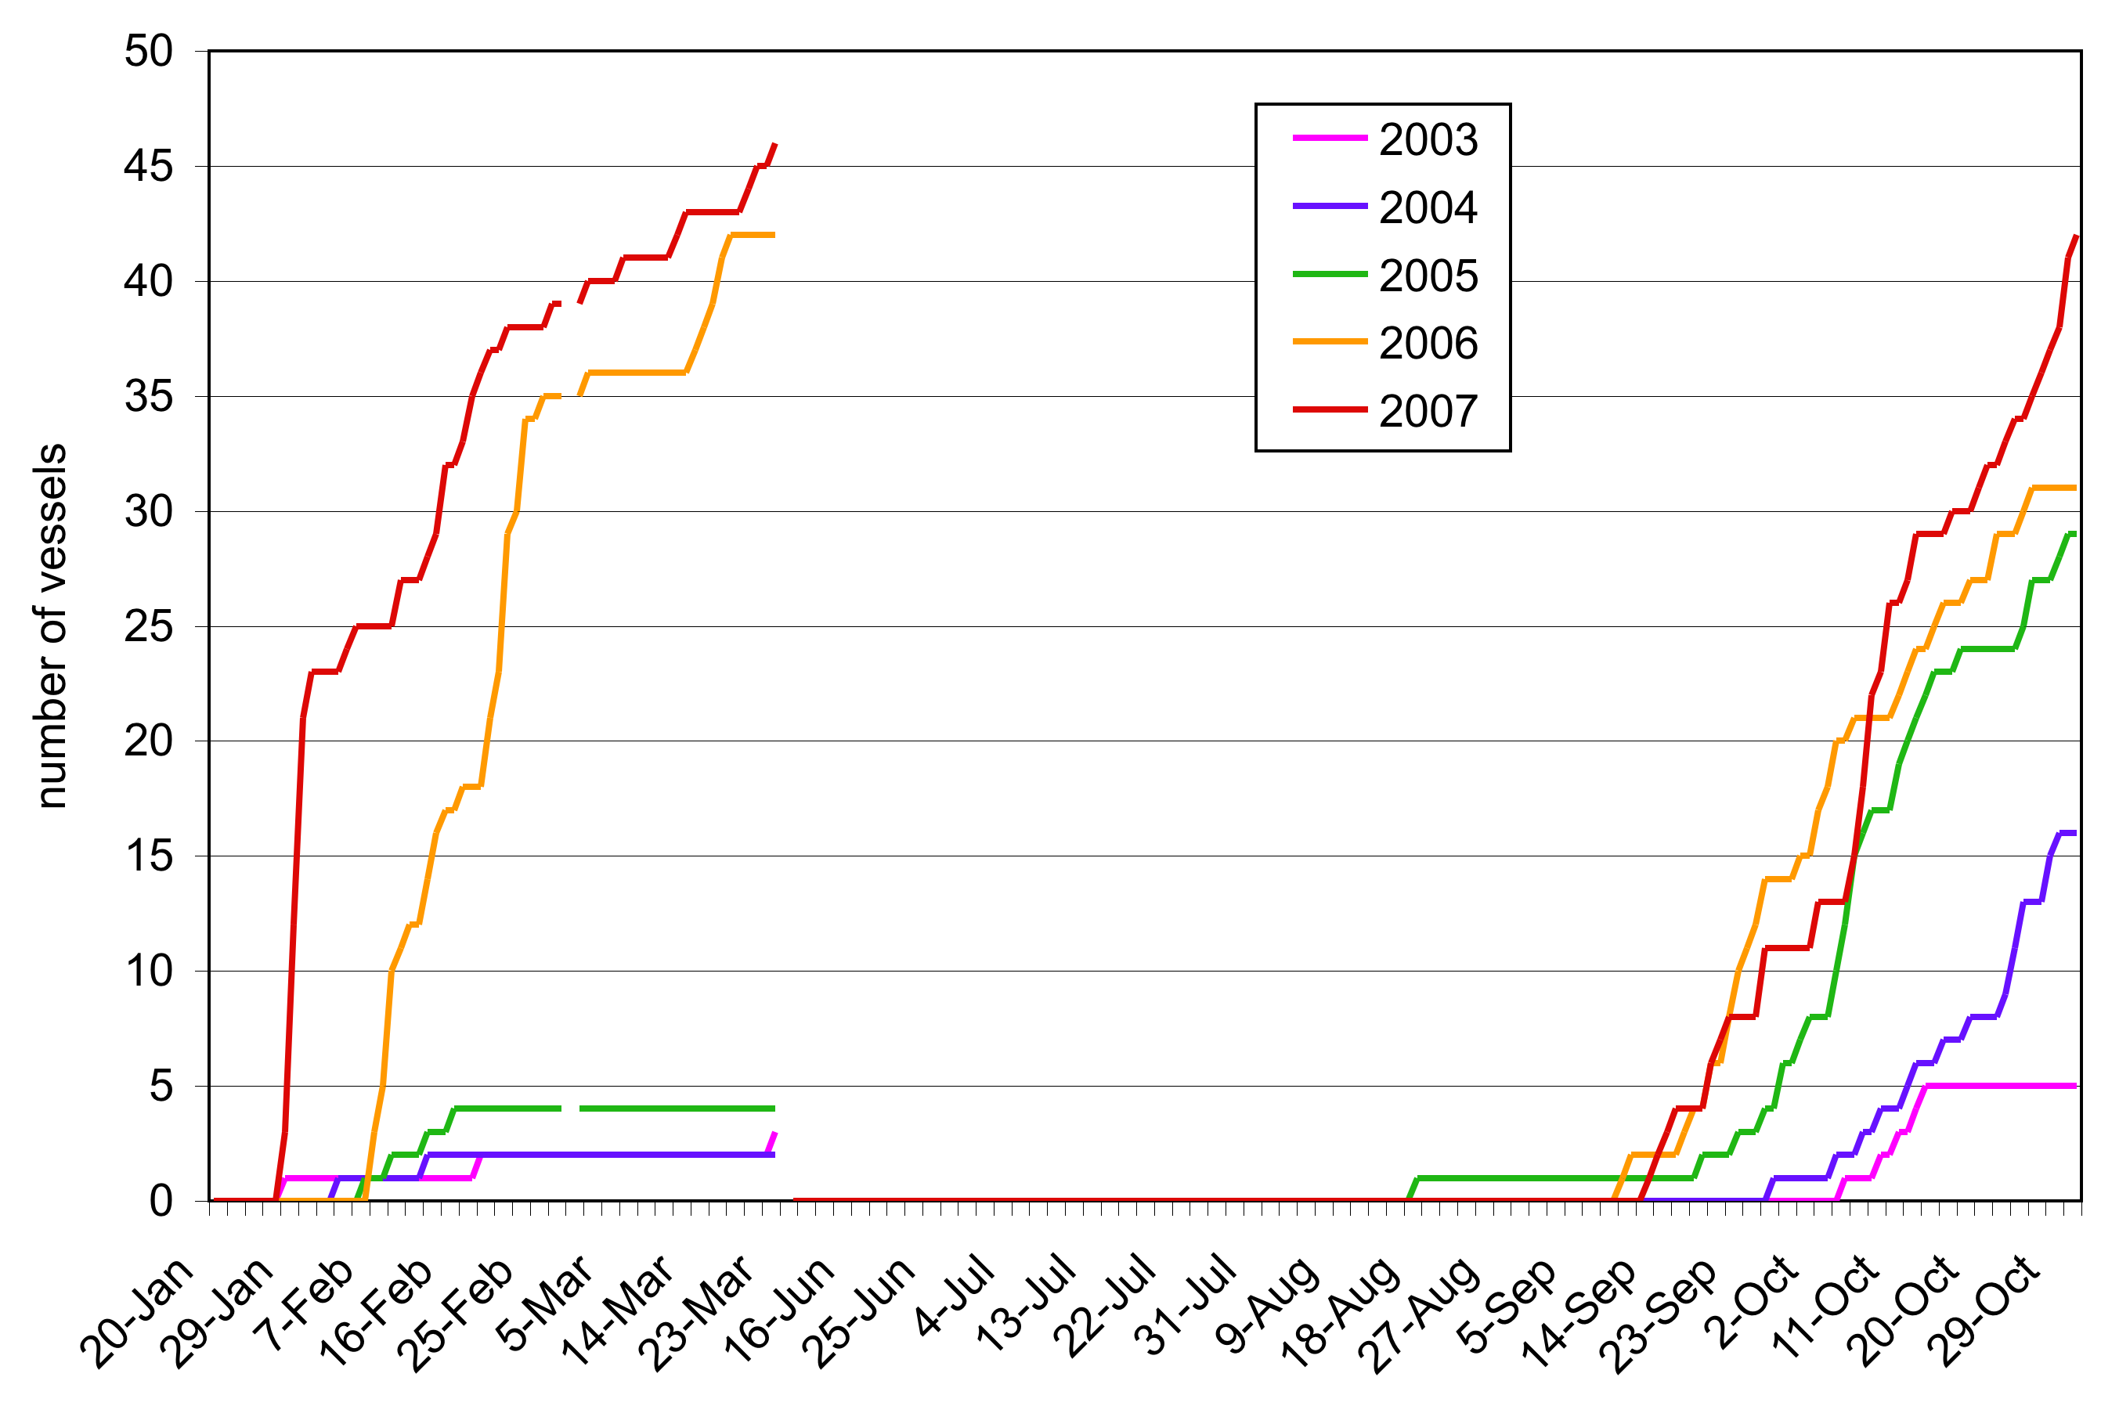
Vessels run out of credits under the 68,392 PPA hardcap even in low and moderate abundance years
Notes:
This is for the inshore sector only

Slide 10
Even in low encounter periods many vessels run out of credits under the PPA Hardcap
year | # of Inshore sector vessels that run out of credits
2003 | 11
2004 | 33
2005 | 37
2006 | 54
2007 | 56
Notes:
INSHORE ONLY !!!!!!
Even worse if legacy allocations were not implemented.

Slide 11
Cost of Bycatch to Pollock Industry
The “real cost” of Chinook Salmon bycatch under a hardcap is the value of the forgone Pollock left unharvested.
These costs can be considerable.
A good incentive plan should reflect these real costs and not be based on penalties and rewards that are arbitrarily set (and easily nullified).

Slide 12
Components of the Recommended Market-Incentive Program
Legacy Allocation Component
Reallocates ITEC annually from high bycatch vessels to cleaner vessels. Creates inter-annual accountability.
Transfer Component
Regulates trading. Enhances allocation and trading incentives (penalties/rewards) during low encounter times.
(Buy-side Limit, Dynamic Salmon Savings)
Notes:
ITEC = Individual Tradable Encounter Credit

Slide 13
Legacy Allocation
Sectors are given fixed seasonal allocations of ITEC as specified in the PPA.
ITEC are distributed to individual vessels via the coops according to a uniform ITEC allocation formula. This formula adjusts allocations to reward low bycatch and penalize high bycatch.
The ITEC allocation formula is designed to distinguish consistent good/bad behavior from random noise. (i.e. chance encounters)

Slide 14
Legacy Allocation (cont’d)
Vessels that run out of ITEC must stop fishing. They can resume fishing only after buying sufficient ITEC to cover expected fishing activity.
Efficient vessels with surplus credits can earn additional revenue by selling them.
Vessels with high bycatch rates may need to purchase additional credits from clean vessels (if they are willing to sell) when they run out.

Slide 15
Rewards and Penalties associated with Legacy Allocation (per C-2)
ITEC allocations are adjusted based on individual vessel bycatch performance:
vessels with low bycatch rates are rewarded with increased ITEC allocation.
vessels with high bycatch rates are penalized with decreased allocation.

Slide 16
Incentives associated with Legacy Allocation
The Legacy Allocation rewards (and punishes) consistent good/bad behavior.
Vessels need to continue to have lower-than-average bycatch to maintain the same level of increased ITEC allocation.
Increased ITEC allocation acts as insurance against running out of credits in moderate- and high-encounter years.
Some vessels run out of credits even in low-encounter years.
16
Notes:
“legacy” component of allocation formula pulls P back to 100%, acts like a spring

Slide 17
Even in low encounter periods many vessels run out of credits under the PPA Hardcap
year | # of Inshore sector vessels that run out of credits
2003 | 11
2004 | 33
2005 | 37
2006 | 54
2007 | 56
Notes:
INSHORE ONLY !!!!!!
Even worse if legacy allocations were not implemented.

Slide 18
Uniform ITEC Allocation Formula: determines proportional credits allotments
P_{t =} 1/3 + 1/3 P_{t-1}+ 1/3 Q_{t-1}
constant factor
(pollock)
“legacy” component
(bycatch track record)
bycatch function
(penalty/reward)
ITEC allocations are done pro-rata to pollock quota
Notes:
Just an example of weightings 1/4, 1/2, 1/4 …etc. 1/8, 3/4, 1/8 is also being considered. These parameters can be adjusted to specify asymptotic bounds.

Slide 19
How it works
The legacy allocation rule is designed to minimize the effect of chance encounters (bad luck) in any year putting more credits at the disposal of consistent good players.
-This creates incentive for consistent good performance.
-This reduces fleet bycatch cumulatively through time.
-Incentives are the same every year, from the start.
Notes:
Legacy allocations reflect the long-term history but emphasize current behavior
NOT A ONE-SHOT DEAL…. Cumulative GPA is what counts.

Slide 20
Legacy Incentive: Insurance
During years of moderate to high-encounter:
Many vessels run out of credits, so vessels may not be able to augment initial allocations through purchases.
High-bycatch vessels with reduced ITEC allocation will run out of credits sooner: unfished Pollock can represent a major loss in revenue.
Low-bycatch vessels with increased ITEC allocation can complete more of its Pollock harvest: the extra Pollock can represent a major gain in revenue.

Slide 21
Magnitude of Legacy Incentives
With extra legacy credits from fishing cleanly in 2003 and 2004, these vessels were able to capture significant additional revenue in 2005.
Vessel | 2005 credits gained/lost | Net Gain/Loss due to Legacy Reallocation
L | 0 | $0.00
W | 11 | $53,223.77
R | 24 | $116,146.40
B | 9 | $43,554.90
Notes:
Sector harcap was exceeded in 2005.

Slide 22
Magnitude of Legacy Incentives
The costs of unfished Pollock under the PPA hard cap can be considerable for the Inshore sector.
Legacy Allocation redistributes ITEC to cleaner, more efficient vessels that can harvest more pollock for each ITEC.
Vessel | 2007 credits gained/lost | Net Gain/Loss due to Legacy Reallocation
L | (21) | ($58,184.09)
W | 17 | $47,101.41
R | 35 | $96,973.49
B | (29) | ($80,349.46)
Notes:
even small changes in proportional allocation factor, P, can result in large values of Revenue gains or losses.

Slide 23
Legacy Allocation during years of low salmon encounter
Reducing bycatch during low-encounter years has a larger effect on increasing ITEC allocation. Thus, incentives to reduce bycatch are stronger during low encounter times.
Reducing bycatch by 10 salmon in 2006 (a high encounter year) increases ITEC allocation by an average of 1.11 credits in 2007.
Reducing bycatch by 10 salmon in 2003 (a low encounter year) increases ITEC allocation by an average of 2.84 credits in 2004.
Notes:
years of low salmon encounter - below the hardcap
already shown that vessels are incentivized to reduce bycatch

Slide 24
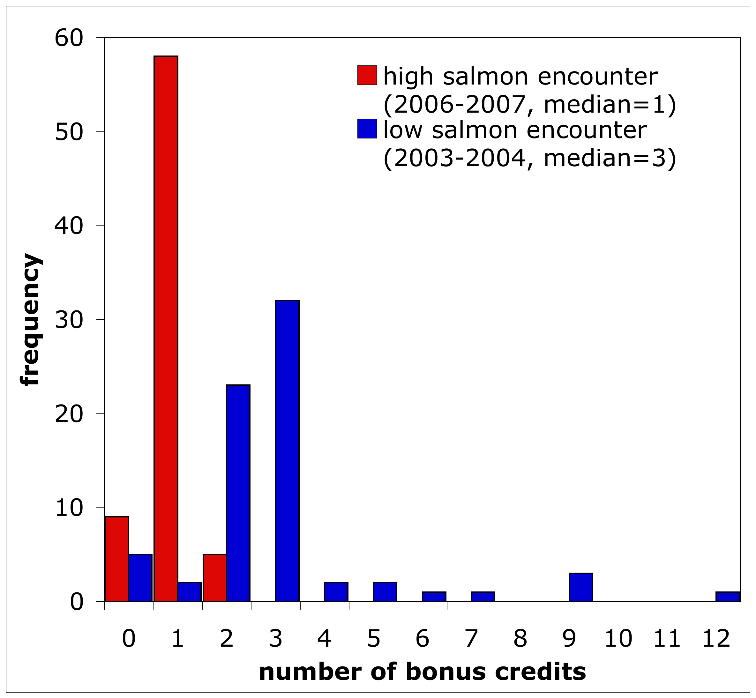
Legacy Program
Individual Vessel Incentives - Rewards: There is more reward
incentive to avoid bycatch during low chinook salmon
encounter
years (blue).
Think of this as gaining
additional insurance by fishing cleanly
Notes:
The downstream financial reward of having additional ITEC can be large!

Slide 25
Legacy Program
Individual Vessel Incentives - Penalties: Every vessel’s future
allocation of ITEC is at risk of being reduced if their relative
performance is poor. This penalty is greater during low salmon
encounter years (blue).
Think of this as having
reduced insurance
due to high bycatch

Slide 26
Legacy Allocation during years of low salmon encounter
Therefore, the incentive to reduce bycatch is roughly 3x higher during low-encounter years
Increased ITEC allocation can be worth up to
~$7k/credit in Pollock revenue.
Notes:
10 salmon ~ $14,000
So actually around $2,000 - $5,000 / credit on average.

Slide 27
Summary: Legacy ITEC Reallocation
Legacy Allocation redistributes credits towards more efficient vessels with low bycatch that can maximize Pollock harvest with respect to salmon bycatch.
This increases the amount of Pollock that can be harvested in years in which the fleet runs against the hardcap (2005, 6, 7).
This provides incentive for vessels to reduce bycatch in low and moderate encounter years in order to maintain (or increase) ITEC allocation to avoid foregoing Pollock.
Notes:
low-bycatch vessels are naturally more efficient with credits, are able to fish more pollock for the same quantity of ITEC

Slide 28
Legacy Market-Incentive Program 2 Components:
Legacy Allocations
Transfer Rules (trading rules)

Slide 29
Trading is Necessary Under the PPA hard cap
year | # of Inshore sector vessels that run out of credits
2003 | 11
2004 | 33
2005 | 37
2006 | 54
2007 | 56
Notes:
Maybe this slide should be repeated …. To make this point earlier (with legacy)? … or perhaps use the graph, with the same title. Or just repeat this slide 2X.

Slide 30
Vessels Run Out of Credits Under the PPA Hardcap (Inshore)

Slide 31
Why have transfer rules?
During years of low salmon encounter, a high hard cap may result in an oversupply of ITEC for available for sale. This oversupply will tend to lower credit prices and diminish short-term trading incentives.
Solution:
Create transfer rules to prevent potential abuse, control supply, and strengthen the long-term incentives of Legacy Allocation.

Slide 32
Transfer Rules
Buy-Side Transfer Limit
Vessels may only purchase a fixed fraction of their initial ITEC allocation. (prevents hoarding and abuse)
Dynamic Salmon Savings Rule
Controls supply of ITEC by setting credits aside “Salmon Savings.”
Adaptive to the level of salmon abundance.

Slide 33
Transfer Rules
Transfers occur between individual vessels (per C-2).
Transfer Rules amplify vessel-level incentives (per C-2).

Slide 34
Transfer Rules
prevent abuse (hoarding) of abundant credits during low-encounter years
increase short-term trading incentives (especially in low-encounter years) (C-2)
increase the strength of long-term incentives created by Legacy Allocation (C-2)

Slide 35
Buy-Side Transfer Limit
Consider a limit of 1/3: vessels may only purchase up to 1/3 of their annual allocation.
A vessel that is allocated 300 credits for the year (for A and B seasons combined) can only purchase a total of 100 additional credits from other vessels willing to sell them.
Lease Provision: If the vessel then leases an amount of pollock equal to its original allocation (doubling the amount of pollock), the number of credits it may buy (if available) is also doubled to 200 credits.

Slide 36
Rewards and Penalties associated with Buy-Side Transfer Limits
The number of credits a vessel may buy moves in tandem with its ITEC allocation:
Vessels with low bycatch rates are rewarded with increased buy-side limits. (in addition to an increased ITEC allocation)
Similarly, vessels with high bycatch rates are penalized with decreased limits.
Notes:
Because the purchase limit is a fixed fraction of ITEC allocation, incentives to increase allocation are magnified.

Slide 37
Dynamic Salmon Savings (DSS)
Adaptive to Chinook abundance and evens out the supply of saleable credits.
Limits the supply of ITEC during low encounter years (when salmon stocks are most vulnerable).
Does not hamper vessel’s ability to use full ITEC allocation if needed.
Notes:
Edited )

Slide 38
Dynamic Salmon Savings (DSS)
When vessels finish fishing in the B season, some credits are “set aside or saved”.
The percentage of credits “saved” is the Salmon Savings Rate (SSR).
The SSR is computed such that the sector has enough credits to harvest the remaining pollock.
Prior to the determination of an SSR, credit transactions are governed by a Provisional Salmon Savings Rule (like tax withholding).
Notes:
Edited )

Slide 39
Provisional Salmon Savings Rule (PSSR)
Prior to finishing fishing, (and having credits retired) vessels may still transfer credits.
The appropriate number of credits are set aside to cover eventual retirement. (PSSR is similar to tax withholding)
This number (PSSR) is determined by the maximum SSR before the SSR has been calculated.
This rule prevents avoidance of Dynamic Salmon Savings by selling credits before they can be retired.
Notes:
Edited & corrected.

Slide 40
Provisional SSR Example
Suppose the maximum SSR is 40%.
Provisional SSR = maximum SSR = 40%.
Thus, if a vessel wishes to sell 60 credits before the SSR is set, it must set aside 40 ITEC in reserve.
If the SSR is set to 40%, all 40 reserve credits are retired.
If the SSR is less than 40%, some of the 40 reserve credits are returned.
Notes:
note that 40 reserve != 40% of 60, rather it is 40% of 100 credits.

Slide 41
Calculating a Salmon Savings Rate
The Salmon Savings Rate (SSR) is computed using an estimate of the number of credits needed to fish the Pollock allocation.
This estimate can be made accurately when 2/3 of the B season Pollock allocation is caught (cf Sugihara 1994) .
The SSR corresponds to the number of credits that are not needed to finish fishing the Pollock allocation.
Notes:
edited

Slide 42
Calculating a Salmon Savings Rate
A maximum SSR provides an upper bound on the SSR. It is the “withholding maximum” that determines the Provisonal Salmon Savings Rate. It should be set so that the resulting PSSR does not prohibit required credit transactions.
A maximum SSR set too high can make credits too expensive for vessels that need to buy ITEC before the SSR can be computed.
Notes:
edited

Slide 43
Calculating a Salmon Savings Rate
 | A | B | C | D | E | F
2000 | 16-Sep | 37001 | 254 | 7540 | 29461 | 79.6%
2001 | 11-Sep | 31578 | 277 | 7770 | 23808 | 75.4%
2002 | 5-Sep | 24955 | 1655 | 21550 | 3405 | 13.6%
2003 | 2-Sep | 24318 | 256 | 7560 | 16758 | 68.9%
2004 | 31-Aug | 25859 | 1890 | 23900 | 1959 | 7.6%
2005 | 29-Aug | 21122 | 4142 | 46420 | -25298 | 0.0%
2006 | 10-Sep | 12182 | 3591 | 40910 | -28728 | 0.0%
2007 | 2-Sep | 14848 | 1465 | 19650 | -4802 | 0.0%
A = date when 2/3 Pollock caught
B = sector credits remaining (including 100% carry-forward from A season)
C = bycatch caught (up to the date in A)
D = predicted season bycatch + buffer
E = estimated surplus credits
F = allowable salmon savings rate

Slide 44
Dynamic Salmon Savings during years of low salmon encounter
The effective supply of credits is reduced most strongly during years of low salmon encounter.
This increases the value of ITEC and strengthens short-term trading incentives.
Provisional Salmon Savings: withholding tax on A-season and early B-season sales.
During these times, large numbers of credits may be retired (equivalent to a lowered hard cap), without affecting the ability of the Pollock Industry to harvest its full pollock TAC.
Notes:
Puts the brakes on bad actors / abusive players.

Slide 45
Dynamic Salmon Savings More savings occur during low encounter periods
Notes:
in years of extremely low encounter, retire over 10,000 credits from the Inshore sector alone!
By comparison, a fixed transfer tax of 20% retires credits only when transfers take place.

Slide 46
Dynamic Salmon Savings
Over an 8-year period, DSS “saved” over 4 times as many credits as a fixed transfer tax of 20%.
DSS: 33,111
Tax: 7,596

Slide 47
Rewards and Penalties associated with Dynamic Salmon Savings
The value of ITEC is increased by Dynamic Salmon Savings.
Efficient vessels with low bycatch rates are rewarded with additional revenue from selling more expensive credits.
Inefficient vessels with high bycatch rates are penalized by having to pay higher prices for ITEC.
Notes:
short-term incentives

Slide 48
Incentives associated with Dynamic Salmon Savings
The supply of credits affects short-term trading incentives to avoid bycatch: an overabundance of credits can reduce the strength of these incentives during years of low encounter.
Dynamic Salmon Savings regulates the supply of credits so that the short-term trading incentives to avoid bycatch are maintained at all levels of abundance. (per C-2)

Slide 49
Overview of the Recommended Market-Incentive Program
Legacy Allocation Component (long-term)
reallocates ITEC based on bycatch performance
Promotes consistent good behavior and inter-annual accountability (track record).
Transfer Component (long- and short-term)
buy-side transfer limits
Dynamic Salmon Savings (DSS)
enhances allocation and trading incentives
Notes:
ITEC = Individual Tradable Encounter Credit

Slide 50
Summary: C-2 Checklist (see Table)
The Legacy Market-Incentive Program creates incentives for individual vessels.
Vessels are rewarded for low bycatch rates and penalized for high bycatch rates.
Vessels are incentivized to reduce bycatch in all years at all levels of salmon encounter.
These incentives are both short-term (trading) and long-term (cumulative insurance).
Both legacy and transfer components have a stronger effect during years of low salmon encounters.

Slide 51
END

Slide 52
Calculation of Modified Z-Scores
variance in bycatch rates is higher in years of high encounter:
Z-scores are computed using an estimated standard deviation based on historical data:
Smaller vessels experience more noise than larger vessels:
standard deviations are adjusted for vessel size
for companies owning multiple vessels, adjustments are done based on the total

Slide 53
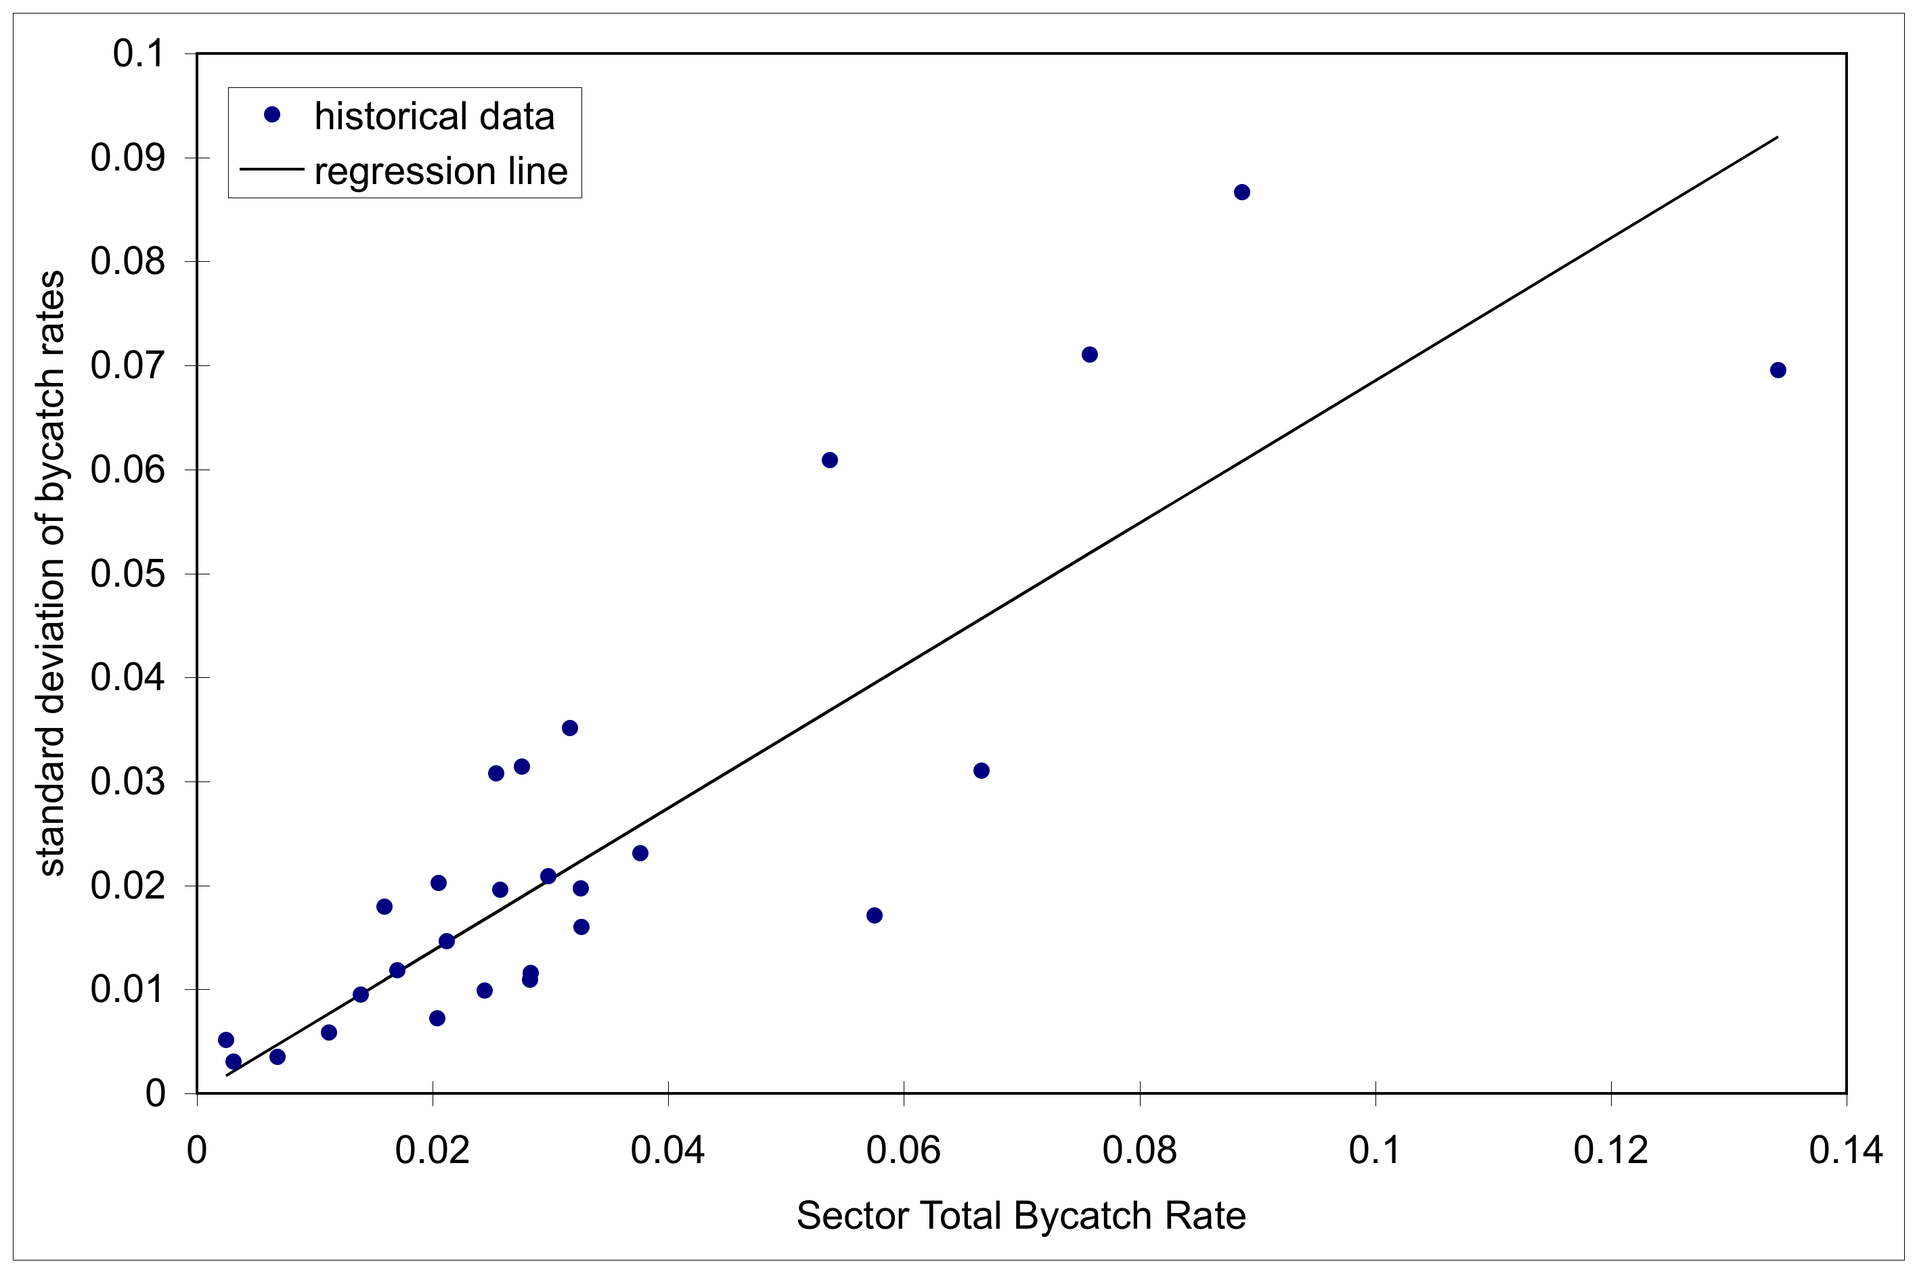
Estimated Standard Deviation
Analysis by Karl Haflinger, Sea State Inc.

Slide 54
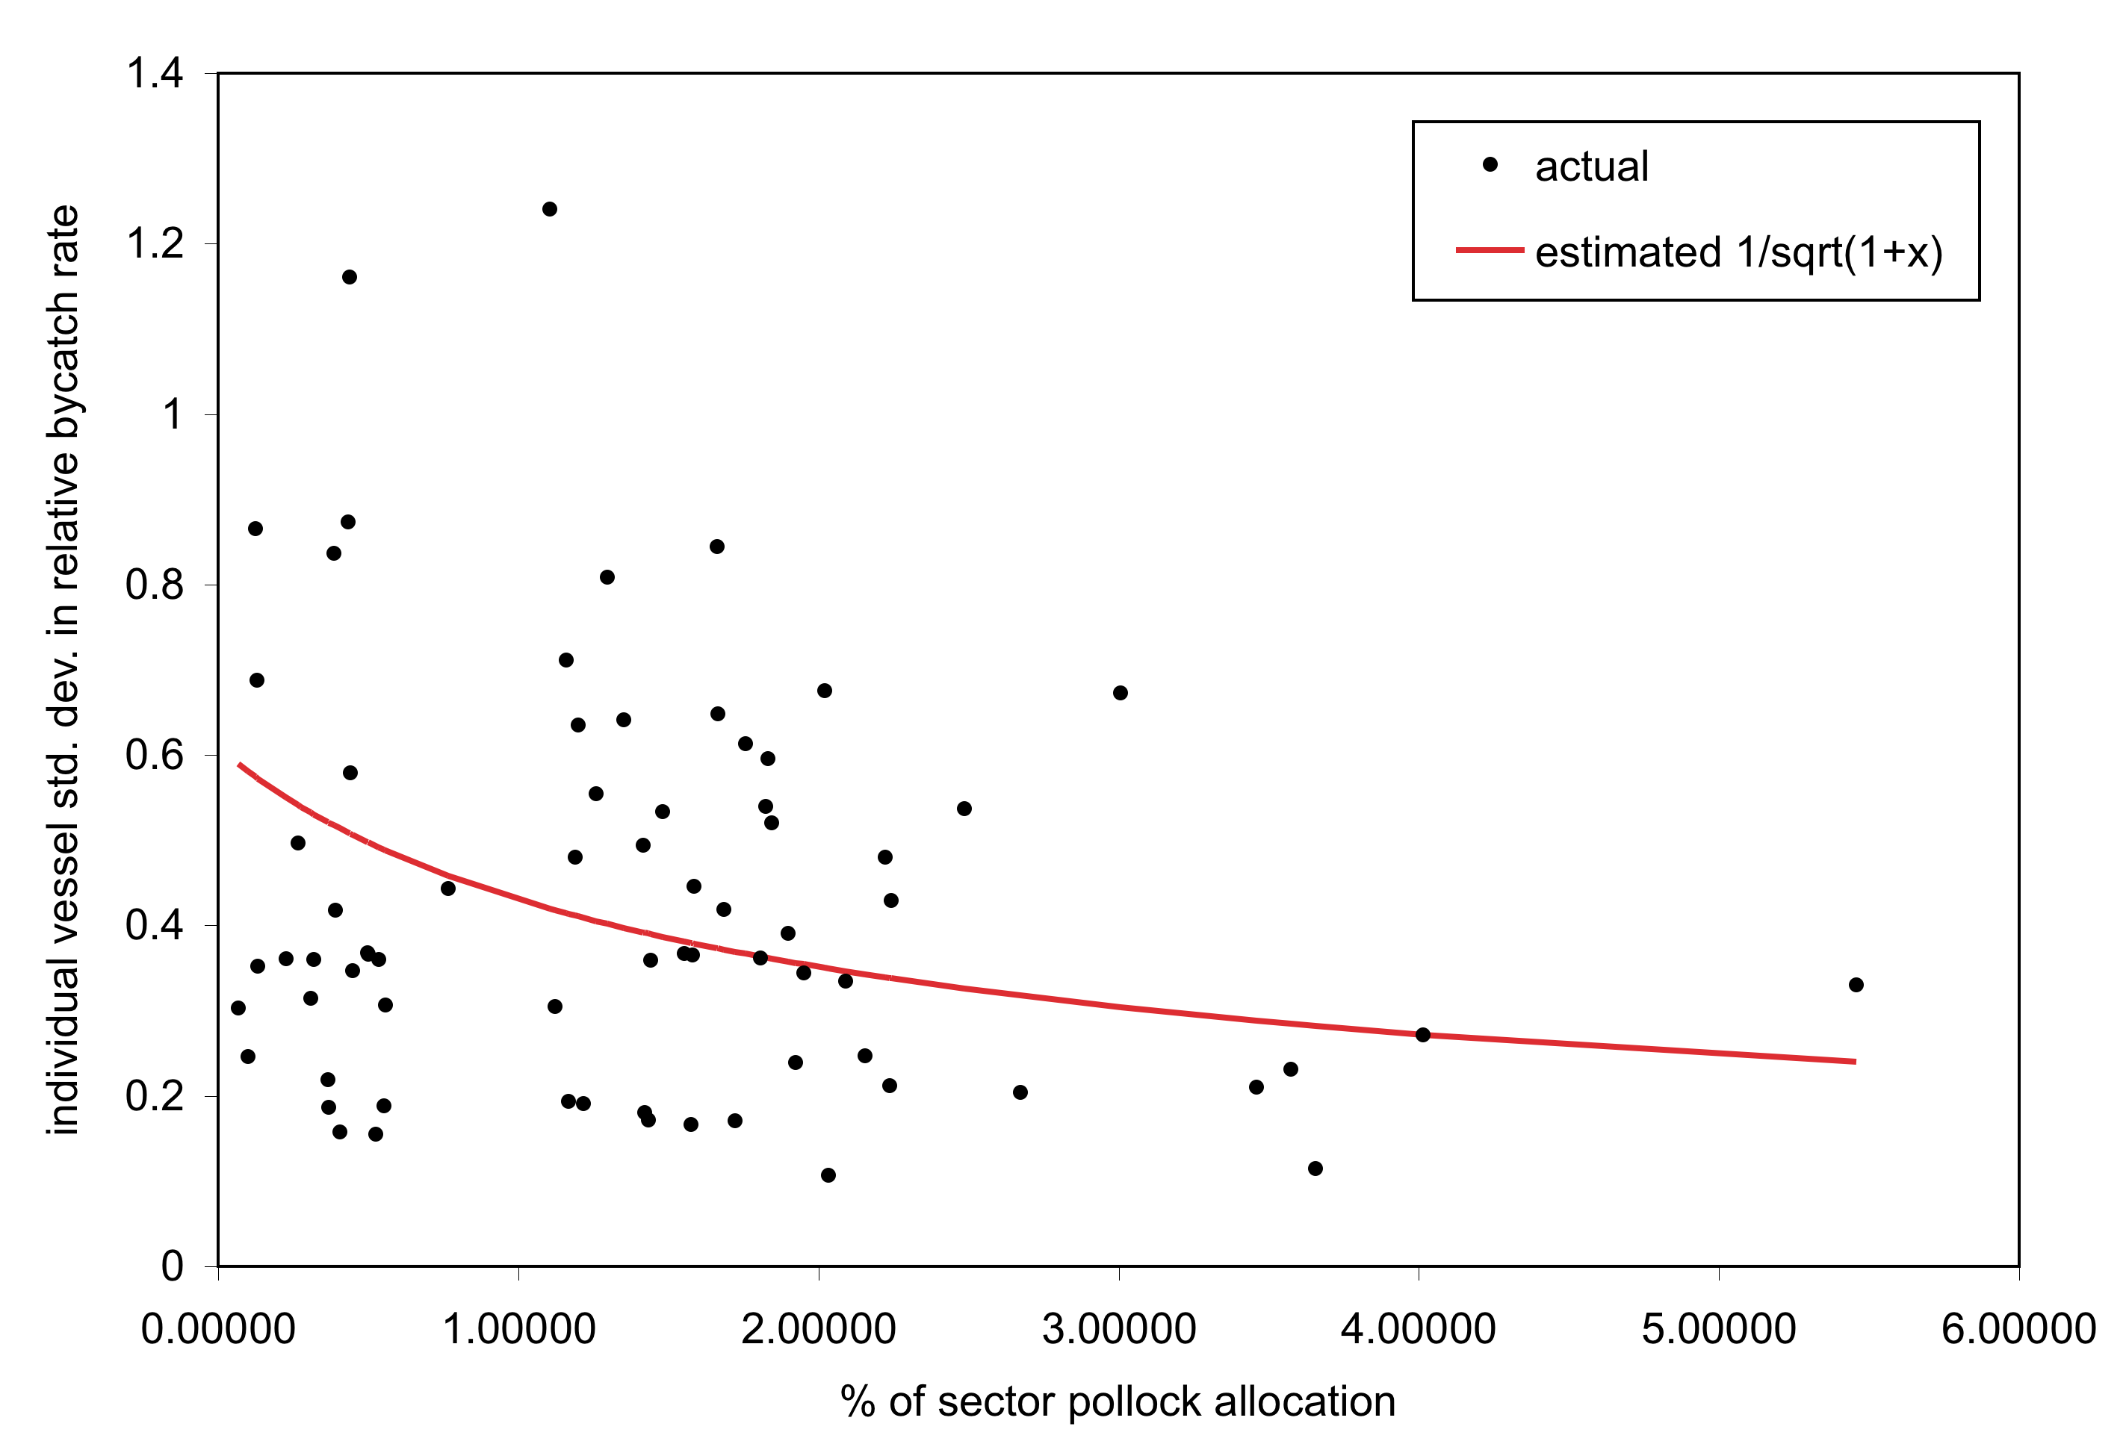
Effect of Vessel Size

Slide 55
Scaling of Incentives
The penalty function affects the relative strength of Legacy Allocation incentives for vessels with various relative bycatch rates.
The relative strength of incentives is proportional to the slope of the penalty function.
The absolute strength of incentives is set by the bycatch function, Q, which scales the penalty function and the chosen constants for the allocation formula.

Slide 56
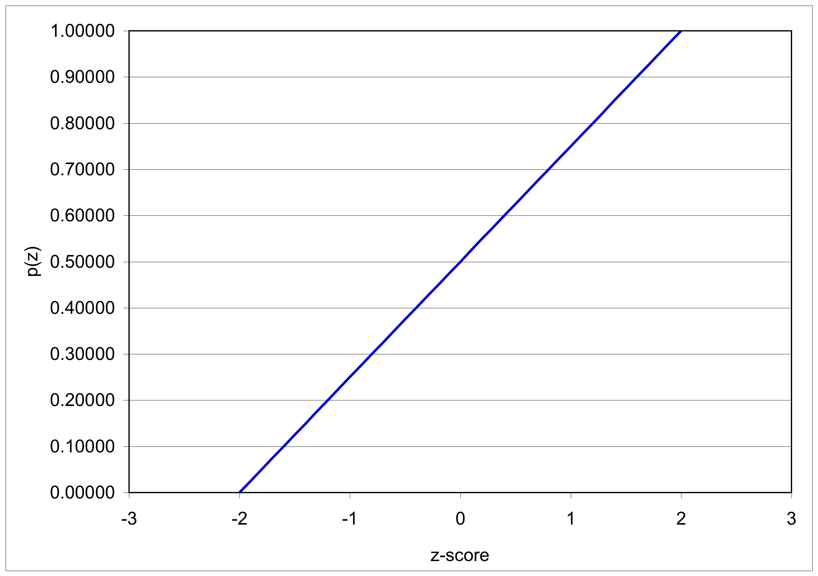
Actual Penalty Function: linear

Slide 57
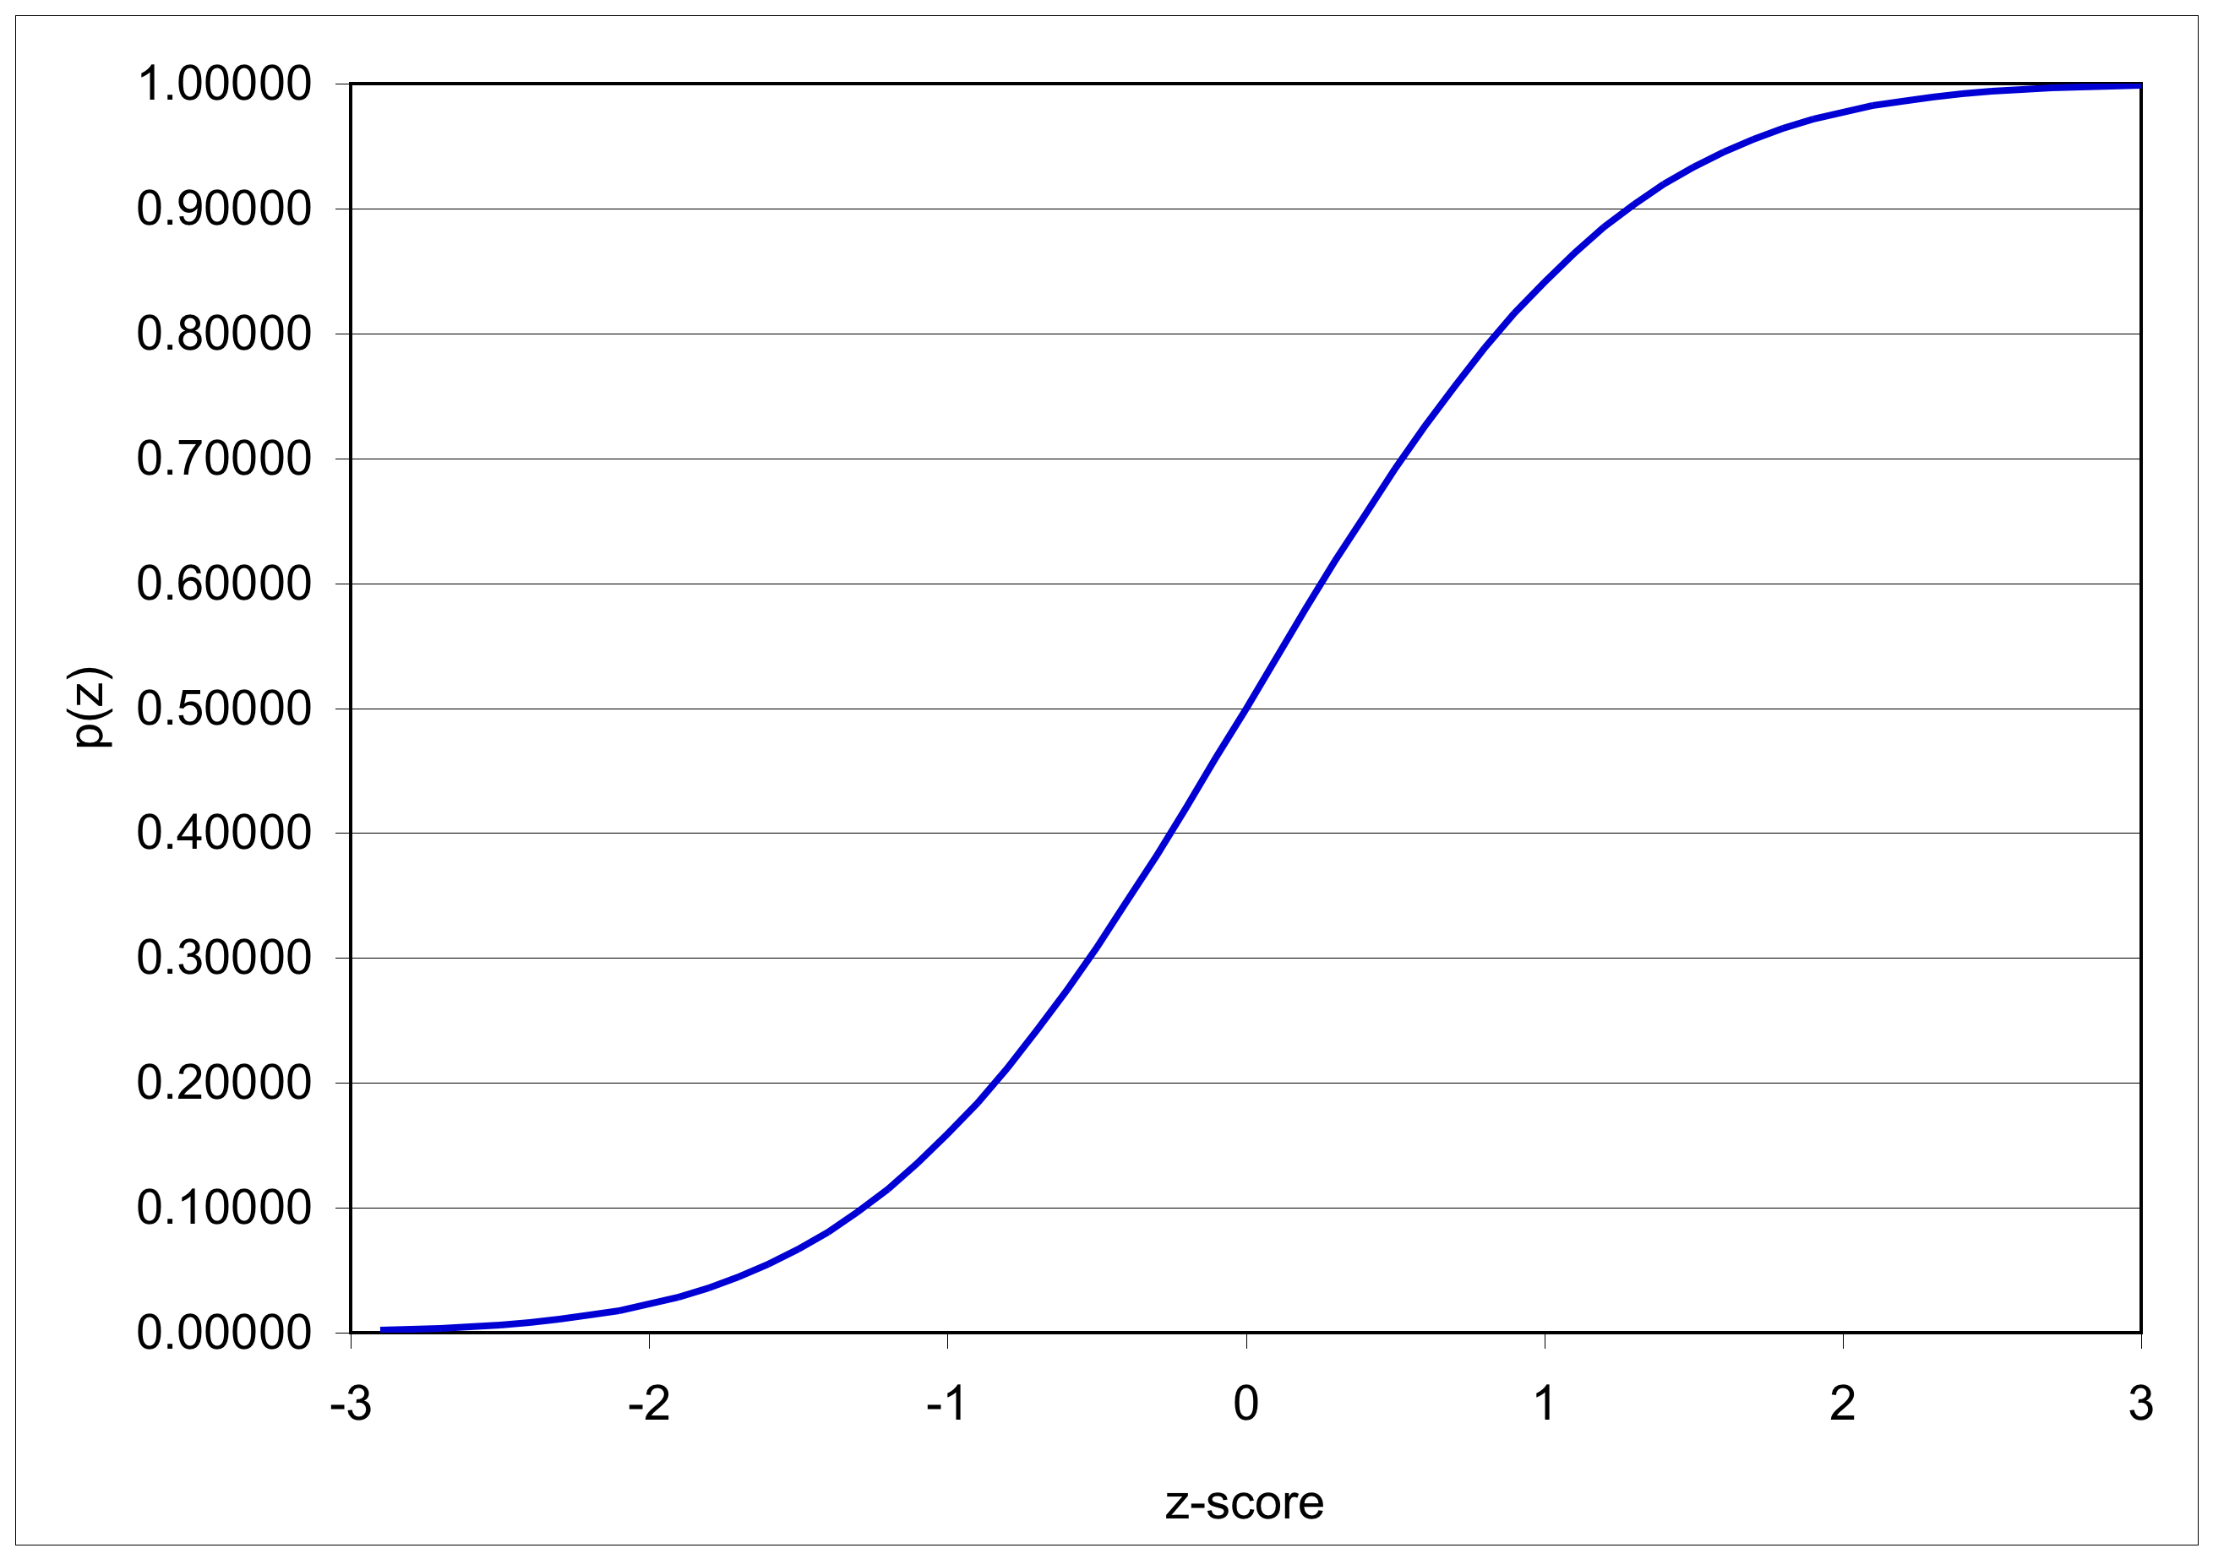
Alternate Penalty Function 1: cumulative p-values

Slide 58
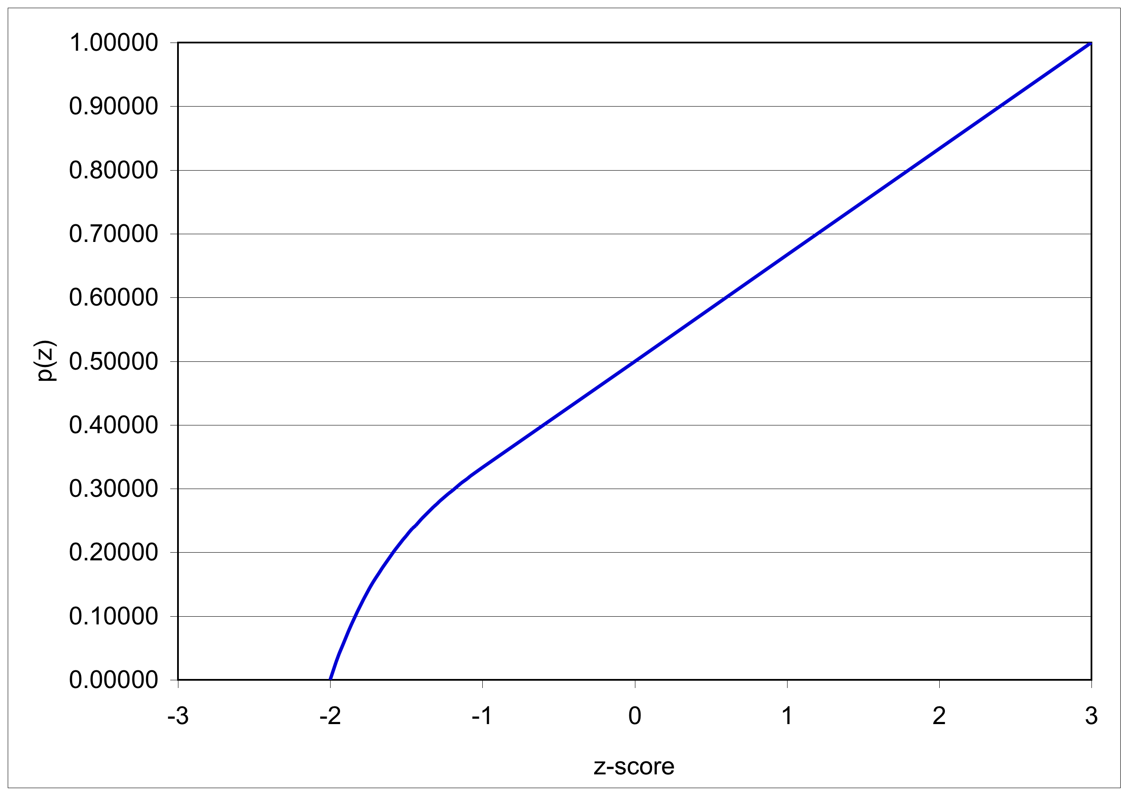
Alternate Penalty Function 2: curvilinear

Slide 59
A Fixed Transfer Tax
A Fixed Transfer Tax would impose a fixed tax, say 20%, on all credit transfers.
Issues:
transfers are rare in low-encounter years: the tax is ineffective at these times
transfers are common in moderate- and high-encounter years: the tax “retires” credits when they are most needed

Slide 60
Dynamic Salmon Savings (DSS)
DSS lowers the effective credit supply in low abundance years (when salmon stocks are most vulnerable).
It does not lower the effective credit supply in high-encounter years (when Pollock fishing is credit-limited.)
A provisional rule regulates transfers before a Salmon Savings Rate is set.

Slide 61
Credit transfers across sectors
Sectors with Dynamic Salmon Savings (DSS) may sell credits to any other sector.
Sectors without DSS may buy credits from any other sector.
A sector with DSS cannot buy credits from a sector without DSS.

Slide 62
Dynamic Salmon Savings
When vessels finish fishing in the B season, some credits are “retired”.
The percentage of credits “retired” is the Salmon Savings Rate (SSR).
The SSR is computed such that the sector has enough credits to harvest the remaining Pollock.
Prior to the determination of an SSR, credit transactions are governed by a Provisional Salmon Savings Rule.
Notes:
SSR is computed separately for each year, depending on the level of salmon-encounter experienced so far.

Slide 63
Provisional Salmon Savings Rule
Prior to finishing fishing, (and having credits retired) vessels may still transfer credits.
The appropriate number of credits are set aside to cover eventual retirement. (This calculation is similar to tax withholding.)
This number (the provisional SSR) is determined by the maximum SSR.
This rule prevents avoidance of Dynamic Salmon Savings by selling credits before they can be retired.
Notes:
PSSR operates in a manner analogous with income tax withholding. Because withholding uses the maximum SSR, vessels never have to “pay up” when they finish fishing: they will only be refunded credits.

Slide 64
Incentives associated with Buy-Side Transfer Limits
Vessels are limited in the number of credits they can buy.
There is uncertainty in the number of credits needed to finish fishing Pollock.
The costs of unfished Pollock can be high
Thus, vessels are incentivized to minimize bycatch so as to not run out of available ITEC. (initial allocation + purchase limit)
Notes:
Short-term trading incentives of purchase limits.

Slide 65
Legacy Program

