Slide 1

GROUP 31 PRESENTATION
Topic
Security Camera

Slide 2

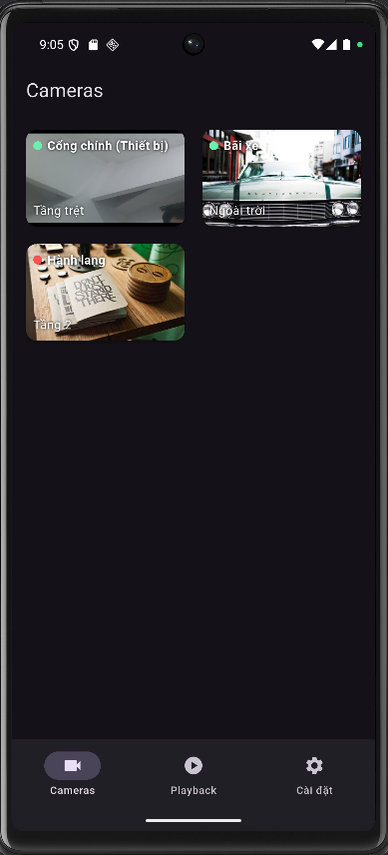
#1. VIEW LIVE CAMERA & TAKE PICTURES
#2. SAVE PHOTO TO APPLICATION MEMORY
#3. PHOTO GALLERY (PLAYBACK)
#4. PHOTO SHARING & 3 TAB NAVIGATION
#5. GLOBAL STATE MANAGEMENT (APPSTATE/PROVIDER)

Slide 3

#1. VIEW LIVE CAMERA &
TAKE PICTURES

Slide 4

Objective:
Display live images from the device camera and take photos.
Main content:
Use the camera plugin to control the camera via CameraController.
When the user clicks “Take a photo”, the controller calls takePicture() → the result is passed to SnapshotSaver.save() to save the photo.
The LiveView screen displays the camera stream, the capture button, and a notification when the photo is saved successfully.
The captured photo is added to the photo gallery (Playback).
Connection:
→ Call directly to snapshot_saver.dart (function #2).
→ Display result in GalleryPage (#3).

Slide 5
#2. SAVE PHOTO TO APPLICATION MEMORY

Slide 6
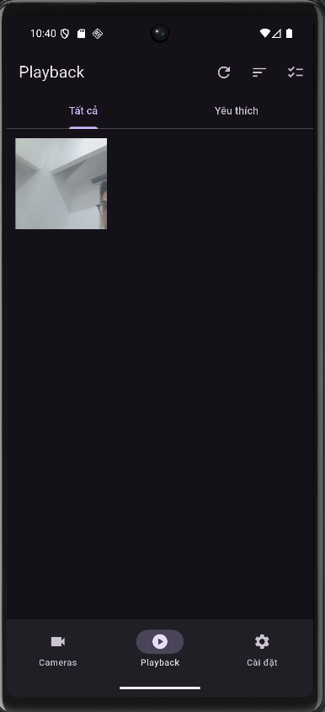
Objective:
Create, save and manage photos taken from the camera in the app memory.
Main content:
Core file: lib/utils/snapshot_saver.dart.
Automatically creates a “Snapshots” folder inside the application folder (App Storage).
Provides the following functions:
+ save() – writes images (XFile → File).
+ listFiles() – reads all saved images.
+ delete() – deletes a specific image.
+ deleteAll() – deletes all images.
Does not require runtime permissions (because it is stored in internal memory).
Used by LiveViewPage (when capturing) and GalleryPage (when displaying/deleting).
Connection:
→ Link to Camera (part 1) and Gallery (part 3).

Slide 7
#3. PHOTO GALLERY (PLAYBACK)

Slide 8
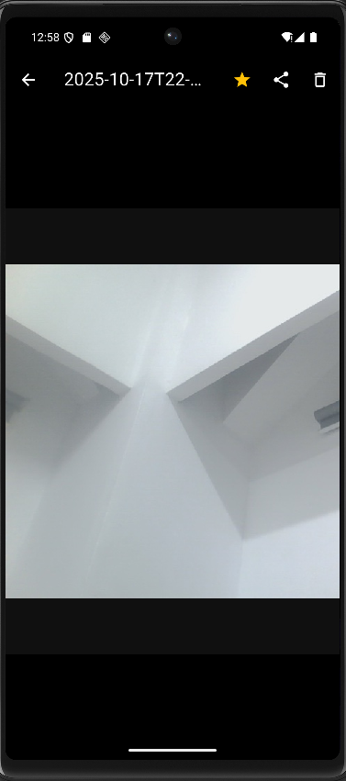
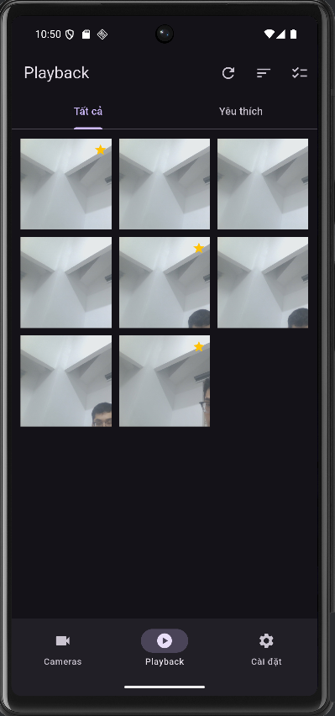
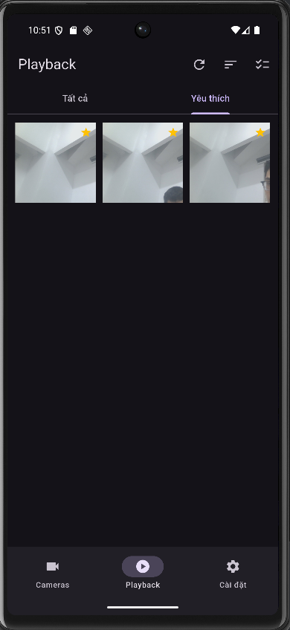
Objective:
Manage and review all captured photos, support deleting, sharing and marking as favorites.
Main content:
GalleryPage:
ImageViewerPage:
Grid views:
FavoritesStore:
SharedPreferences (data exists after exiting the app).
Automatically delete photos/videos after a specified time
Link:
+ GalleryPage ↔ ImageViewerPage (open image).
+ Image Viewer Page ↔ Favorites Store
(favorite, delete photos).

Slide 9
#4. PHOTO SHARING
&
3 TAB NAVIGATION

Slide 10
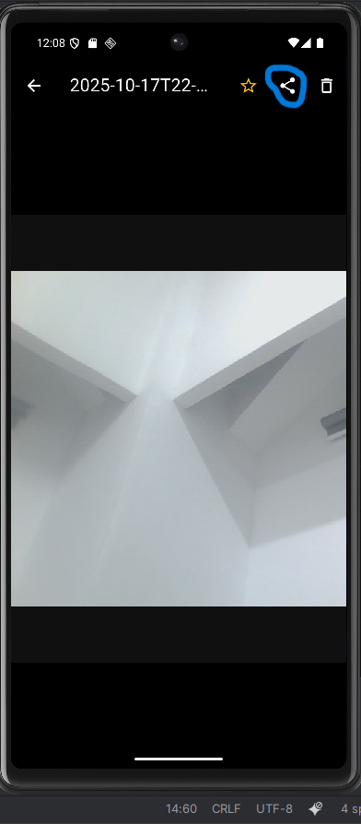
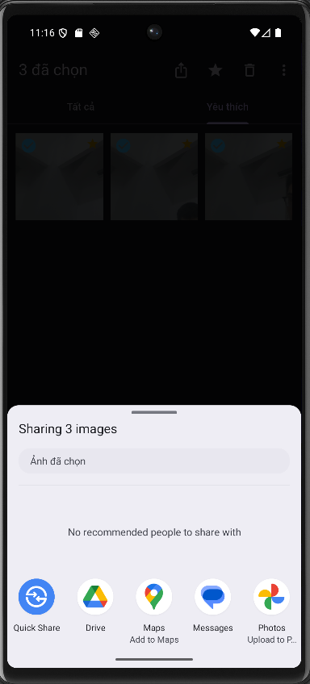
Objective:
Helps users share photos and move between main sections of the app.
Main content:
Share photo:
+ Use share_plus library to send photos out.
+ _shareSelected(): share multiple photos at once.
+ _shareCurrent(): share an image being viewed.
Navigation:
+ main.dart uses NavigationBar with 3 main tabs:
1️⃣ Cameras – take photos
2️⃣ Playback – view photos
3️⃣ Settings – settings
+ or change tab with setState() and _index.

Slide 11
#5. GLOBAL STATE MANAGEMENT (APPSTATE/PROVIDER)

Slide 12
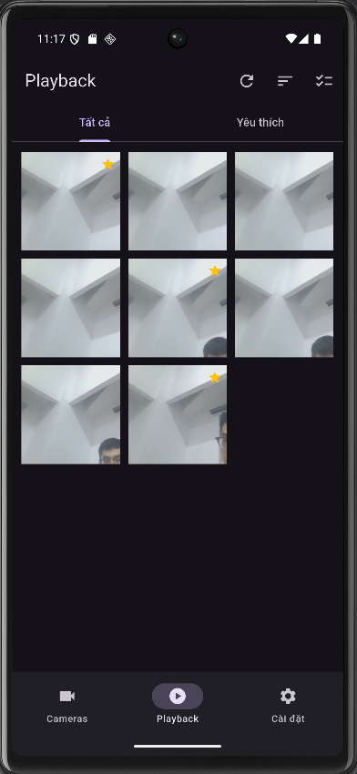
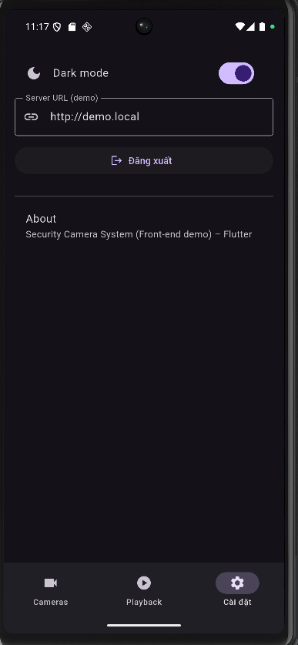
Objective:
Sync and manage shared data between screens in your app.
Main content:
Dark Mode: allows users to switch between light and dark interfaces, globally managed via AppState and updated instantly using Provider.
Main file: app_state.dart (ChangeNotifier) ​​and main.dart (Provider).
Managed variables: darkMode, serverUrl, cameras, username, loggedIn.
How it works:
+ Provide AppState at root via ChangeNotifierProvider.
+ Use context.watch() to read and context.read() to update data.
Application:
+ CamerasPage gets the list of cameras.
+ SettingsPage changes Dark Mode.

Slide 13
FUTURE SOFTWARE DEVELOPMENT

Slide 14
FUTURE SOFTWARE DEVELOPMENT
1. ☁️ Save photos and videos to the Cloud (Cloud Sync)
2. 🧠 Face / Motion Recognition (AI Detection)
3. 🖥️ Remote control and viewing (Remote Access via Web or App Link)
4. 🤖 Object detection and smart warning (AI Object Detection)

Slide 15


