Slide 1
Introduction to Named Entity Recognition (NER)
An NLP Project using spaCy

Slide 2
What is Natural Language Processing (NLP)?
NLP is a field of Artificial Intelligence focused on enabling machines to understand and process human language.
Examples:
- Translation
- Chatbots
- Text classification

Slide 3
What is Named Entity Recognition (NER)?
NER is the process of identifying and classifying entities in text into categories such as:
- PERSON
- ORGANIZATION
- LOCATION
- DATE
- MONEY

Slide 4
Example of NER
Input: 'Barack Obama was born in Hawaii in 1961.'
Output:
- Barack Obama → PERSON
- Hawaii → GPE (Location)
- 1961 → DATE

Slide 5
Methodology
User inputs text through a terminal interface.
Text is processed using spaCy’s NLP pipeline.
Named entities are extracted and classified (e.g., PERSON, DATE).
Results and entity counts are displayed clearly to the user.

Slide 6
Title: Model Used: en_core_web_sm
Pretrained small English model from spaCy.
Supports tokenization, POS tagging, and NER.
Lightweight and efficient for fast processing.
Ideal for demos, learning, and simple NLP tasks.

Slide 7
Tools Used
- Python
- spaCy Library
- VS Code for development
- pptx for presentation generation

Slide 8
Features of the Project
- Accepts user input
- Performs Named Entity Recognition
- Displays entities with type and description
- Summarizes entity type counts
- User-friendly terminal interface

Slide 9
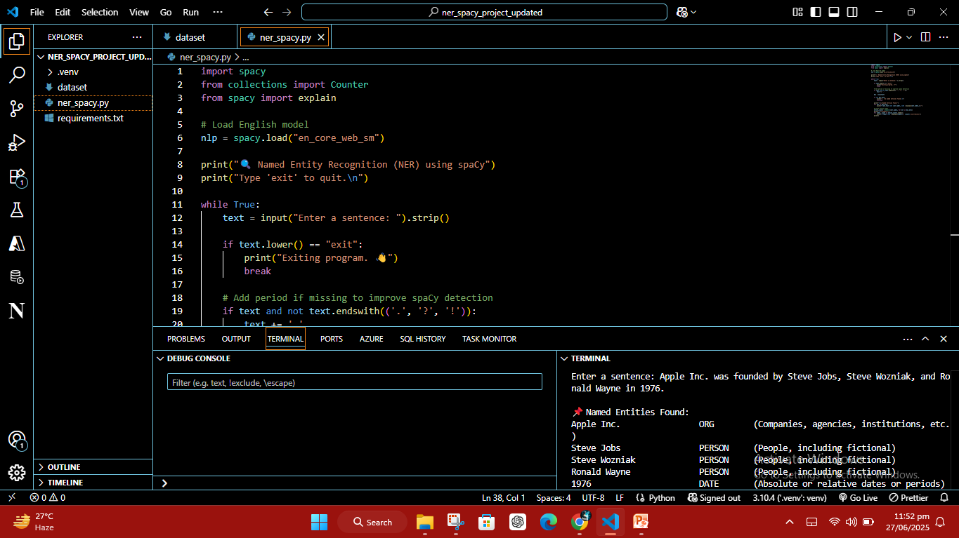
NER Output Demo

Slide 10
Conclusion
NER is a foundational task in NLP that helps extract structured information from unstructured text.
This project demonstrates a simple and interactive NER application using spaCy.

