Slide 1

Smart Client Session Management System
Muhammad Ali (22-Arid-5403)
Haider Ali(22-Arid-5354)
M Umer Farooq(22-Arid-5438)
Sami Hafeez(22-Arid-)
(Date: 14/09/2025)
Supervisor: Mr Ahsan Raees
Department of Computer Science
Barani Institute of Management Sciences, Rawalpindi

Slide 2
Introduction
In today’s digital world, user authentication and session management play a crucial role in ensuring secure access to online systems. Weak session handling often leads to vulnerabilities such as session hijacking, unauthorized access, and insecure logout. Enterprises, educational institutions, and online platforms require reliable session management systems to protect sensitive data and maintain trust. This project focuses on developing a secure and efficient Smart Client Session Management System that provides users with robust session creation, monitoring, and termination features.
Notes:
1- main usage social media
2- twitter facebook
3- usage of twiiter entertainment
4- share karty hain news without authentication of current affairs
5- schemers is ka faida uthaty hain yeah 1 thread ha
6- isko overcome karnay kay liay bohat say reserachers nay different techniques use ki hain isay overcome karny ky liay

Slide 3
Existing Systems
No. | Author(s) & Year | Methodology | Findings / Accuracy | Deficiency
1 | Alharbi et al., 2021 | Proposed a secure session management framework with encryption & timeout policies; evaluated on web applications | Improved confidentiality and prevented session hijacking; showed resilience in test environments | Tested only on limited dataset; no evaluation for mobile/web hybrid apps
2 | MDPI Authors, 2022 | Designed JWT-based prototype with behavior-weighted authentication | Reduced unauthorized access and improved anomaly detection in test scenarios | Implementation complexity and risk of false positives
3 | Kumar & Singh, 2022 | Comparative survey of modern session/token handling methods (cookies vs OAuth2/JWT) | Found OAuth2 and JWT more scalable and secure compared to traditional cookies | Mostly theoretical survey; lacked real-world implementation testing

Slide 4
Problem Statement
Poorly managed user sessions increase the risk of security breaches, unauthorized access, and data compromise. Current approaches lack:
Secure creation and destruction of sessions.
Real-time tracking of active sessions.
Integrated reporting or analytics.
This research aims to design and implement a Smart Client Session Management System that overcomes these weaknesses by offering secure session handling, monitoring, and reporting capabilities in an easy-to-use web interface.

Slide 5
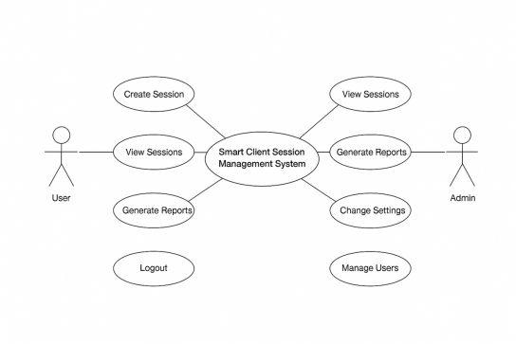
Proposed Solution (System Model)
The proposed system ensures secure session handling through Node.js and Express.js with session middleware. It allows users to:
Create sessions securely.
View active sessions in real-time.
Logout and terminate sessions properly.
Generate session reports for monitoring and auditing.
Future enhancements include database integration for persistent session storage and AI-driven anomaly detection to identify abnormal user activity.

Slide 6
Tools and Technology
Frontend: HTML, CSS, JavaScript
Backend: Node.js, Express.js
Session Handling: express-session library
Database (Future): MySQL or MongoDB
Development Methodology: Agile (iterative sprints for session creation, viewing, reporting, and enhancements)

Slide 7
functional-non requirments
3.2 Functional Requirements
Functional requirements define the specific behaviors and operations a system must perform to fulfill user needs [3]. In the Smart Client Session Management System, the functional requirements are as follows.
FR-3.2.1: The system shall allow users to create secure sessions with unique identifiers.
FR-3.2.2: The system shall allow users and admins to view active sessions.
FR-3.2.3: The system shall allow users to securely logout from any active session.
FR-3.2.4: The system shall allow admins to generate reports of session activities.
FR-3.2.5: The system shall allow admins to configure session-related settings.
3.3 Non-Functional Requirements
Non-functional requirements describe the qualities and constraints of the system, such as performance, usability, and security [3]. For the Smart Client Session Management System, the non-functional requirements are as follows.
NFR-3.3.1 Scalability: The system should handle multiple concurrent sessions efficiently.
NFR-3.3.2 Security: Sessions should be protected from hijacking and unauthorized access using secure cookies and encryption.
NFR-3.3.3 Reliability: The system should maintain consistent performance and session NFR-3.3.4 Usability: The interface should be simple, user-friendly, and accessible.
NFR-3.3.5 Extensibility: The system should be designed to support future enhancements, such as database integration and AI-based monitoring.

Slide 8
Significance
The project demonstrates how secure session management can be achieved in a simple and scalable way. By integrating session monitoring and reporting, the system improves transparency and strengthens security. Unlike existing cookie-based approaches, this project lays the foundation for future integration with AI-based monitoring and persistent databases.
.

Slide 9
References
DIVA Thesis, 2024: DIVA et al. conducted an empirical study in 2024 focusing on real-world deployments of JSON Web Token (JWT) systems to assess their compliance with the RFC 8725 security recommendations. The study gathered data from several open-source and commercial web applications, analyzing how each implementation handled token expiration, signature algorithm configuration, and vulnerable migration paths. Their findings showed that a large percentage of applications misuse JWT by setting overly long token lifetimes and neglecting algorithm verification (e.g. accepting “none” or weak HMAC without checking). Moreover, many systems stored secret keys insecurely or reused them across services. The accuracy of detecting insecure JWT setups was high (over 80%) among the sampled applications. However, the study was limited by its dataset size (about 30 applications) and did not include mobile-only or IoT-based systems. Thus, while the conclusions are strong for the sampled set, generalization to all types of web applications remains uncertain.
Source: “Empirical Study of JWT Deployments vs RFC8725 Best Practices” (DIVA Thesis, 2024). [You would cite the thesis link / university repository here].

Slide 10


