Slide 1
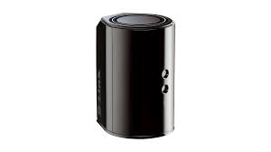
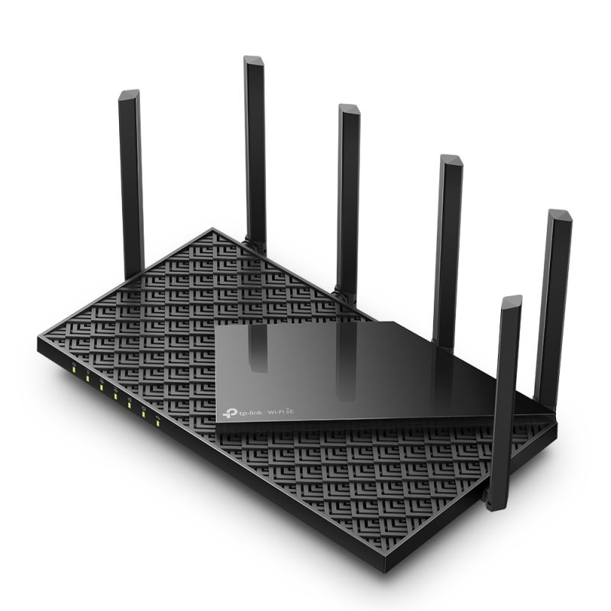
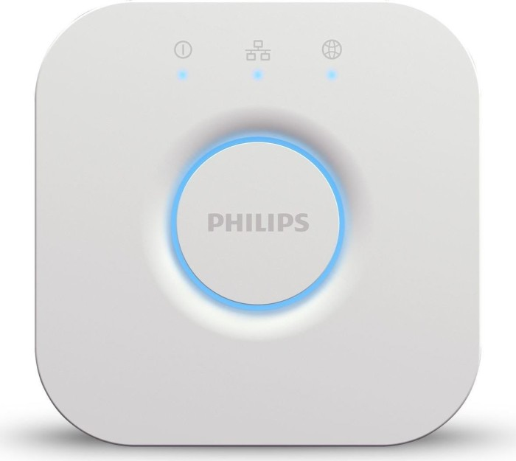
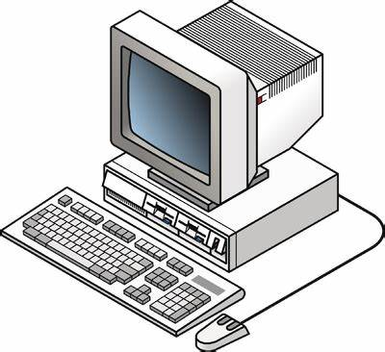
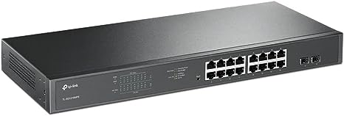
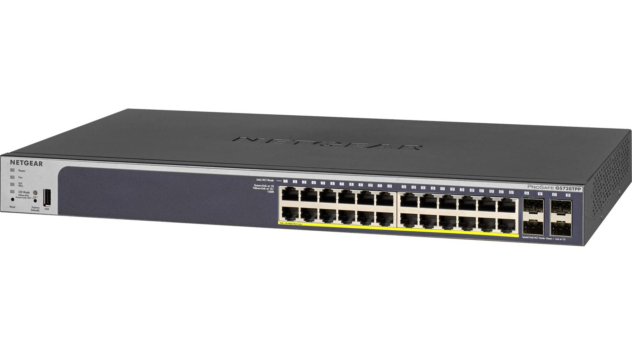
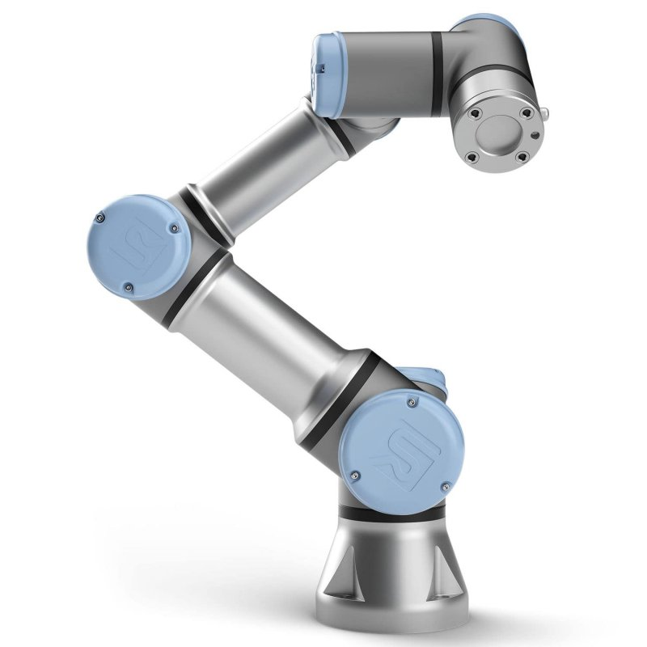
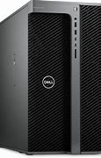
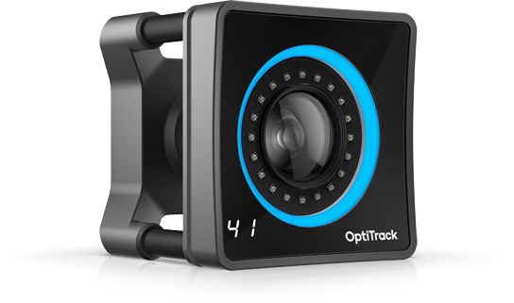
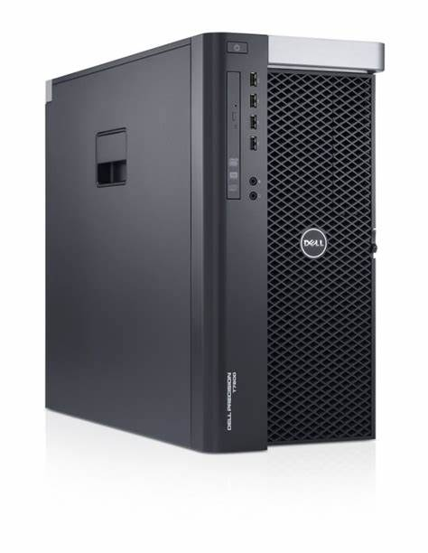
The Volciclab Network Infrastructure
NYUAD residential network
Volciclab local network
(black cables)
Only fixed IP devices shown
TP Link router
Volciclab-2.4G
Volciclab-5G
Volciclab-6G
192.168.42.1
DHCP range:
192.168.42.35-254
Etisalat router, for cameras
(with d-link firmware)
192.168.69.100
DHCP range:
192.168.101-199
OptiTrack computer
Volciclab network
192.168.42.5
Hue Bridge,
(white cable)
192.168.42.132
(on DHCP)
(directly to router)
Netgear switches
(PoE, managed)
192.168.69.201
192.168.69.200
Optotrak SCU on truss
192.168.42.2
Universal Robots UR3e
Robotic arm, direct access
192.168.42.10
TP-Link switch
Other devices
on DHCP
Ethernet 1
Optotrak SCU on desk
192.168.42.3
Volciclab 2
Experimental computer
192.168.42.8
Ethernet 1
Volciclab 1
Experimental computer
192.168.42.7
Ethernet 1
OptiTrack cameras
(x18, on separate IPs)
Volciclab Server
File server
4 TB RAID 1, mounted as X:\
192.168.42.6
NYUAD network
Camera network
(blue cables)
Do not connect
anything else
Shared storage + robocopy backup
Ethernet 2

