Slide 1
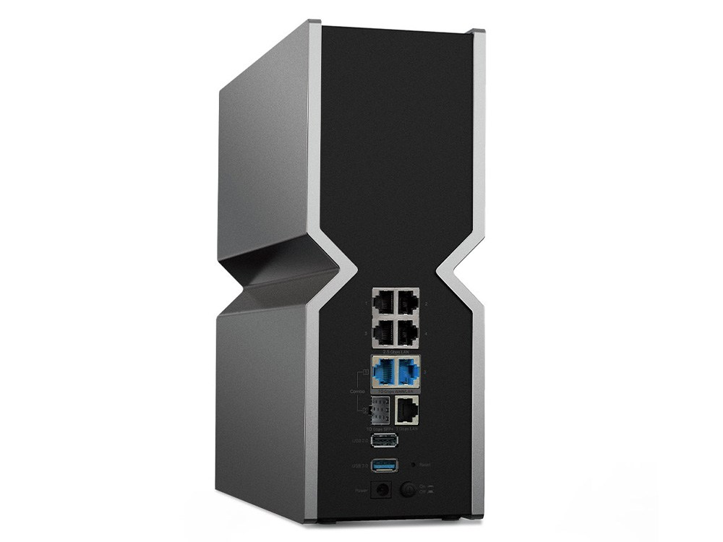
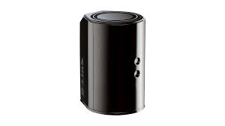
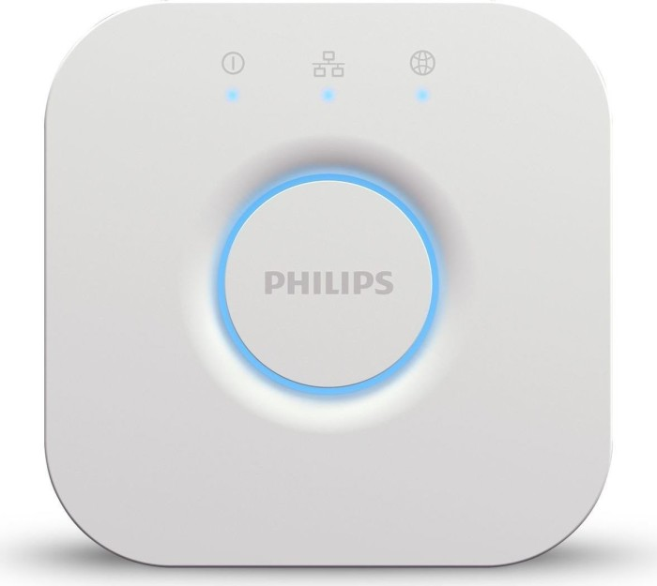
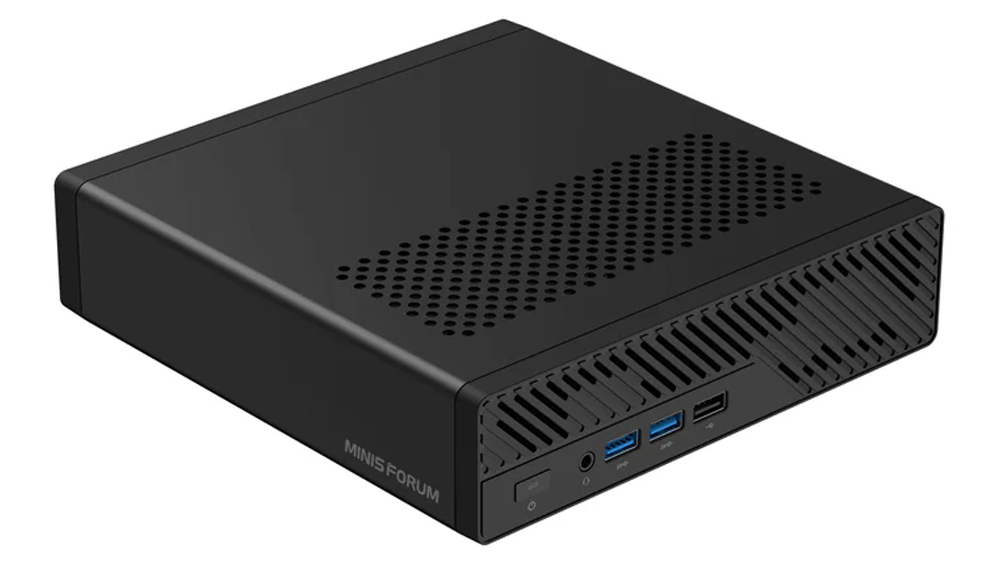
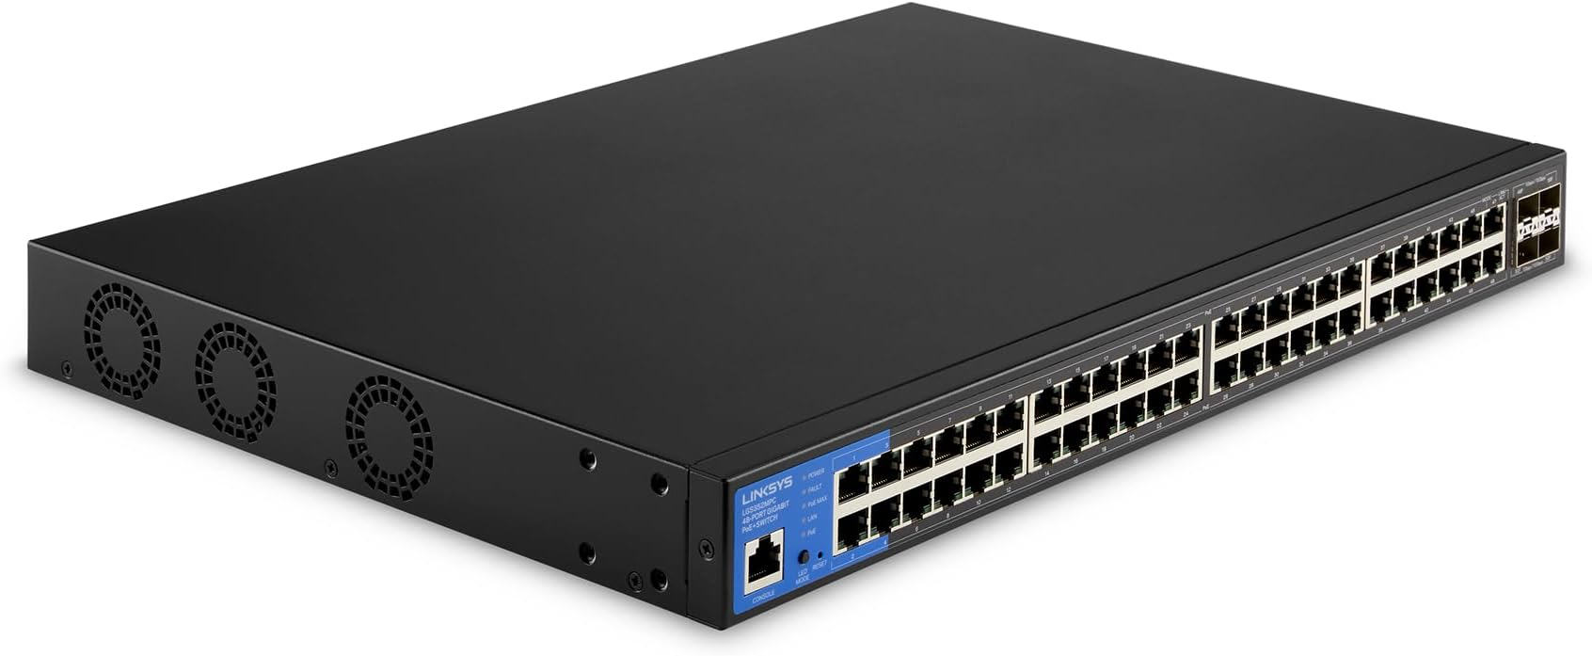
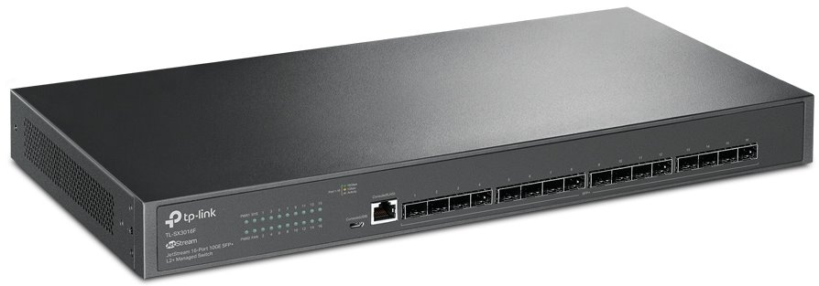
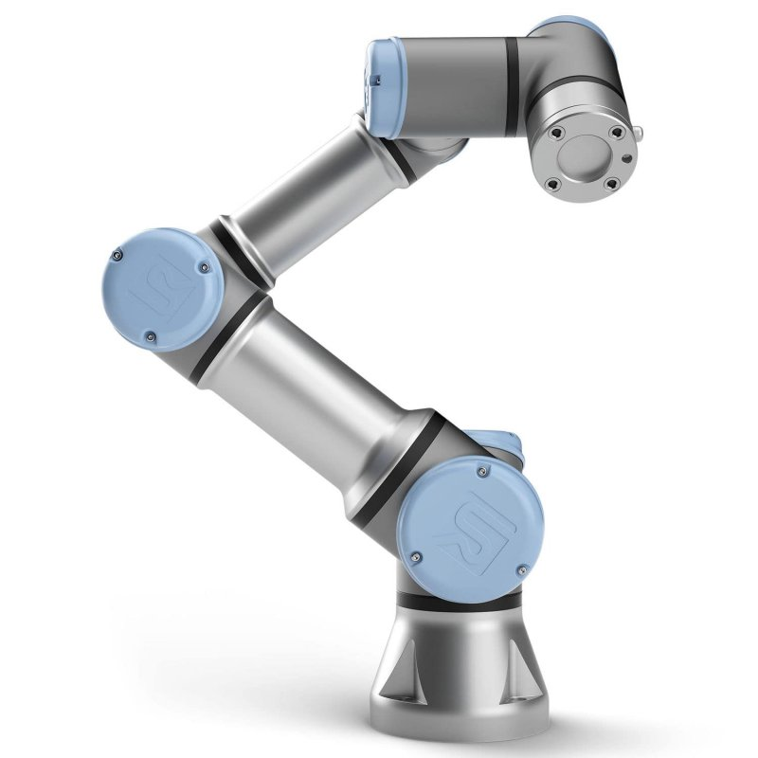
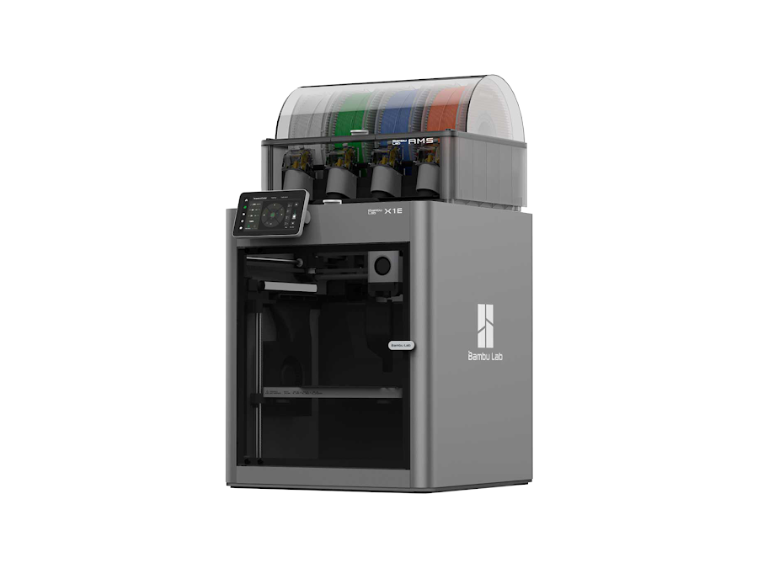
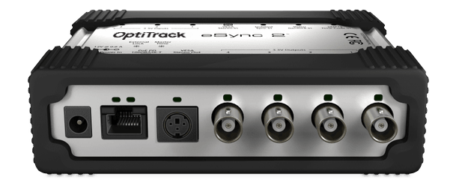
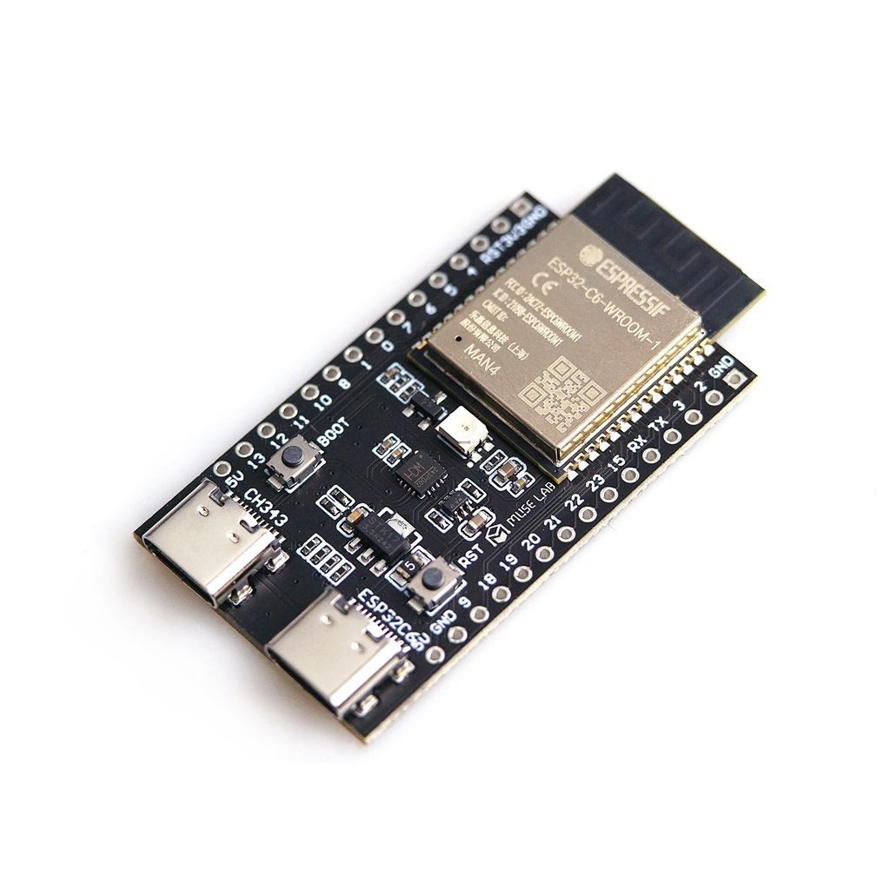
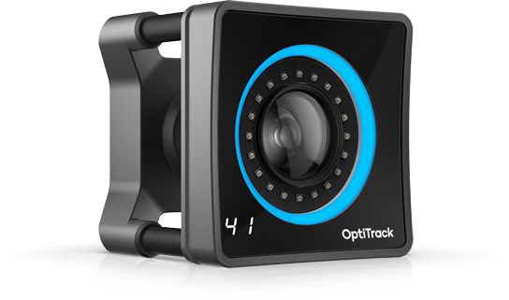
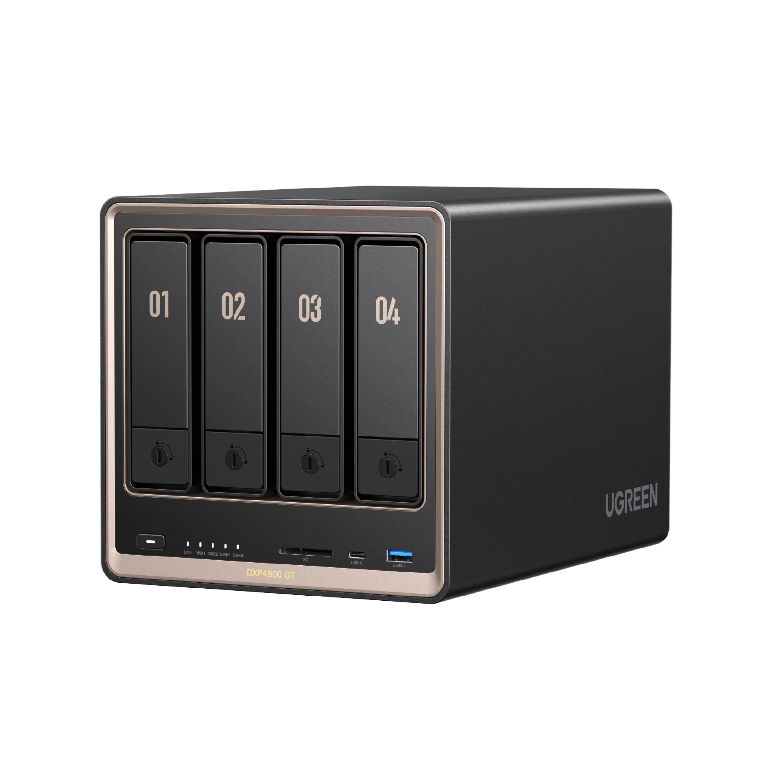
The Volciclab Network Infrastructure
NYUAD ResNet ’DSL’
TP Link BE900
Volciclab-2.4G
Volciclab-5G
Volciclab-6G
192.168.42.1
DHCP range:
192.168.42.50-249
Etisalat router, for cameras
(with d-link firmware)
192.168.69.100
DHCP range:
192.168.101-199
Volciclab local network
(black cables)
Only key devices shown
see table for details!
OptiTrack computer
Volciclab network
192.168.42.5
Hue Bridge,
(white cable)
192.168.42.132
Universal Robots UR3e
Robotic arm, direct access
192.168.42.10
TP-Link SX-3016F
192.168.42.9
Linksys LGS352MPC
192.168.69.200
Volciclab Server
File and web server
4 TB ZFS, mounted as X:\
192.168.42.6
Volciclab Printer
Bambu X1e, LAN mode
192.168.42.123
LVTTL GPIO
OptiTrack Trigger Box
Volciclab-2.4G
192.168.42.4
Drive X
← Nightly sync
Storage on campus server
Nightly dump →
OptiTrack cameras
(x18, on separate IP-s)
NYUAD network
Volciclab NAS
Ugreen DXP4800GT
16TB RAID 1
mounted as V:\ and W:\
4 TB RAID 1 – future use
192.168.42.16
Camera network
(blue cables)
Do not connect
anything else
See docs for
AI inference capabilities

