Slide 1
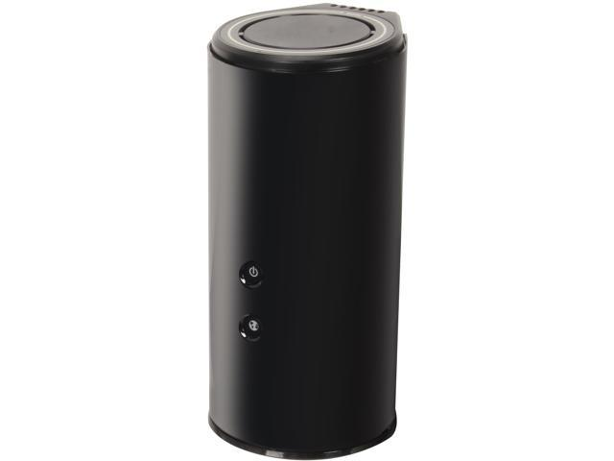
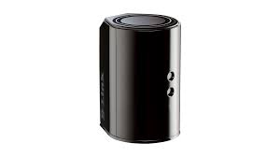
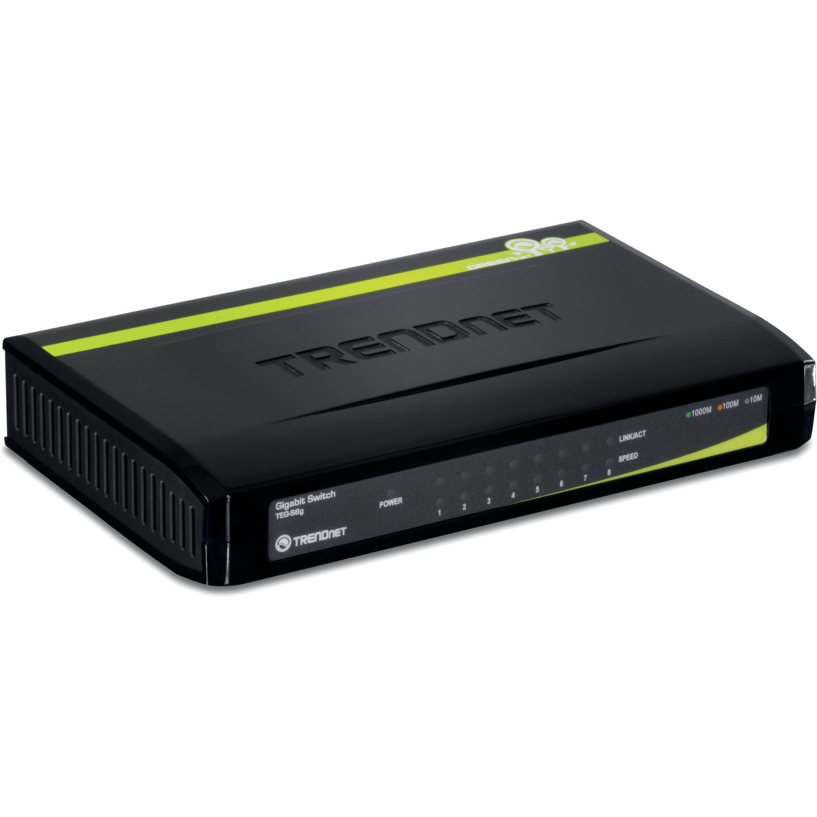
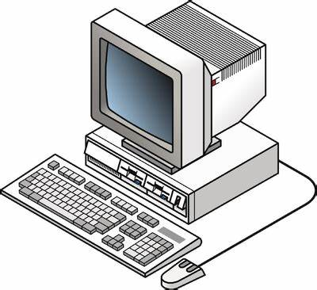
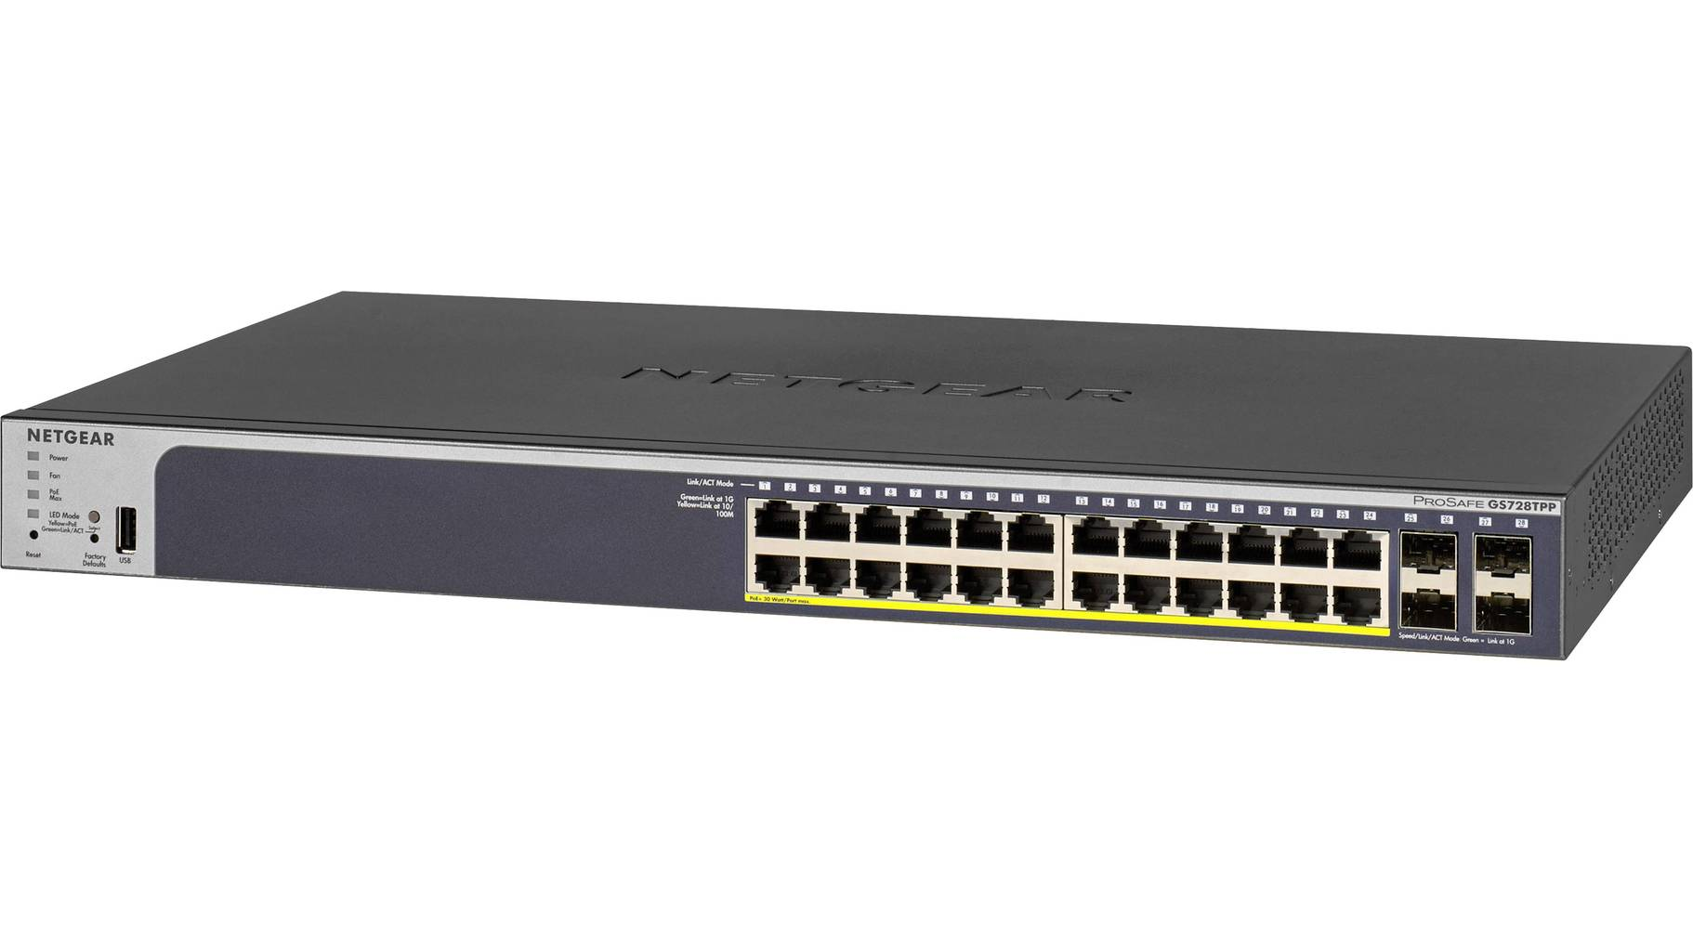
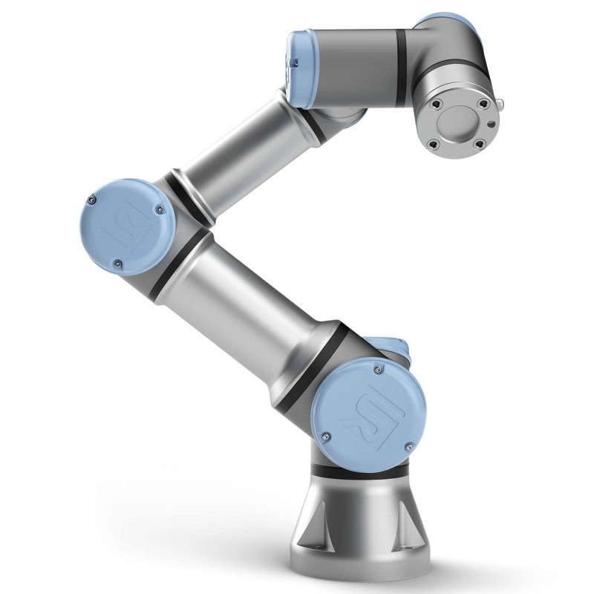
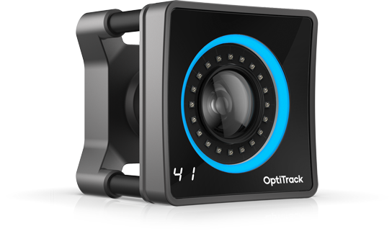
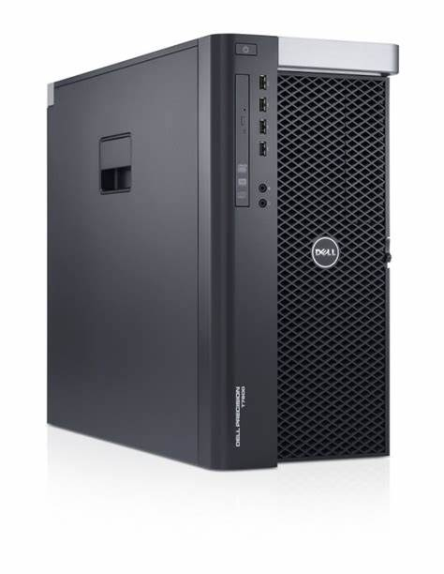
The Volciclab Network Infrastructure
NYUAD network
(gray cables)
Etisalat router, for cameras (with d-link firmware)
192.168.69.100
DHCP range: 192.168.101-199
D-Link router Volciclab-2.4G Volciclab-5G
192.168.42.1
DHCP range:
192.168.42.35-254
Volciclab local network
(black cables)
(when needed)
OptiTrack computer
Volciclab network
192.168.42.5
Other devices on DHCP
Netgear switch
(PoE, managed)
192.168.69.200
Optotrak SCU on truss 192.168.42.2
Ethernet sockets on lab wall
Trendnet switch
Universal Robots UR3e Robotic arm, direct access
192.168.42.10
OptiTrack computer
Camera network (DHCP)
Optotrak SCU on desk 192.168.42.3
Ethernet 1
Ethernet 1
Ethernet 2
OptiTrack cameras
(x12, on separate IPs)
Volciclab 1
Experimental computer
192.168.42.6
Volciclab 2
Experimental computer
192.168.42.7
Camera network
(blue cables) Do not connect anything else
Ethernet 2

