Slide 1
Robot
TCP
Server
UDP
Your code
I’m not busy.
Is the robot busy?
Please tell me what to do.
The robot is not busy.
nothing
`false’
Please tell me what to do.
nothing
freedrive;ON
freedrive(1)
TIME
Please tell me what to do.
freedrive
What is the status of the robot?
Please send argument.
ON
freedrive
`freedrive’
Please tell me what to do.

Slide 2
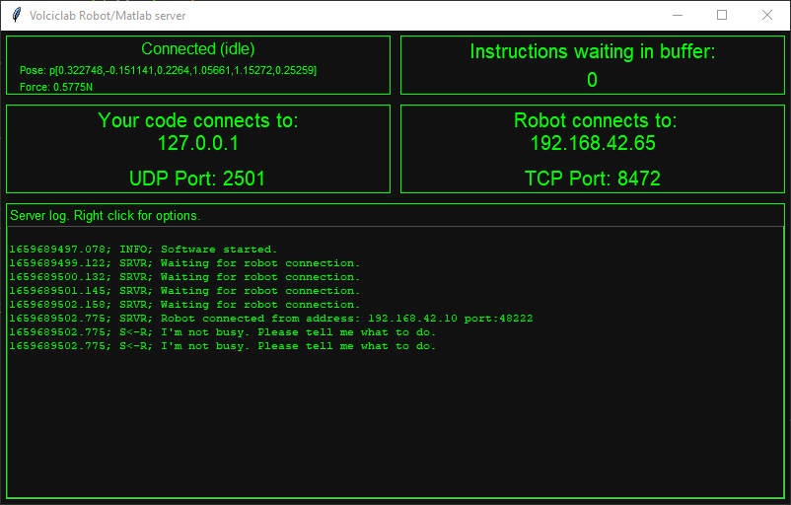
Current pose as reported by the robot.
Right click to copy to clipboard
Robot status
This should be 0
or a small number
Force applied on tool
How to set your code
and how to set the robot program
Unix time, millisecond precision
Actual packets and messages
sent across the network
Who sent this message to whom

