Slide 1
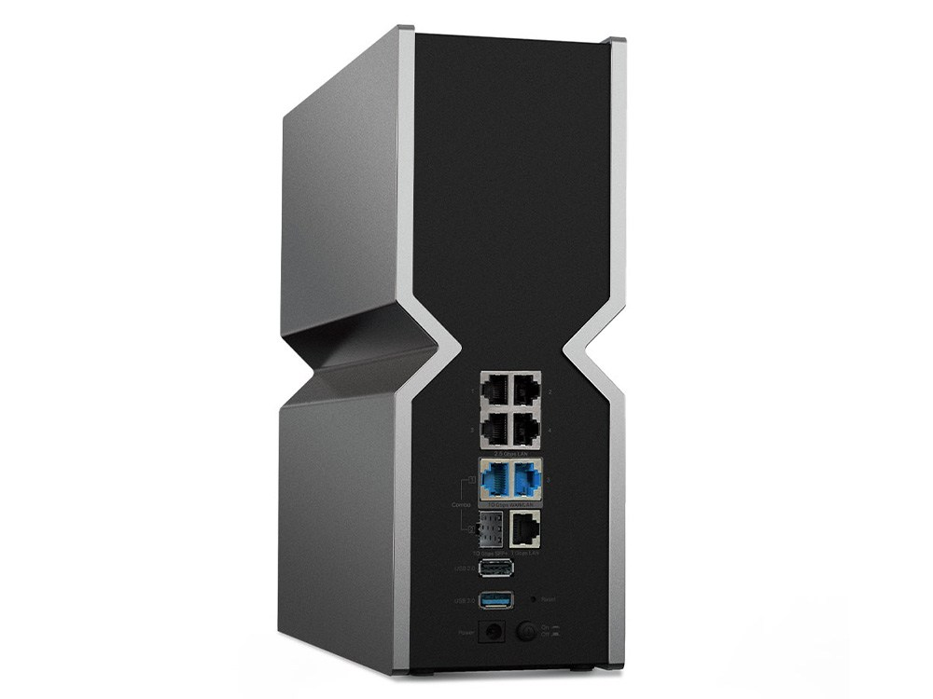
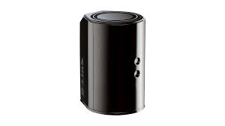
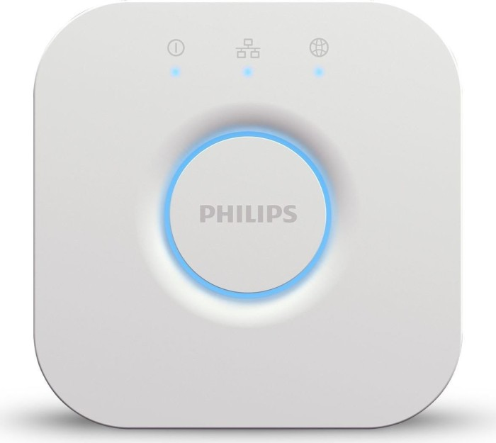
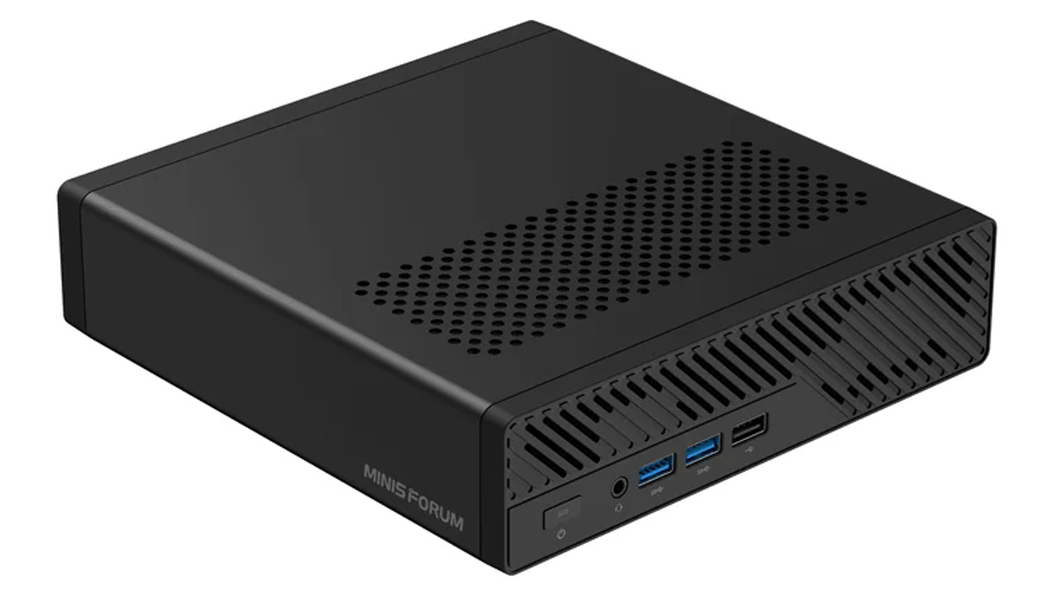
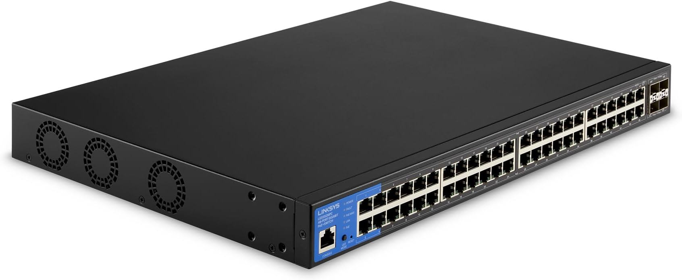
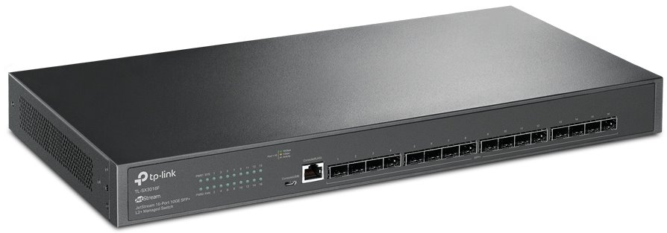
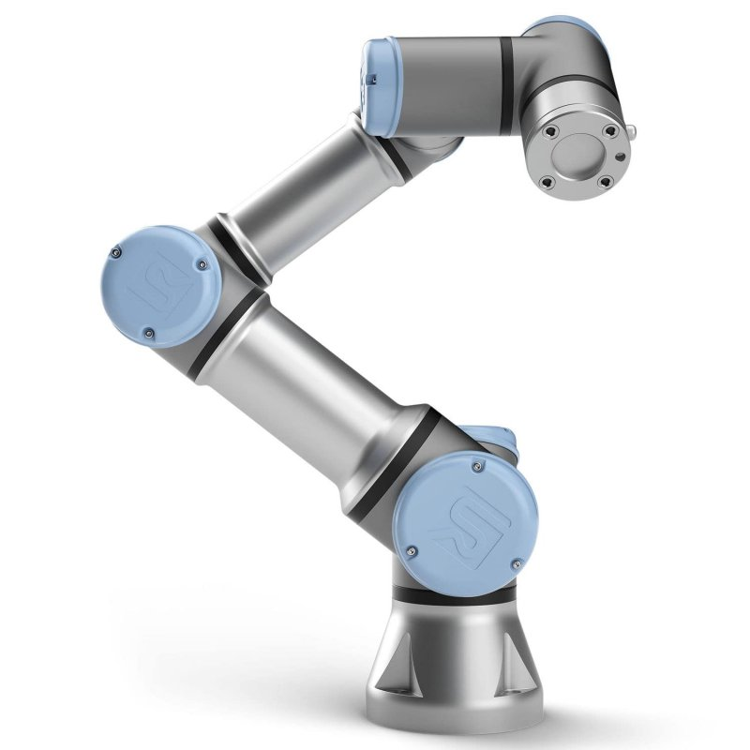
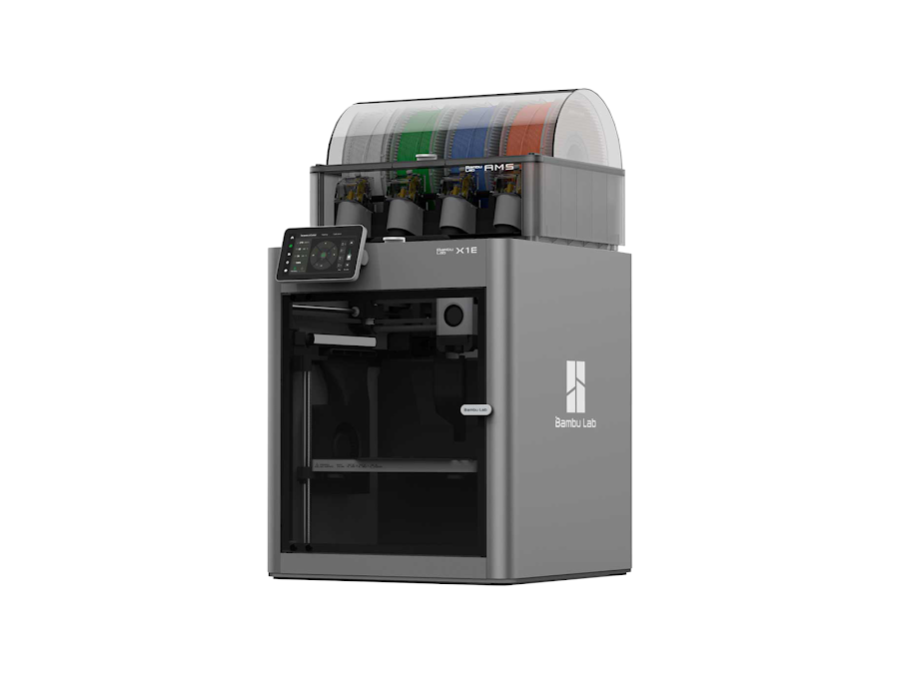
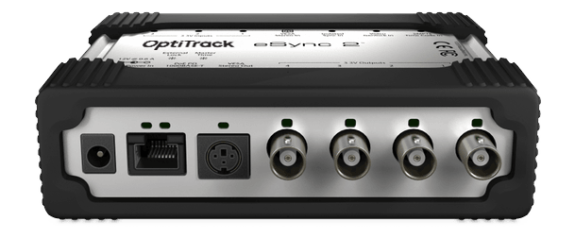
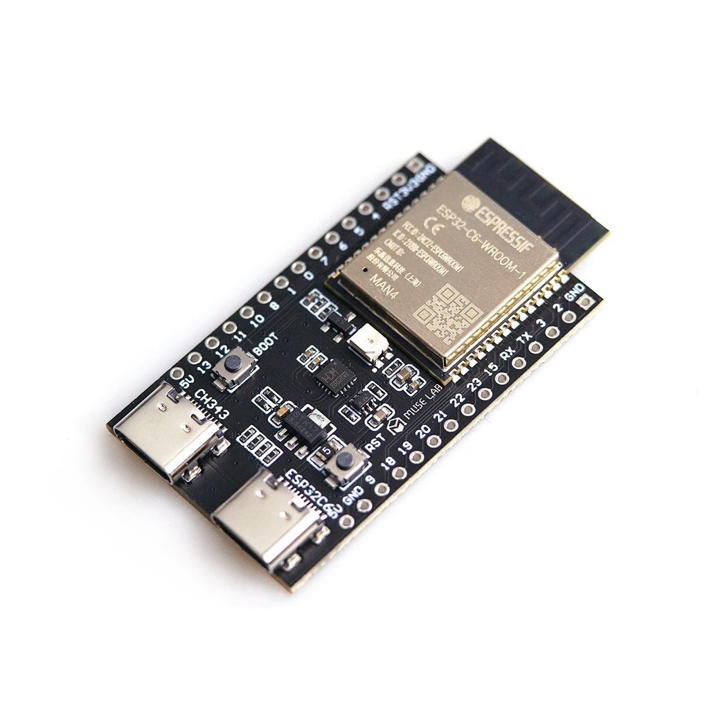
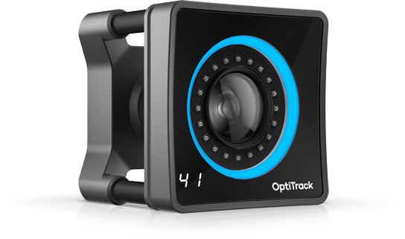
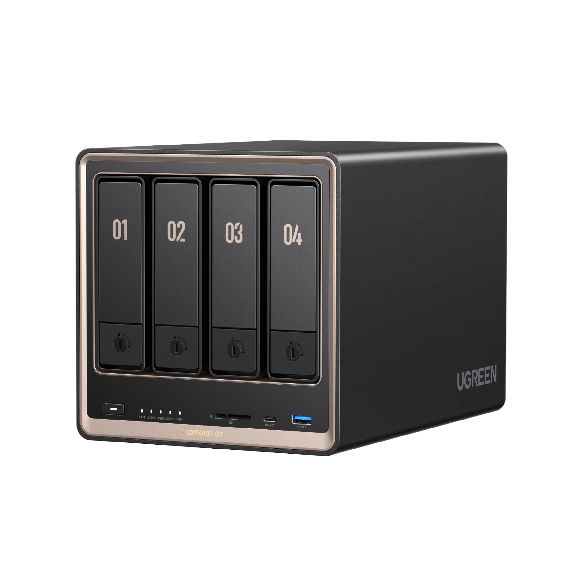
The Volciclab Network Infrastructure
NYUAD ResNet ’DSL’
TP Link BE900
Volciclab-2.4G
Volciclab-5G
Volciclab-6G
192.168.42.1
DHCP range:
192.168.42.50-249
Etisalat router, for cameras
(with d-link firmware)
192.168.69.100
DHCP range:
192.168.101-199
Volciclab local network
(black cables)
Only key devices shown, see table for details!
OptiTrack computer
Volciclab network
192.168.42.5
Hue Bridge,
(white cable)
192.168.42.132
TP-Link SX-3016F
192.168.42.9
Linksys LGS352MPC
192.168.69.200
Universal Robots UR3e
Robotic arm, direct access
192.168.42.10
Volciclab Server
File, and LAMP server
4 TB RAID 1, mounted as X:\
192.168.42.6
Volciclab Printer
Bambu X1e, LAN mode
192.168.42.123
LVTTL GPIO
OptiTrack Trigger Box
Volciclab-2.4G
192.168.42.4
Storage on campus server
Nightly backup
NYUAD network
OptiTrack cameras
(x18, on separate IP-s)
Camera network
(blue cables)
Do not connect
anything else
Volciclab NAS
Ugreen DXP4800GT
16TB RAID 1, mounted as V:\ and W:\
192.168.42.16
See docs for
AI inference capabilities

