Slide 1
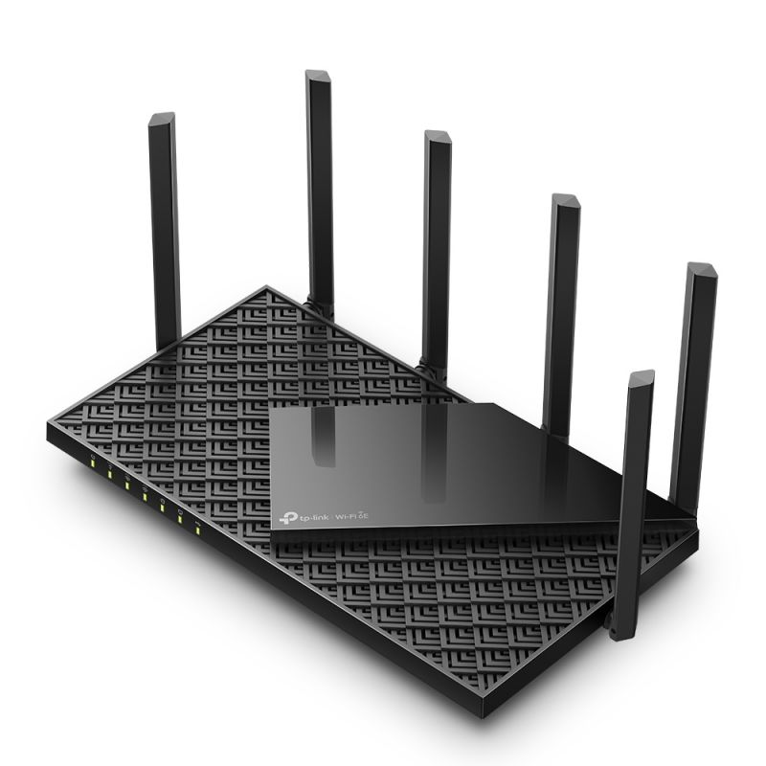
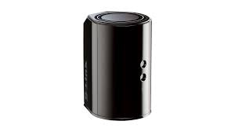
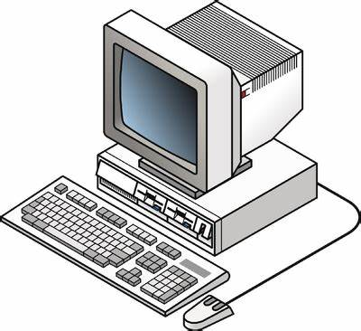
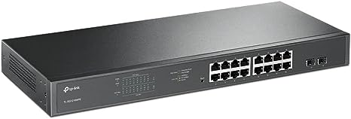
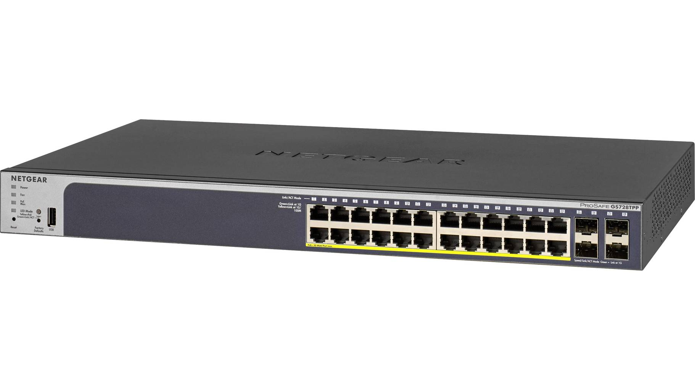
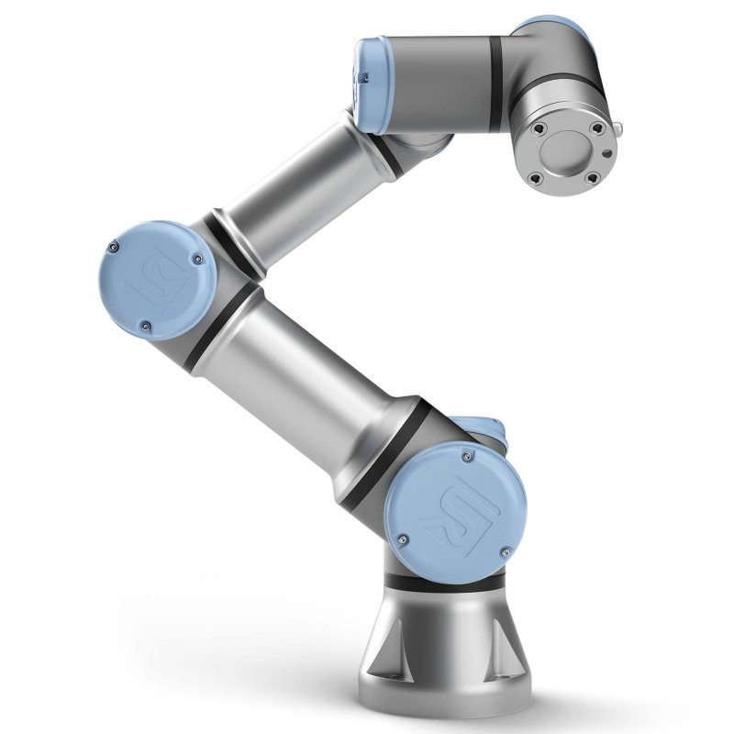
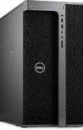
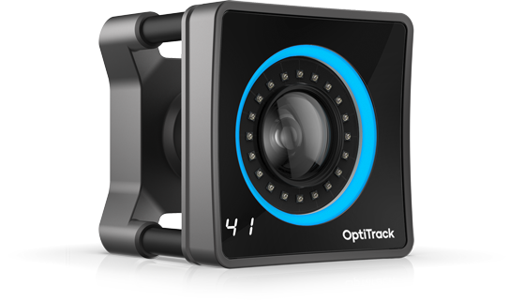
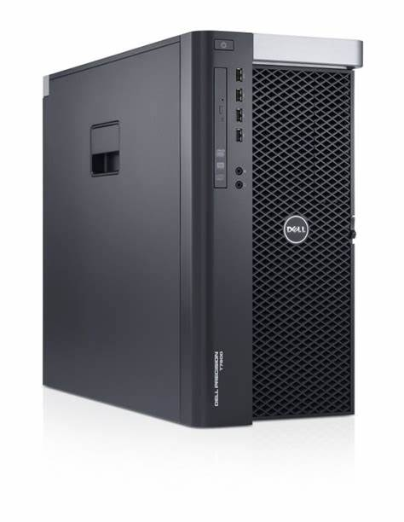
The Volciclab Network Infrastructure
NYUAD residential network
Volciclab local network
(black cables) Only fixed IP devices shown
TP Link router Volciclab-2.4G Volciclab-5G Volciclab-6G
192.168.42.1
DHCP range:
192.168.42.35-254
Etisalat router, for cameras (with d-link firmware)
192.168.69.100
DHCP range: 192.168.101-199
OptiTrack computer
Volciclab network
192.168.42.5
Other devices on DHCP
Netgear switches
(PoE, managed)
192.168.69.201
192.168.69.200
Optotrak SCU on truss 192.168.42.2
TP-Link switch
Universal Robots UR3e Robotic arm, direct access
192.168.42.10
Ethernet 1
Optotrak SCU on desk 192.168.42.3
Volciclab 2
Experimental computer
192.168.42.8
Ethernet 1
Volciclab 1
Experimental computer
192.168.42.7
Ethernet 1
OptiTrack cameras
(x18, on separate IPs)
Volciclab Server
File server
4 TB RAID 1, mounted as X:\
192.168.42.6
NYUAD network
Camera network
(blue cables) Do not connect anything else
Shared storage + robocopy backup
Ethernet 2

