Slide 1
Software Models and UML
CSC 4110 : Prepared by Arif Shariar Rahman
UML Lecture | 1

Slide 2
Learning objectives
Explain why software engineers use models.
Differentiate predictive, extracted, and prescriptive models.
Identify major UML diagram families: structure and behavior diagrams.
Draw basic activity, use case, and class diagrams.
Use actors, system boundaries, include/extend/generalization relationships, multiplicity, aggregation, composition, and dependency correctly.
Write a structured use case description using preconditions, basic flow, alternatives, postconditions, and special requirements.
UML Lecture | 2

Slide 3
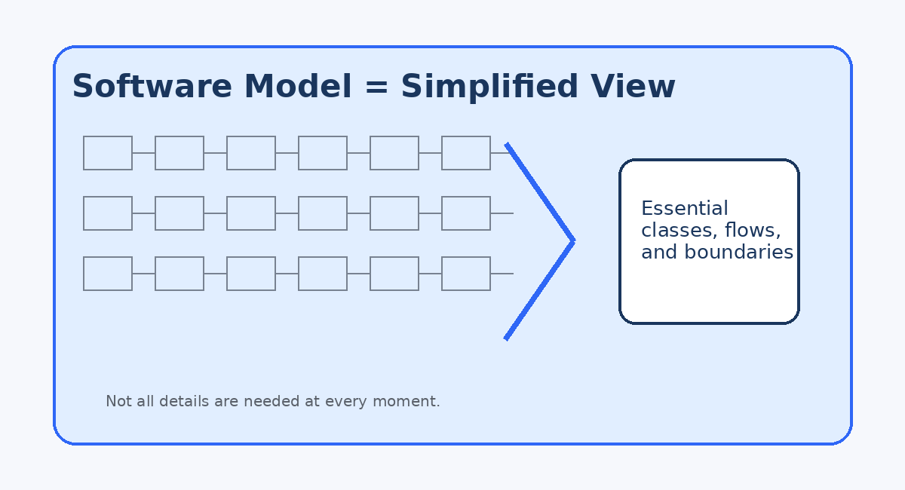
Why do we need software models?
A model is a simplified view of a software system.
It retains the important properties and omits unnecessary clutter.
Different stakeholders need different views:
Customers care about user goals and workflows.
Developers care about classes, interfaces, dependencies, and data flow.
Project managers care about risk, scope, and effort.
Good models help teams reason about complexity before mistakes become expensive.
UML Lecture | 3

Slide 4
Roles of software models
Model role | When created | Main purpose | Example
Predictive / Design | Before implementation | Predict structure, behavior, risk, and effort | Class diagram before coding a hospital system
Extracted | After or during implementation | Answer questions about existing code | Reverse-engineered dependency diagram
Prescriptive | Maintained with code | Define rules/constraints for evolution | Architecture rule: UI cannot access database directly
Key point: “model” does not always mean “up-front documentation”; it can also explain or govern existing software.
UML Lecture | 4

Slide 5
Criteria for successful software modeling
Essential information retained Classes, actors, flows, rules, dependencies
Clutter removed Low-level implementation details hidden when they are not needed
Audience-aware Model speaks to the stakeholder’s current question
Consistent with system Model does not contradict the code or requirements
Warning: a model that omits important information can become misleading and cause design mistakes.
UML Lecture | 5

Slide 6
What is UML?
Unified Modeling Language: a standard graphical notation for software analysis and design.
UML provides pictures or views of an object-oriented system.
It helps communicate system structure and behavior before or during implementation.
It is not a programming language; it is a modeling language.
It is useful because “a picture is worth a thousand words.”
OO System: Hospital Appointment App
Make appointment
Patient
Appointment - date: Date - status: String +confirm()
UML is most effective when every diagram answers a specific question.
UML Lecture | 6

Slide 7
UML diagram families
UML Diagrams
Structure Diagrams
Behavior Diagrams
Activity
Class
Sequence
Component
Collaboration / Communication
Package
State
Implementation/Deployment
Use Case
Structure = what the system is made of.
Behavior = what happens over time.
UML Lecture | 7

Slide 8
Activity diagrams: modeling workflows
Activity diagrams are behavior diagrams: they describe what must happen.
Demonstrate the logic of an algorithm.
Describe the steps performed in a use case.
Illustrate a business process or workflow between users and the system.
Clarify complicated flows and alternative paths.
Model operations, functions, or method-level behavior.
Example: Password reset workflow
User requests reset
System emails link
User enters new password
System confirms update
UML Lecture | 8

Slide 9
Components of an activity diagram
Each symbol has a precise meaning.
Action
Start node black circle
Action rounded rectangle
Decision node diamond with guard conditions
Control flow connector showing order
End node outlined final circle
Common mistake: using a decision node without labeling the outgoing conditions, such as [valid] and [invalid].
UML Lecture | 9

Slide 10
Activity diagram example: User login
This expands the simple “user login” example into an executable workflow.
Scenario notes • Normal path: credentials are valid, user sees dashboard. • Alternative path: invalid credentials, system displays error. • Guard conditions should be explicit: [valid], [invalid], [retry].
Enter username & password
Validate credentials
valid?
Show error message
Open dashboard
UML Lecture | 10

Slide 11
Swim lanes: who performs each action?
Swim lanes partition an activity diagram by responsibility.
Customer
Select product
Checkout
Web App
Create order
Request payment
Confirm order
Payment Gateway
Authorize card
Swim lanes make responsibility explicit: user action vs system action vs external service action.
UML Lecture | 11

Slide 12
Use case diagrams: external view of system behavior
Use case diagrams emphasize what a system does, not how it does it.
A use case describes a goal-oriented interaction between an actor and a system.
It is closely connected to scenarios: examples of what happens when someone interacts with the system.
Use cases help discover requirements and system scope.
They are most useful early in requirements analysis and stakeholder communication.
Clinic System Boundary
Make appointment
Cancel appointment
Patient
UML Lecture | 12

Slide 13
Actors in use case diagrams
An actor is outside the system and interacts with it.
Actors may be human users, peripheral devices, external systems, subsystems, or time-based events.
Actors are represented with stick figures and must be labeled.
A single actor can represent many physical users.
Actors are not part of the system boundary.
Patient
Payment Gateway
Timer
Human user
External system
Time event
Ask: “Does this thing initiate or participate in a scenario?” If yes, it may be an actor.
UML Lecture | 13

Slide 14
Actor vs stakeholder
A stakeholder may care about the system without directly acting in a scenario.
Actor
Stakeholder
Has behavior that interacts with the system.
Primary actor initiates an interaction to achieve a goal.
Supporting actor helps the use case complete a sub-goal.
Has an interest in the system outcome.
May not interact with the system in any scenario.
Examples: supplier, vendor, stock agency, regulator, manager.
Example: A hospital administrator is a stakeholder; they become an actor only if they log in and use administrative functions.
UML Lecture | 14

Slide 15
How to identify actors
Use these questions during requirements elicitation.
Who is interested in the scenario or system?
Where in the organization will the system be used?
Who benefits from the system?
Who supplies, uses, or removes information?
Does one person play several different roles?
Do several people play the same role?
Classroom prompt: identify actors for a Wayne State course registration system.
UML Lecture | 15

Slide 16
Use cases and scenarios
Alternative: no doctor available
Each use case represents one user-visible function or goal.
A use case can contain several paths through the system.
Each path is a scenario.
Use cases are drawn as ovals/ellipses.
Actors are stick figures; communications are lines connecting actors to use cases.
Use case names should be active verb phrases: “Make appointment,” “Withdraw cash,” “Generate report.”
Use case: Make appointment
Basic path: appointment booked
Failure: patient not validated
UML Lecture | 16

Slide 17
Use case relationships and system boundary
A boundary rectangle defines the scope of the system.
Clinic Application
Association: actor communicates with use case.
Boundary: what is inside the system scope.
Actors remain outside the rectangle.
Use cases inside the boundary must be functions provided by the system.
Make appointment
Update profile
Patient
UML Lecture | 17

Slide 18
Sample use case diagram: Hospital / clinic system
A realistic example that combines multiple actors and use cases.
Hospital System
Make Appointment
View Schedule
Patient
Doctor
Cancel Appointment
Update Medical Record
Process Payment
Billing System
UML Lecture | 18

Slide 19
Use case relationship: Generalization
Generalization represents inheritance from child to parent.
Use when specialized actors or use cases share common behavior.
Arrow points from child to parent.
It is represented by a line with a hollow triangle arrowhead.
Example: New Patient and Returning Patient are specialized forms of Patient.
Patient
New Patient
Returning Patient
In UML notation, the hollow triangle points to the more general parent.
UML Lecture | 19

Slide 20
Use case relationships: <<include>> and <<extend>>
These two relationships are often confused.
<<include>> = required reusable behavior
<<extend>> = optional or conditional behavior
ATM Withdrawal
<<include>>
Validate User
Make Appointment
<<extend>>
Update Patient Info
The base use case always uses the included use case.
Good for common required functionality such as authentication.
The extension happens only under a condition.
Example: update patient info only if profile is outdated.
UML Lecture | 20

Slide 21
Use case relationship summary
Choose the relationship based on meaning, not visual convenience.
Relationship | Meaning | Arrow direction | Example
Association | Actor communicates with use case | Actor ↔ use case | Patient — Make appointment
Generalization | Child specializes parent | Child → Parent | New Patient → Patient
<<include>> | Required reused behavior | Base → Included | Withdraw Cash → Validate User
<<extend>> | Optional/conditional behavior | Extension → Base | Update Info → Make Appointment
Rule of thumb: include = mandatory subfunction; extend = conditional addition.
UML Lecture | 21

Slide 22
Use case textual template
A diagram shows scope; a use case description gives operational detail.
Brief description What task is being performed?
Actors Primary and secondary actors
Preconditions What must already be true?
Basic flow Successful scenario steps
Alternative flows What if something goes wrong?
Postconditions What is true after success/failure?
Special requirements Rules, constraints, guidelines
UML Lecture | 22

Slide 23
Example use case: ATM Withdrawal
A formal use case turns a diagram into testable requirements.
ID
FR1: ATM_Withdraw
Description
Bank customer withdraws money from a bank account using an ATM.
Actors
Primary: Bank Customer Secondary/supporting: Bank, ATM Machine
Preconditions
1. Active network connection to the bank. 2. ATM has cash available.
UML Lecture | 23

Slide 24
ATM Withdrawal: basic successful flow
A basic flow describes the normal success path.
1. Insert bank card
2. Validate user
3. Select “Withdraw Cash”
4. Select account
5. Enter amount
6. Bank approves transaction
7. Dispense cash
8. Return card
9. Print receipt
Each step should be observable enough to support review, implementation, or test design.
UML Lecture | 24

Slide 25
ATM Withdrawal: alternative flows and constraints
Alternative flows make the requirements realistic and testable.
Invalid user Validate User fails → use case ends with failure condition.
Wrong account Bank card is not associated with selected account → show message and return to account selection.
Wrong amount Amount cannot be created with available bills → ask customer to reenter amount.
Exceeds individual limit Amount exceeds maximum withdrawal → show warning and return to amount entry.
Exceeds daily limit Bank rejects transaction due to daily limit → show warning and return to amount entry.
Special requirements Cash in multiples of $20; maximum individual withdrawal $500; log complete and incomplete transactions.
UML Lecture | 25

Slide 26
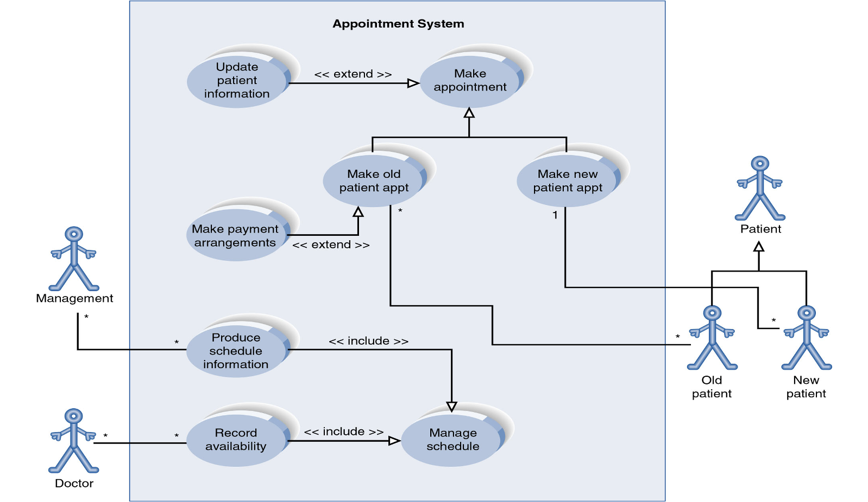
Appointment System

Slide 27
UML class diagrams
A class diagram shows the static structure of an object-oriented system.
A class diagram pictures classes in an OO system.
It shows fields/attributes and methods/operations.
It shows connections between classes that interact or inherit from one another.
It does not show algorithmic details or the exact sequence of object interactions.
Appointment
- date: Date - status: String - fee: double
+ confirm(): void + cancel(): boolean
Patient
UML Lecture | 26

Slide 28
Diagram of a single class
A class rectangle is divided into name, attributes, and operations.
Student
<<interface>> Shape
- name: String - id: int - totalStudents: int
+ calculateArea(): double
# getID(): int ~ getEmail(): String + calculateGPA(crs: Course[]): float
Class name goes on top. Attributes are optional in the middle. Operations are optional at the bottom.
For interfaces, do not omit the methods that define the interface contract.
UML Lecture | 27

Slide 29
Class attributes and operations
Visibility tells who can access a field or method.
Symbol | Visibility | Example
+ | public | + name: String
# | protected | # age: int
- | private | - DOB: String
~ | package/default | ~ courses[100]: Course
Operation signature pattern
visibility name(parameters) : return_type
+ calculateGPA(crs: Course[]) : float + Student(n: String, dob: String)
Constructors normally omit return type; void methods may omit return type in many UML teaching contexts.
UML Lecture | 28

Slide 30
Relationships between classes
Class diagrams become powerful when relationships are modeled correctly.
Generalization Inheritance or interface implementation
Association Objects are connected or use one another
Aggregation Weak “part-of” relationship
Composition Strong whole-part lifetime ownership
Dependency Temporary use; often implementation detail
UML Lecture | 29

Slide 31
Class relationship: Generalization
Inheritance arrows point upward to the parent.
<<interface>> Shape
Abstract class parent: solid line with hollow triangle.
Interface implementation: dashed line with hollow triangle.
Abstract classes often use italic names.
+ calculateArea(): double
RectangularShape
- width: int - height: int / area: double
+ calculateArea(): double + contains(x:int,y:int): bool
Rectangle
Square
UML Lecture | 30

Slide 32
Association multiplicity
Multiplicity specifies how many objects participate in a relationship.
1
1
Common multiplicities 1 = exactly one * = zero or more 2..4 = between 2 and 4 3..* = three or more 0..1 = optional / at most one
Car
Engine
1
*
Book
Page
Multiplicity is one of the most testable pieces of a class diagram.
UML Lecture | 31

Slide 33
Association types: aggregation, composition, dependency
The diamond and line style change the meaning.
Aggregation: weak part-of
Composition: strong ownership
Dependency: temporary use
Team
Player
Book
Page
Lottery
Random
Aggregation: the part can exist independently of the whole.
Composition: the parts live and die with the whole.
Dependency: one class uses another temporarily; often not an intrinsic part of object state.
UML Lecture | 32

Slide 34
Class diagram example: Hotel reservation system
This example connects the UML class concepts to a real project domain.
Guest
Reservation
Room
- name: String - email: String
- checkIn: Date - checkOut: Date - status: String
- roomNo: String - type: String - rate: double
Interpretation A guest can have many reservations. Each reservation books one room and may have one payment.
1
*
*
1
+ makeReservation()
+ cancel() + changeDates()
+ isAvailable()
1
0..1
Payment
- amount: double - status: String
+ authorize()
UML Lecture | 33

Slide 35
Sequence diagrams: time-ordered interaction view
A sequence diagram complements a class diagram by showing messages over time.
Shows objects or actors across the top and time flowing downward.
Useful when the question is “who sends what message to whom, and in what order?”
Example: booking an appointment involves Patient, Web App, Doctor Calendar, and Database.
Patient
Web App
Doctor Calendar
Database
requestAppointment()
checkAvailability()
saveAppointment()
confirmation
showConfirmation()
UML Lecture | 34

Slide 36
State diagrams: lifecycle of one object
A state diagram is useful when an object has important status changes.
Shows valid states of an object and transitions between them.
Useful for objects such as Reservation, Order, Ticket, Account, or Payment.
Complements activity diagrams: activity diagrams show workflow; state diagrams show object lifecycle.
Requested
approve
Confirmed
Checked In
cancel
Cancelled
Completed
UML Lecture | 35

Slide 37
Common UML mistakes to avoid
UML is valuable only when notation and meaning match.
Putting actors inside system boundary Fix: Actors are external to the system.
Using include/extend randomly Fix: Include is required; extend is optional/conditional.
Drawing every implementation detail Fix: A model should simplify, not duplicate code.
Omitting multiplicity Fix: Multiplicity often encodes key requirements.
Treating class diagrams as database ERDs Fix: They overlap, but class diagrams model objects and behavior too.
Leaving diagrams stale Fix: A misleading model is worse than no model.
UML Lecture | 36

