Slide 1
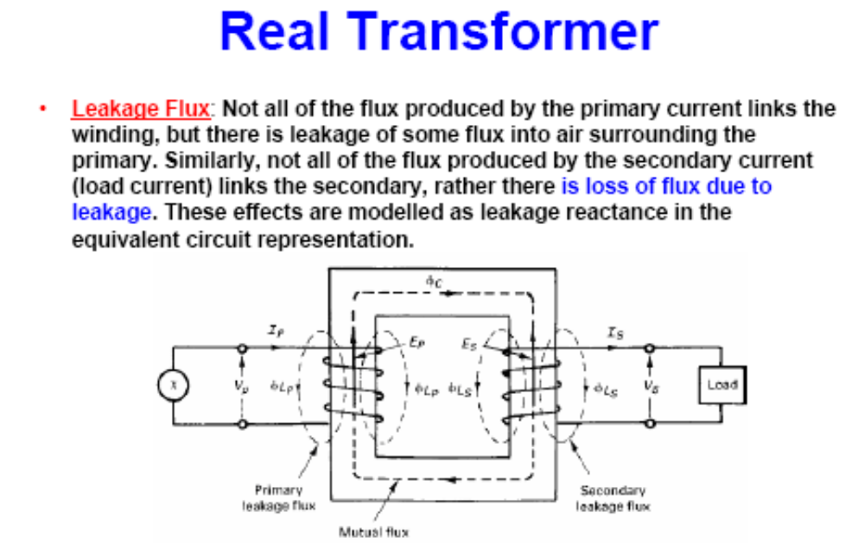

Slide 2
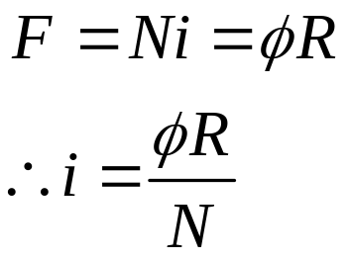
Magnetization Current in a Real transformer
Although the output of the transformer is open circuit, there will still be current flow in the primary windings
  Magnetization current, iM
  Core-loss current, ih+e
The relation between current and flux is proportional since

Slide 3
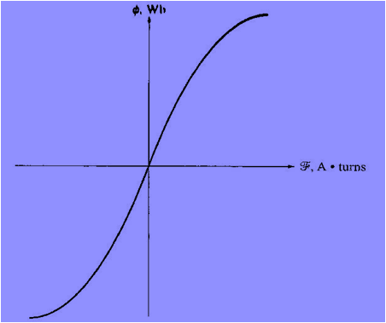
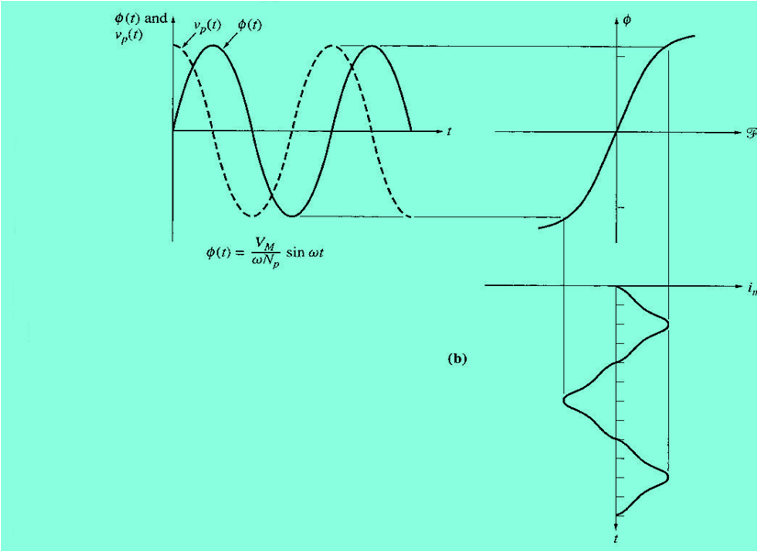
Magnetization Current in a Real transformer
Therefore, in theory, if the flux produce in core is sinusoidal, therefore the current should also be a perfect sinusoidal. Unfortunately, this is not true

Slide 4
Magnetization Current in a Real transformer
current in a transformer has the following characteristics:
  It is not sinusoidal but a combination of high frequency oscillation
  The current lags the voltage at 90o
  At saturation, the high frequency components will be extreme

Slide 5
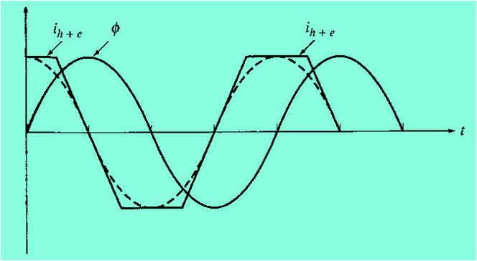
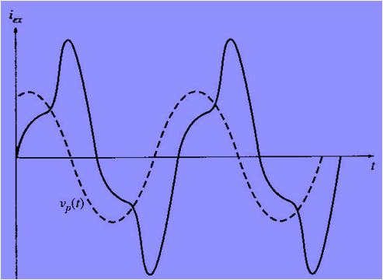
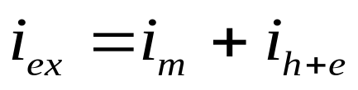
Magnetization Current in a Real transformer
Core-loss current:
Eddy current loss> Eddy current is dependent upon the rate of change of flux
Hysteresis loss > a non linear loss
At no-load, the primary windings is known as the excitation current

Slide 6
Magnetization Current in a Real transformer
The equivalent circuit of a transformer
Taking into account real transformer, there are several losses that has to be taken into account in order to accurately model the transformer, namely:
1- Copper (I²R) Losses
2- Eddy current Losses
3- Hysteresis Losses
4- Leakage flux

Slide 7
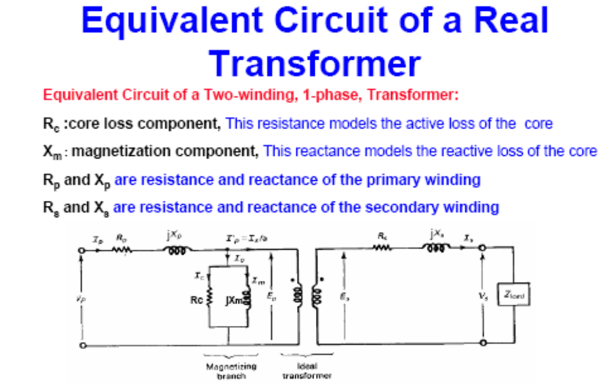

Slide 8
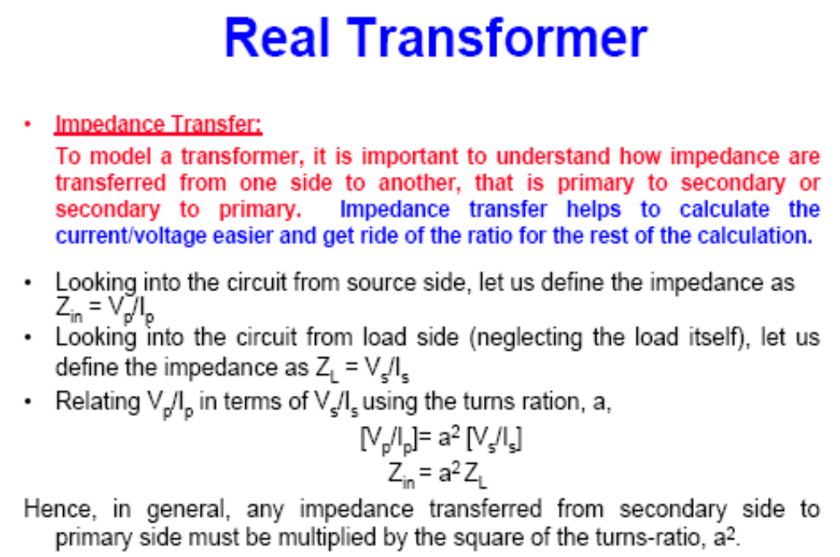

Slide 9
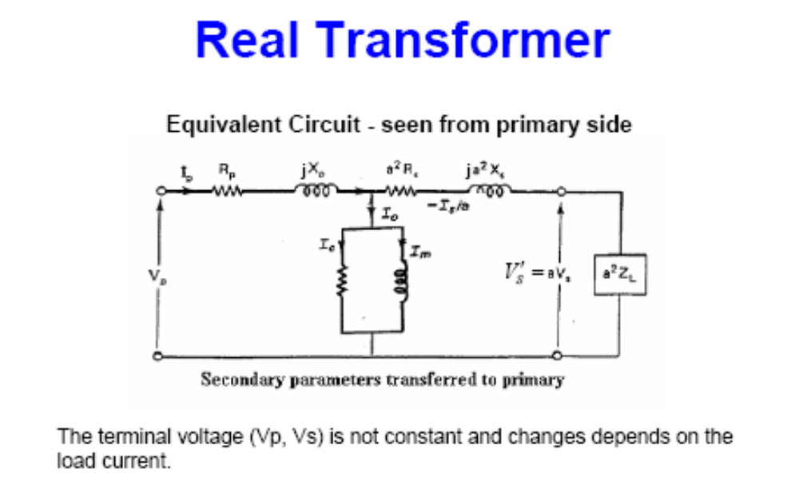

Slide 10
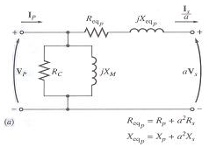
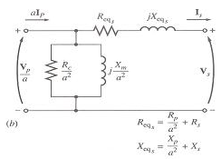
Equivalent Circuit a) referred to primary side b) referred to secondary side

Slide 11
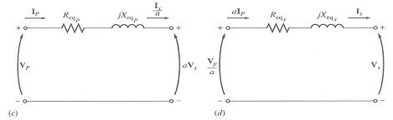
Approximate equivalent circuit
Approximate equivalent circuit c) Referred to primary side (no exicitation) d) Referred to secondary side (no excitation).

Slide 12
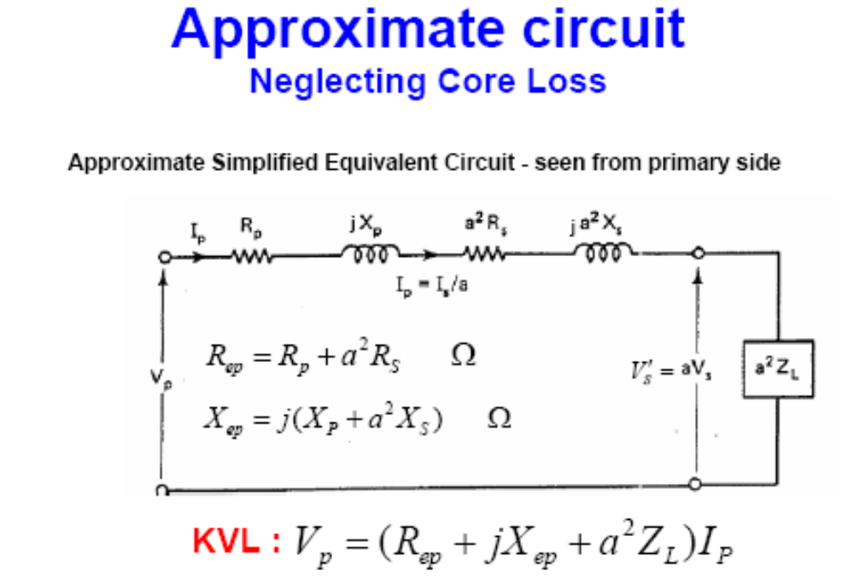

Slide 13
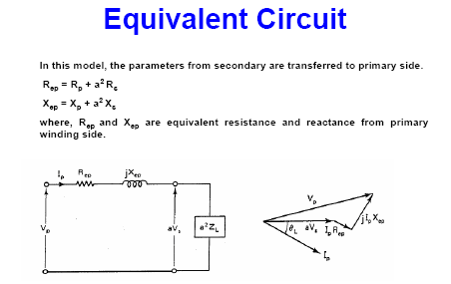

Slide 14
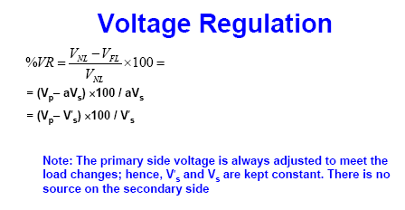

Slide 15
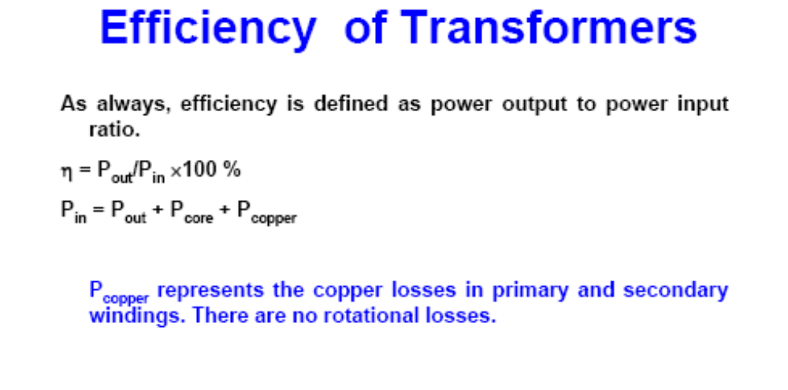

Slide 16
Example 3
A not-quite-ideal transformer having 90 turns on the primary and 2250 turns on the secondary is connected to a 120 V, 60 hz source. The coupling between the primary and the secondary is perfect but the magnetizing current is 4 A. calculate:
The effective voltage across the secondary terminals
The peak voltage across the secondary terminals.
The instantaneous voltage across the secondary when the instantaneous voltage across the primary is 37 V.
Ans: 3000V, 4242 V, 925 V.

Slide 17
Example 4
An ideal transformer having 90 turns on the primary and 2250 turns on the secondary is connected to a 200 V, 50 Hz source. The load across the secondary draws a current of 2 A at a power factor of 80 per cent lagging. Calculate :
The effective value of the primary current
The instantaneous current in the primary when the instantaneous current in the secondary is 100 mA.
The peak flux linked by the secondary winding.
Ans: 50 A, 2.5 A, 10 mWb.

Slide 18
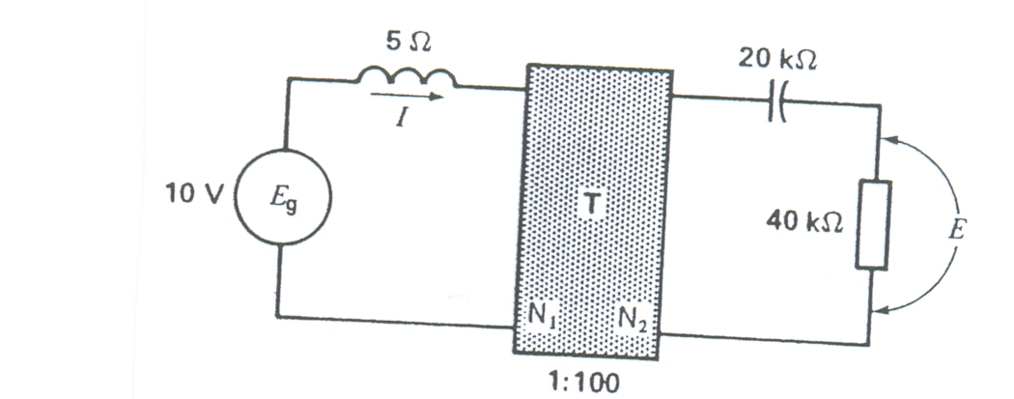
Example 5
Calculate voltage E and current I in the circuit of Fig. shown below, knowing that the ideal transformer T has a primary to secondary turns ratio of 1;100.
Ans: 800 V, 2 A.

Slide 19
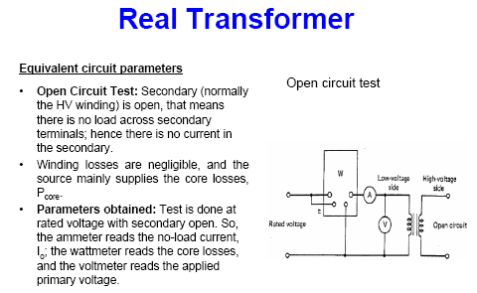

Slide 20
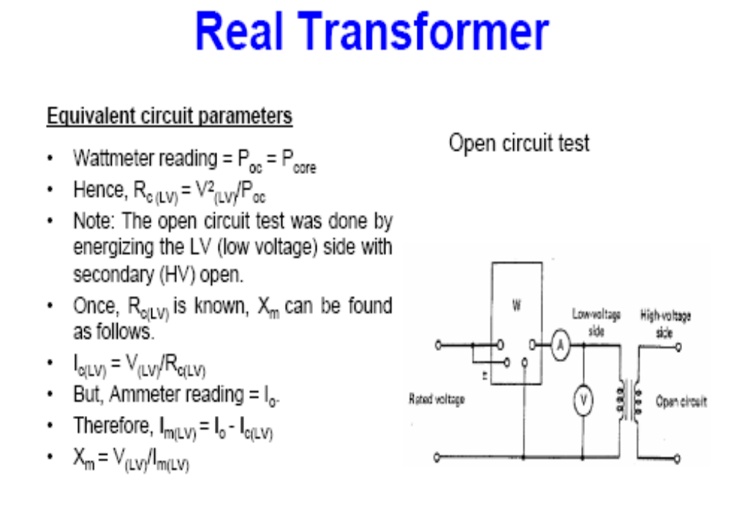

Slide 21
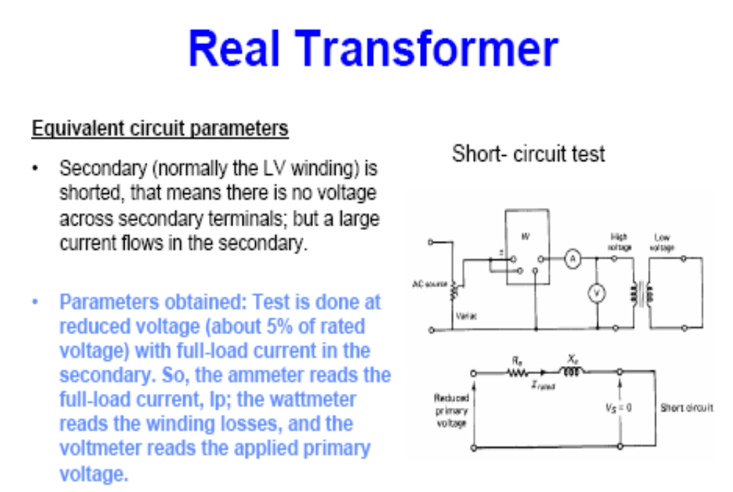

Slide 22
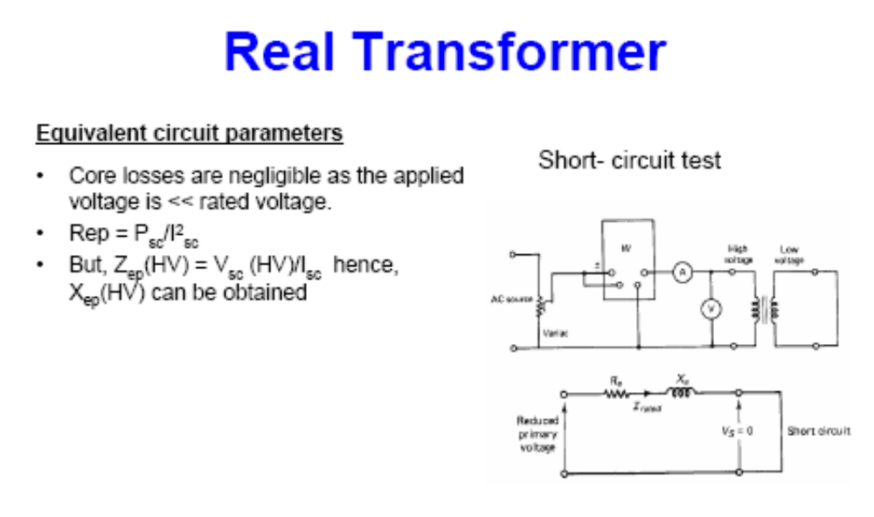

Slide 23
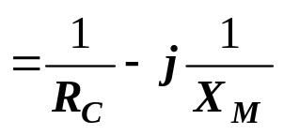
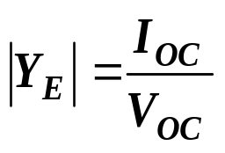
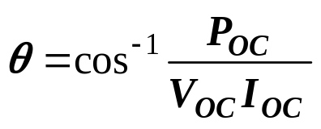
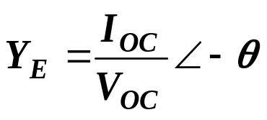
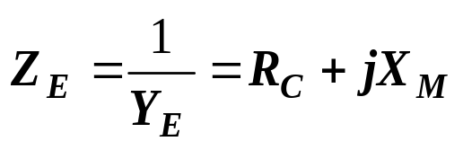
Determination of transformer parameters: Open Circuit Test
Total excitation admittance, Y_{E} = G_{C} - jB_{M}
The magnitude of the excitation admittance (referred to primary),
The angle of the admittance ,from the circuit power factor.
The power factor is always lagging for a real transformer. Hence,
Hence

Slide 24
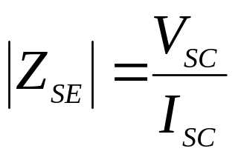
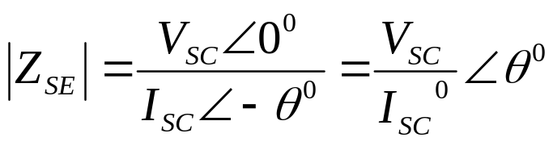
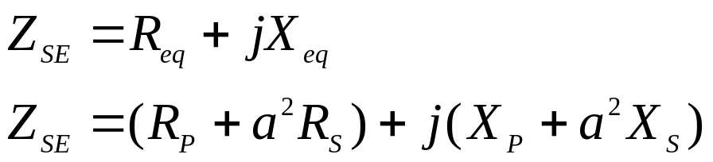
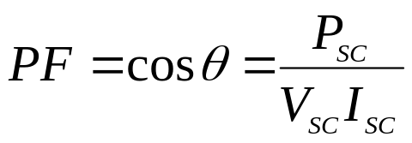
Determination of transformer parameters: Short Circuit Test
Magnitude of series impedance:
Power factor:

Slide 25
Three Phase Transformer
Three phase transformer consists of 3 transformers.
It is connected independently or in combination of 3 transformers.
Primary and secondary windings can be connected as wye (Y) or delta (∆)
Thus, there are 4 types of connections:
  Wye – wye (Y-Y)
  Wye – delta (Y-∆)
  Delta – wye (∆-Y)
  Delta – delta (∆-∆)

Slide 26
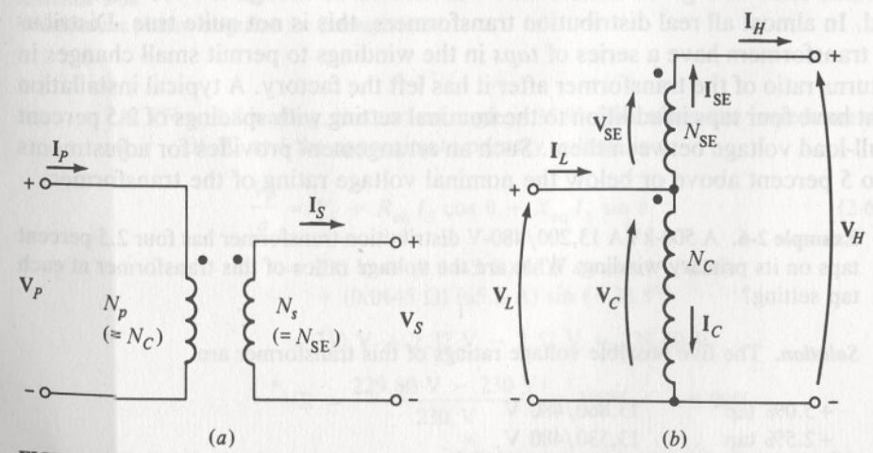


The autotransformer
On some occasions it is desirable to change voltage levels by only a small amount. A special-purpose transformer, called an autotransformer, is used in these cases.
The voltages in the coils are related to the voltages at the terminals by the Equations
And the currents in the coils are related to the currents at the terminals by the equations
the relationship between the two sides of an autotransformer

Slide 27
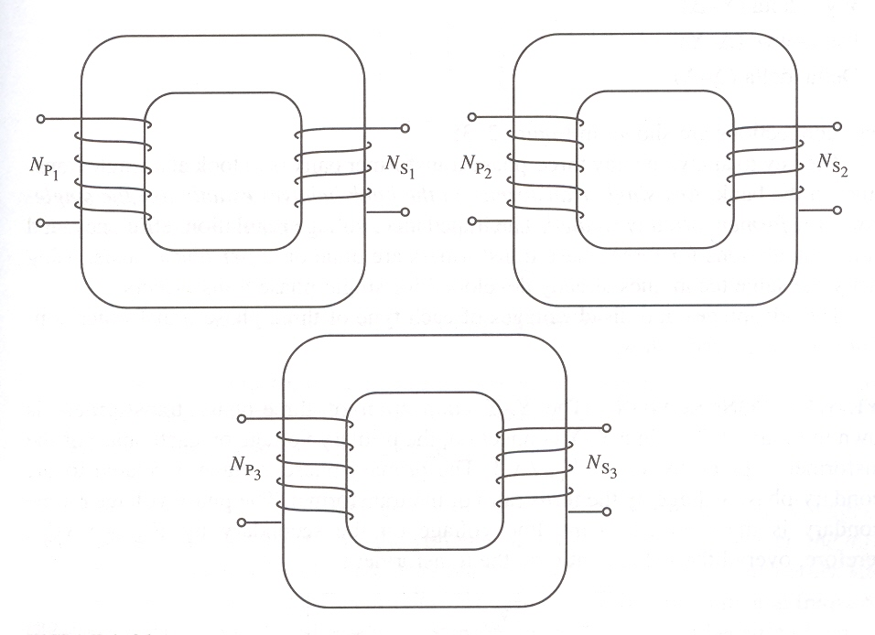
3 phase Transformer
3 phase transformer connected independently

Slide 28
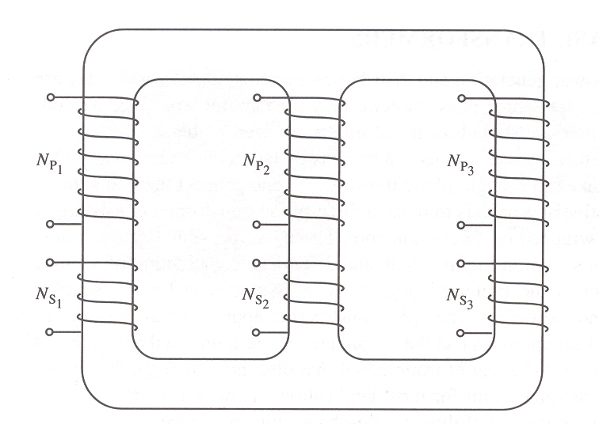
Three Phase Transformer
Three phase transformer connected to a common core with three legs

Slide 29
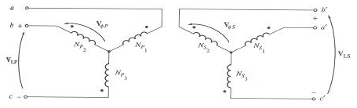
Connection Y-Y
Three Phase transformer Y-Y connection

Slide 30
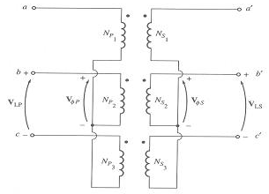
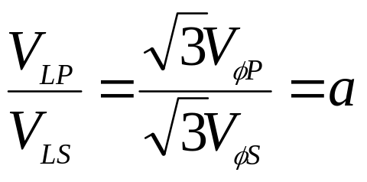
Transformer Connection Y-Y

Slide 31
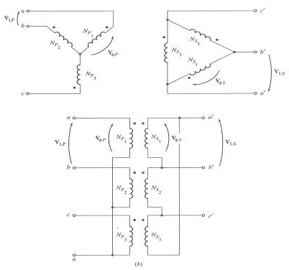
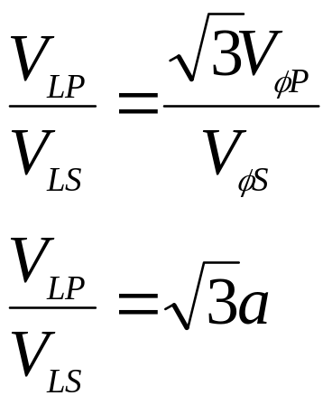
Transformer Y-∆ Connection

Slide 32
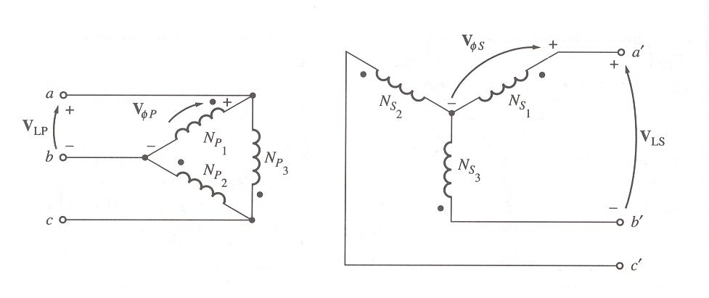
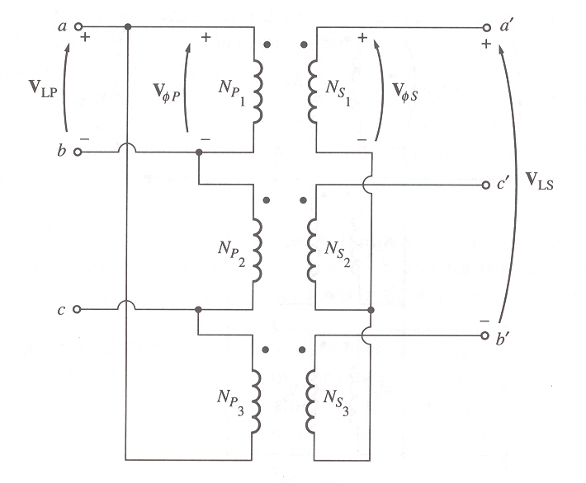
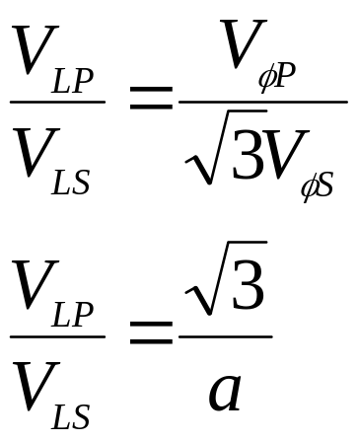
Transformer ∆-Y Connection

Slide 33
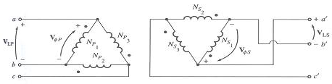
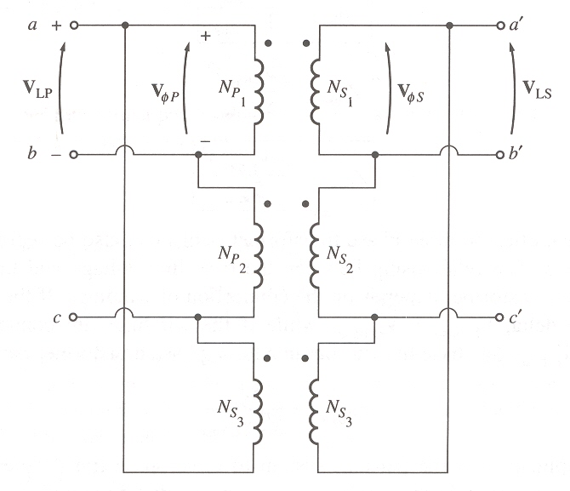
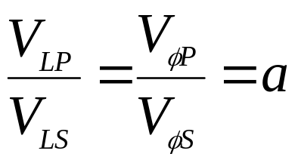
Transformer ∆-∆ Connection

Slide 34
Three-phase transformation using two transformers
In addition to the standard three-phase transformer connections, there are ways to perform three-phase transformation with only two transformers
Some of the more important two-transformer connections are
1. The open- Δ (or V-V) connection
2. The open-Y-open- Δ connection
3. The Scott-T connection

Slide 35
Instrument transformers
Instrument transformers are small transformers intended to supply low values of current and voltage to measuring instruments and protective relays.
Current transformer (CT)> used in measurement of high current
1. It’s a step up transformer
2. Secondary side is usually rated up to 5 A
3. Primary circuit have few turns
Potencial transformer (CT) > used in measurement of high voltage
1. It’s a step down transformer
2. Secondary side is usually rated 110 V

Slide 36
