Slide 1
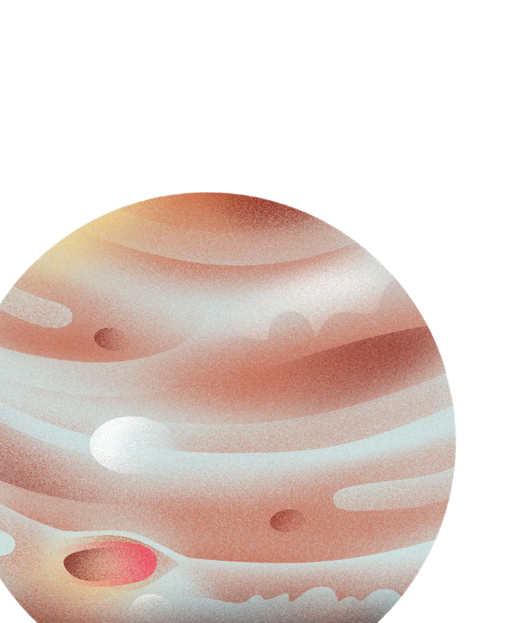
Project
The Three Body Problem; Sun, Earth, and Jupiter
By:
Aaron Eyoel
Haleluya Fasil
Hemen Aschalew
Meklit Birhanu
Yeamlak Cherinet
AAU summer camp, September 2026

Slide 2
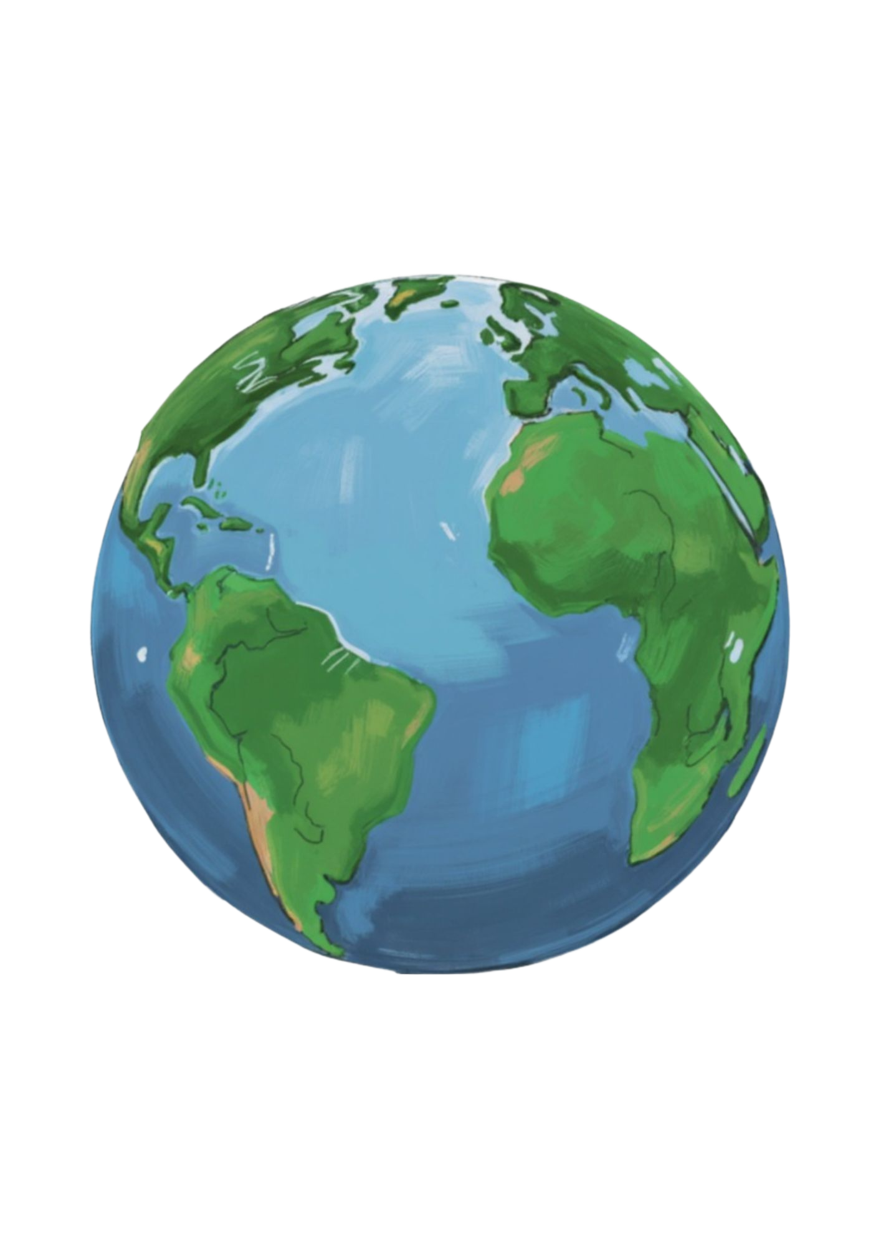
Gravity
Gravity is an invisible force that pulls any two objects with mass towards each other.
Sir Isaac Newton mathematically defined universal gravitation in 1687.
The Two Body System
The two-body system is a foundational concept in physics that predicts the motion of two objects that interact with each other through a single force, usually gravity.

Slide 3

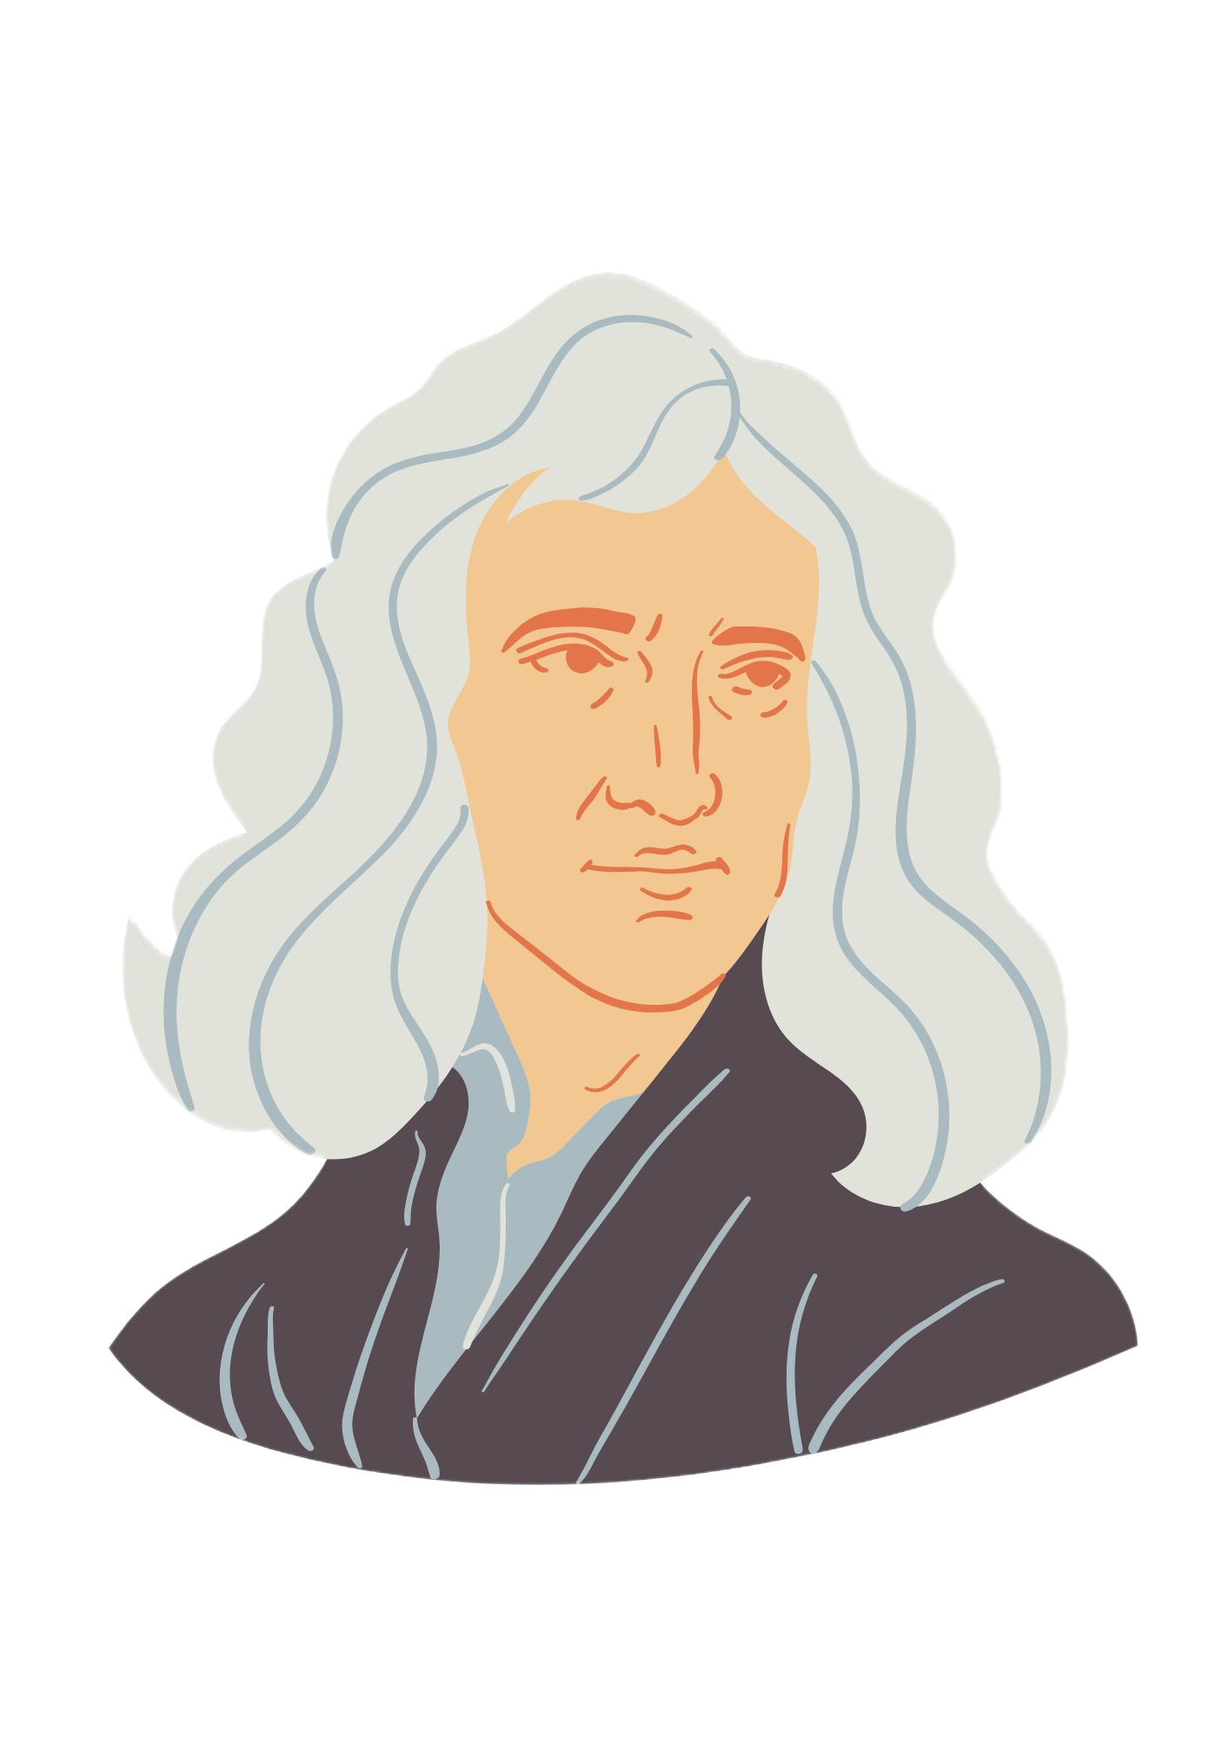
Kepler
Described planetary orbits observationally in the early 1600’s
Newton
In 1687, Newton officially solved the mathematical two body problem in 1687 in his famous work principa mathematica.

Slide 4
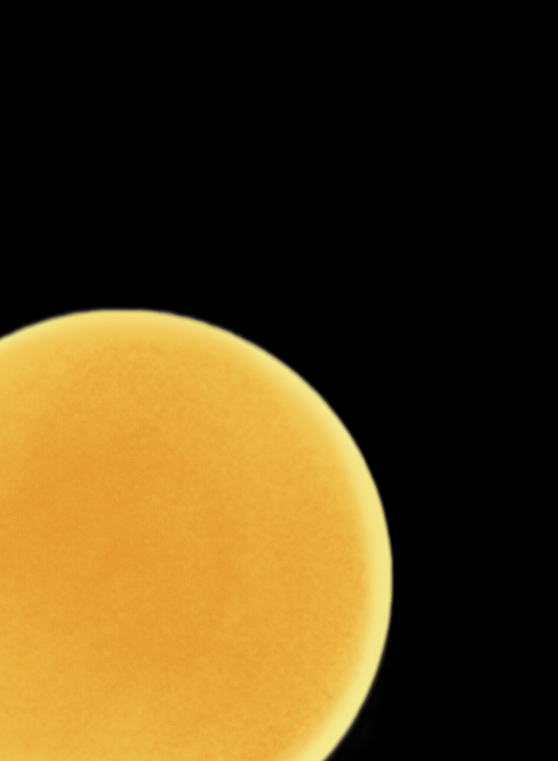
The three body system
A three-body system is any group of three physical objects in space that all pull on each other with gravity at the exact same time.
Because every objects force constantly tugs and shifts the other two, their paths become impossible to predict with a single mathematical formula.
2009 experiment
2,500 simulations: Supercomputer modeled our solar system 5 billion years into the future.
1 mm shift: Moving mercury changed the final outcome drastically
3 major outcomes, one important conclusion

Slide 5
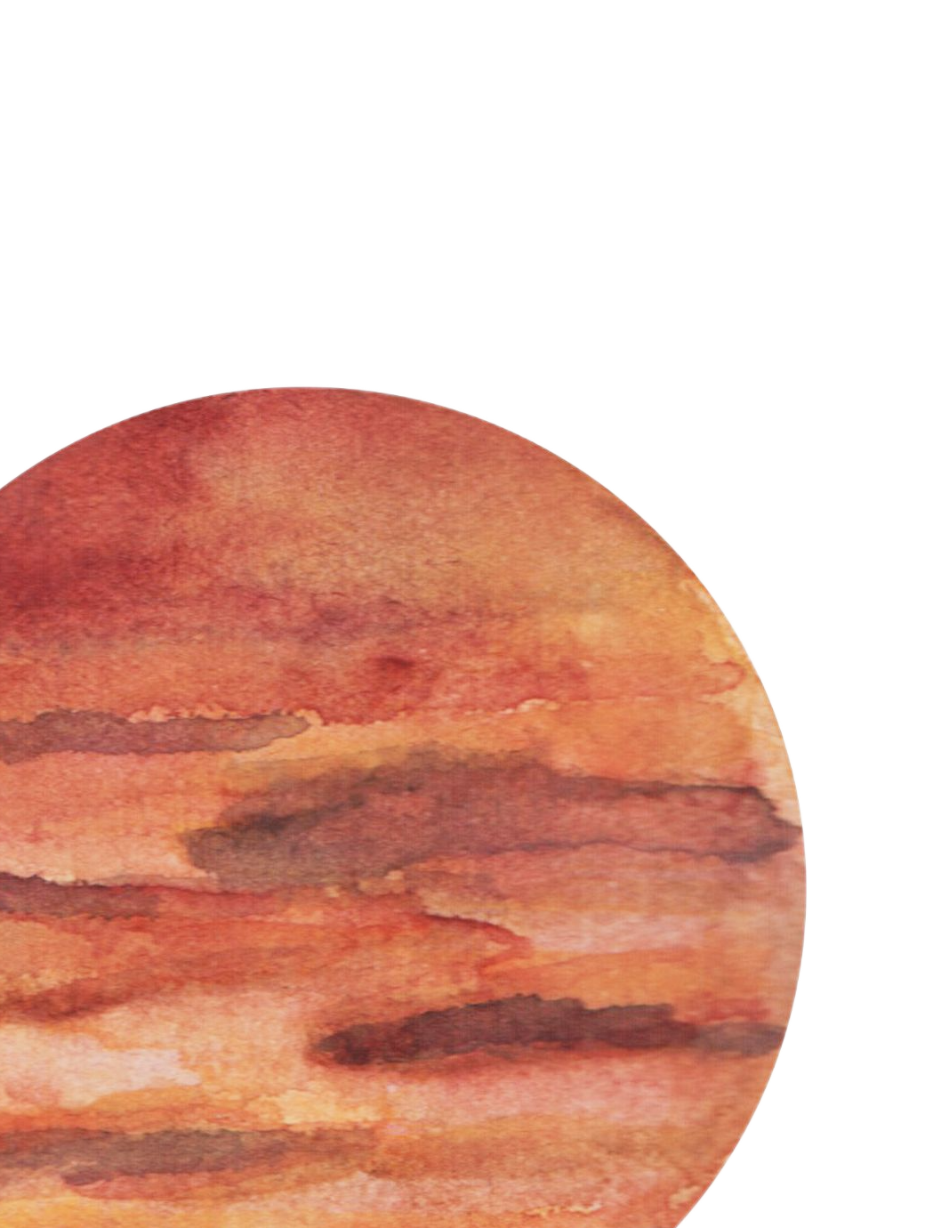
Properties of the three body problem
Deterministic but chaotic
Even the smallest change and tiniest gravitational tweaks can eventually trigger planetary collisions.
There is no single mathematical formula to represent the movement of each object.

Slide 6
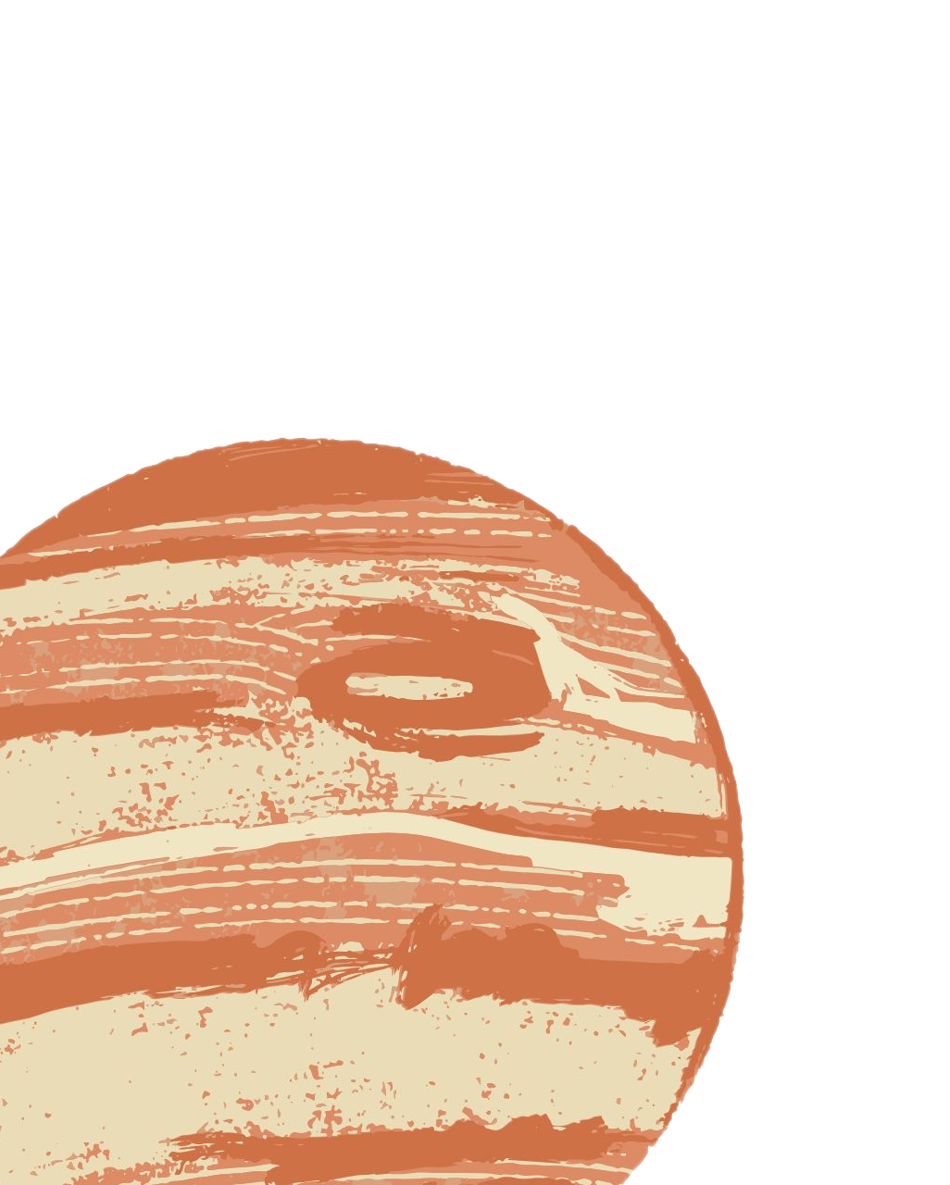
Project Objective
Jupiter exerts a gravitational force on the Earth every once in a while, when they line up.
This phenomena triggered a question: Will Jupiter be able to pull the earth away from its orbit after millions or billions of years?
Our main goal: to find out if Jupiter actually pulls the earth away in the foreseeable future.

Slide 7

Algorithm:
Step 1 — Load the tools NumPy for math Matplotlib for graphs
Step 2 — Define two reusable functions In this step, two functions are set; one for velocity, the other for position. These formulas are to be used later in the code.
Step 3 — Set the constants Constant Values: these are values that are not going to change throughout the entire code
G = 6.674×10⁻¹¹ (Gravitational constant)
ms = 1.989×10³⁰ kg
me = 5.972×10²⁴ kg
mj = 1.898×10²⁷ kg
dt = 300 seconds (Time step: 5 minutes per loop pass)
Total simulation time — 12 years in seconds

Slide 8
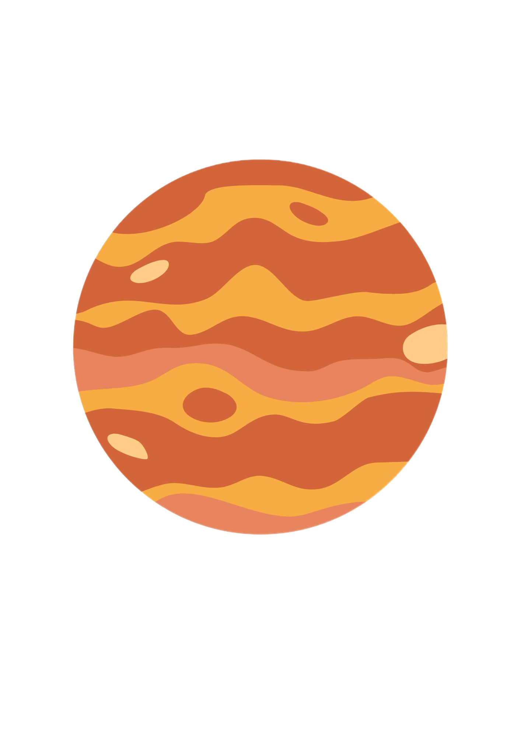
Step 4 — Set starting positions and velocities Sun starts at the origin (0, 0), initially at rest Earth starts 1.471×10¹¹ m to the right of the Sun, moving upward at 30,290 m/s Jupiter starts 7.405×10¹¹ m to the right of the Sun, moving upward at 13,070 m/s
Step 5 — Correct the Sun's position and velocity for conservation of momentum The total momentum of an isolated system must be zero. If Earth and Jupiter are already moving, the Sun must move slightly in the opposite direction to balance them.
Step 6 — Calculate the initial distances between every pair of bodies There are 3 unique pairs for distance: Earth–Sun, Jupiter–Sun, and Earth–Jupiter
dx_es = xe - xs, r_es = √(dx_es² + dy_es²)
dx_js = xj - xs, r_js = √(dx_js² + dy_js²)
dx_ej = xe - xj, r_ej = √(dx_ej² + dy_ej²)

Slide 9
Step 7 — Calculate the initial acceleration of every object Each body is pulled by BOTH other bodies at the same time. The total acceleration is the sum of both pulls:
Earth: acc_ex = −G·ms·dx_es/r_es³ − G·mj·dx_ej/r_ej³
Jupiter: acc_jx = −G·ms·dx_js/r_js³ − G·me·dx_ej/r_ej³
Sun: acc_sx = +G·me·dx_es/r_es³ + G·mj·dx_js/r_js³
Step 8 — Run the simulation loop for 12 years We write a code using a loop, which allows the computer to repeat some equation by for some amount of time by updating the data values. It is called a for loop, and it allows us to perform millions of equations repeatedly.
Step 9 — Plot the full orbital paths Draw the complete trails of all three bodies as dashed lines (Sun in yellow, Earth in blue, Jupiter in red).
Step 10 — Animate the simulation Place a dot on each body's trail and move it forward every frame, skipping every 60 recorded steps so the animation plays at a visible speed rather than showing every single 5-minute increment.

Slide 10
Assumptions
Only the three bodies we selected are interacting in this system
The only force acting on these bodies is gravity; we are assuming that the system is an isolated system.
We assumed that this movement has a constant velocity for some bit of time.

Slide 11
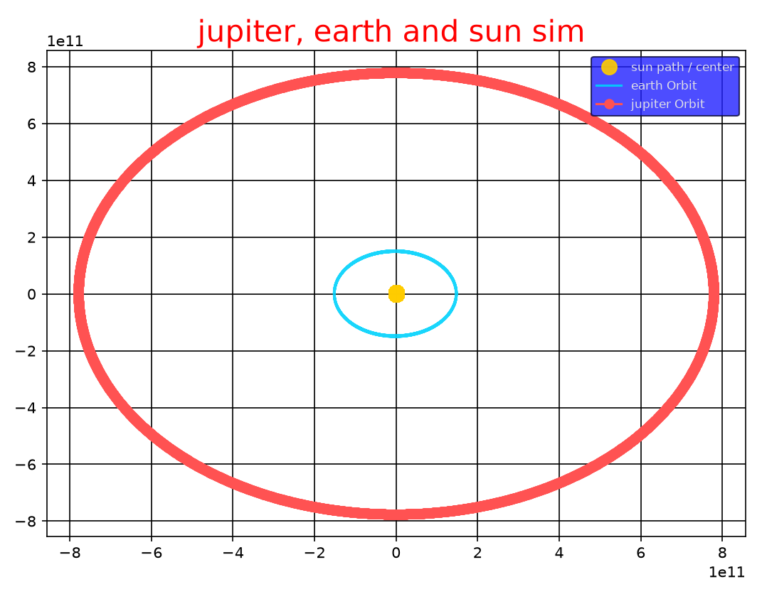
Findings
Through this experiment, we found out that Jupiter won’t pull the earth away from its orbit for the next 12 years.

Slide 12
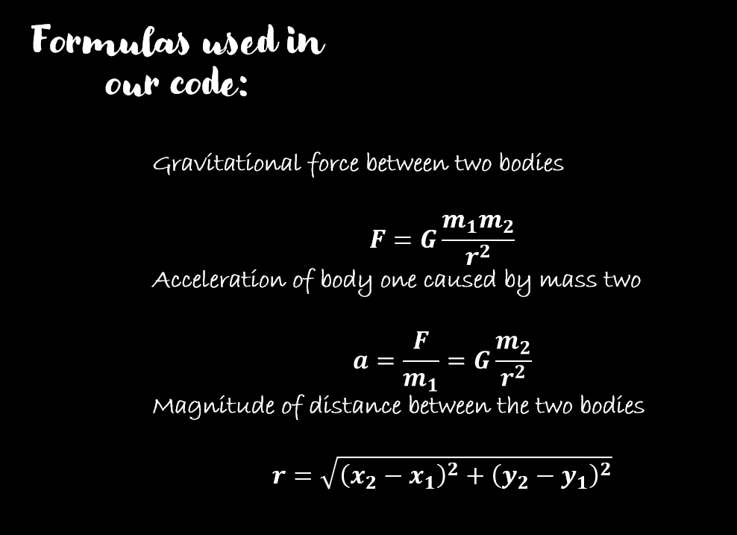
Setbacks and model limitations
One of the major setbacks on our project was the time constraint as two weeks time was rather too little to dive deep in such big sea of concept.
Limitations of our model include the assumption in which the velocity was constant for some few minutes and the two-body formula we used to replace complicated formulas.

Slide 13
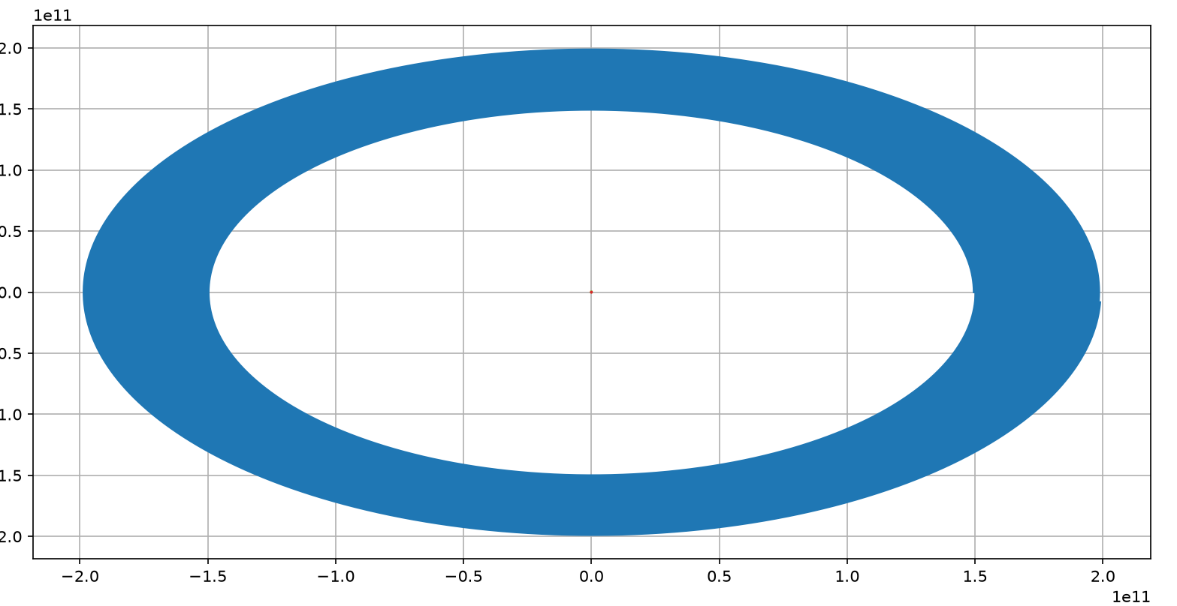
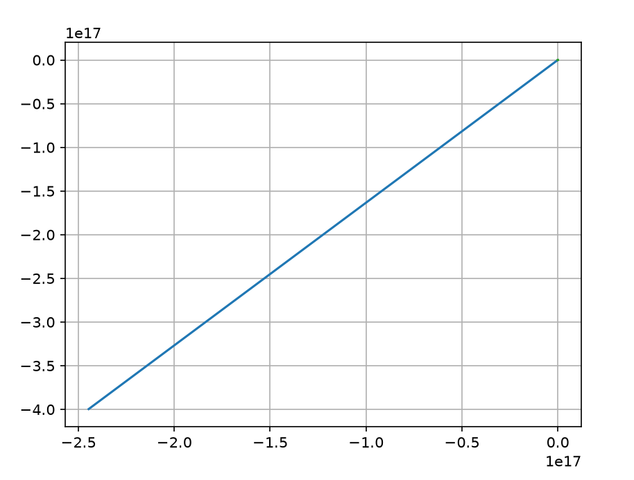
Even though our latest code doesn’t have these problems, we have encountered several bugs and logical errors in many parts of the code. These bugs and errors were many caused by complex naming and un-updated variables. They ended up creating empty and faulty graphs.
Bugs and errors

Slide 14
Special thanks to:
Our mentors Dr. Dagne, Getsh and Bruh
Family and friends who supported us through this journey
And our audience for listening to our presentation.

