Slide 1
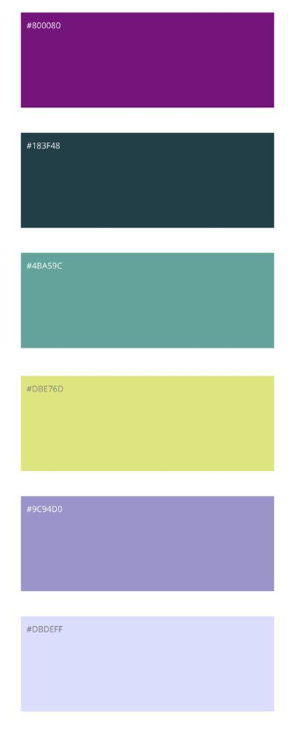




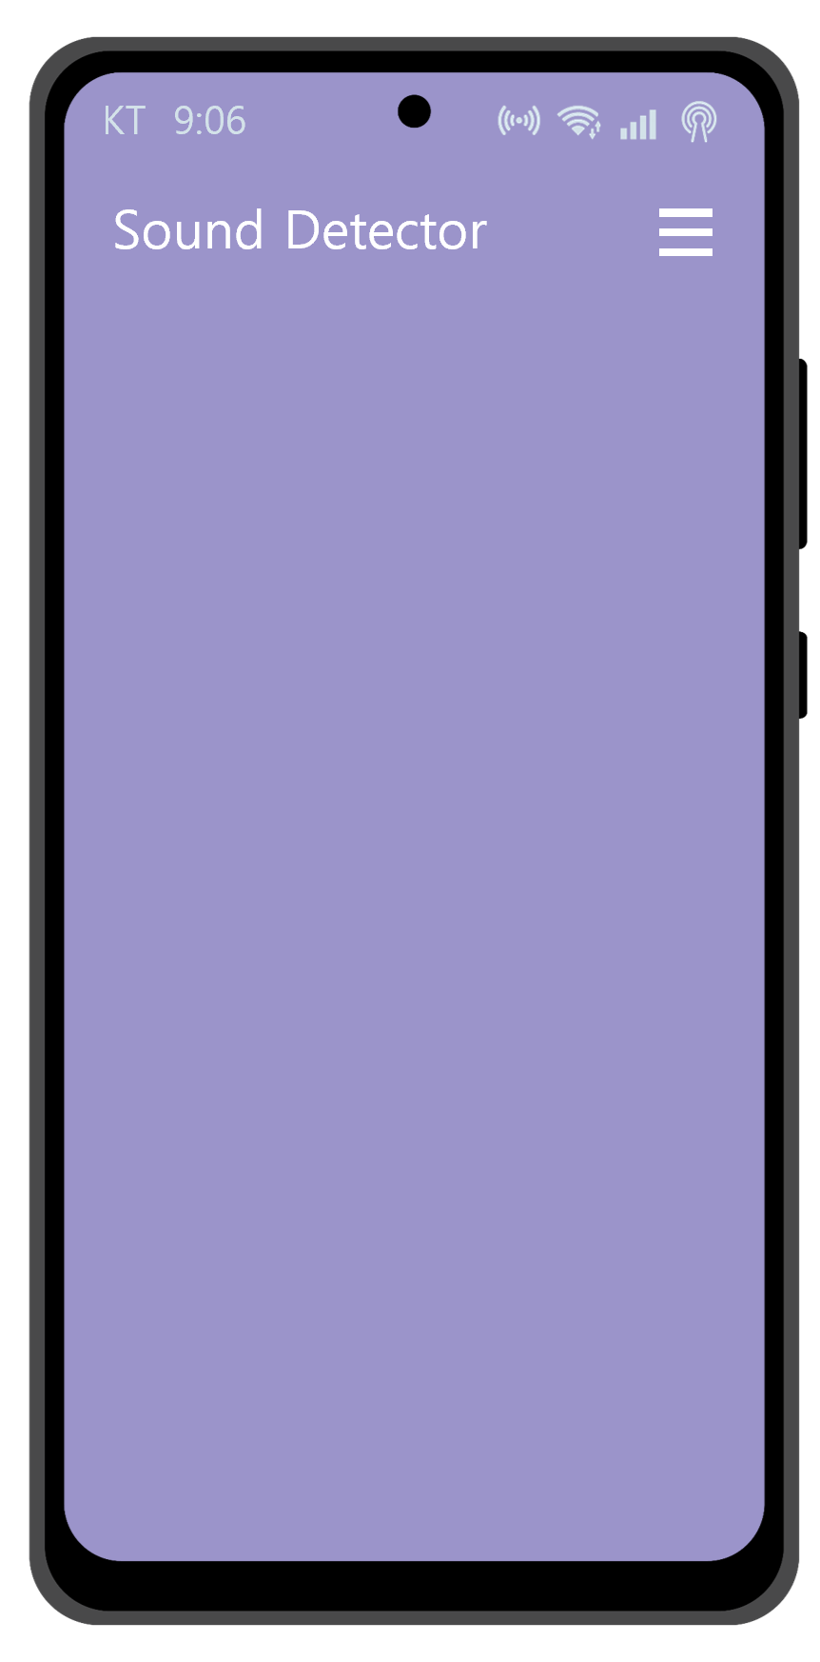
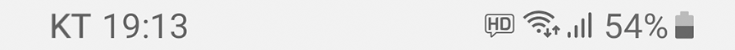
https://fonts.google.com/icons

Slide 2
Setting
History
Setting
Setting
Setting
Notification setting
Sound, Vibration
Sound
Car horn
Select detection
Dog bark
Sound, Vibration
Siren
Vibration
Car horn
94%
Siren
2%
Car horn
94%
Siren
2%
Dog bark
1%
None
3%
Dog bark
1%
None
3%
Start
Start
Save
Save

Slide 3
History
History
Car horn
2023.09.11 17:35
Car horn – 75%
2023.12.45 17:35
Car horn – 75%
2023.12.45 17:35
Car horn – 75%
2023.12.45 17:35
Car horn – 75%
Car horn
94%
Siren
2%
2023.12.45 17:35
Dog bark
1%
None
3%
Car horn – 75%
Play
2023.12.45 17:35
Is this detection useful?
Yes
No

Slide 4
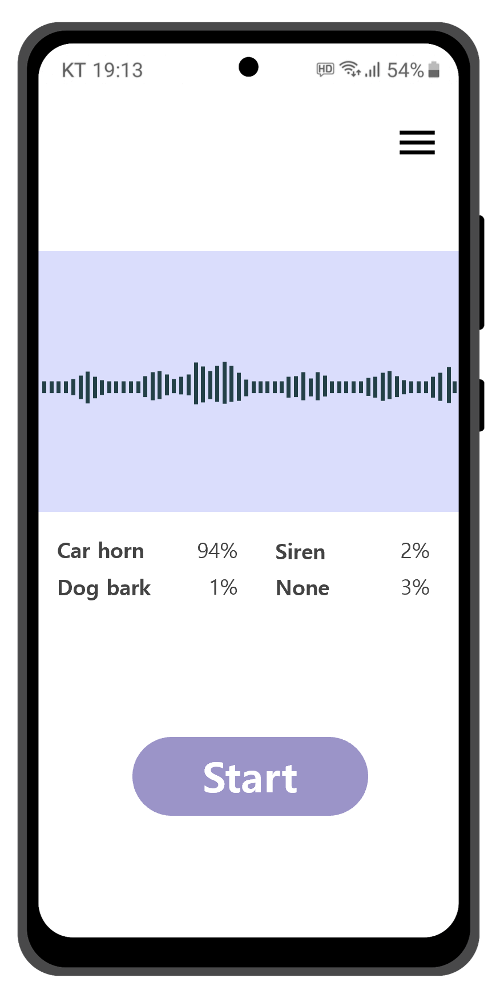
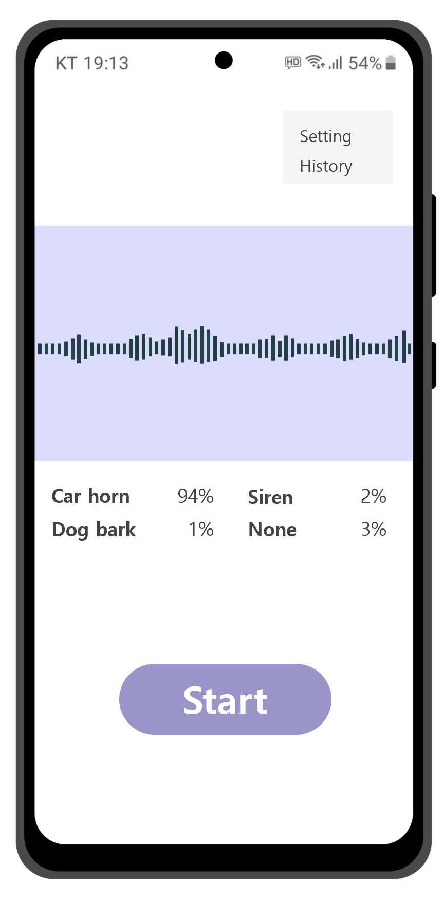
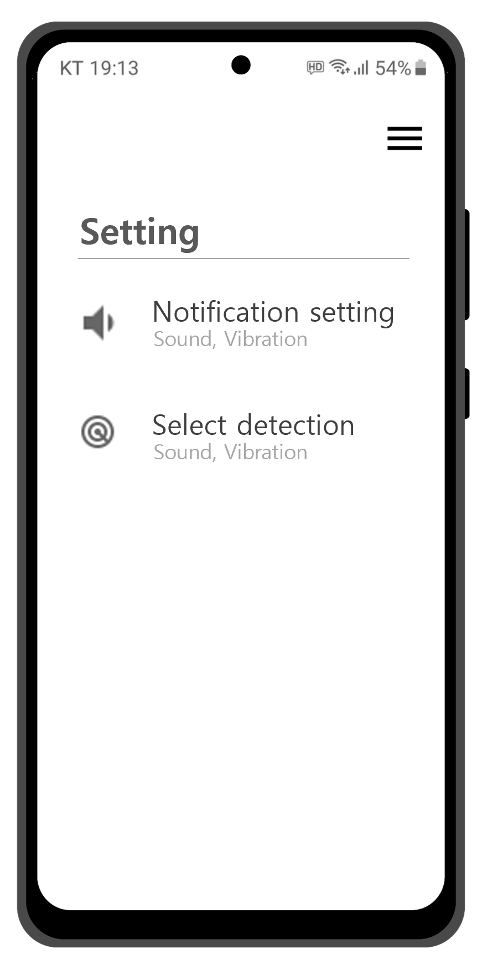
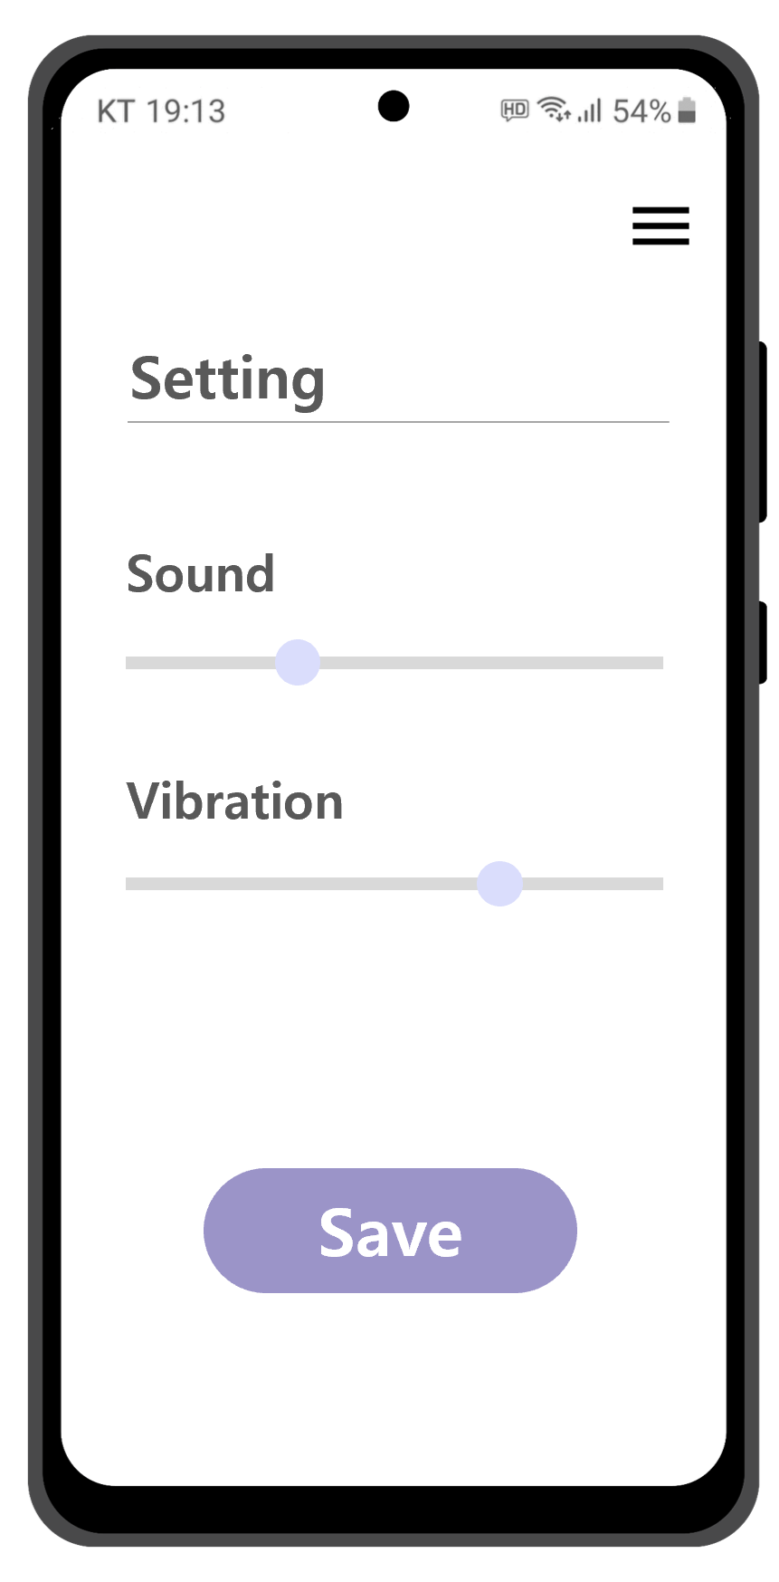

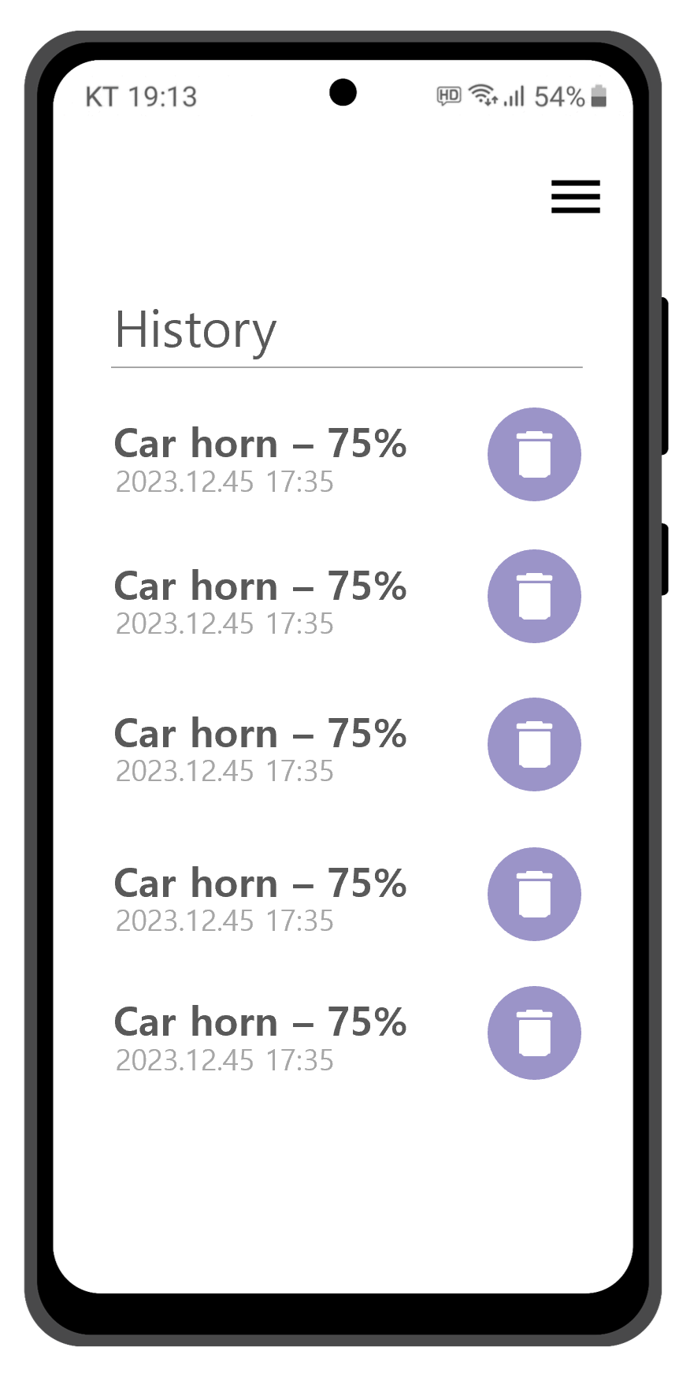
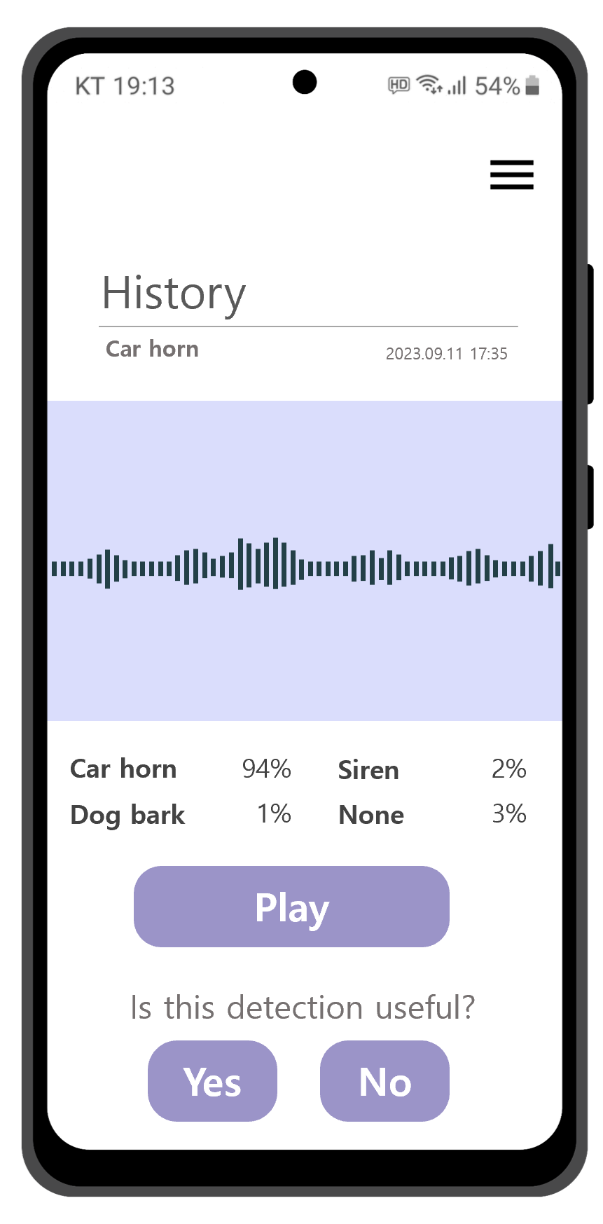
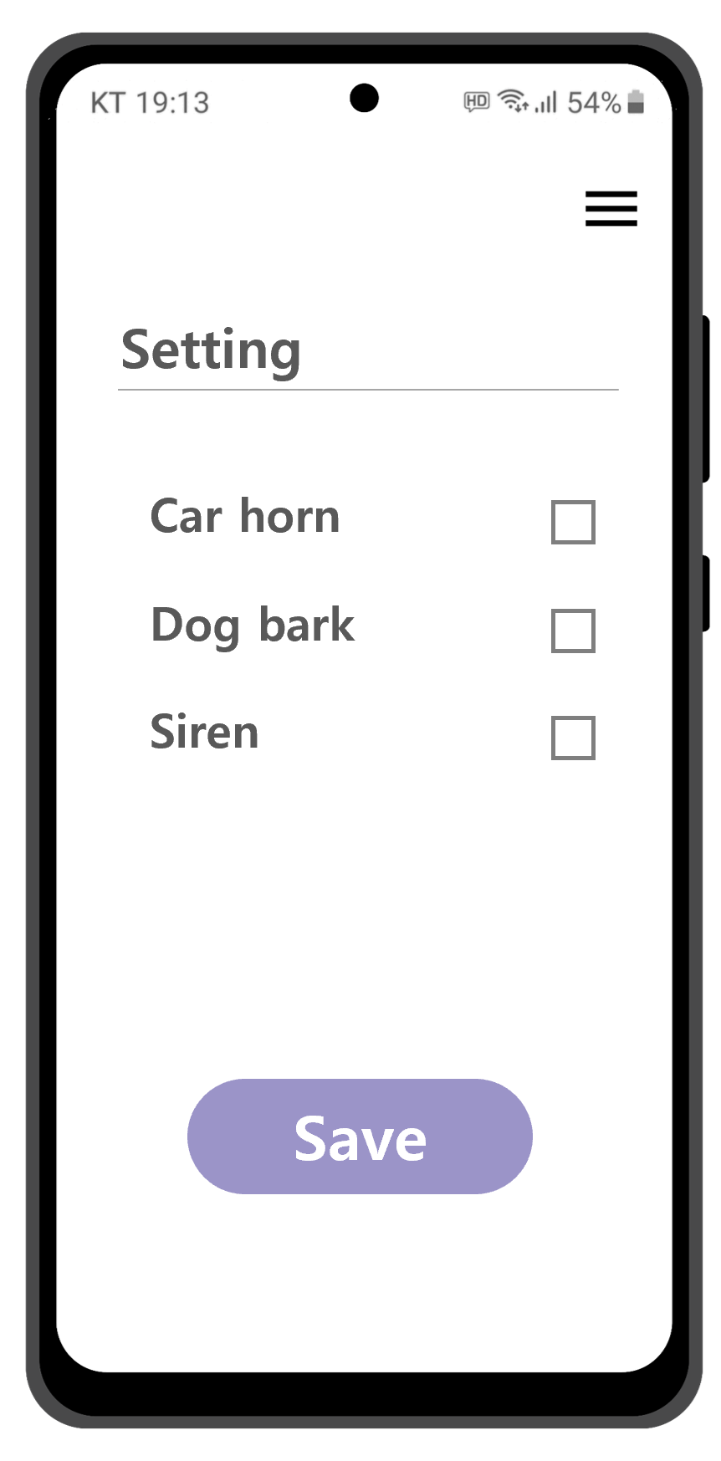
main
setting
Setting_noti
Setting_dect
history_idx
history_view

