Slide 1
DATABASE LAB
PROJECT

Slide 2
MEMBERS
SHOPIFY
01
TRẦN THỊ HẰNG - 20176748 - 37%
02
DƯƠNG THỊ HUÊ - 20176772 - 37%
03
CAO QUỐC KHÁNH - 20176794 - 10%
04
QUYỀN QUANG HUY - 20176783 - 16%

Slide 3
01
QUICK INTRODUCTION
03
FRAMEWORK
SHOPIFY
INTERNET SHOPPING
02
E-R DIAGRAM
04
DEMO

Slide 4
QUICK INTRODUCTION
SHOPIFY
INTERNET SHOPPING

Slide 5
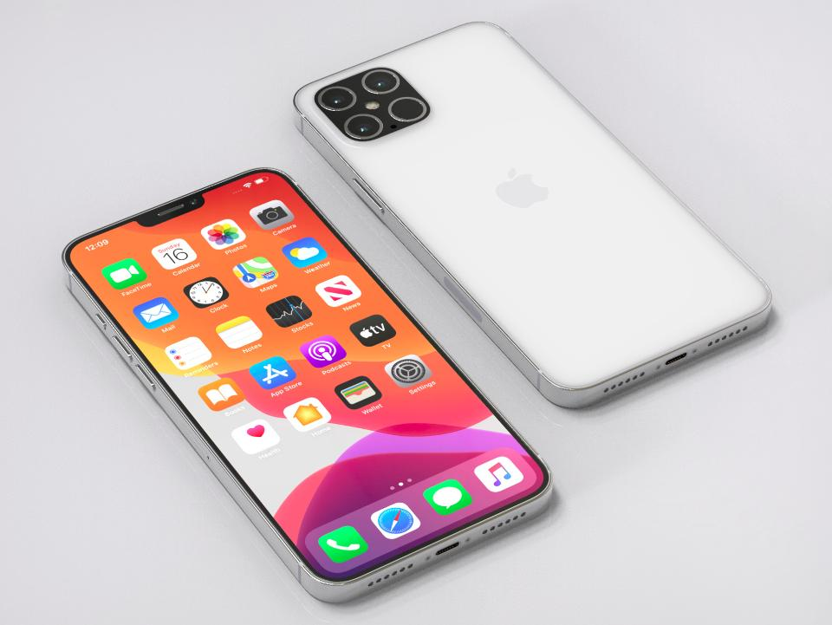
QUICK INTRODUCTION
WEB FOR CLIENTS
Customers can buy smartphones in the store via this website.
WEB FOR ADMIN
Admin access this website to control database of store such as the quantity of phones imported and exported day by day, … It helps admin have statistics about the store.

Slide 6
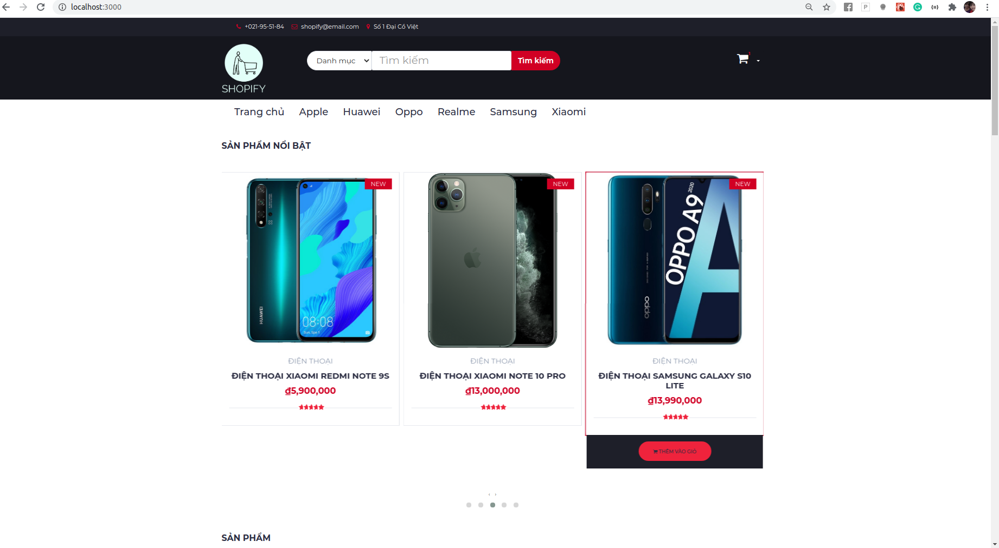
Webpage for customers
Content Here
You can simply impress your audience and add a unique zing and appeal to your Presentations.
Content Here
You can simply impress your audience and add a unique zing and appeal to your Presentations.
Homepage

Slide 7
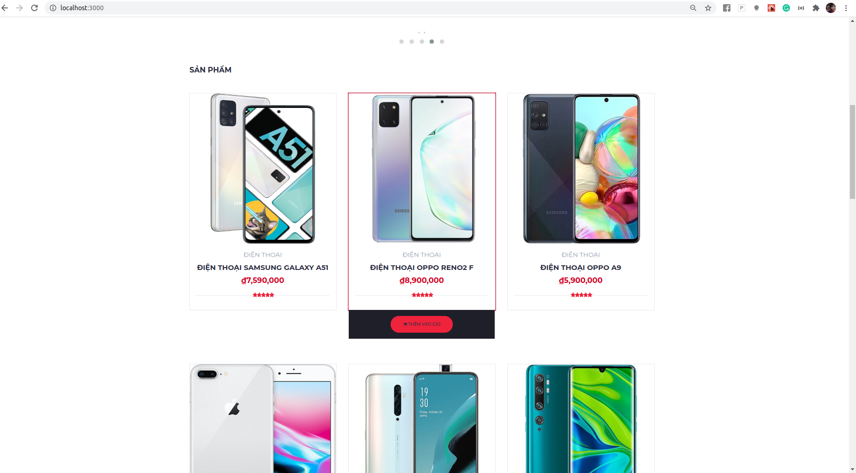
Webpage for customers
Content Here
You can simply impress your audience and add a unique zing and appeal to your Presentations.
Content Here
You can simply impress your audience and add a unique zing and appeal to your Presentations.
Homepage

Slide 8
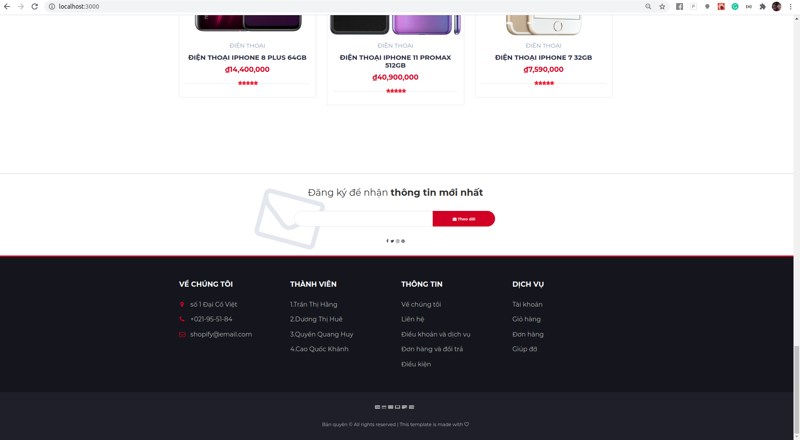
Webpage for customers
Content Here
You can simply impress your audience and add a unique zing and appeal to your Presentations.
Content Here
You can simply impress your audience and add a unique zing and appeal to your Presentations.
Footer

Slide 9
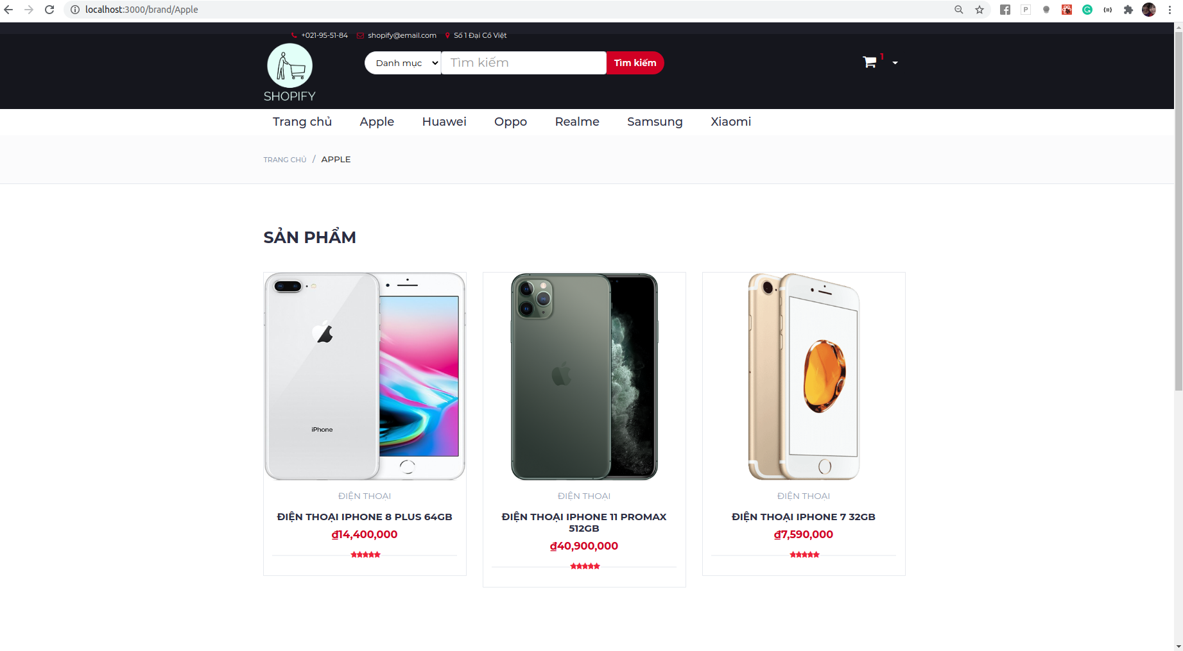
Webpage for customers
Content Here
You can simply impress your audience and add a unique zing and appeal to your Presentations.
Content Here
You can simply impress your audience and add a unique zing and appeal to your Presentations.
Show products by brand

Slide 10
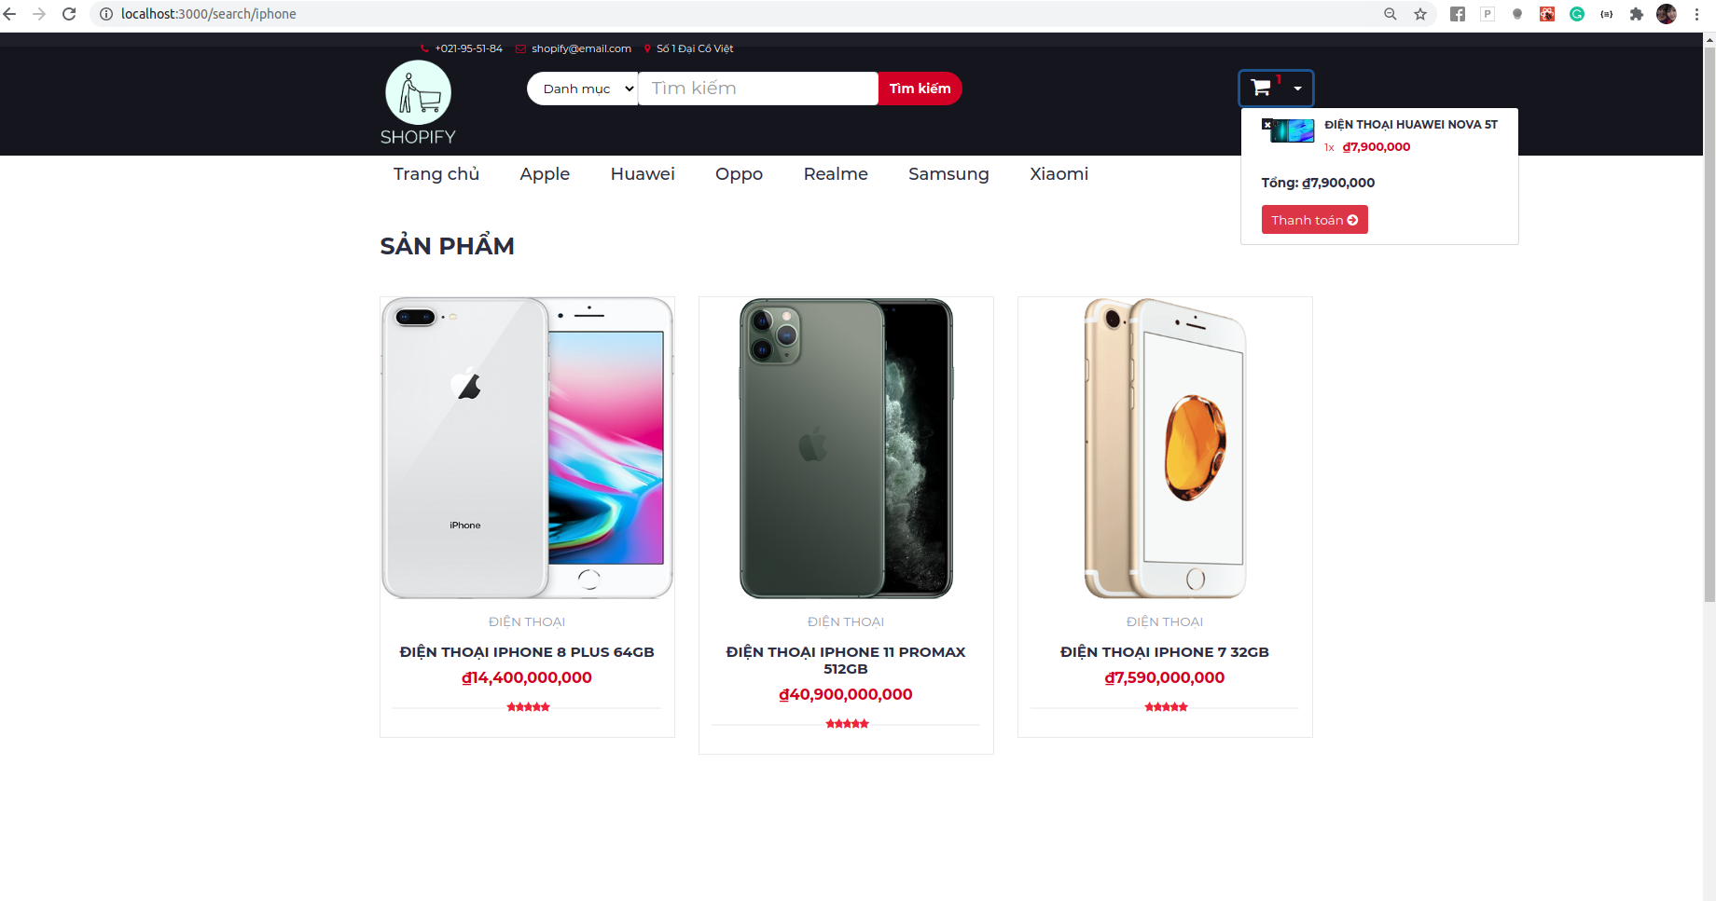
Webpage for customers
Content Here
You can simply impress your audience and add a unique zing and appeal to your Presentations.
Content Here
You can simply impress your audience and add a unique zing and appeal to your Presentations.
Add product to cart

Slide 11
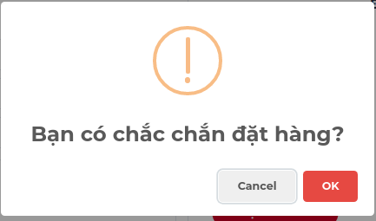
Webpage for customers
Content Here
You can simply impress your audience and add a unique zing and appeal to your Presentations.
Content Here
You can simply impress your audience and add a unique zing and appeal to your Presentations.
Block Alert

Slide 12
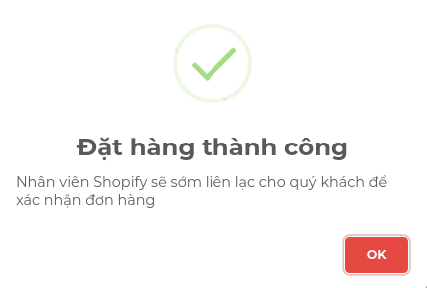
Webpage for customers
Content Here
You can simply impress your audience and add a unique zing and appeal to your Presentations.
Content Here
You can simply impress your audience and add a unique zing and appeal to your Presentations.
Block Alert

Slide 13
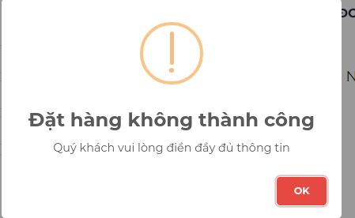
Webpage for customers
Content Here
You can simply impress your audience and add a unique zing and appeal to your Presentations.
Content Here
You can simply impress your audience and add a unique zing and appeal to your Presentations.
Block Alert

Slide 14
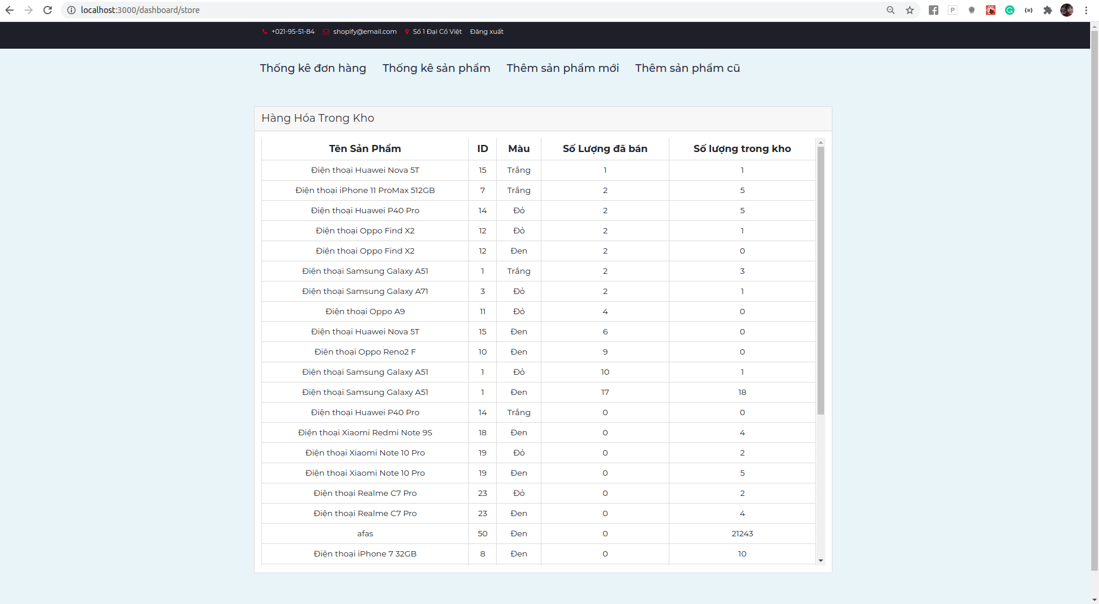
Webpage for admin
Content Here
You can simply impress your audience and add a unique zing and appeal to your Presentations.
Content Here
You can simply impress your audience and add a unique zing and appeal to your Presentations.
Information of products

Slide 15
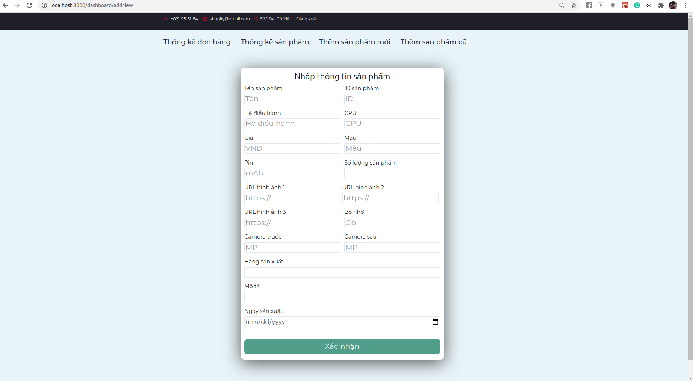
Webpage for admin
Content Here
You can simply impress your audience and add a unique zing and appeal to your Presentations.
Content Here
You can simply impress your audience and add a unique zing and appeal to your Presentations.
Add new product

Slide 16
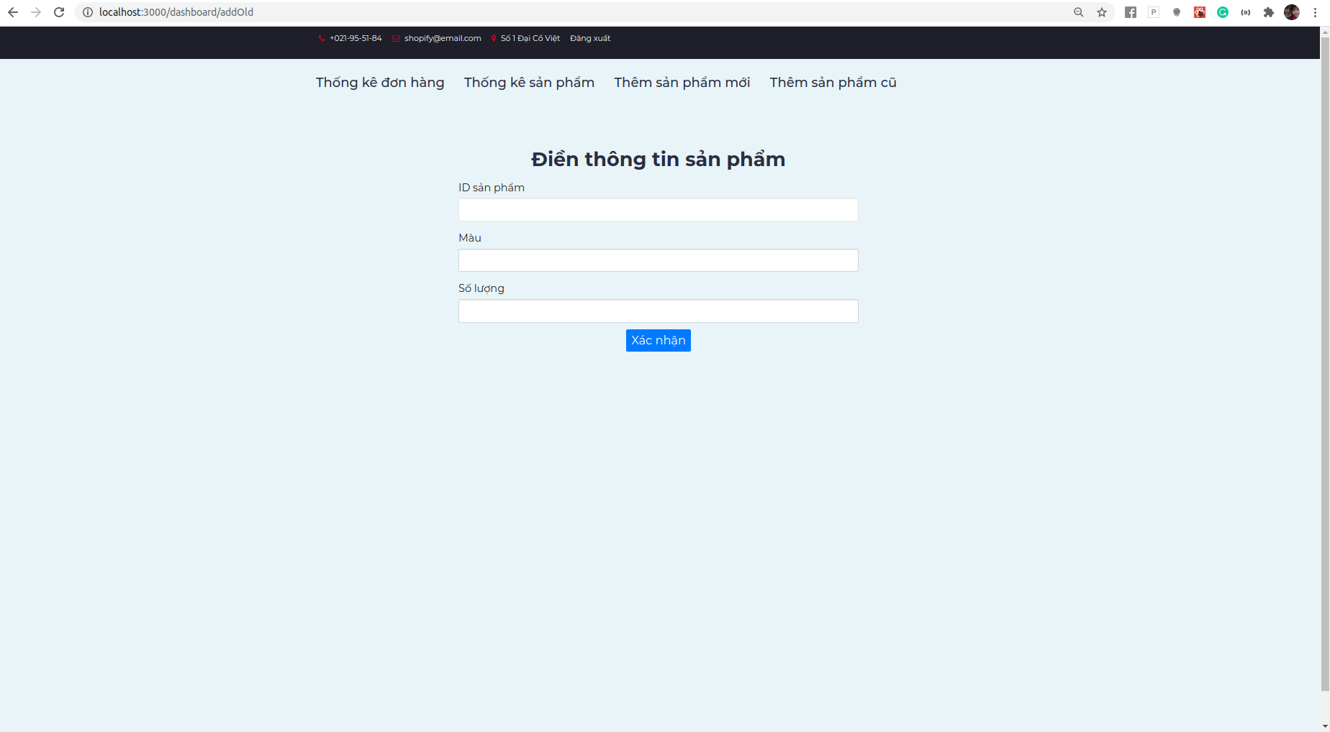
Webpage for admin
Content Here
You can simply impress your audience and add a unique zing and appeal to your Presentations.
Content Here
You can simply impress your audience and add a unique zing and appeal to your Presentations.
Add old product (quantity)

Slide 17
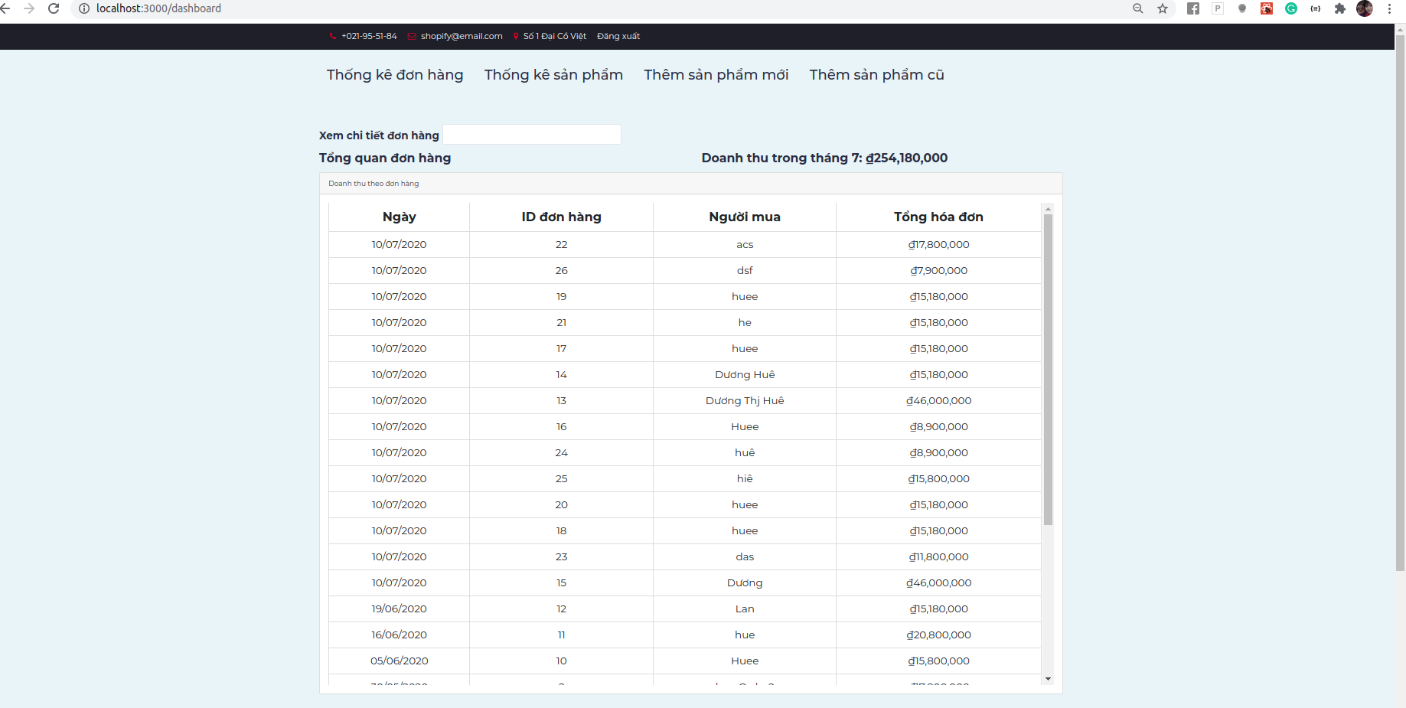
Webpage for admin
Content Here
You can simply impress your audience and add a unique zing and appeal to your Presentations.
Content Here
You can simply impress your audience and add a unique zing and appeal to your Presentations.
Orders

Slide 18

Webpage for admin
Content Here
You can simply impress your audience and add a unique zing and appeal to your Presentations.
Content Here
You can simply impress your audience and add a unique zing and appeal to your Presentations.
Orders graph

Slide 19
ER DIAGRAM
SHOPIFY
INTERNET SHOPPING

Slide 20
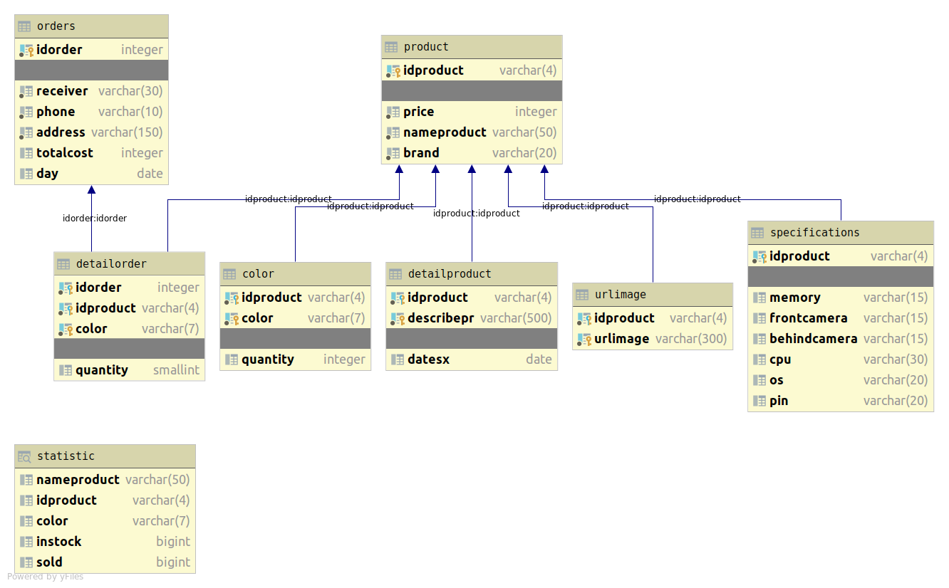
ER
DIAGRAM

Slide 21
FRAMEWORK
SHOPIFY
INTERNET SHOPPING

Slide 22

FRONT END
React JS

Slide 23
FRONT END
JSX
Components
Rendering
Easy to use, easy to learn

Slide 24

BACK END
Node JS

Slide 25
BACK END
React JS
Ideal for real-time web
Highly scalable
Allows smooth sync

Slide 26

DATABASE
PostgreSQL

Slide 27
DATABASE
Support Node JS
Open source DBMS
Reliability and stability
Strong support

Slide 28
DEMO
SHOPIFY
INTERNET SHOPPING

Slide 29
THANK YOU

