Slide 1
Bank Loan Performance Dashboard
DATA ANALYST PORTFOLIO PROJECT
SQL Server | Power BI
Presented by Harsh Jairam Yadav
Notes:
Good morning. I will walk you through the Bank Loan Performance Dashboard I built in Power BI on SQL Server data. It covers 38,576 loans issued in 2021. I will start with how a bank makes and loses money on loans, then show the findings, each dashboard page, and the decisions the numbers support.

Slide 2
Business context: how a bank makes and loses money on loans
1. Lend
2. Collect
3. Lose on defaults
The bank funds the loan to the borrower.
›
Borrower repays the loan plus interest over time.
›
Some borrowers stop paying and the loan is Charged Off.
Dashboard: Funded Amount
Dashboard: Amount Received
Dashboard: Bad Loan %
Profit = amount received − funded amount. Risk = loans that are Charged Off.
Summary: how is the loan book performing?
Overview: who borrows, why, and where?
Details: which individual loans sit behind the numbers?
Notes:
Start with real life. A bank lends money, that is the funded amount. Borrowers pay it back with interest, that is the amount received. The bank earns when received is higher than funded. The bank loses when a borrower stops paying and the loan is charged off. Every KPI on this dashboard maps to one of these three steps, and the three pages answer: how are we doing, who and where do we lend, and which loans sit behind the numbers.

Slide 3
Executive summary: a growing book with 86% healthy loans
38.6K
$435.8M
$473.1M
86.2%
Loan applications
Funded amount
Received (+$37.3M over funded)
Good loans
Growth: Monthly applications nearly doubled (2.3K in January to 4.3K in December); December funding rose 13.0% on November.
Risk: 13.8% of loans are Charged Off. They returned only $0.57 per $1 lent and carry a higher rate and DTI than fully paid loans.
Action: Monitor the 1,098 Current loans (highest rate, 15.1%, and DTI, 14.7%) and screen high-DTI, high-rate borrowers.
Notes:
Start with the answer. The book is growing, most loans are healthy, but the bad loans are expensive and need attention. Total received exceeds total funded by $37.3M. Growth: applications nearly doubled across the year. Risk: charged-off loans returned only 57 cents per dollar and carry higher rate and DTI. Action: watch the Current loans and screen high-DTI, high-rate borrowers.

Slide 4
Method: SQL for the logic, Power BI for the insight
Source data
Definitions
1
bank_loan_data: 38,576 loans issued Jan to Dec 2021 (status, grade, DTI, term, purpose, state).
MTD: December 2021
PMTD: November 2021
MoM: (MTD − PMTD) ÷ PMTD
Good loan: Fully Paid or Current
Bad loan: Charged Off
SQL (SQL Server)
2
Aggregations for every KPI with MTD and PMTD filters, used as the reference answer.
Power BI model
3
Connected to SQL Server, cleaned the data and added a date table for MTD and MoM.
SELECT loan_status,
COUNT(id) AS LoanCount,
SUM(loan_amount) AS Funded,
SUM(total_payment) AS Received,
AVG(int_rate*100) AS Rate
FROM bank_loan_data
GROUP BY loan_status;
Dashboard and validation
4
Three pages with slicers; totals reconciled with the SQL output.
Notes:
Explain the pipeline in four steps. Data came from the bank_loan_data table. I wrote SQL for every KPI so each number has a reference answer. Power BI connects to SQL Server, with a date table for time intelligence. Then I built the three pages and reconciled the totals with the SQL output. On the right are the definitions, which matter for reading every number correctly.

Slide 5
December scorecard: bigger loans, higher cost, more cash back
KPI | Total | MTD (Dec) | MoM | Analyst read-out
Loan applications | 38.6K | 4.3K | +6.9% | More borrowers entering the funnel each month
Funded amount | $435.8M | $54.0M | +13.0% | Grows faster than applications: average loan about $12.5K vs $11.3K overall
Amount received | $473.1M | $58.1M | +15.8% | December cash received ($58.1M) exceeded loans funded ($54.0M)
Avg interest rate | 12.0% | 12.4% | +3.5% | New lending is priced above the book average
Avg DTI | 13.3% | 13.7% | +2.7% | Borrowers carry slightly more debt relative to income: a trend to watch
MTD = December 2021. MoM = % change versus November. Rate and DTI are averages across loans.
Notes:
These five KPIs sit on top of every page. Read the table as total, December, and change versus November. Funded amount grew 13.0% while applications grew 6.9%, so the average loan got bigger: about $12.5K in December against $11.3K overall. Cash received in December, $58.1M, exceeded funding of $54.0M. Interest rate and DTI both edged up, which is the trend to watch.

Slide 6
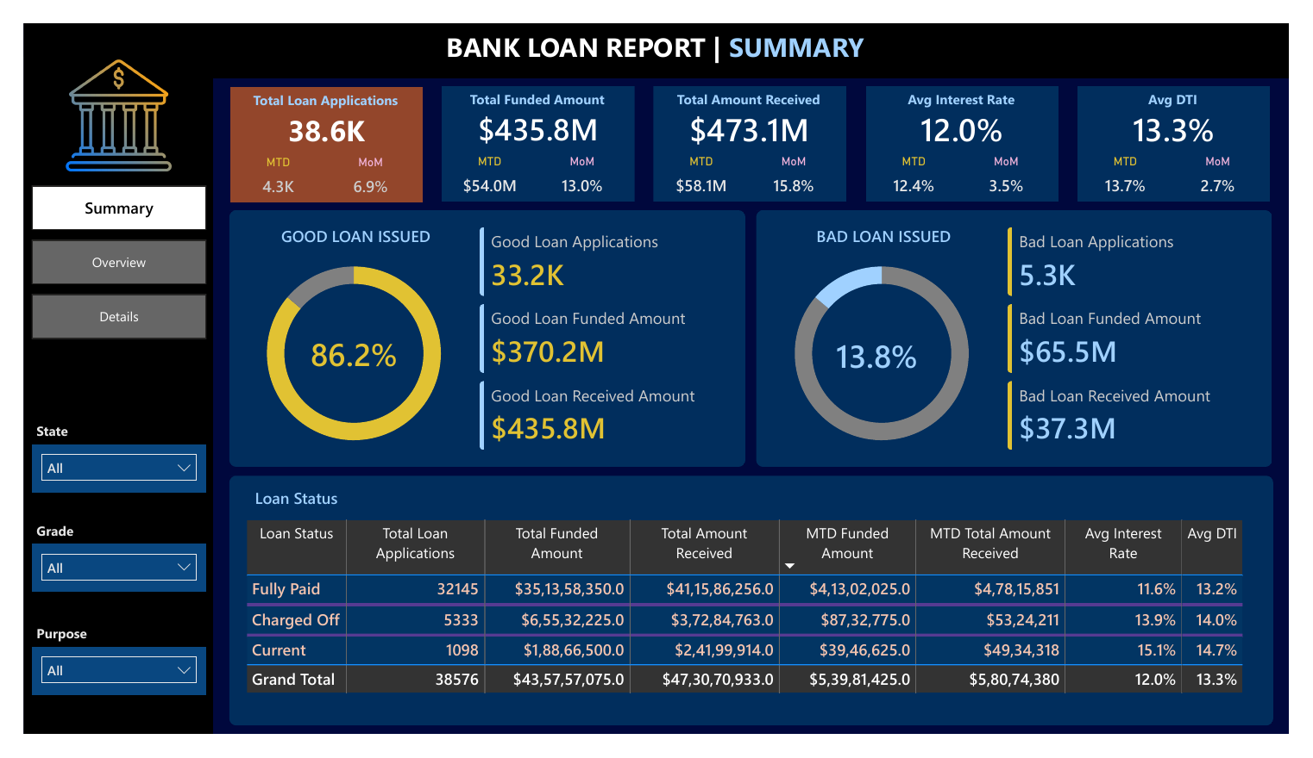
Summary page: portfolio health at a glance
KPI strip
Volume, money lent, money repaid, rate and DTI, each with MTD and MoM.
Good vs bad rings
Good: 33.2K loans, $370.2M funded. Bad: 5.3K loans, $65.5M funded.
Loan status grid
Fully Paid 32,145. Charged Off 5,333. Current 1,098. Rate: 11.6%, 13.9%, 15.1%.
Notes:
Show the Summary page. The KPI strip is on top. The two rings split the book into good loans, 86.2%, and bad loans, 13.8%. The grid at the bottom breaks the book by loan status. Notice the rate rises from 11.6 for Fully Paid, to 13.9 for Charged Off, to 15.1 for Current. The State, Grade and Purpose slicers filter the whole page.

Slide 7
Charged-off loans cancel out 43% of the surplus from good loans
Measure | Good loans | Bad loans
Share of loans | 86.2% | 13.8%
Applications | 33.2K | 5.3K
Funded amount | $370.2M | $65.5M
Amount received | $435.8M | $37.3M
Net cash result | +$65.6M | −$28.2M
Back per $1 lent | $1.18 | $0.57
Net cash result = amount received − funded. Current loans are still repaying, so their figure is partial.
Bad loans lost $28.2M. A higher rate on charged-off loans (13.9% vs 11.6%) did not make up for the defaults.
Notes:
This is the key risk slide. Good loans received $435.8M on $370.2M funded, a surplus of $65.6M. Bad loans received $37.3M on $65.5M funded, a shortfall of $28.2M. That shortfall cancels out about 43 percent of the good-loan surplus. The chart shows charged-off loans carry a higher rate and DTI than fully paid loans, and that the Current loans are highest on both. Note Current loans are still repaying, so their received amount is partial.

Slide 8
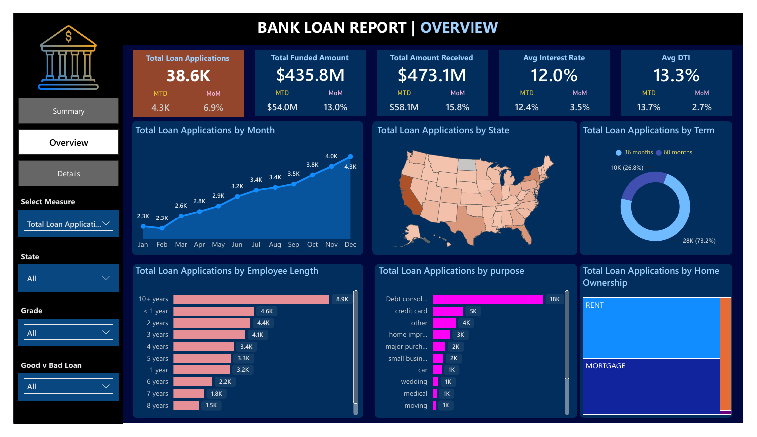
Overview page: who borrows, why, and where
Trend
Applications rise in every month after February: 2.3K to 4.3K.
Mix
36-month loans: 73.2% (28K). Debt consolidation: 18K, about 47%.
Filters
Select Measure switches charts between applications, funded and received. Slicers: State, Grade, Good vs Bad.
Notes:
Show the Overview page. Applications rise in every month after February, from 2.3K to 4.3K. The donut shows 73.2 percent of loans are 36-month loans. Debt consolidation leads with 18K applications, about 47 percent of the total. The Select Measure slicer switches every chart between applications, funded amount and amount received, so the same page answers three questions.

Slide 9
Borrowing demand is concentrated in a few mainstream segments
Chart | Finding | Business implication
Month (line) | Applications nearly doubled, 2.3K to 4.3K | Demand is rising, so risk monitoring must scale with volume
State (map) | California is the darkest state, the biggest market | Track regional concentration of exposure
Term (donut) | 36 months 73.2% (28K); 60 months 26.8% (10K) | Mostly shorter loans, which limits long-duration risk
Employee length (bar) | 10+ years largest (8.9K); under 1 year next (4.6K) | Stable borrowers lead, but newer-job borrowers are a large group
Purpose (bar) | Debt consolidation 18K (about 47%); credit card 5K | Many customers refinance existing debt: watch repayment capacity
Home ownership (tree map) | Rent and Mortgage are the two largest blocks | Few outright owners, so collateral and stability vary
Notes:
Read row by row: the chart, the finding, then the implication. Volume is rising, so risk monitoring has to scale with it. California is the largest state market, so regional exposure needs tracking. Most loans are 36 months, which limits long-duration risk. Nearly half of loans are for debt consolidation, meaning customers are refinancing existing debt. Renters and mortgage holders dominate.

Slide 10
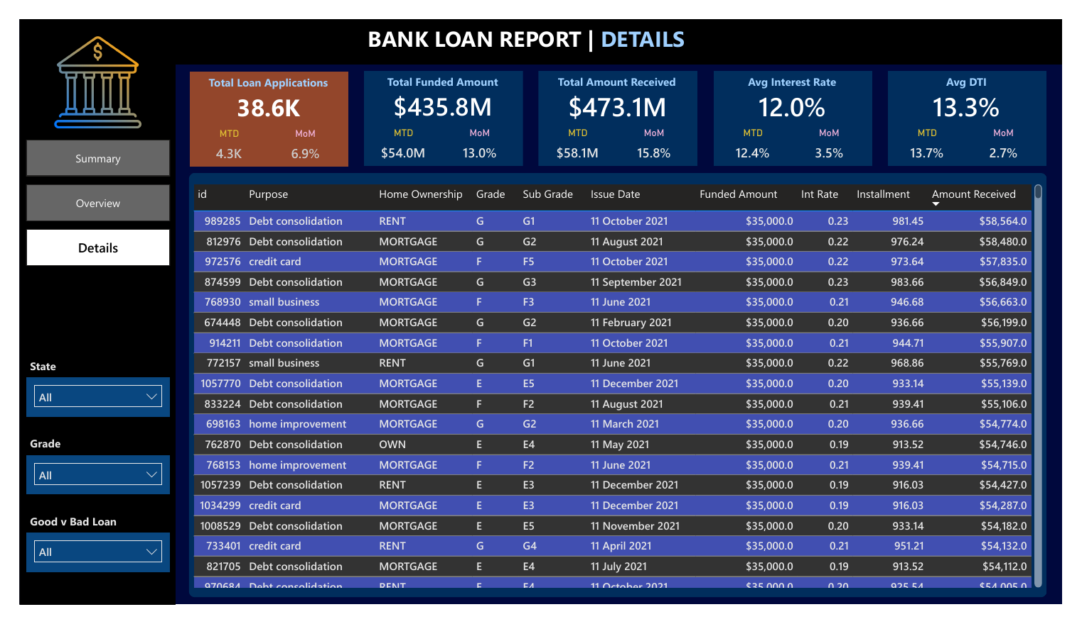
Details page: the loan-level audit trail behind every KPI
Purpose
Audit trail: trace any KPI to individual loans by id, grade, rate and amount received.
How to use
Sorted by amount received. Slice by State, Grade and Good vs Bad loan.
What stands out
Top earners are $35,000 loans in grades E to G at 19% to 23%, returning $54K to $58.6K: high reward, high risk.
Notes:
The Details page is the audit trail. Any KPI can be traced to individual loans by id, purpose, grade, sub grade, issue date, rate, instalment and amount received. It is sorted by amount received. The top rows are all 35,000 dollar loans in grades E to G at 19 to 23 percent, returning 54 to 58 thousand dollars. That is high reward, but these are also the riskiest grades.

Slide 11
Recommendations: monitor, screen and grow selectively
What the dashboard shows | Why it matters in real life | Recommended action | Priority
1,098 Current loans have the highest rate (15.1%) and DTI (14.7%) | Outcome is not known yet, and a heavy debt load makes late payment more likely | Track their repayments monthly and flag early misses | High
Charged-off loans: DTI 14.0% vs 13.2%, rate 13.9% vs 11.6% (fully paid) | In this data, defaulted borrowers carried more debt and costlier loans | Add DTI and rate checks to approval rules | High
Bad loans lost $28.2M, 43% of the good-loan surplus | Defaults wipe out profit earned on healthy loans | Track the Charged Off share (13.8%) every month | High
Demand centres on debt consolidation, 36-month terms and California | Proven demand lowers the cost of winning customers | Focus campaigns there, with exposure limits per state | Medium
Limits and next step: one year of data; 'good' includes Current loans that may still default. Next, add default rate by grade and state.
Notes:
Close with decisions, and explain the real-life logic for each. Current loans have the highest rate and DTI and their outcome is not known yet, so track them early. Defaulted borrowers in this data had higher DTI and rates, so add those checks to approvals. Bad loans wiped out 43 percent of the good-loan surplus, so track the Charged Off share monthly. Where demand is proven, focus marketing, but cap exposure per state. Be open about limits: one year of data, and good loans include Current loans that may still default.

Slide 12
Thank you
KEY TAKEAWAYS
Lending is growing and 86.2% of loans are healthy
Bad loans cost $28.2M, so risk screening matters
Monitor Current loans and grow in proven segments
Questions and discussion
Notes:
Repeat the three takeaways in your own words, then invite questions. Useful facts if asked: 38,576 loans, $435.8M funded, $473.1M received, 86.2% good loans, MTD means December 2021, MoM compares December with November.

