Slide 1

Writing Your Own Ray Tracer From Scratch Is Wasting Your Time
Kasimir Rothbauer
Advanced Topics in Computer Graphics

Slide 2
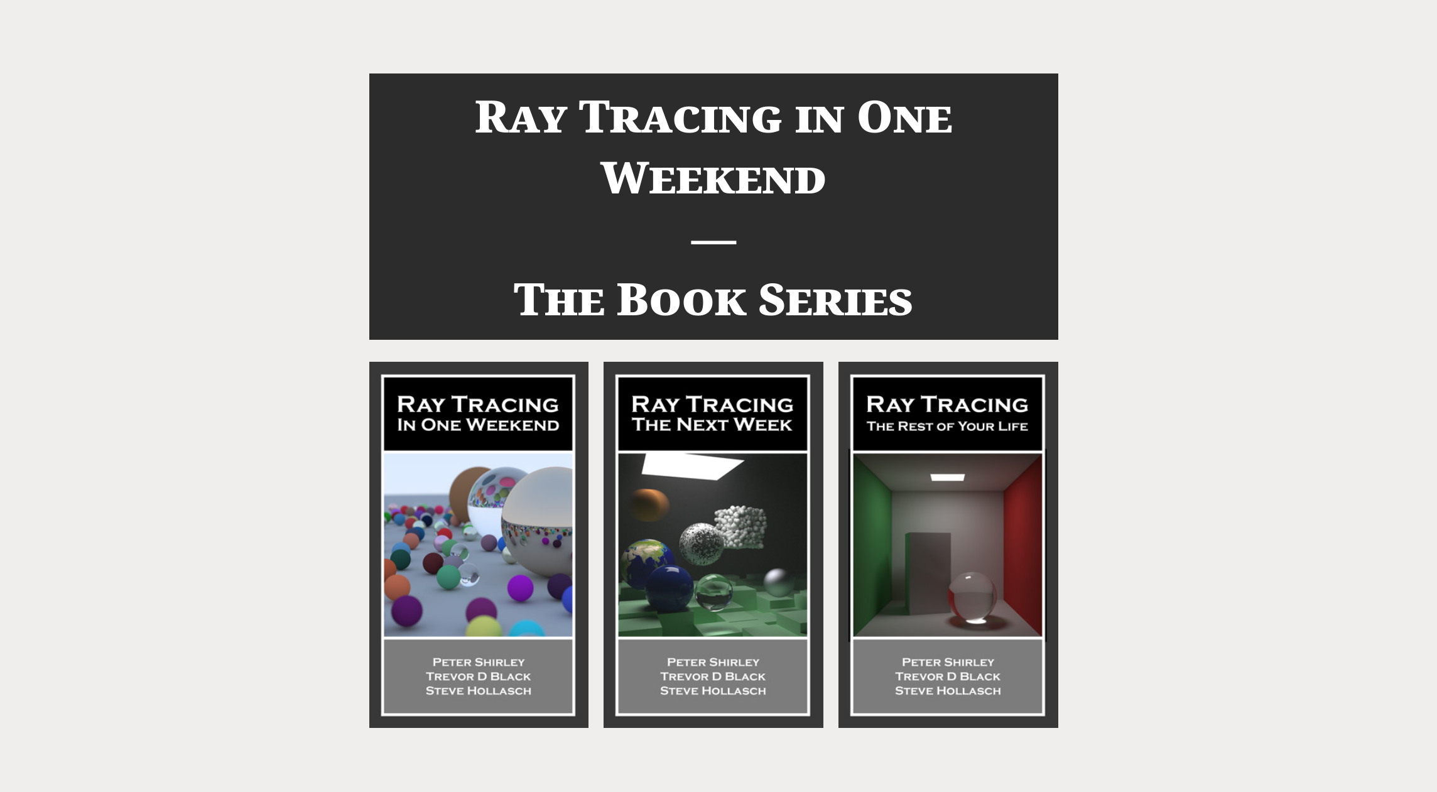

Slide 3
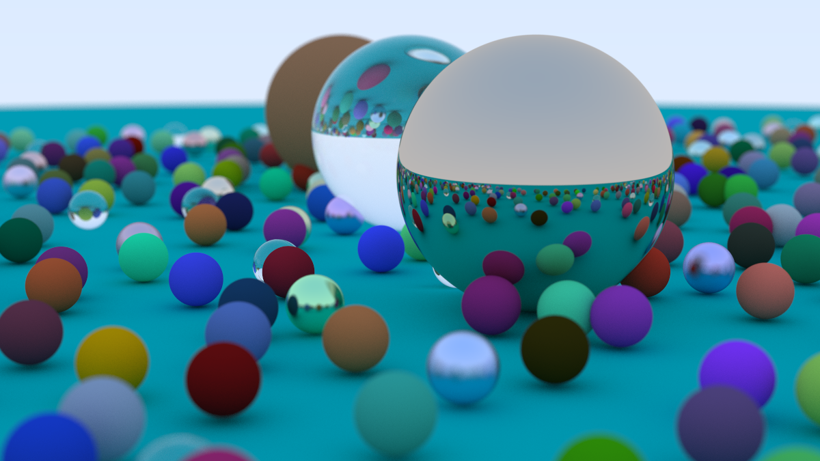

Slide 5
WOW
Kasimir Rothbauer
Writing Your Own Ray Tracer From Scratch Is Wasting Your Time

Slide 6
Roadmap
- Write all in C++
- Get Image
- Get Rays
- Get Colors
- Get Objects
- Profit?
Kasimir Rothbauer
Writing Your Own Ray Tracer From Scratch Is Wasting Your Time

Slide 7
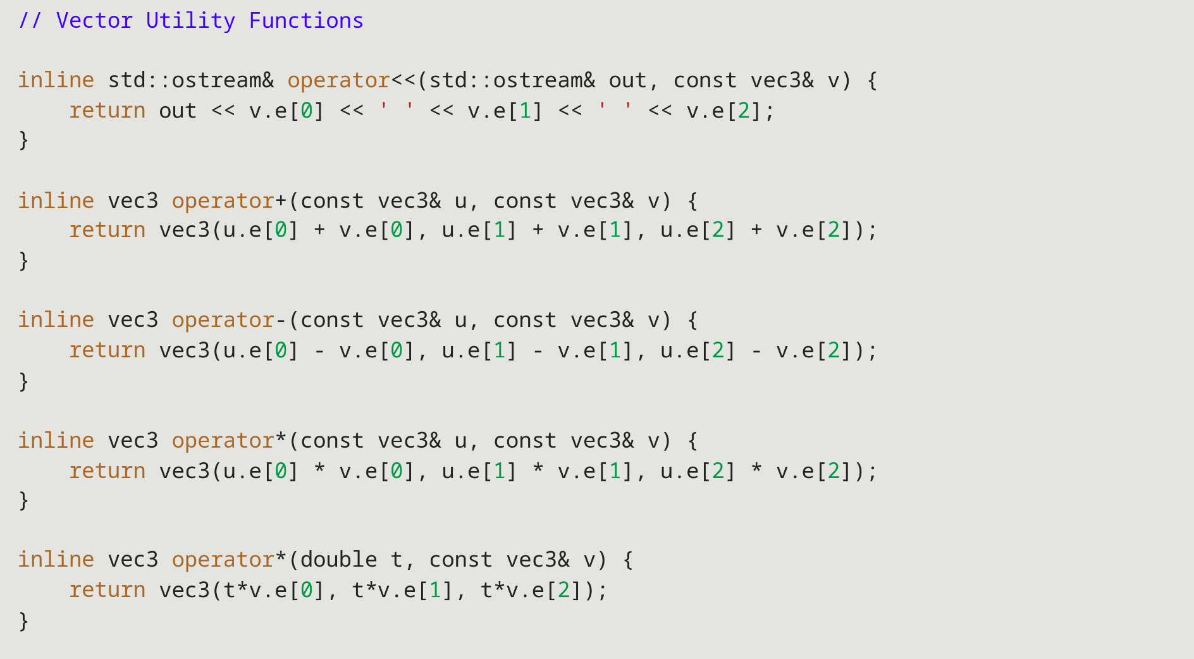
Write C++
Kasimir Rothbauer
Writing Your Own Ray Tracer From Scratch Is Wasting Your Time

Slide 8
Get Image – Image.ppm
P3
2 2
255
255 0 0 0 255 0
0 255 0 255 0 0
- Header
- RGB Values for each pixel
Kasimir Rothbauer
Writing Your Own Ray Tracer From Scratch Is Wasting Your Time

Slide 9
Get Rays – Vectors with Distance
- Shoot Rays Through Viewport
- If Distance Infinity: Return Color of Background
- If Hit: Return Color of Object
Kasimir Rothbauer
Writing Your Own Ray Tracer From Scratch Is Wasting Your Time

Slide 10
Write C++
Kasimir Rothbauer

Slide 11
First Gradien Image
Lerp
Linear Interpolation
Writing Your Own Ray Tracer From Scratch Is Wasting Your Time

Slide 12
Get Object – Spheres
- Create Spheres as Objects
- “Simple” Formula: x² + y² + z² = r²
- On Hit Return Color
Kasimir Rothbauer
Writing Your Own Ray Tracer From Scratch Is Wasting Your Time

Slide 13
Write C++
Kasimir Rothbauer
Writing Your Own Ray Tracer From Scratch Is Wasting Your Time

Slide 14
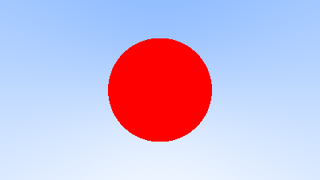
First Sphere(?)
Kasimir Rothbauer
Writing Your Own Ray Tracer From Scratch Is Wasting Your Time

Slide 15
Write C++
Kasimir Rothbauer
Writing Your Own Ray Tracer From Scratch Is Wasting Your Time

Slide 16

Include Surface Normals
Kasimir Rothbauer
Writing Your Own Ray Tracer From Scratch Is Wasting Your Time

Slide 17
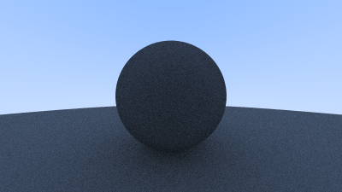
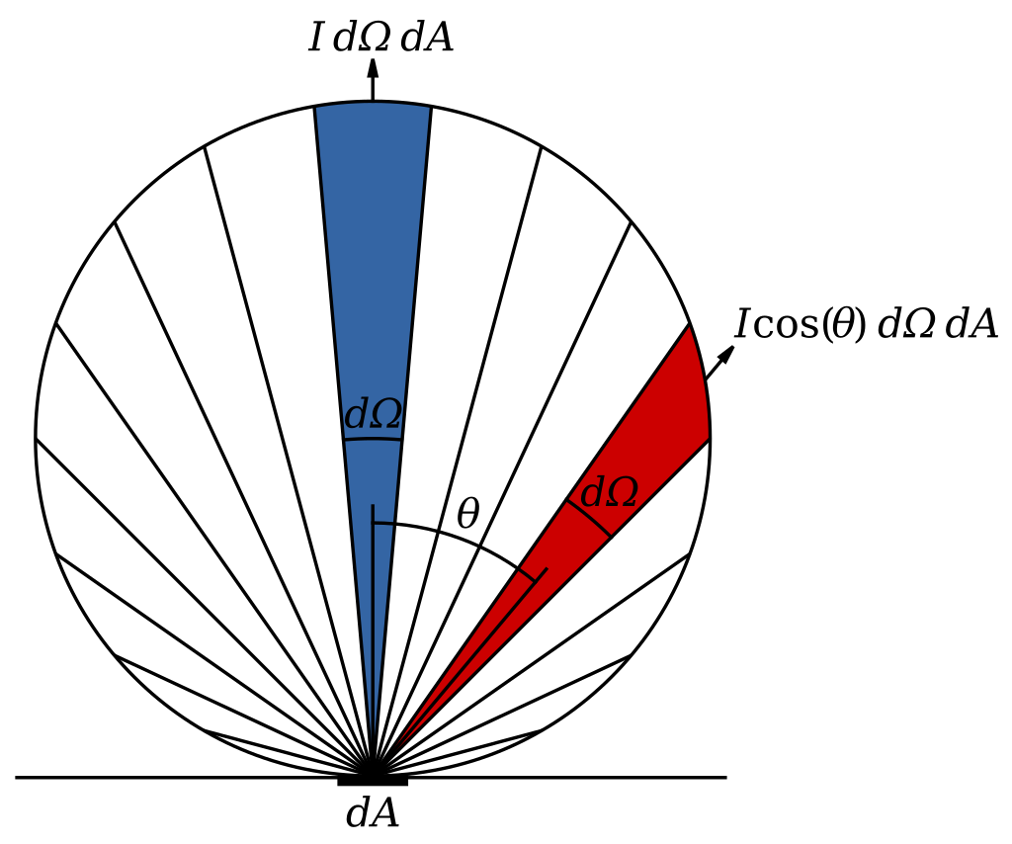
Spheres: Diffuse Materials
- Lambertian Reflection
Kasimir Rothbauer
Writing Your Own Ray Tracer From Scratch Is Wasting Your Time

Slide 18
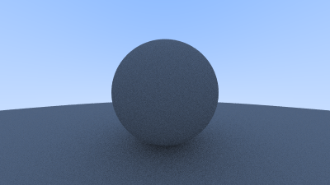
Sphere: Shadow Acne
- Floating Point Errors
- Ray Intersects Inside
Sphere?
- Insert Padding
- 0.000001
Kasimir Rothbauer
Writing Your Own Ray Tracer From Scratch Is Wasting Your Time

Slide 19
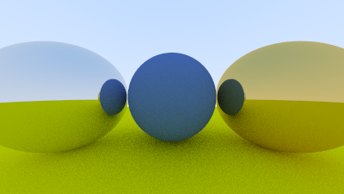
Spheres: Shiny Materials
- Incoming Angle =
Outgoing Angle
Kasimir Rothbauer
Writing Your Own Ray Tracer From Scratch Is Wasting Your Time

Slide 20
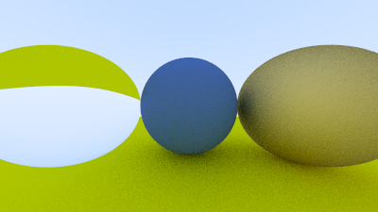

Spheres: Glass Materials
- Snells Law
- Ideal Refraction
Kasimir Rothbauer
Writing Your Own Ray Tracer From Scratch Is Wasting Your Time

Slide 21
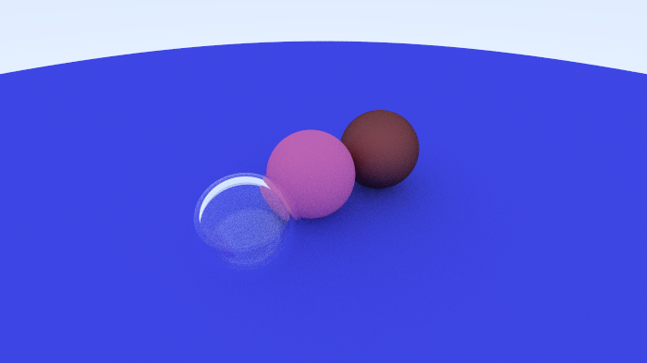
Changing The View
Kasimir Rothbauer
Writing Your Own Ray Tracer From Scratch Is Wasting Your Time

Slide 22
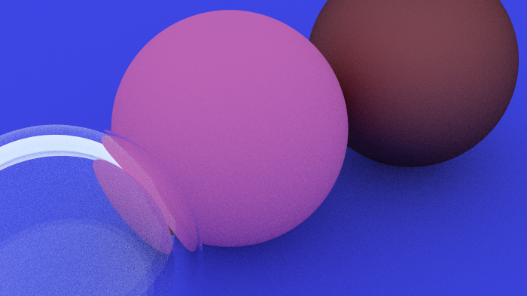
Zooming In
Kasimir Rothbauer
Writing Your Own Ray Tracer From Scratch Is Wasting Your Time

Slide 23
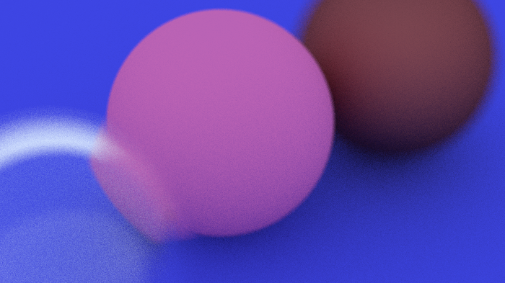
Defocus Blur
- Create Fuzz
- Fuzz by Creating
Random Values
On Unit Sphere
Kasimir Rothbauer
Writing Your Own Ray Tracer From Scratch Is Wasting Your Time

Slide 24
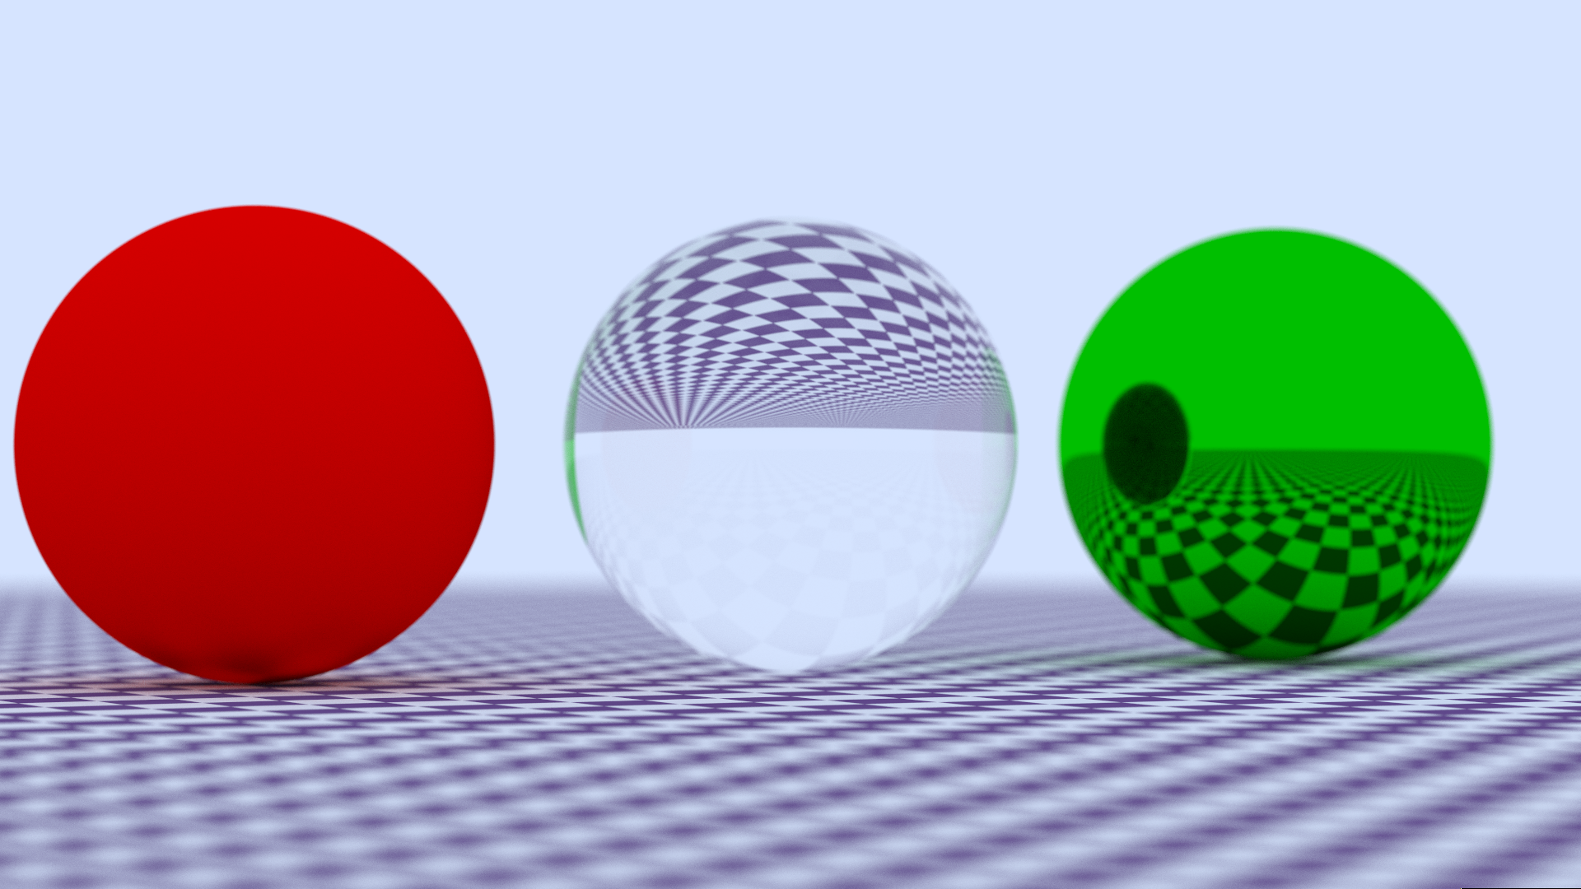
Defocus Blur - Issues
- Create Fuzz
at given Distance
- Glass Behind Sphere
Still Sharp
Kasimir Rothbauer
Writing Your Own Ray Tracer From Scratch Is Wasting Your Time

Slide 25
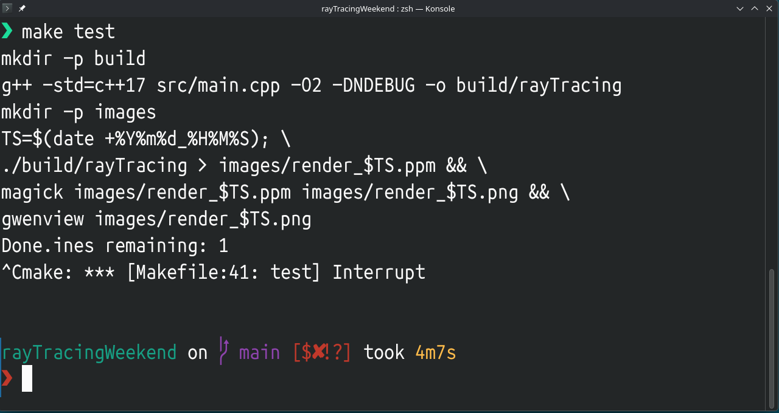
Why Wasting Time
Kasimir Rothbauer
Writing Your Own Ray Tracer From Scratch Is Wasting Your Time

Slide 26
Bounding Volume Hierarchies
Kasimir Rothbauer
Writing Your Own Ray Tracer From Scratch Is Wasting Your Time

Slide 27
Wasting Time - CPU
- Only Using CPU
- Single Threaded
- Use GPU for Parallelization
Kasimir Rothbauer
Writing Your Own Ray Tracer From Scratch Is Wasting Your Time

Slide 28
Final Image

Slide 30
Wasting Time – Stop While You Can
- No “Advanced Computer Graphics”
- Never Perfect
- What About Light Sources?
- Caustics?
- Never Ending
- Simply Use An Existing Ray Tracer
Kasimir Rothbauer
Writing Your Own Ray Tracer From Scratch Is Wasting Your Time

Slide 31
Benefits
- Deepen C++ Knowledge
- Own Makefile Creation
- Pretty Renders
- Playing Around With The Code
- Enhance Ray Tracer Further
Kasimir Rothbauer
Writing Your Own Ray Tracer From Scratch Is Wasting Your Time

Slide 33
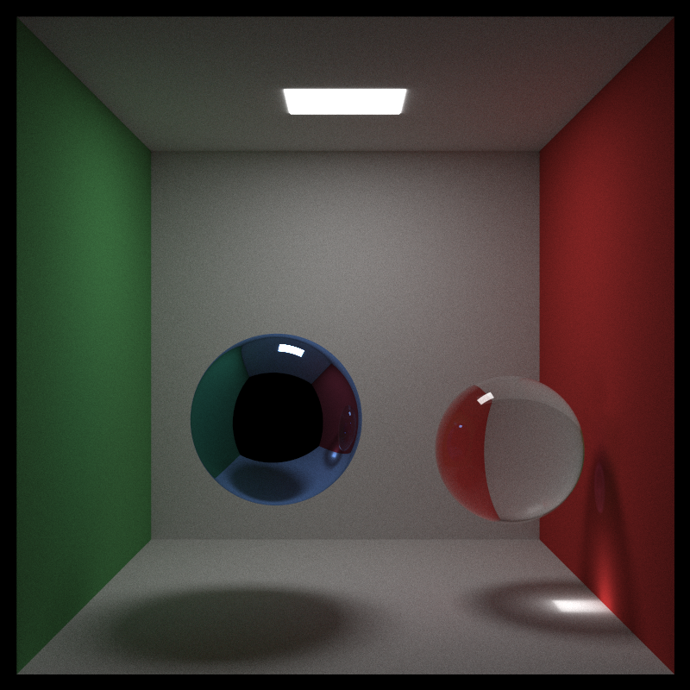
1.5h

