Slide 1
MapReduce:
Simplified Data Processing on Large Clusters
Jeff Dean, Sanjay Ghemawat
Google, Inc.

Slide 2
Motivation: Large Scale Data Processing
Many tasks: Process lots of data to produce other data
Want to use hundreds or thousands of CPUs
  ... but this needs to be easy
MapReduce provides:
  Automatic parallelization and distribution
  Fault-tolerance
  I/O scheduling
  Status and monitoring

Slide 3
Programming model
Input & Output: each a set of key/value pairs
Programmer specifies two functions:
map (in_key, in_value) -> list(out_key, intermediate_value)
    Processes input key/value pair
    Produces set of intermediate pairs
reduce (out_key, list(intermediate_value)) -> list(out_value)
    Combines all intermediate values for a particular key
    Produces a set of merged output values (usually just one)
Inspired by similar primitives in LISP and other languages

Slide 4
Example: Count word occurrences
map(String input_key, String input_value):
// input_key: document name
// input_value: document contents
for each word w in input_value:
EmitIntermediate(w, "1");
reduce(String output_key, Iterator intermediate_values):
// output_key: a word
// output_values: a list of counts
int result = 0;
for each v in intermediate_values:
result += ParseInt(v);
Emit(AsString(result));
Pseudocode: See appendix in paper for real code

Slide 5
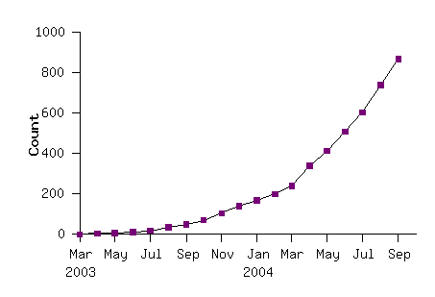
Model is Widely Applicable
MapReduce Programs In Google Source Tree
Example uses:
distributed grep |  | distributed sort |  | web link-graph reversal
term-vector per host |  | web access log stats |  | inverted index construction
document clustering |  | machine learning |  | statistical machine translation
... |  | ... |  | ...

Slide 6
Implementation Overview
Typical cluster:
      100s/1000s of 2-CPU x86 machines, 2-4 GB of memory
      Limited bisection bandwidth
      Storage is on local IDE disks
      GFS: distributed file system manages data (SOSP'03)
      Job scheduling system: jobs made up of tasks, scheduler assigns tasks to
      machines
Implementation is a C++ library linked into user programs

Slide 7
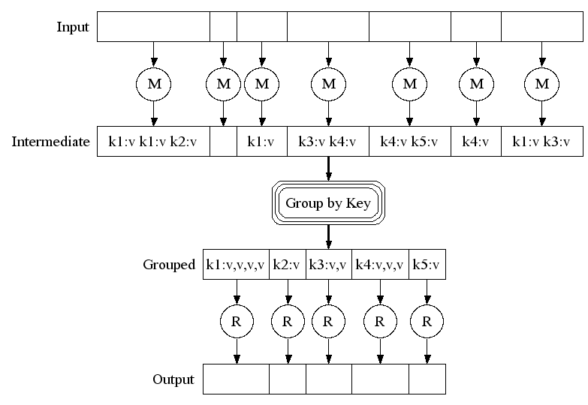
Execution

Slide 8
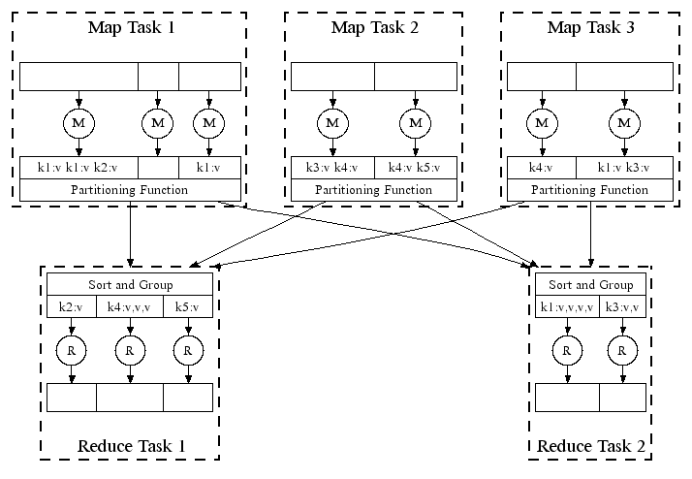
Parallel Execution

Slide 9
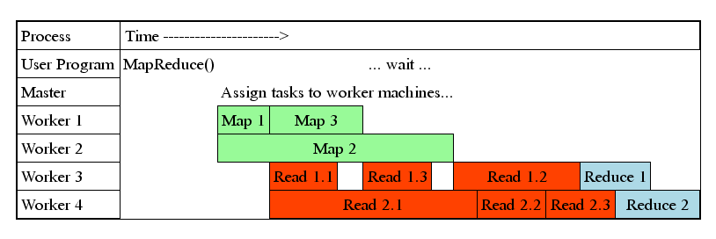
Task Granularity And Pipelining
Fine granularity tasks: many more map tasks than machines
* Minimizes time for fault recovery
* Can pipeline shuffling with map execution
* Better dynamic load balancing
Often use 200,000 map/5000 reduce tasks w/ 2000 machines

Slide 10
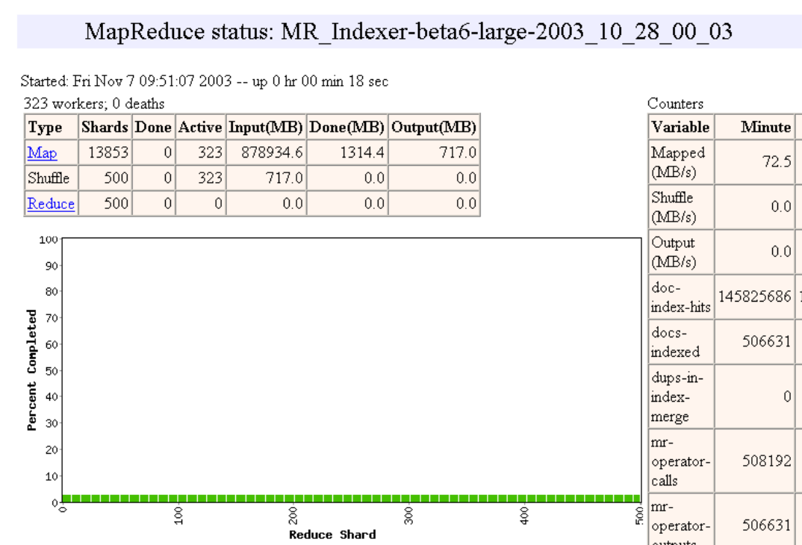

Slide 11
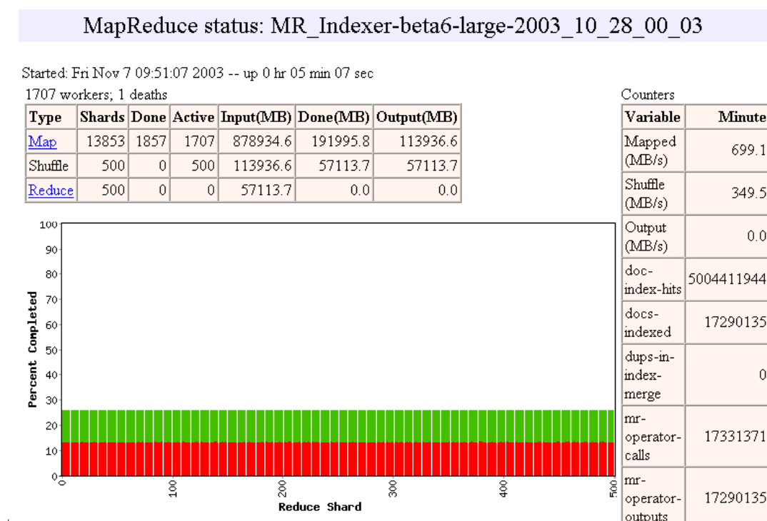

Slide 12
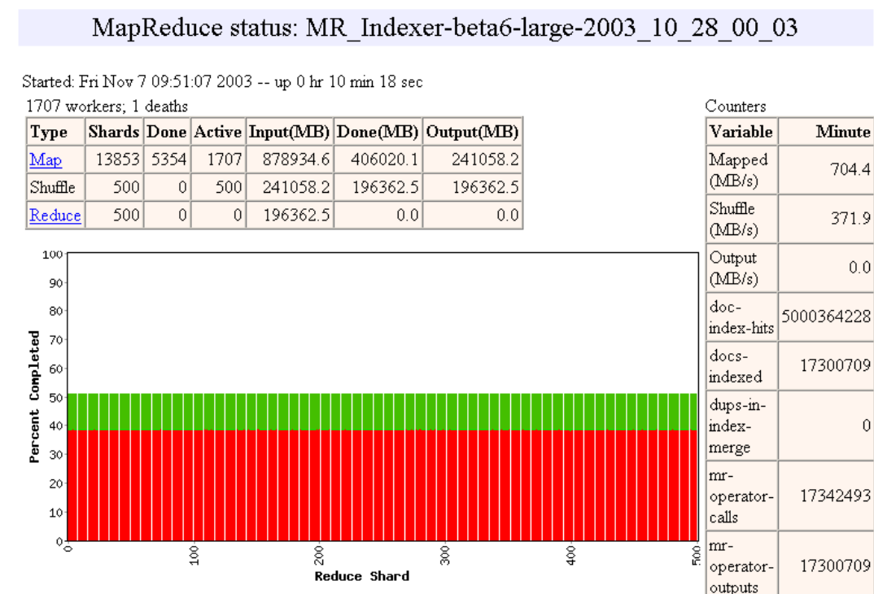

Slide 13
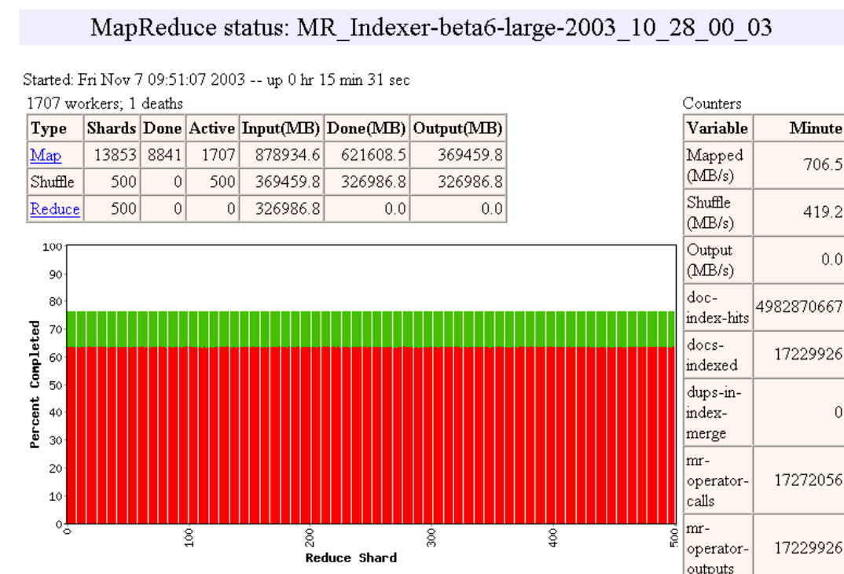

Slide 14
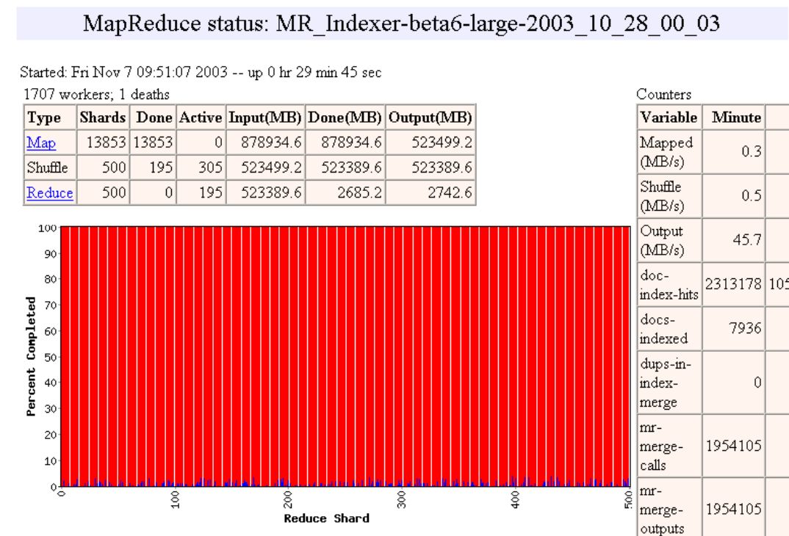

Slide 15
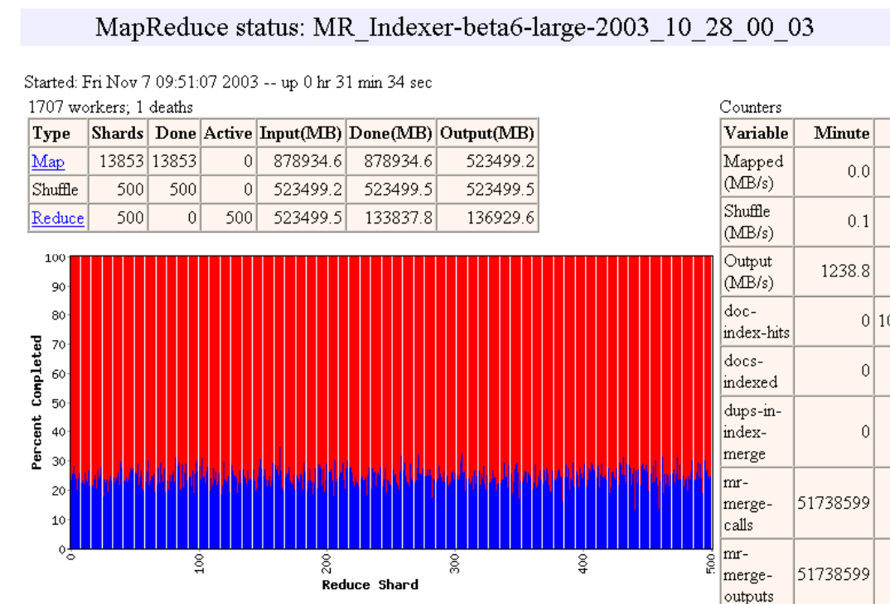

Slide 16
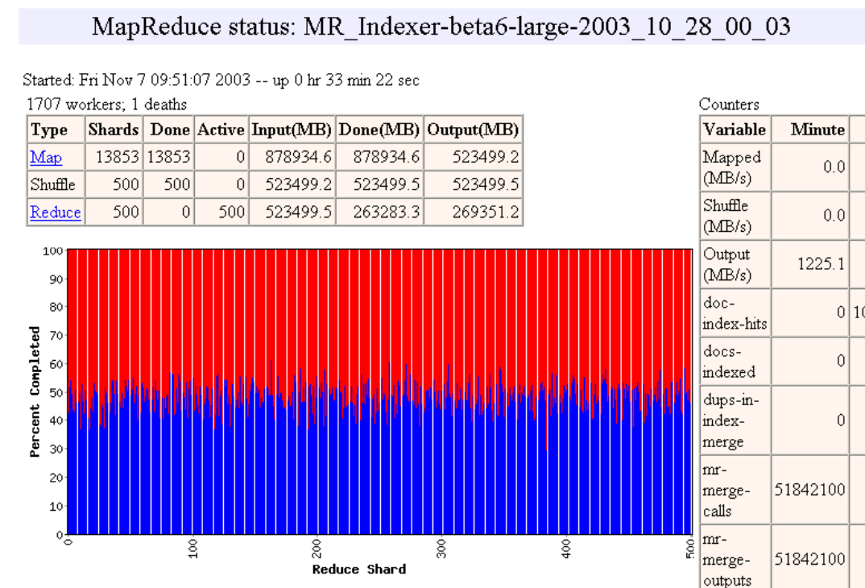

Slide 17
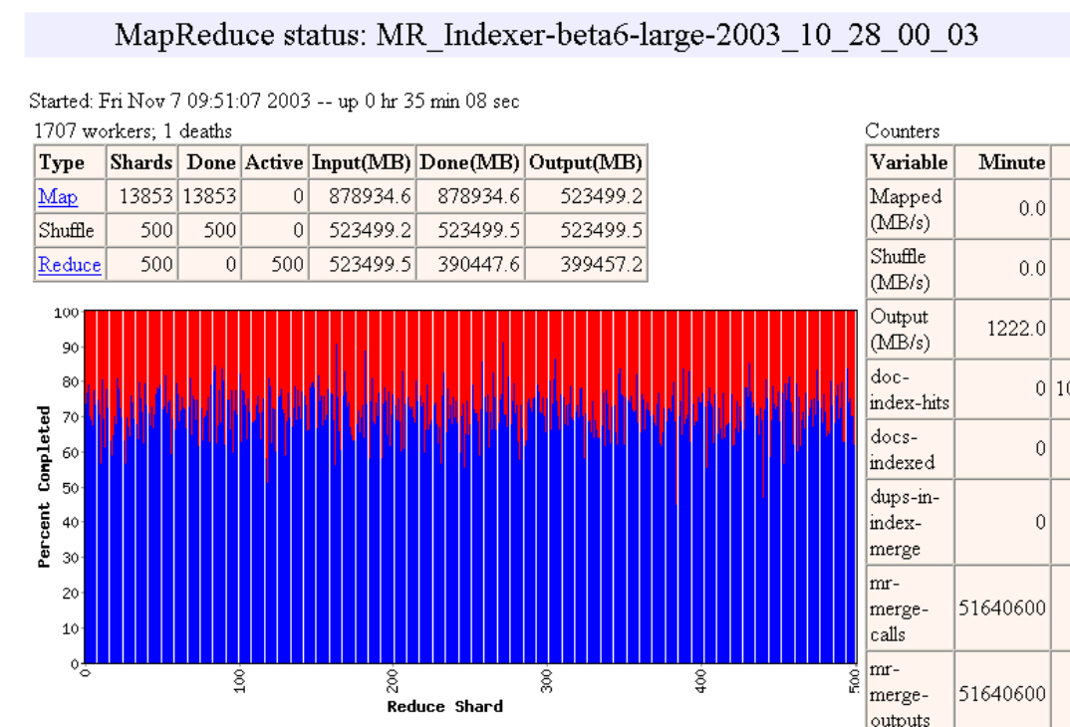

Slide 18
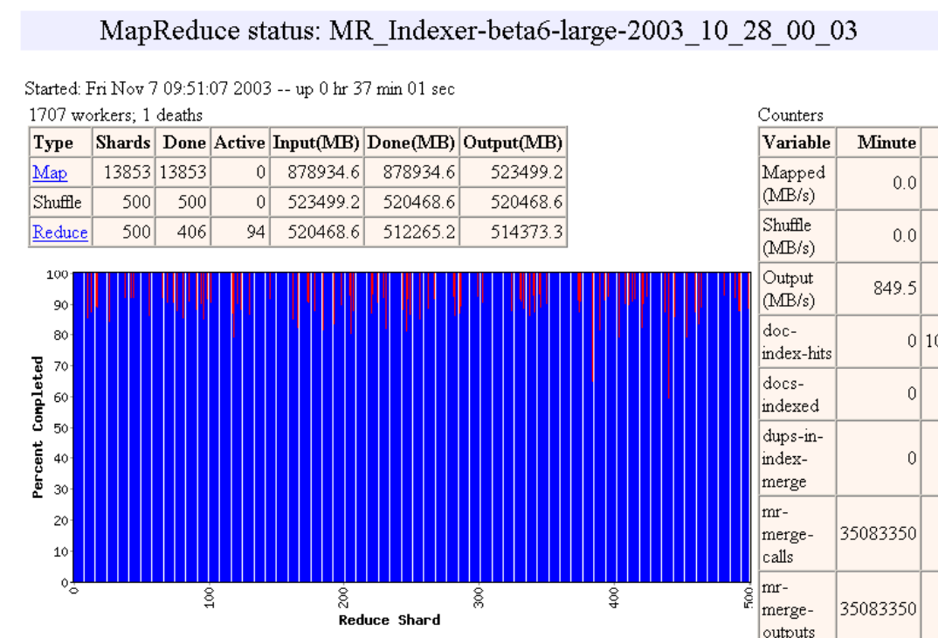

Slide 19


Slide 20


Slide 21
Fault tolerance: Handled via re-execution
  On worker failure:
    Detect failure via periodic heartbeats
    Re-execute completed and in-progress map tasks
    Re-execute in progress reduce tasks
    Task completion committed through master
  Master failure:
    Could handle, but don't yet (master failure unlikely)
Robust: lost 1600 of 1800 machines once, but finished fine
Semantics in presence of failures: see paper

Slide 22
Refinement: Redundant Execution
Slow workers significantly lengthen completion time
    Other jobs consuming resources on machine
    Bad disks with soft errors transfer data very slowly
    Weird things: processor caches disabled (!!)
Solution: Near end of phase, spawn backup copies of tasks
    Whichever one finishes first "wins"
Effect: Dramatically shortens job completion time

Slide 23
Refinement: Locality Optimization
Master scheduling policy:
  Asks GFS for locations of replicas of input file blocks
  Map tasks typically split into 64MB (== GFS block size)
  Map tasks scheduled so GFS input block replica are on same machine or same rack
Effect: Thousands of machines read input at local disk speed
  Without this, rack switches limit read rate

Slide 24
Refinement: Skipping Bad Records
Map/Reduce functions sometimes fail for particular inputs
  Best solution is to debug & fix, but not always possible
  On seg fault:
    Send UDP packet to master from signal handler
    Include sequence number of record being processed
  If master sees two failures for same record:
    Next worker is told to skip the record
Effect: Can work around bugs in third-party libraries

Slide 25
Other Refinements (see paper)
  Sorting guarantees within each reduce partition
  Compression of intermediate data
  Combiner: useful for saving network bandwidth
  Local execution for debugging/testing
  User-defined counters

Slide 26
Performance
Tests run on cluster of 1800 machines:
  4 GB of memory
  Dual-processor 2 GHz Xeons with Hyperthreading
  Dual 160 GB IDE disks
  Gigabit Ethernet per machine
  Bisection bandwidth approximately 100 Gbps
Two benchmarks:
MR_GrepScan 1010 100-byte records to extract records matching a
rare pattern (92K matching records)
MR_SortSort 1010 100-byte records (modeled after TeraSort
benchmark)

Slide 27
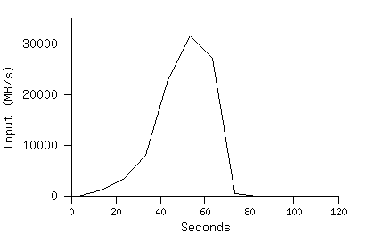
MR_Grep
Locality optimization helps:
1800 machines read 1 TB of data at peak of ~31 GB/s
Without this, rack switches would limit to 10 GB/s
Startup overhead is significant for short jobs

Slide 28
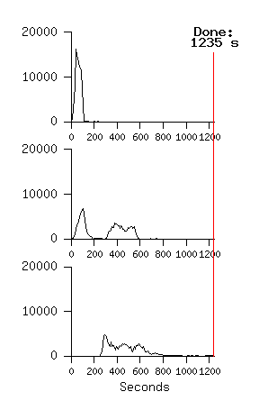
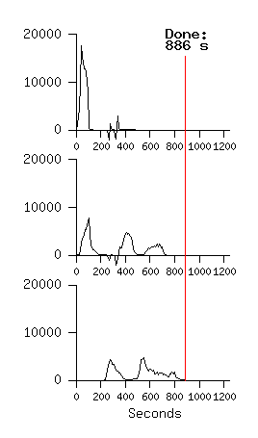
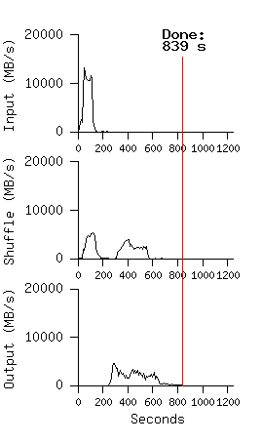
MR_Sort
Backup tasks reduce job completion time significantly
System deals well with failures
Normal No backup tasks 200 processes killed

Slide 29
Experience: Rewrite of Production Indexing System
Rewrote Google's production indexing system using MapReduce
  Set of 10, 14, 17, 21, 24 MapReduce operations
  New code is simpler, easier to understand
  MapReduce takes care of failures, slow machines
  Easy to make indexing faster by adding more machines
— — — — —

Slide 30
Usage: MapReduce jobs run in August 2004
Number of jobs 29,423
Average job completion time 634 secs
Machine days used 79,186 days
Input data read 3,288 TB
Intermediate data produced 758 TB
Output data written 193 TB
Average worker machines per job 157
Average worker deaths per job 1.2
Average map tasks per job 3,351
Average reduce tasks per job 55
Unique map implementations 395
Unique reduce implementations 269
Unique map/reduce combinations 426

Slide 31
Related Work
Programming model inspired by functional language primitives
Partitioning/shuffling similar to many large-scale sorting systems
  NOW-Sort ['97]
Re-execution for fault tolerance
  BAD-FS ['04] and TACC ['97]
Locality optimization has parallels with Active Disks/Diamond work
  Active Disks ['01], Diamond ['04]
Backup tasks similar to Eager Scheduling in Charlotte system
  Charlotte ['96]
Dynamic load balancing solves similar problem as River's distributed queues
  River ['99]

Slide 32
Conclusions
MapReduce has proven to be a useful abstraction
Greatly simplifies large-scale computations at Google
Fun to use: focus on problem, let library deal w/ messy details
Thanks to Josh Levenberg, who has made many significant improvements and to everyone else at Google who has used and helped to improve MapReduce.

