Slide 1
MapReduce: Simplified data processing on large clusters
Jeffrey Dean and Sanjay Ghemawat
Google, Inc.
2004
Diego Gonzalez, Harold Achicanoy

Slide 2
Outline
MapReduce
Programming model
Implementation
Performance
Applications and conclusions

Slide 3
MapReduce

Slide 4
Programming model
Input splits
Intermediate outputs
Final outputs
(Key/Value)
Pairs
(Key/Value)
Pairs
(Key/Value)
Pairs
Map function
Reduce function
Results: Produces a set of merged output values (usually just one)

Slide 5
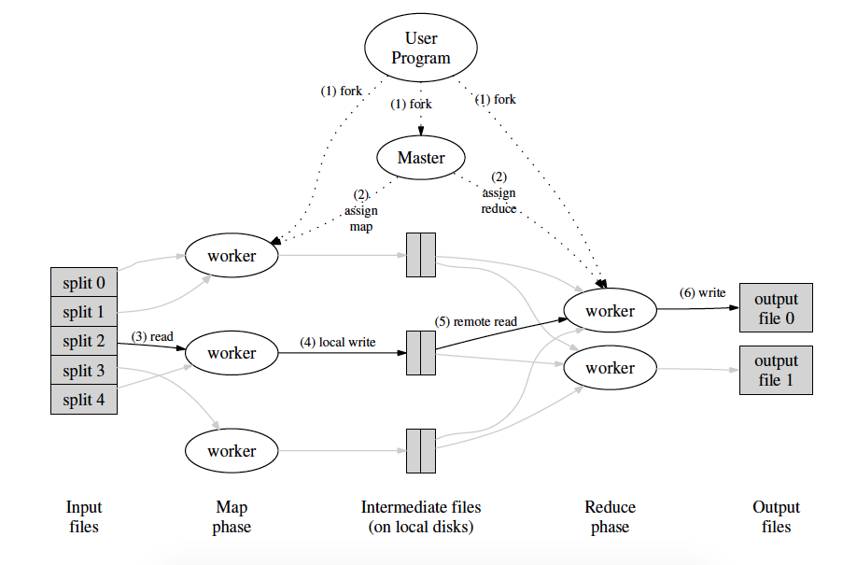
Implementation
Fault tolerance
Master data structures
Locality
Task granularity
Backup task

Slide 6
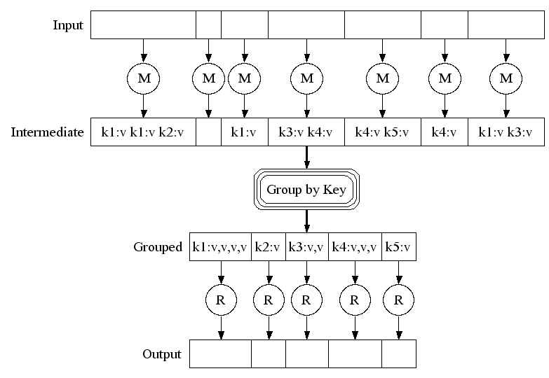
Implementation

Slide 7
Refinements
Partitioning function: This tends to result in fairly well-balanced partitions.
Ordering guarantees: to support efficient random access lookups by key
Combiner function: Partial combining significantly speeds up certain classes of MapReduce operations.
Input and output types: To produce data in different formats and it is easy for user code to add support for new output types.

Slide 8
Refinements
Skipping bad records: it detects which records cause deterministic crashes and skips these records in order to make forward progress.
Local execution: To help facilitate debugging, profiling, and small-scale testing.
Status information: it shows the progress of the computation.
Counters: Users have found the counter facility useful for sanity checking the behavior of MapReduce operations.

Slide 9
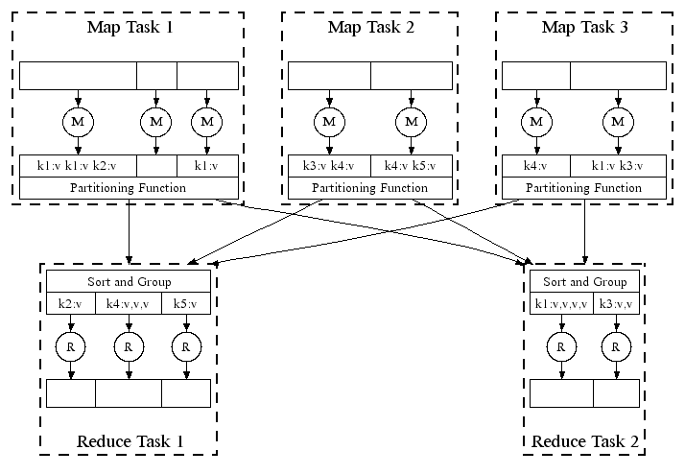
Refinements

Slide 10
Performance
1 TB of processed data
1800 machines
Each machine had two 2GHz Intel Xeon processors with Hyper-Threading enabled, 4GB of memory, two 160GB IDE disks, and a gigabit Ethernet link.
Grep: The grep program scans through 10¹⁰ 100-byte records, searching for a relatively rare three-character pattern (the pattern occurs in 92,337 records).
Sort: The sort program sorts 10¹⁰ 100-byte records (approximately 1 terabyte of data).

Slide 11
Applications
Conclusions
Large-scale machine learning problems
Clustering problems for the Google News and Froogle products
Extraction of data used to produce reports of popular queries
Extraction of properties of web pages for new experiments and products
MapReduce provides:
Automatic parallelization and distribution
Fault-tolerance
I/O scheduling
Status and monitoring

