Slide 1
Tana River, Taita Taveta and Makueni’s problems
Harold Achicanoy

Slide 2
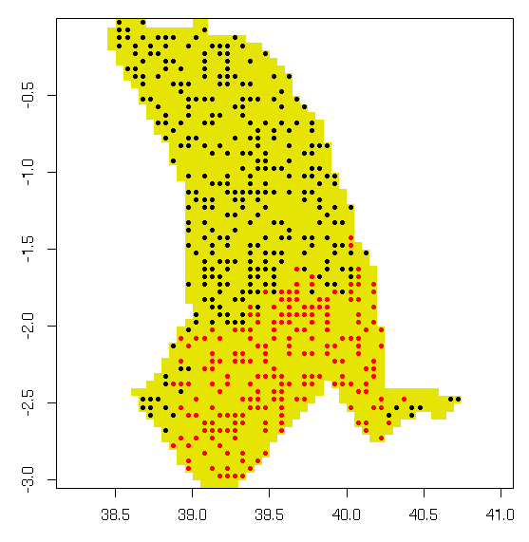
Tana River
Tana River raster has: 1345 valid cells LONG TIME to process!
With sampling applied we used: 500 valid cells
That are being showed in the left map (all points)
But … when I tried to calculate the agro-climatic indexes
Only red points after sampling are reporting data
And this number varies through: period, RCP, GCM and
Measured variable
What happened with the black ones?

Slide 3
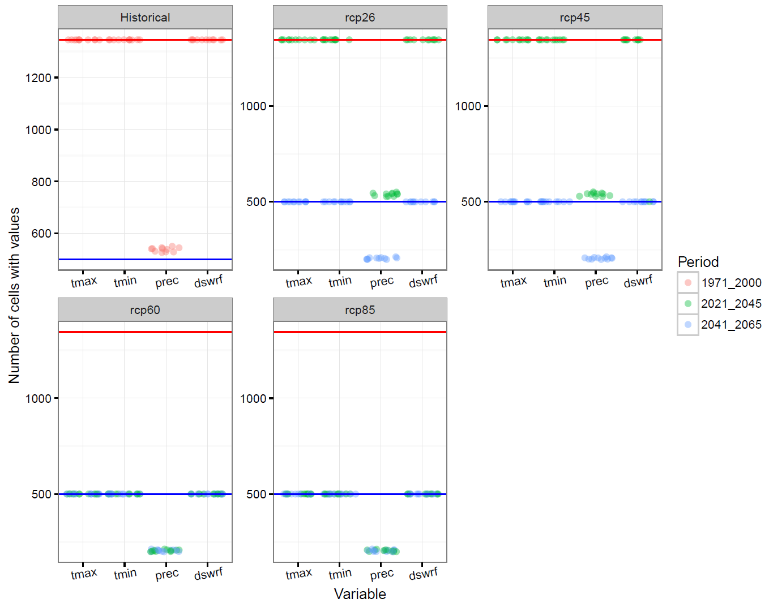
Red and blue lines represent the
Expected number of valid cells
After processing
Only with precipitation cases we have problems: historical and
future data.

Slide 4
Summary
After verify observed data (which its source is CHIRPS), all of them are correct and has 1342 valid cells.
So, the problem probably is on GCM data (historical and future) …
Checking…

Slide 5
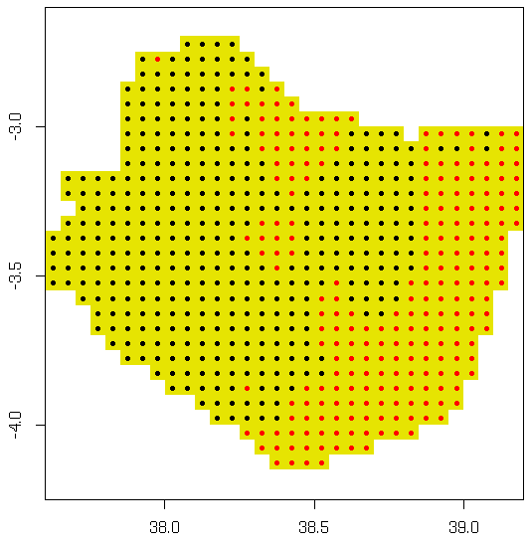
Taita Taveta
Precipitation data
Taita Taveta raster has: 618 pixels
But … when I tried to calculate the agro-climatic indexes
Only red points (240 pixels with complete information) for
second season report data (first season didn’t have problems)
And this number varies through: period, RCP and GCM
What happened with the black ones?

Slide 6
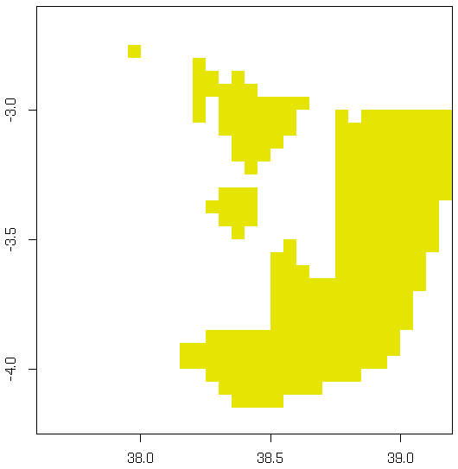
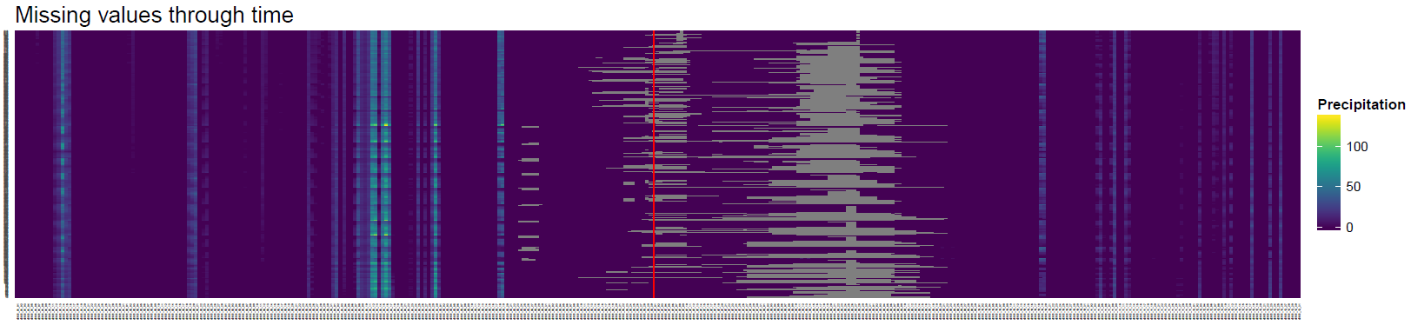
2021-08-26
2021
This behavior appears in all years during second semester

Slide 7
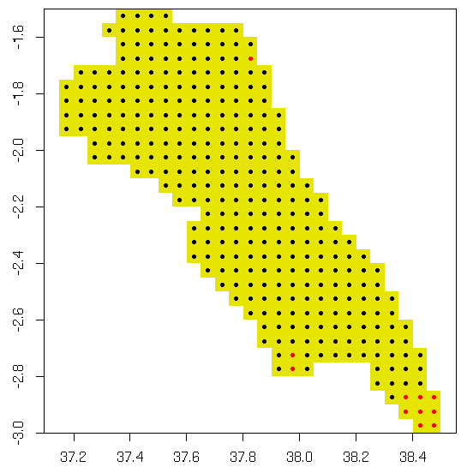
Makueni
Precipitation data
Makueni raster has: 319 pixels
But … when I tried to calculate the agro-climatic indexes
Only red points (11 pixels with complete information) for
second season report data (first season didn’t have problems)
And this number varies through: period, RCP and GCM
What happened with the black ones?

Slide 8
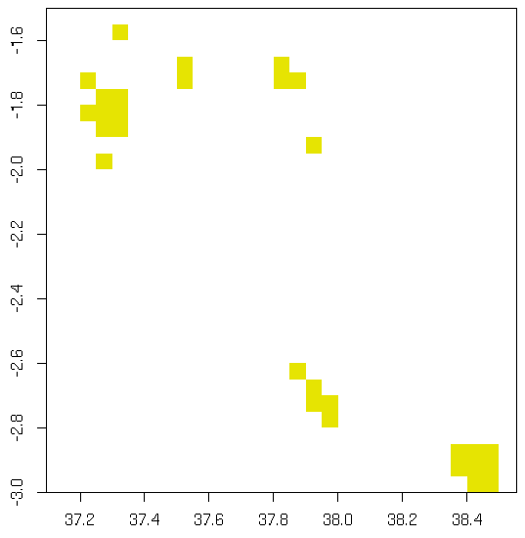
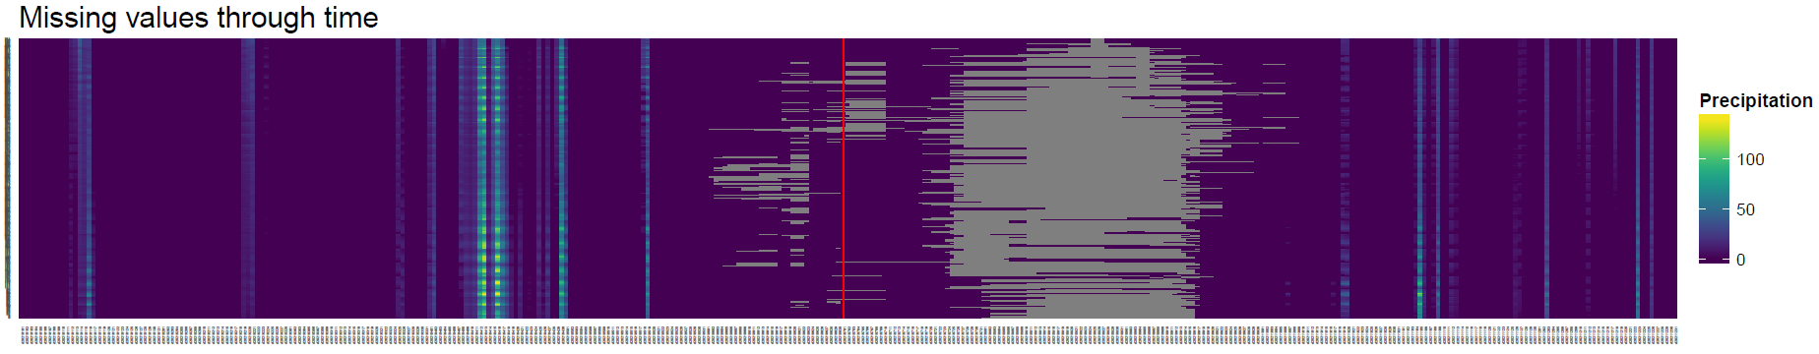
2021-08-25
2021

Slide 9
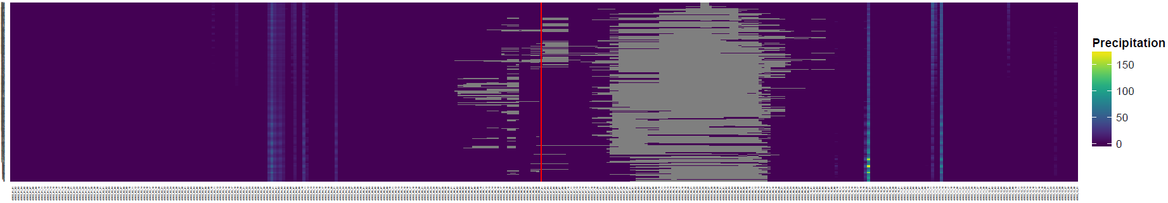
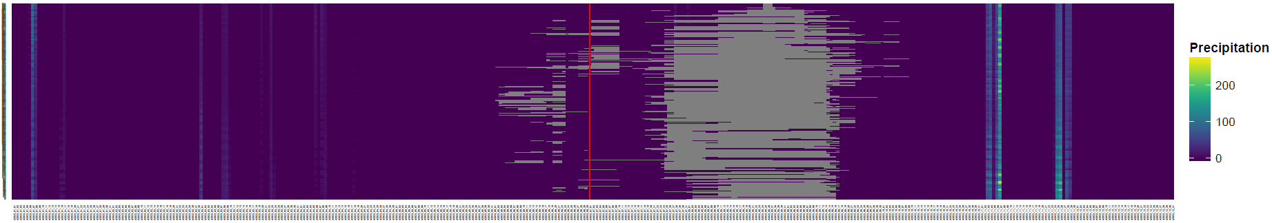
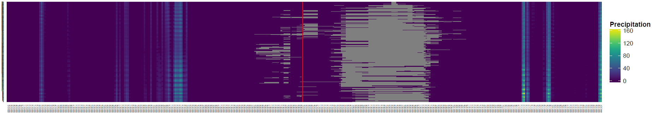
2022
2023
2024

