Slide 1
Taita Taveta

Slide 2
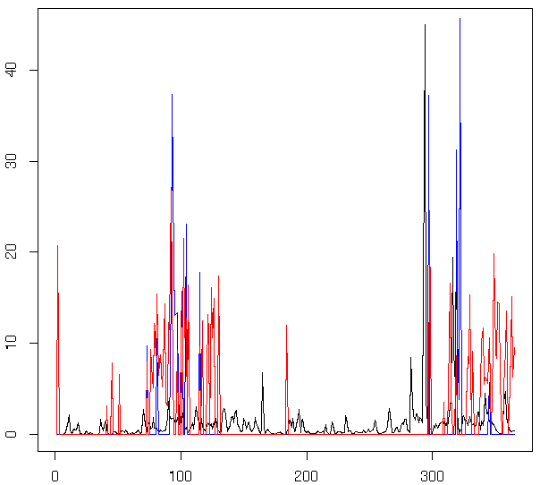
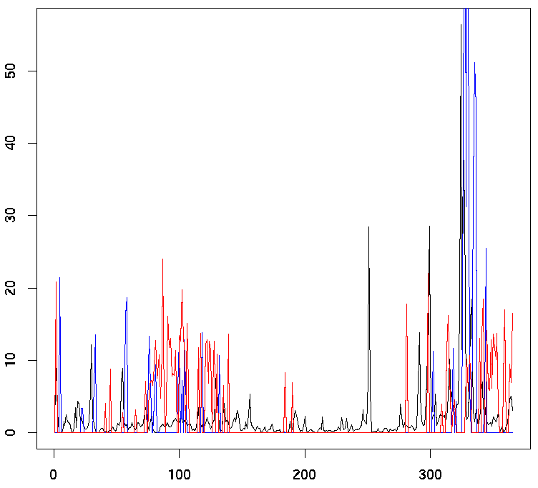
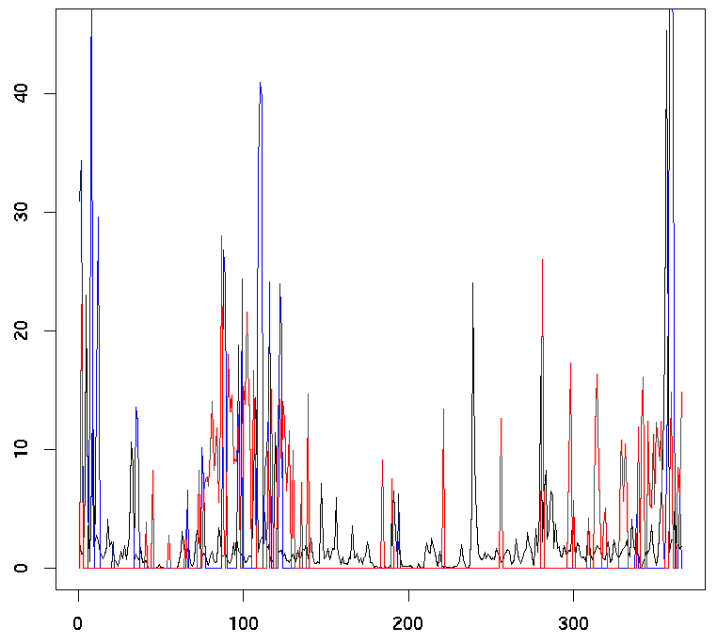
Year: 2022
Pixel: 39
Coordinates: (lon=37.925, lat=-2.775)
Year: 2030
Pixel: 43
Coordinates: (lon= 38.125, lat= -2.775)
Year: 2041
Pixel: 76
Coordinates: (lon = 38.175, lat = -2.825)

Slide 3
Makueni

Slide 4
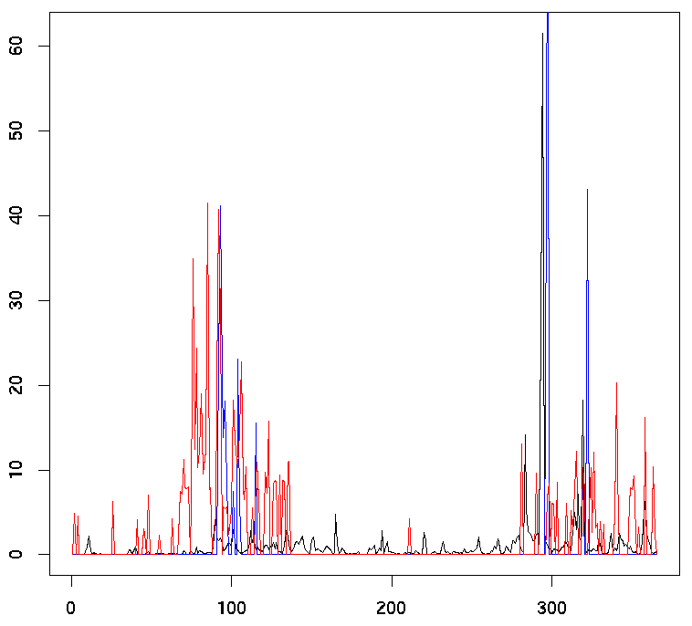
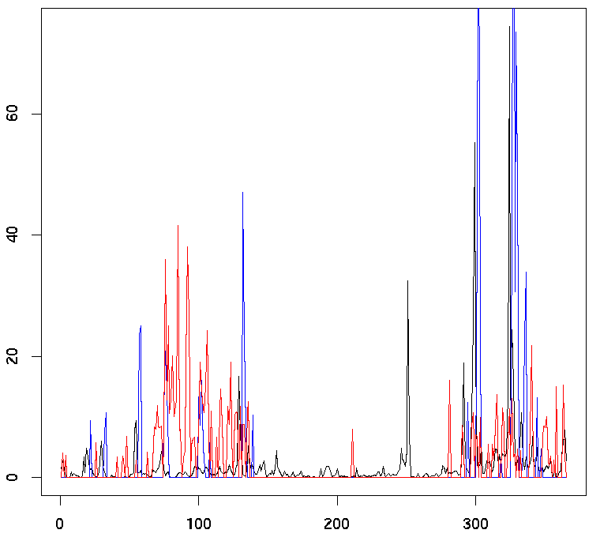
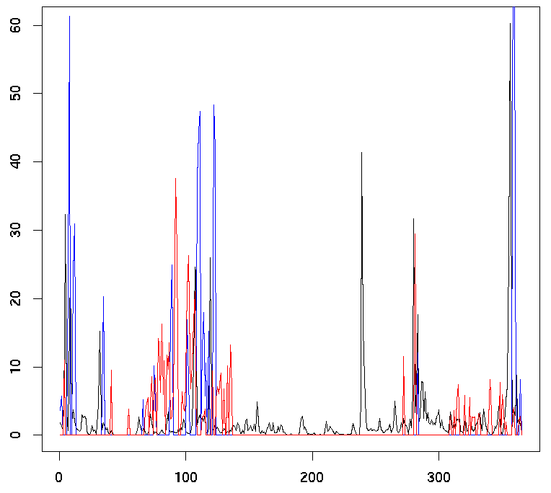
Year: 2022
Pixel: 33
Coordinates: (lon=37.425, lat=-1.575)
)
Year: 2030
Pixel: 91
Coordinates: (lon=37.625, lat=-1.675)
Year: 2041
Pixel: 136
Coordinates: (lon=37.175, lat=-1.775)

