Slide 1

‘Meme’ Stock Outlier Detection
MSDS 436 Final Project
Arthur Swanson
Husein Adenwala

Slide 2
Executive Summary
Introduction: Meme stocks have become very popular among retail investors that comment on social media platforms during the COVID-19 pandemic. Meme stocks are created when a company's shares start trending with individual investors on social media platforms and quickly skyrocket in price.
With a large amount of data being produced on social media platforms, it is difficult to identify the meme stock before or when the price takes off. Unsupervised algorithms aided by stock data can aid in identifying metrics of a meme stock.
`
Conclusion: Stock price was inversely correlated (mildly) to positive sentiment on Twitter. K-means clustering shows that Tesla was the most distinct cluster and could potentially suggest that we can detect meme stock activity using K-means clustering but more data over a longer period is needed.
Results: We provide evidence that these stocks display common stylized facts for the dynamics of price, trading volume, and social media activity. Understanding these properties helps investment analysts in their decisions.

Slide 3
Research Objective
Identify stocks
Identify meme stocks using unsupervised clustering
Find insights
Find insights from twitter sentiment analysis and stock price data
Identify trends
Help investment analysts identify trends in stock attribution data to make better investment decisions.

Slide 4
Sourcing the Data
Data Source | Process
Twitter API | Hourly batch scripts to get data using the Twitter development (free tier) API for a group of stocks limited by API count limitation. Stock symbols were used as key words to search for the tweets; however, this did capture many irrelevant tweets that were cleaned up during sentiment analysis.
Yahoo Finance API | Due to limits in number of requests on Y Finance API, we ran on-demand scripts on an EC2 instance to get Stock price attribution data. This step was done after sentiment analysis and data transformation as the Y Finance data is curated and did not require any pre-processing.

Slide 5


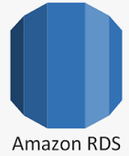


Data Pipeline Overview
Twitter API Using a Twitter developer account, Python API to get tweets tagged to stock symbol
Prepare
Sentiment analysis on tweets. Merge Y Finance and Twitter data on stock symbol and date stamp
Database
Store the transformed data in AWS Aurora PostgreSQL
Ingestion
Load tweet data in S3 bucket with batch scripts
Y Finance API
Get min, max, average, volume, open, close, ticker, data timestamp during ETL process

Slide 6
Data Ingestion, Analysis and Preparation
Hourly python batch scripts to collect Twitter data using API.
Total of 83,000 tweets were collected with limited twitter development access.
The tweets with date and timestamps were ingested in Amazon S3 in csv format.
Used NLP pipeline in an Ec2 instance with python to filter irrelevant tweets, perform text preprocessing, tokenization and perform sentiment analysis using a Bert based transformer model.
Used Yahoo Finance API to collect stock attribution data for the stocks and date and timestamps on post processed Twitter data.
Yahoo Finance and Twitter sentiment data was loaded to AWS aurora (PostgreSQL).

Slide 7
Data Governance
Only collected tweets on days where stock market was open for trading.
Collected tweets at a random sample and did not save user information.

Slide 8
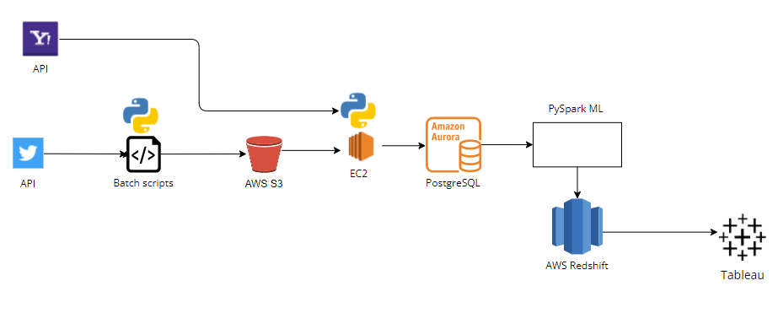




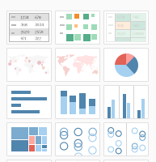

Methodology
Overview of the System Design
Twitter and Yahoo API for data
Batch scripts on local environment to get Twitter data
Scheduled Ec2 instance to perform sentiment analysis on tweets. Got Y Finance data to merge with Twitter sentiment data. ETL to PostgreSQL
PySpark ML to create unsupervised models and load data to Redshift
Save tweets in S3
Data Scientist creates Dashboard files for users
Investment Analyst
6

Slide 9
Methodology and Tools used
Python to collect data from API
Automation/Scheduling Scripts and Batch Processing
Boto3 - Interface with Amazon APIs
AWS S3 – Storage
Ec2 instance with Cron scheduling python- ETL ( Data Transformation, NLP and getting Y Finance data)
AWS Aurora - PostgreSQL to store the processed data
PySpark ML – K-Means clustering model (DBSCAN did not provide discernable clusters)
The transformed Yahoo and Twitter sentiment data with K-means clustering was pushed to AWS redshift
AWS Redshift - Data Warehouse and Insight Result Storage for Deployment to Tableau
Created Tableau TWB files that provide clustering results and dashboard for the end users

Slide 10
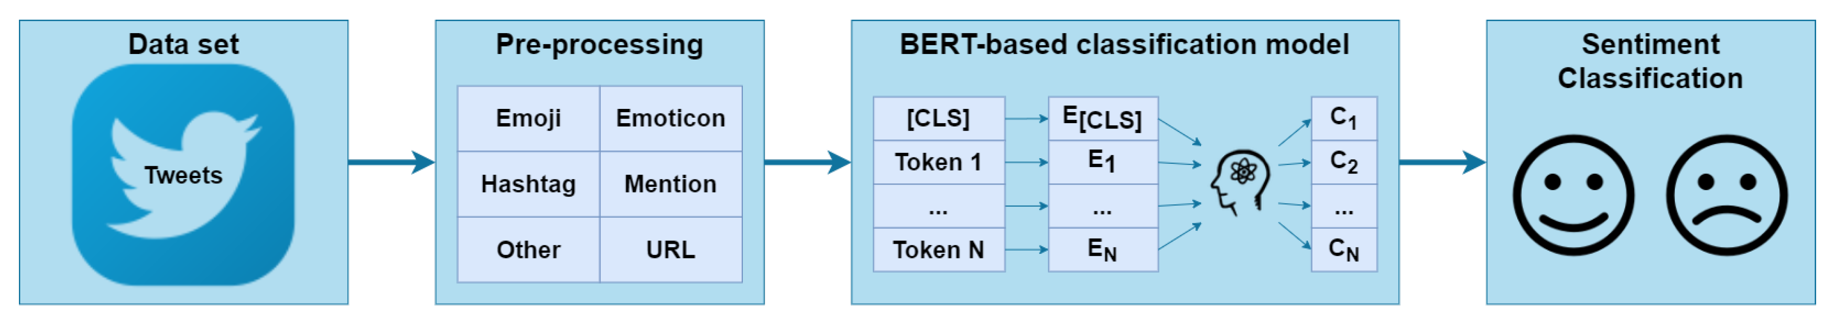
NLP Sentiment Analysis
Used FLAIR NLP framework in python to tokenize and encode the text to get and predict the sentiment of the tweet (FLAIR uses a BERT based transformer model)
Python NLTK library for cleaning text: Removed punctuation and special characters, lower cased, removed URLs and converted emoji to text.
Tweets were classified into positive and negative sentiments

Slide 11
Unsupervised Models
Load Data
Create Pipeline
Create Model
Export Results
Imported Pipeline stack string indexer, standard scalar and vector assembler
Created the model and evaluated the Silhouette score for the K-mean
Exported the model output merge with the loaded data to Tableau
Loaded data from AWS Aurora using sqlalchemy

Slide 12
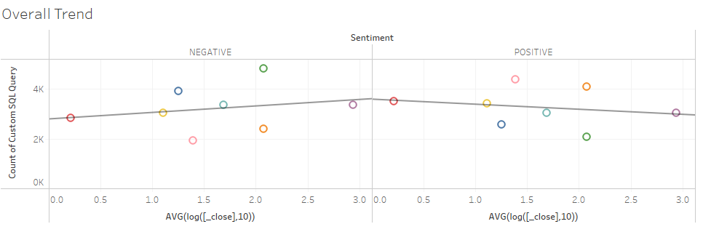
Results: Price – Sentiment Trend
Inverse (modest) relation between twitter sentiment and price
Need more data over longer period to assess trend

Slide 13
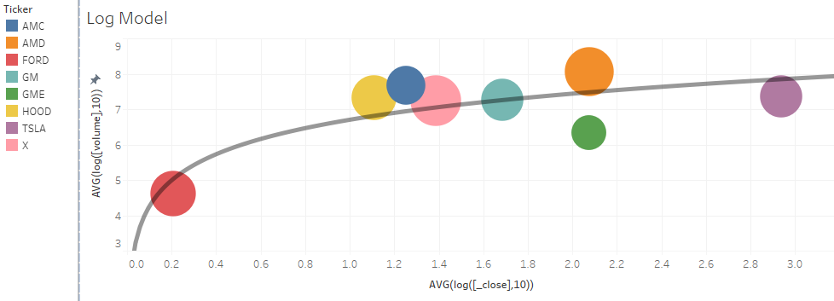
Results: Price - Volume Trend
Price and Volume on logarithmic trend.
TSLA and FORD on extreme end.

Slide 14
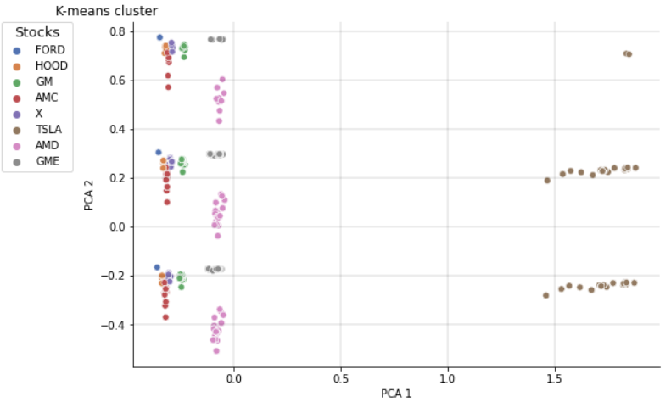
Results: K-Means Cluster
TSLA can be identified as a distinct cluster
However, FORD and TSLA were ‘meme’ stock and the cluster only detected TSLA

Slide 15
Conclusion
Rec0mmendations
Using paid subscription, we can backlog tweets over longer period.
Get a better stock API for more resolute data over 5-minute windows.
Storing tweet and pricing in a NoSQL database like MongoDB would allow for flexibly in changing the schema as we gather more knowledge about the data requirements.
Lessons Learned
Amazon EMR was not utilized and would have been a valuable feature to add.
Stream processing would be ideal application but could not be implemented.
Using all the processes in AWS would be useful for larger application.

Slide 16
References
Das A (2021, Feb 10). K Means Clustering using PySpark on Big Data. Towards Data Science. Retrieved March 10 2022, from, https://towardsdatascience.com/k-means-clustering-using-pyspark-on-big-data-6214beacdc8b.
Jain S (2020, July 26). An Implementation of DBSCAN on PySpark. Towards Data Science. Retrieved March 10 2022 from, https://towardsdatascience.com/an-efficient-implementation-of-dbscan-on-pyspark-3e2be646f57d.
Magajna T (2018, Dec 24) Text Classification with State of the Art NLP Library — Flair. Towards Data Science. Retrieved March 10 20202, form https://towardsdatascience.com/text-classification-with-state-of-the-art-nlp-library-flair-b541d7add21f.
Galarnyk M (2017, Aug 2). T (2018, Dec 24) Text Classification with State of the Art NLP Library — Flair. Towards Data Science. Retrieved March 10 20202 form, https://towardsdatascience.com/setting-up-and-using-jupyter-notebooks-on-aws-61a9648db6c5.

Slide 17
Appendix

Slide 18
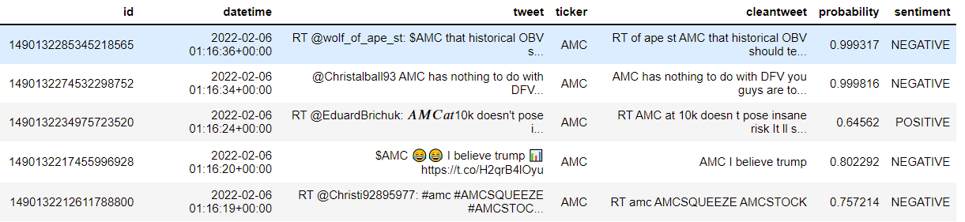
NLP Sentiment example

Slide 19
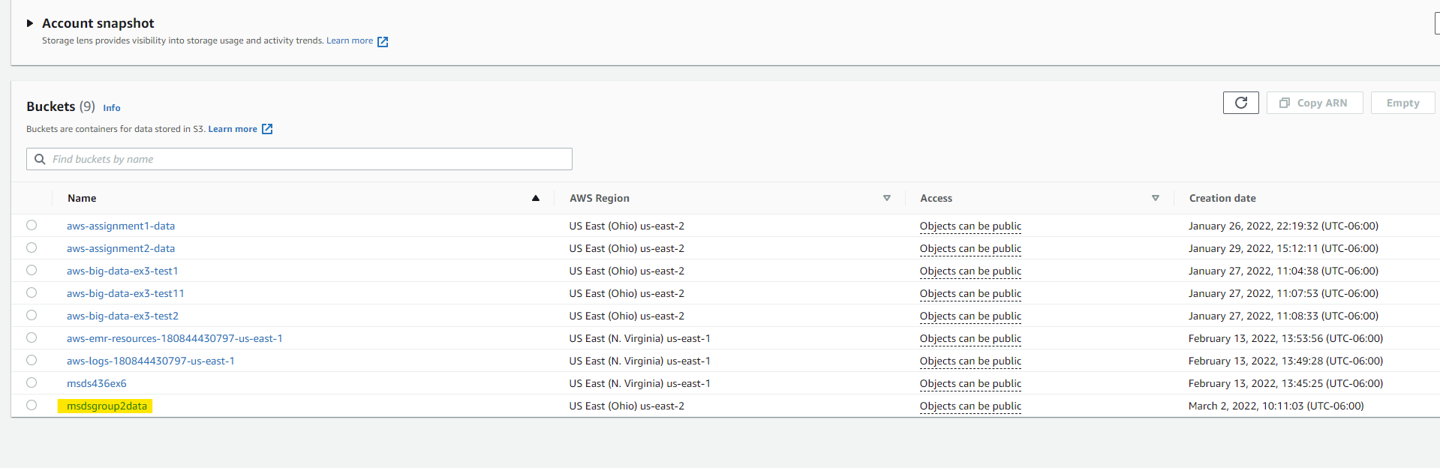
S3 Bucket example

Slide 20
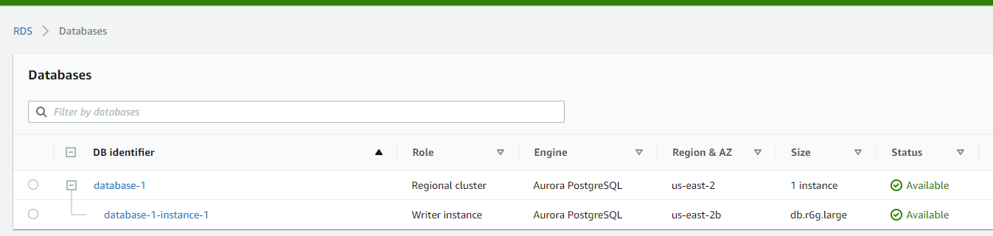
Amazon Aurora PostgreSQL instance

Slide 21
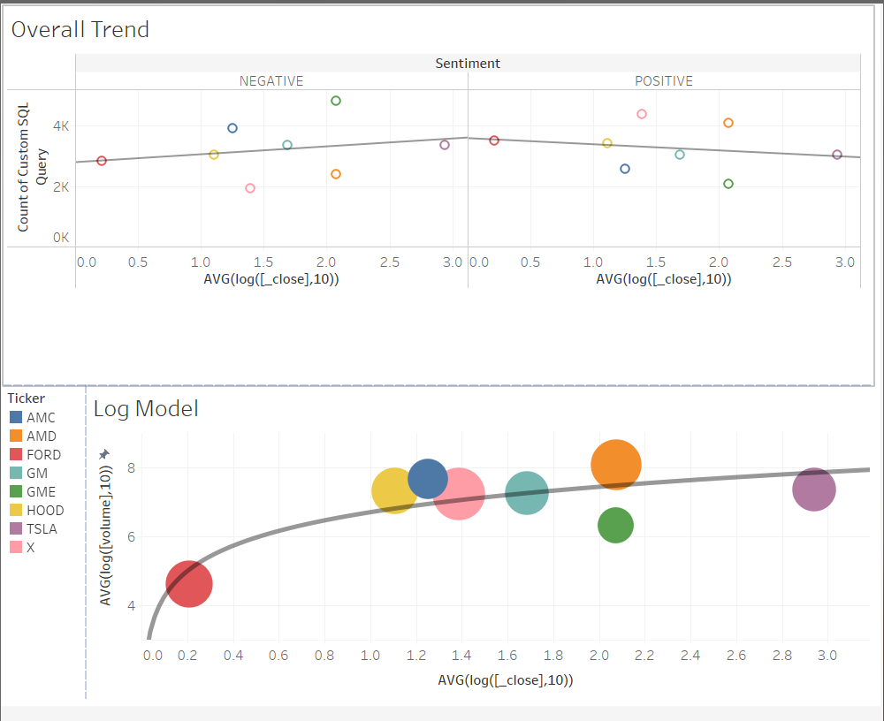
Tableau Dashboard example

