Slide 1

Predicting Environmental, social, and governance Score
By: Husein Adenwala

Slide 2
Executive Summary
Introduction: ESG scores provides stakeholders and investors with the ability to direct their investments towards business that are good corporate citizens. However, there are challenges to
Primary objective: Using companies' financial disclosure and financial news to predict ESG scores.
Secondary objective: verify whether the ESG scores predicted in this research would correlate with market volatility (beta) as predicted by prior research.
Results:
This research did not validate prior research that a higher ESG score would be predictive of lower market volatility.
Reasons :
Small dataset
Sentiment classification model is trained on financial data and not on ESG data
Future work:
Larger dataset for training and evaluating models
Granular classification of ESG fcators
Fine-tuning a BERT model to classify granular ESG factors.
Fine-tuning a BERT Sentiment classification on ESG data.

Slide 3
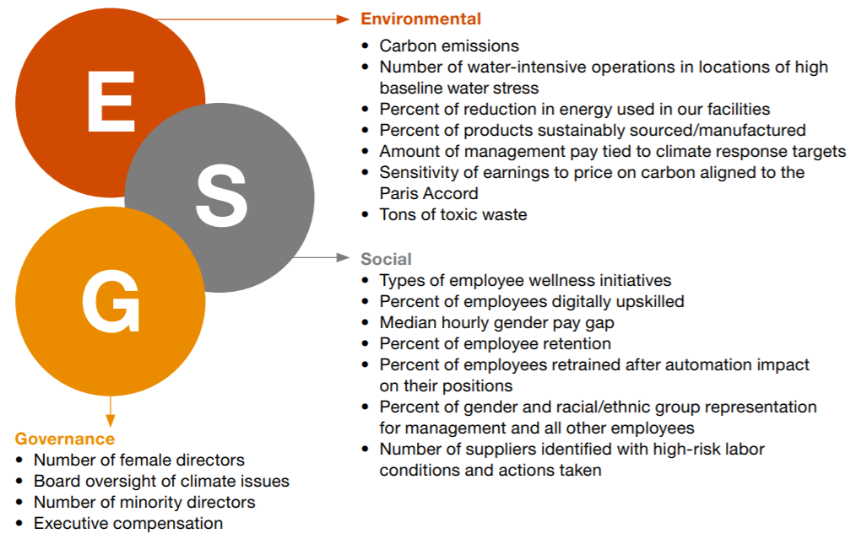
What is ESG?
Environmental, Social, and Corporate Governance (ESG) are the three main topic areas used to measure the sustainability and societal impact of a company.

Slide 4
Opportunity
Growing interest
Individual and large institutions are directing an ever-increasing proportion of their investment towards sustainable strategies.
Companies are disclosing ESG information in periodic financial disclosures.
ESG data
Measuring and reporting inconsistency due to multiple ESG reporting frameworks.
Rating agencies have huge variability in their scores because there is no standardized method of calculating ESG scores.
Regulation
EU law requires companies to disclose information on social and environmental issues.
SEC-proposed rules would require companies to include climate-related disclosure.
NLP Advances
Recent advances in natural language processing (NLP) has given us the ability to analyze more data.
This has provided new avenues to gain insight into companies.

Slide 5
Relevant Foundational Research
NLP is already used to extract financial information from company financial disclosures.
Domain-specific language models show promising results.
Good ESG performance helps reduce stock price volatility.¹
¹Zhou, D., & Zhou, R. (2021). ESG Performance and Stock Price Volatility in Public Health Crisis: Evidence from COVID-19 Pandemic. International journal of environmental research and public health, 19(1), 202. https://doi.org/10.3390/ijerph19010202

Slide 6
Objective
Data: Quarterly Earnings call transcripts, news feeds and press releases
NLP Classification: Identify ESG relevant data
NLP Sentiment Analysis: Positive, Negative, or No Change using sentiment analysis
ESG total sentiment score relative to their industry peers

Slide 7
Method: Project Approach
300 Annual ESG Reports for training
Earnings transcripts, News feed & Press release
Data
Identifying E, S,G text for training and evaluating classification models
Topic Modeling
Finbert-ESG classification model (pre-trained BERT to classify E, S,G & None in ESG data)
FinBERT sentiment model (pre-trained BERT to analyze sentiment in financial texts)
Models
Percentile ranking of mean ESG sentiment within the peer group
ESG Score

Slide 8
Method: Calculating the ESG score
Count the positive, negative and neutral ESG occurrences for a company
Calculate three scores for E,S and G factors respectively, as follows:
Positive occurrence +1
Neutral occurrence +0.5 ( as any mention of ESG indicated That it topics are being discussed)
Negative occurrence -1
Calculate mean of the E, S and G scores to arrive at one overall score
Calculate a percentile score by peer sector based on overall mean score
*This method of calculating reflects the industry approach on how ESG data is scored due to a lack of agreed upon benchmarks. There is no agreed-upon method of calculating ESG score.

Slide 9
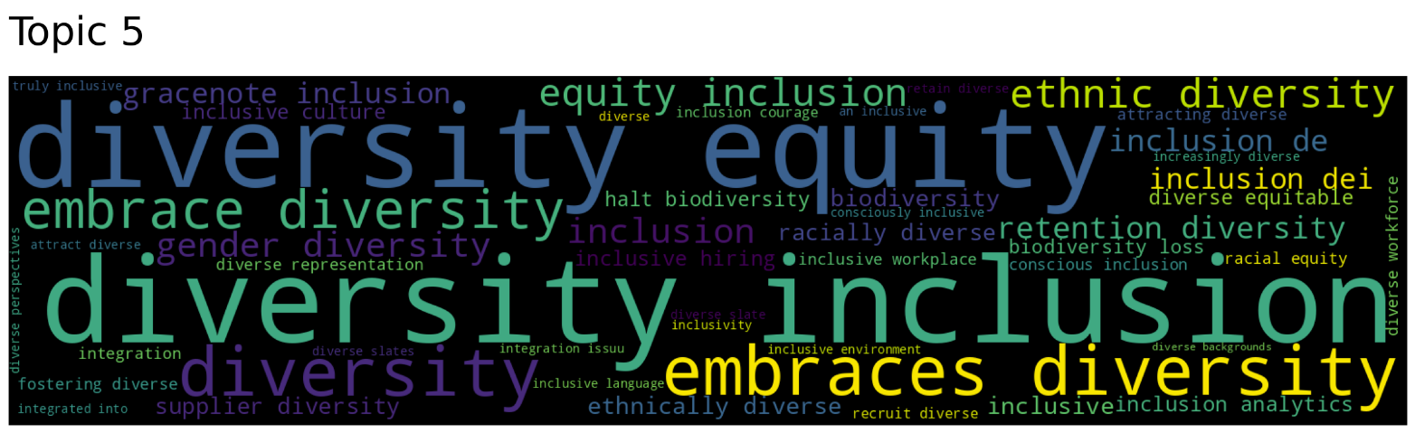
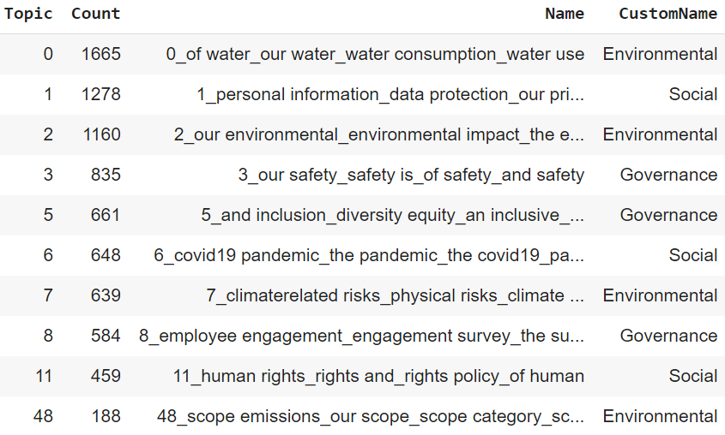
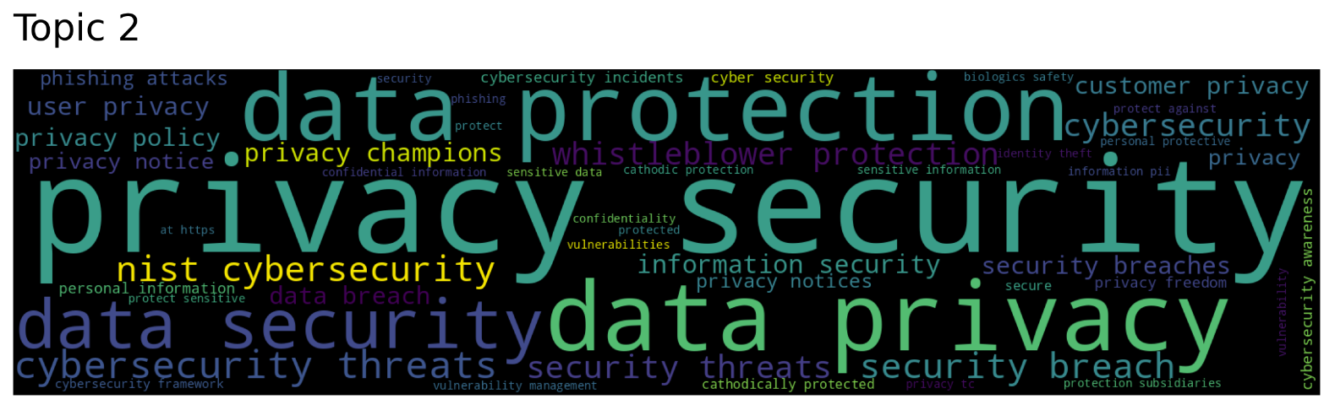
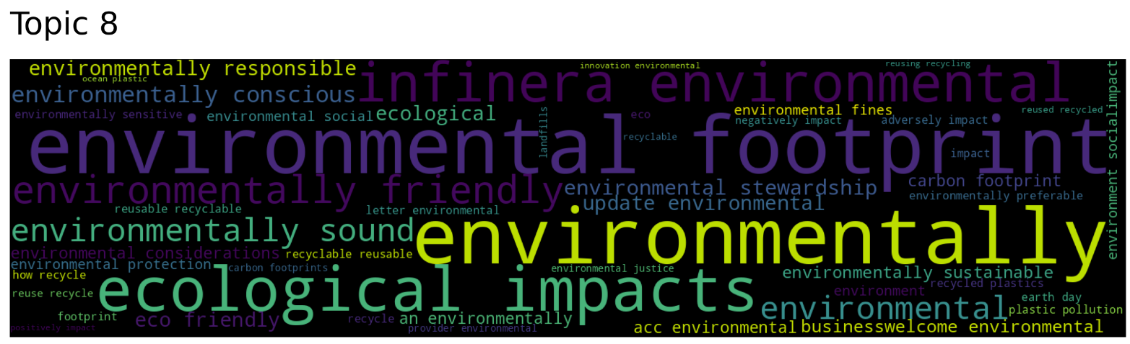
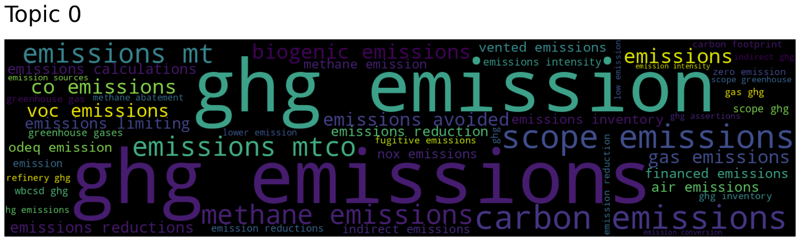
Results – Topic Modeling
Top2vec
BERTopic
Topic extraction example
Topic extraction example
Governance
Social
Environmental

Slide 10
Results – E,S & G Classification Modeling
Machine Learning models
~55%
Fine-tuned BERT model
~65%
Finbert-ESG model
~78%
Example (finBERT ESG):

Slide 11
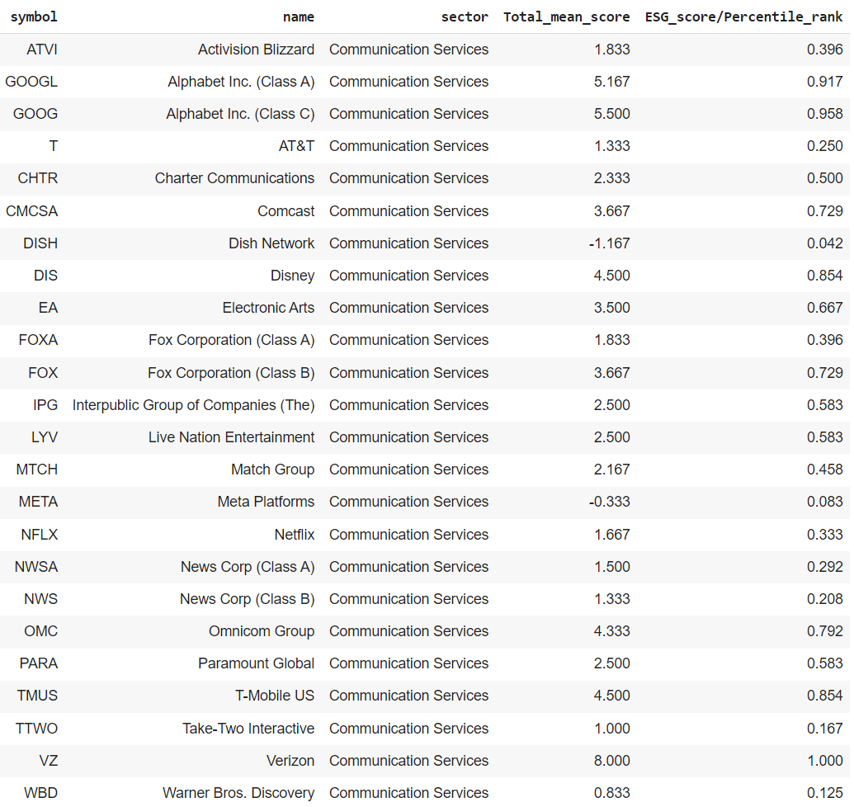
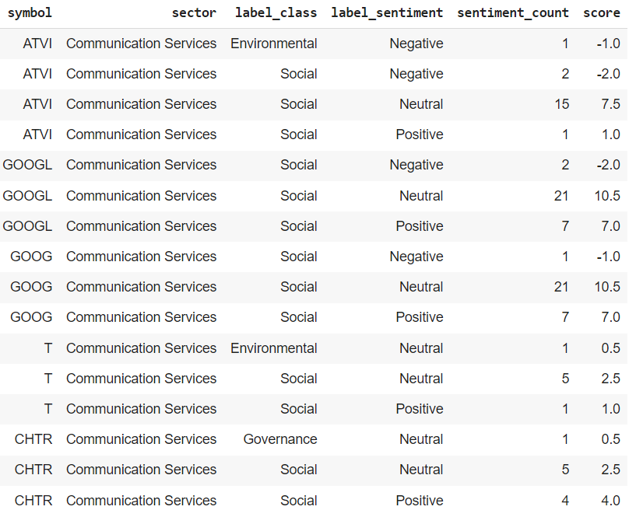
Results – Calculating ESG scores
Using Pretrained FinBERT without any training/test data to label sentiment: Positive, Negative or Neutral
Aggregating Sentiment counts into percentile score
Examples
Example

Slide 12
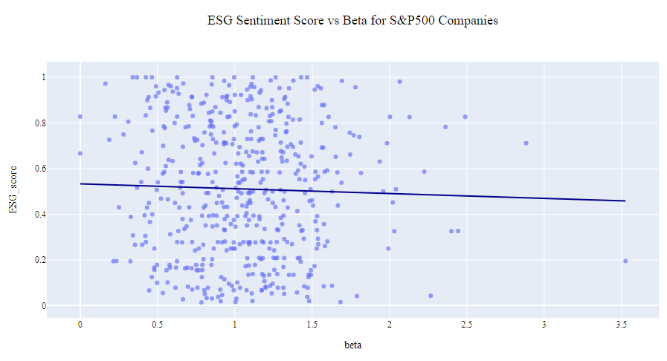
Analysis – ESG Sentiment scores (S&P500)
Comparing ESG calculated Scores with Beta.
Beta indicates stock price volatility.
Closer to 0 indicates less volatility. Above 1 indicates higher volatility compared to the benchmark.

Slide 13
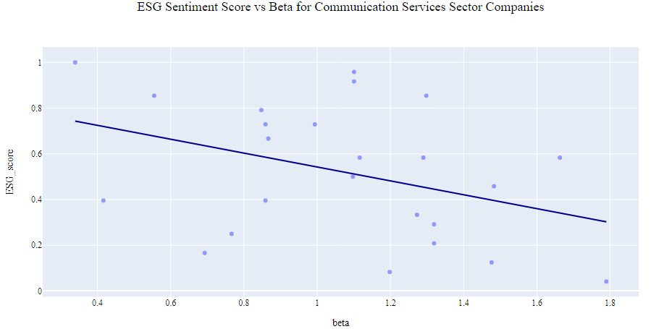
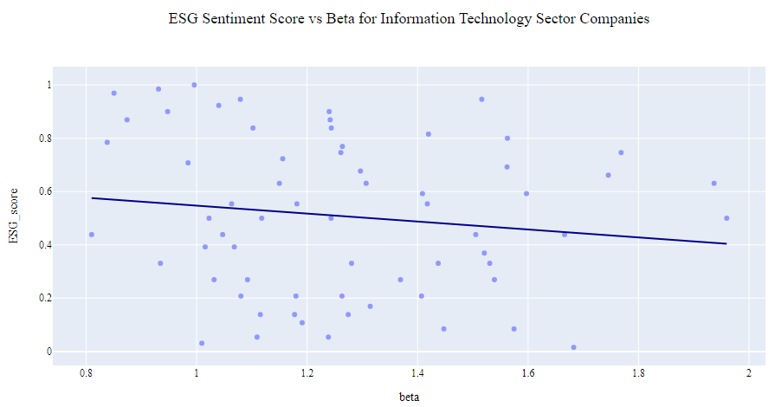
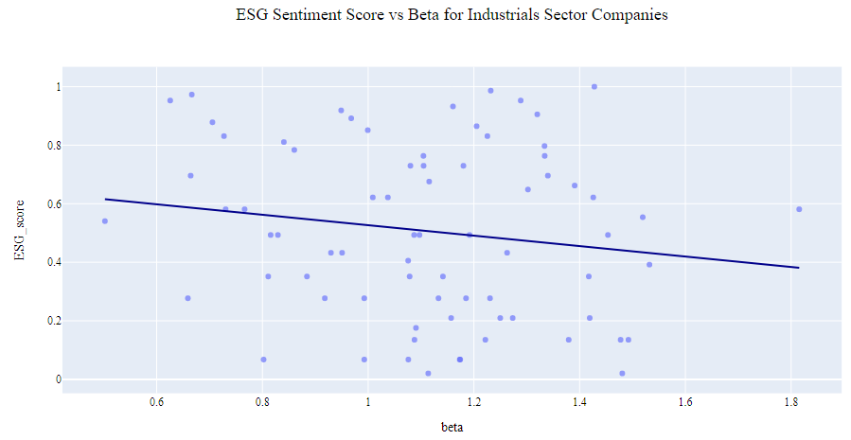
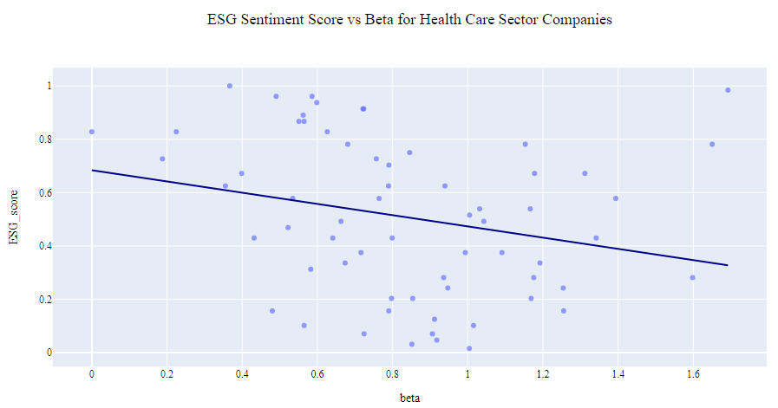
Analysis – ESG Sentiment scores by sector

Slide 14
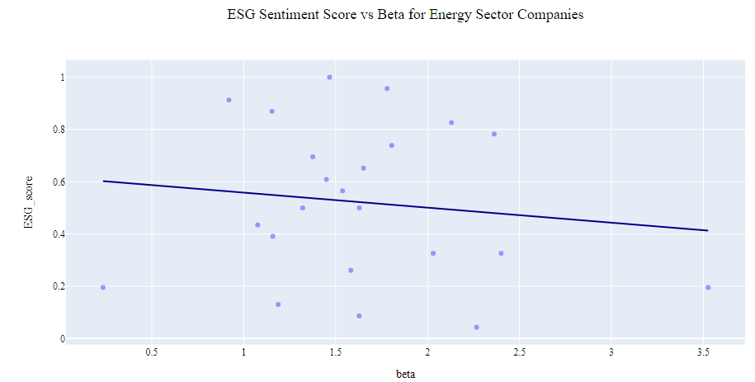
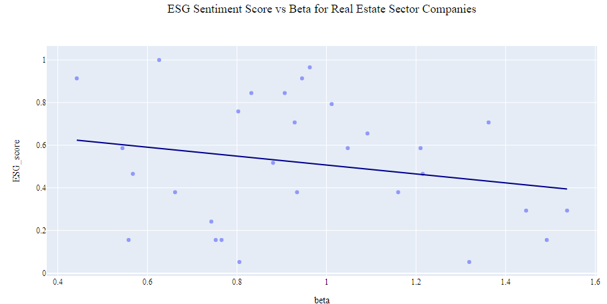
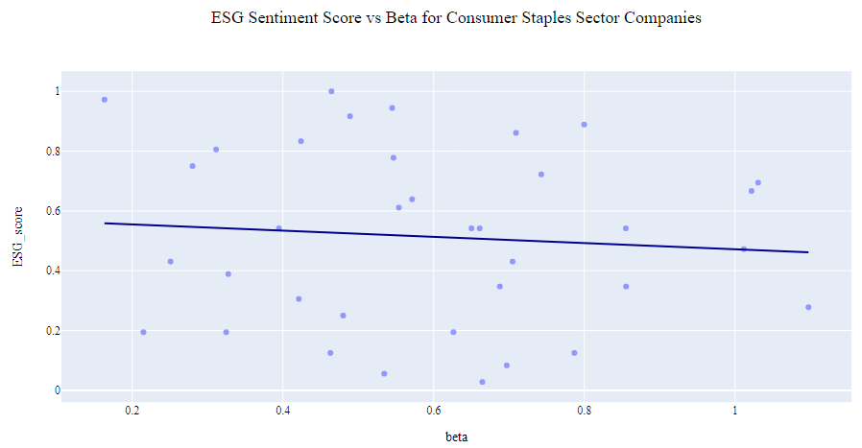

Analysis – ESG Sentiment scores by sector

Slide 15
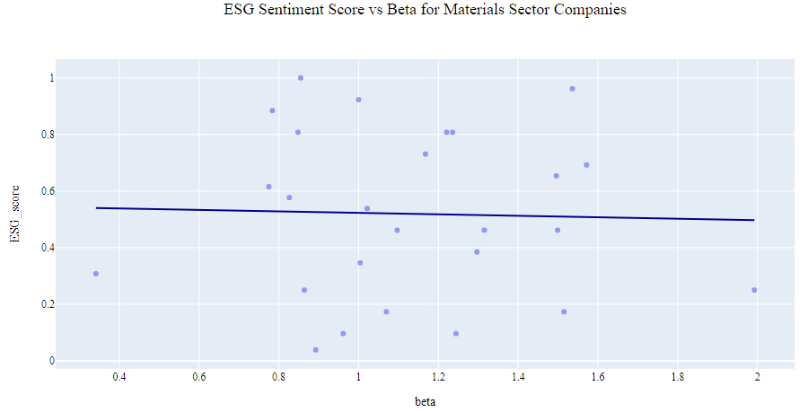
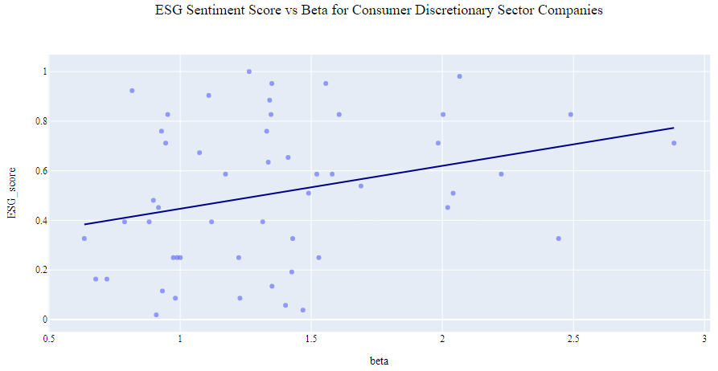
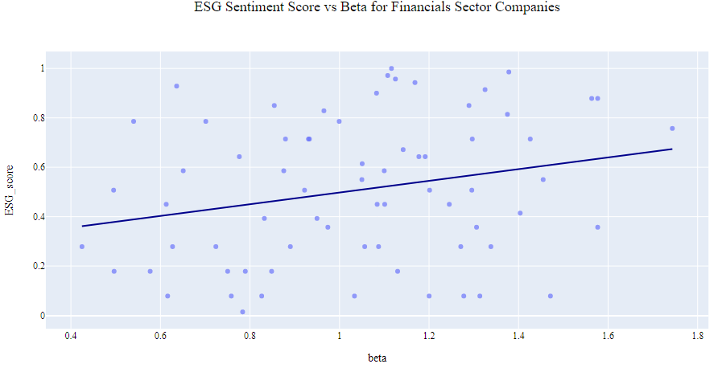
Analysis – ESG Sentiment scores by sector

Slide 16
Interpreting the results
Topic modeling can be used for creating a classification model.
Finbert-ESG classification model does well in extracting relevant ESG sentences.
FinBERT sentiment model does poorly on Environmental text- classifying phrases such as “reducing carbon output” as negative or neutral when they should be positive.
The correlation between calculated ESG score and beta is not clear. There is some indication that there is a small negative correlation.
ESG sentiment score can be a supplement to ESG ratings calculated from annual ESG reports.

Slide 17
Recommendations
Use Large dataset for Topic modeling to finetune Finbert-ESG classification model to create granular factor classification and improve model performance.
A domain-specific sentiment model should be trained, and this will require manual annotation.
Granular ESG factor should have different weights depending on the Sector type.
Calculate ESG score for a large set of companies and for multiple periods.
Compare results across those determined by multiple ESG ratings companies, with the understanding that a comparison will always be relative given differences in scoring.

Slide 18
Thank you for watching
LinkedIn: https://www.linkedin.com/in/husein-adenwala/
GitHub: https://github.com/haaden/MSDS_498
Email: huseinadenwala@gmail.com

Slide 19
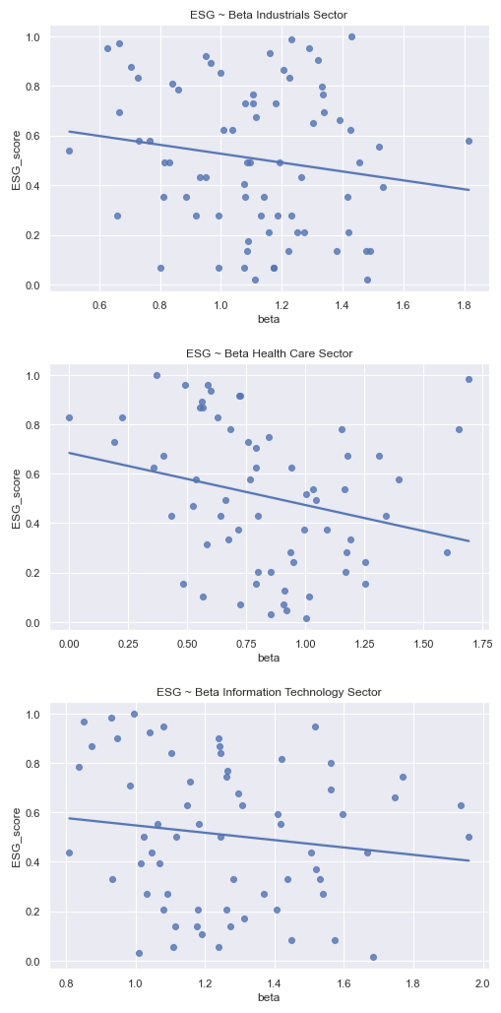
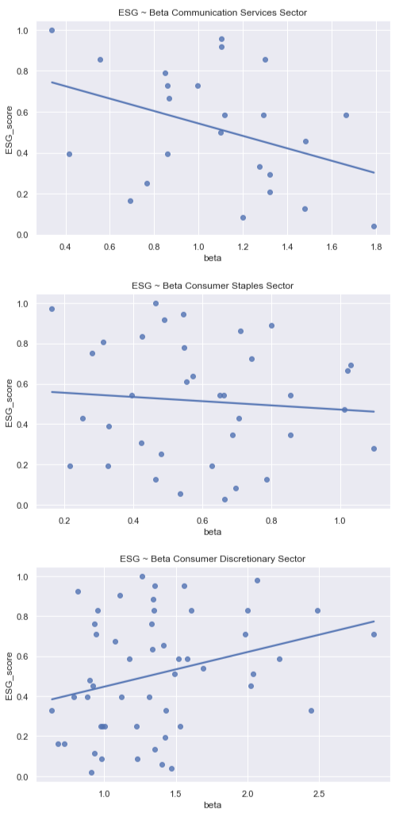
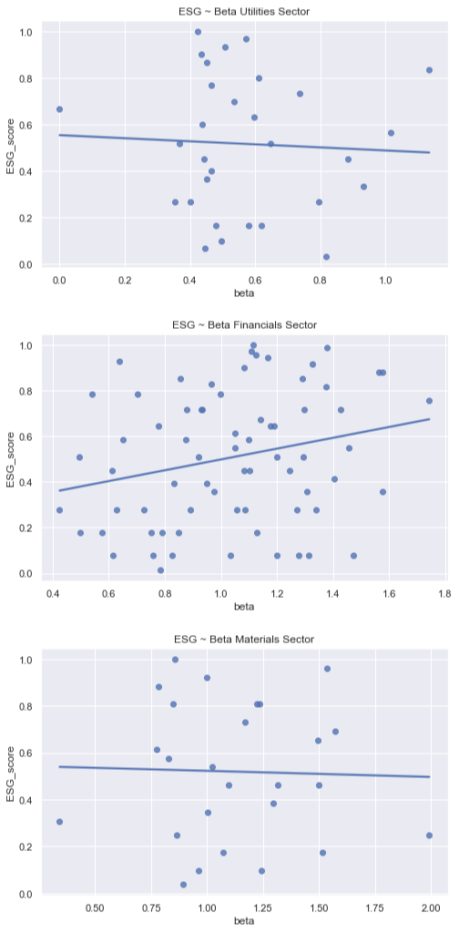
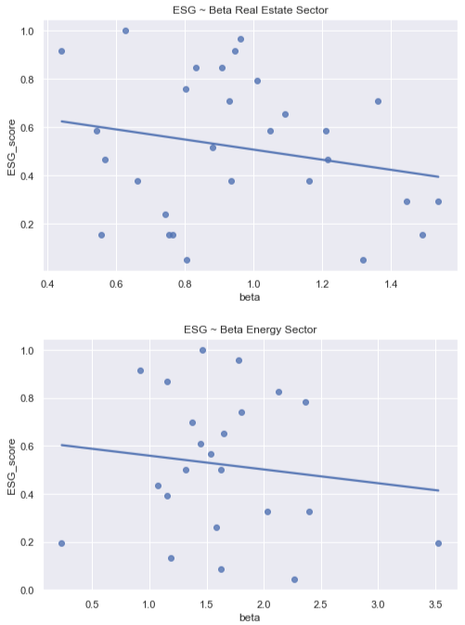

Slide 20
Topic modeling Methods
BERTtopic Model
Leveraging BERT embeddings and a class-based TF-IDF to create easily interpretable topics.
Top2vec
creates a jointly embedded document and word vectors using Universal Sentence Encoder or BERT Sentence Transformer
BERTopic doesn't take into account the cluster's centroid, but it considered all the documents in a cluster as a unique document and extracts topic representations using a class-based variation of TF-IDF

Slide 21
Challenges
Measuring and Reporting Inconsistency due to Multiple ESG reporting frameworks.
Lack of Benchmarking makes peer comparison difficult
Lack of timeliness as ESG reports are Voluntarily disclosed on an annual basis

Slide 22
Challenges
Measuring and Reporting Inconsistency due to Multiple ESG reporting frameworks.
Lack of Benchmarking makes peer comparison difficult
Lack of timeliness as ESG reports are Voluntarily disclosed on an annual basis

Slide 23
Challenges extracting data
Measuring and Reporting Inconsistency due to Multiple ESG reporting frameworks.
Lack of Benchmarking makes peer comparison difficult
Lack of timeliness as ESG reports are Voluntarily disclosed on an annual basis

Slide 24
Opportunity
Individual and large institutions are directing an ever-increasing proportion of their investment towards sustainable strategies.
Companies are disclosing ESG information in periods financial disclosure.
Recent advances in natural language processing (NLP) has given use the ability analyze more data.
This has enhanced corporate transparency and can provide new insights into how companies are being run from an ESG perspective
EU law requires companies to disclose information on social and environmental issues.
SEC proposed rules would require companies to include climate-related disclosure
Growing interest
Regulation
NLP Advances

Slide 25
Opportunity
Growing Interest
Individual and large institutions are directing an ever-increasing proportion of their investment towards sustainable strategies.
Companies are disclosing ESG information in periods financial disclosure
Regulations
EU law requires companies to disclose information on social and environmental issues.
SEC proposed rules would require companies to include climate-related disclosure
Machine learning
Recent advances in natural language processing (NLP) has given use the ability analyze more data.
This has enhanced corporate transparency and can provide new insights into how companies are being run from an ESG perspective

Slide 26
Machine learning
Artificial intelligence
*beta is stock price volatility. Closer to 0 indicates less volatility. Above 1 indicates higher volatility compared to the benchmark.

