Slide 1
Postman – For testing REST API

Slide 2
Postman hints, tested with Feb 2023 version
Create Collection, and there folders and subfolders.
E.g. category_single, category_multiple, idea_single, idea_multiple folders – So you have less test cases in each folder
Create Environment, and there Variables, like BACKEND_SERVER_PORT
Double-click on hard coded parts of the URL, e.g. :8777 and turn it into {{BACKEND_SERVER_PORT}}. Then by changing the current value of the variable, all test cases using that variable get the new value
While creating a new test case variation, start with “Save as”. Otherwise risk losing the old variation
While saving as new, select the collection and folder that suits the best
I used the naming like /api/category/1 (OK) for my test cases. (FAIL) for those that are supposed to fail
While creating a POST or PUT test case, you can first use a singleton GET to get the correct JSON format example.
Then edit it so that it will not have duplicate names, and so that the POST does NOT have the id
The JSON is put to the Body > Raw > Text => JSON. If you suspect a JSON format problem, use e.g. jslint.com.

Slide 3
Postman hints, tested with Feb 2023 version
You can right-click the Collection and scroll list down until you find: Export. You can save your test collection as JSON file e.g. to your git repo, let’s say Postman folder
=> you will get an off-line copy of the test cases, yet somehow sharable by git
Limitation (Feb 2024 situation): Sharing Postman Team online is free for max 3 members.
VS Code has nowadays the REST Client addition.
Does it now support all the same that is mentioned here?
What PostMan has better than VS Code REST client (April 2024) is dynamic creation of correct JWT auth/auth tokens. You will need to tell PostMan these, and without login it can create the login/authentication token:
Username/email/userid/password and other encrypted information
The exact algorithm used in encryption
The backend SECRET hash
In the following SCREENSHOT you can see some basic concepts and ideas of PostMan testing. E.g. the idea of creating multiple test cases, some OK, some failing on purpose. And e.g. creating folders for single item tests, and multiple item tests. Just for clarity and convenience.

Slide 4
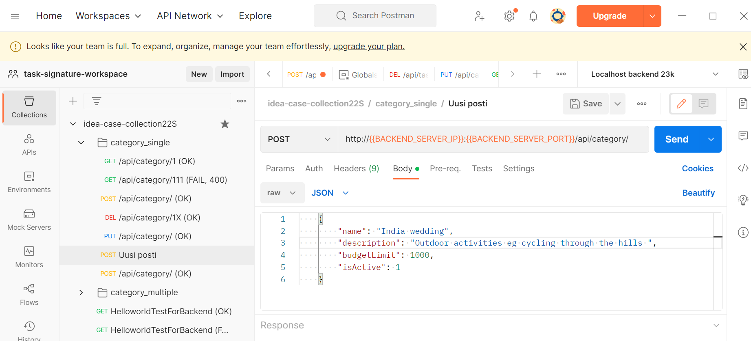
Postman, tested with Feb 2023 version

