Slide 1
Database creation for Idea-case
idea-case-backend – Juhani Välimäki

Slide 2
1. Teacher created a Virtual machine, database and there sandboxes (=schemas) for 70 DB users
To the Finnish CSC cloud, cPouta machines. Here are the installation notes / steps if someone interested:
https://github.com/haagahelia/linux-servers-etc/
https://github.com/haagahelia/linux-servers-etc/blob/main/CSC_virtual_machine_and_user_creation.md (Linux and its 2 users)
And here are the steps used to create the 70 schemas and 70 users to database.
https://github.com/haagahelia/linux-servers-etc/blob/main/mariadb_installation.md

Slide 3
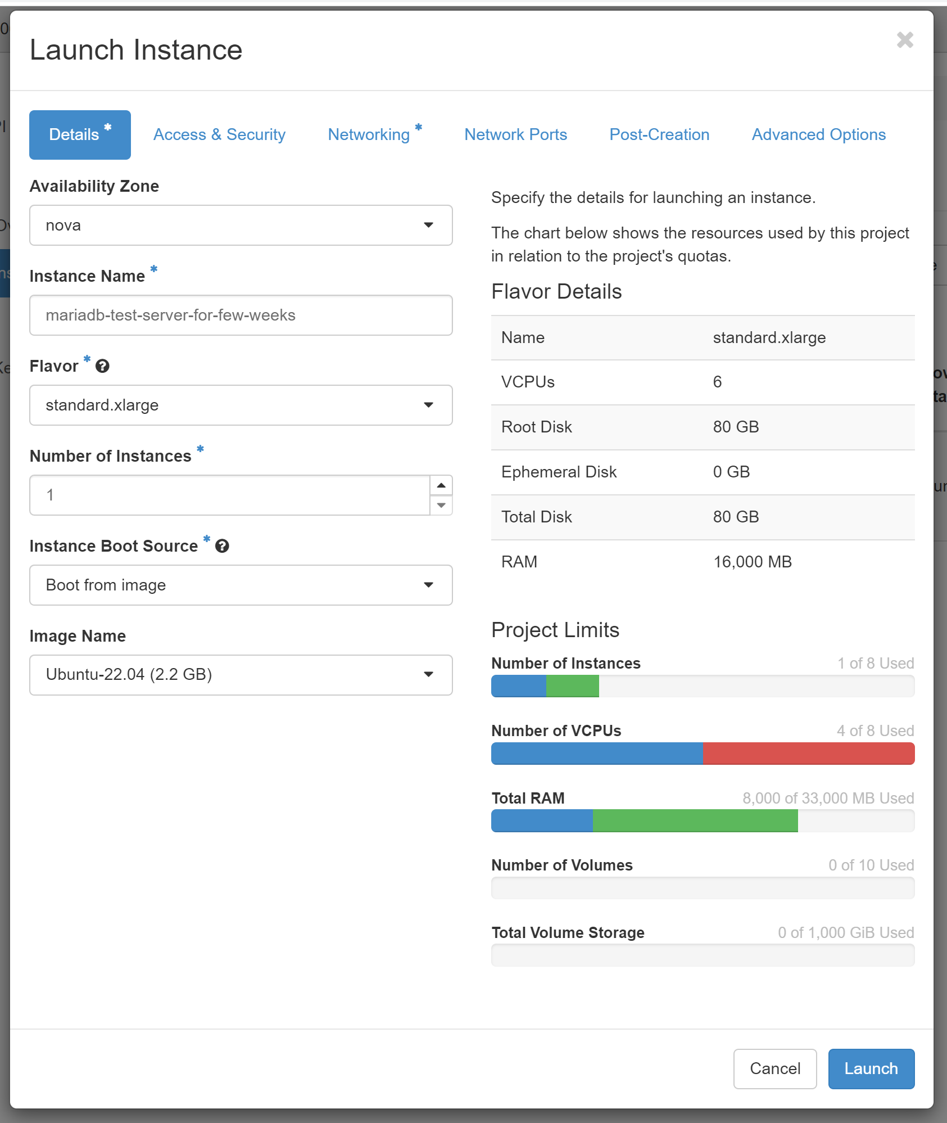
View to some of the creation steps in the cloud…

Slide 4
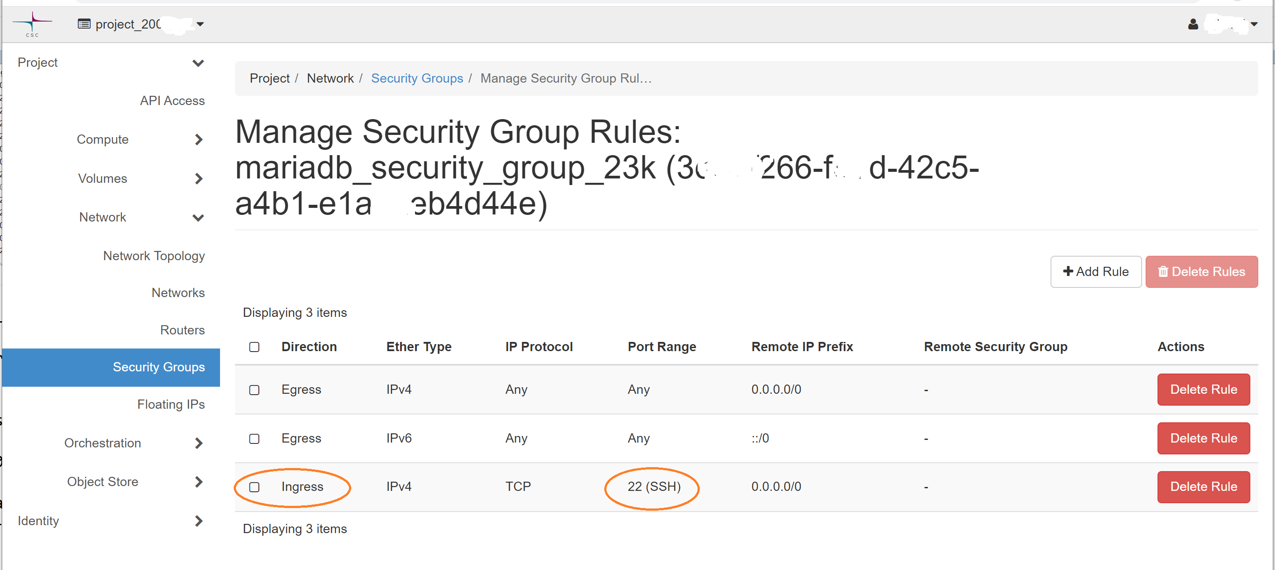
View to some of the creation steps in the cloud…

Slide 5
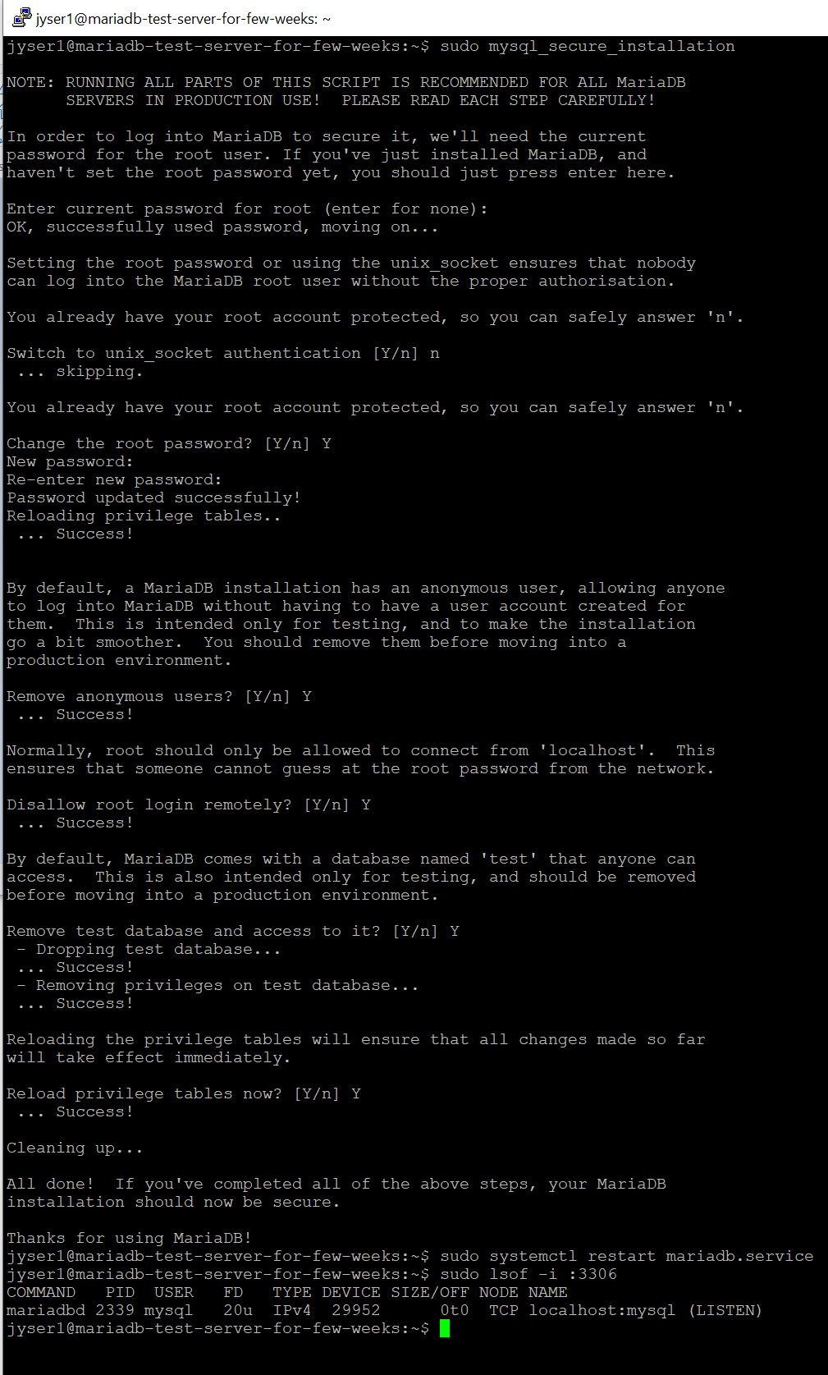
View to some of the creation steps in the cloud… Here running the mysql_secure_installation hardening script or wizard against installed and started MariaDB server

Slide 6
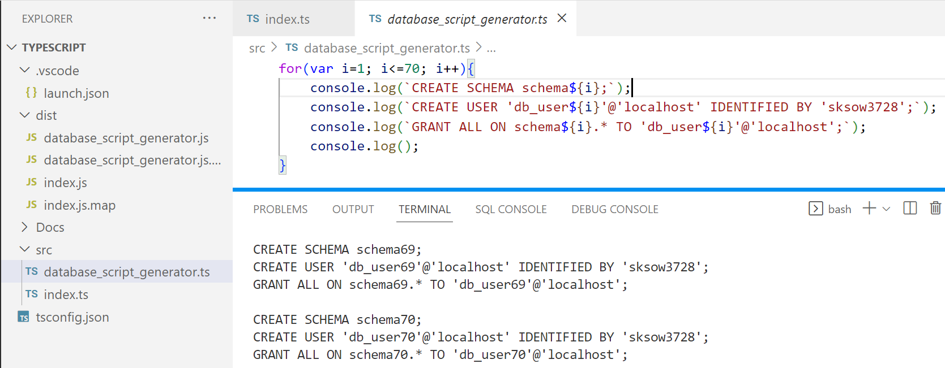
View to some of the creation steps in the cloud…

Slide 7
2. You need to install the needed tools…
For database connection etc. these are needed:
(MariaDB or MySQL, if you want to install your own, instead of using my cloud DB)
ssh – for tunnel creation. E.g. GitBash should have this. Maybe Powershell too
DBeaver – Community Edition. testing the tunnel connection, creating and filling the tables, and possibly creating ER diagrams, looking at the table data while testing, etc.

Slide 8
2. … and use ssh to create the tunnel (SSH port forwarding)
The server only has 2 Linux users. You are going to use the normal user who has just normal rights
Only port 22 open, thus you need to use the tunnel to connect to this MariaDB,
cannot access 3306 directly
ssh -f jyser2@86.50.229.46 -L 3306:localhost:3306 -N (Password given by teacher in Teams>Files)
Red- and blue-marked parts change from case to case. E.g. If some other process has already taken port 3306 in your computer, you can use 3308 as the first number.
Note! Your project .env and such setting must match with the created tunnel. In this case tunnel starts at localhost:3306 (or 3308)
In a true Linux tool style the tunnel creation doesn’t show anything if no problems ☺
lsof -i :3306 (Linux) or netstat -aof | findstr :3306 (Windows) might help you check if tunnel process stil there

Slide 9
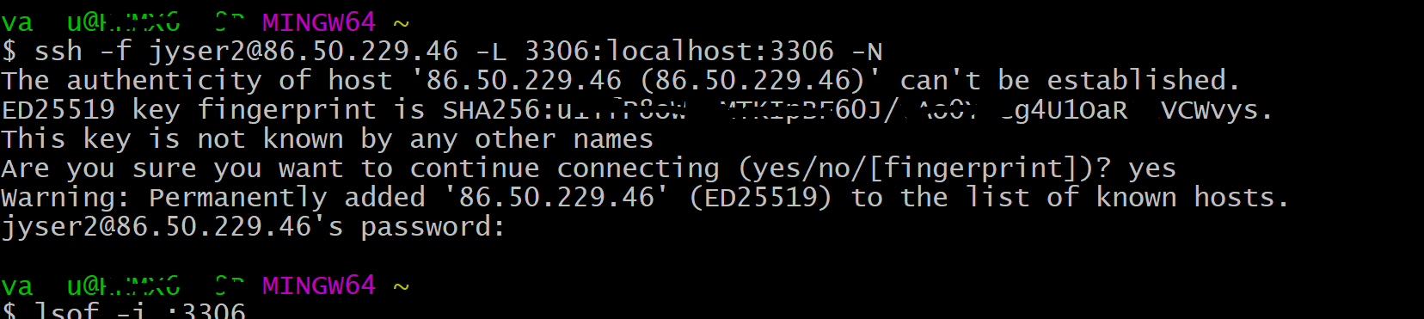
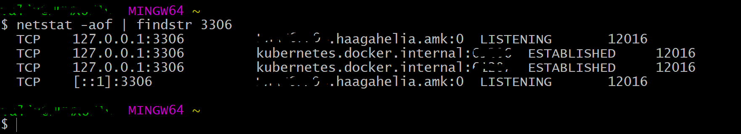
2. … and use ssh to create the tunnel
netstat -aof in Windows might take some time to produce results. Reason unknown.

Slide 10
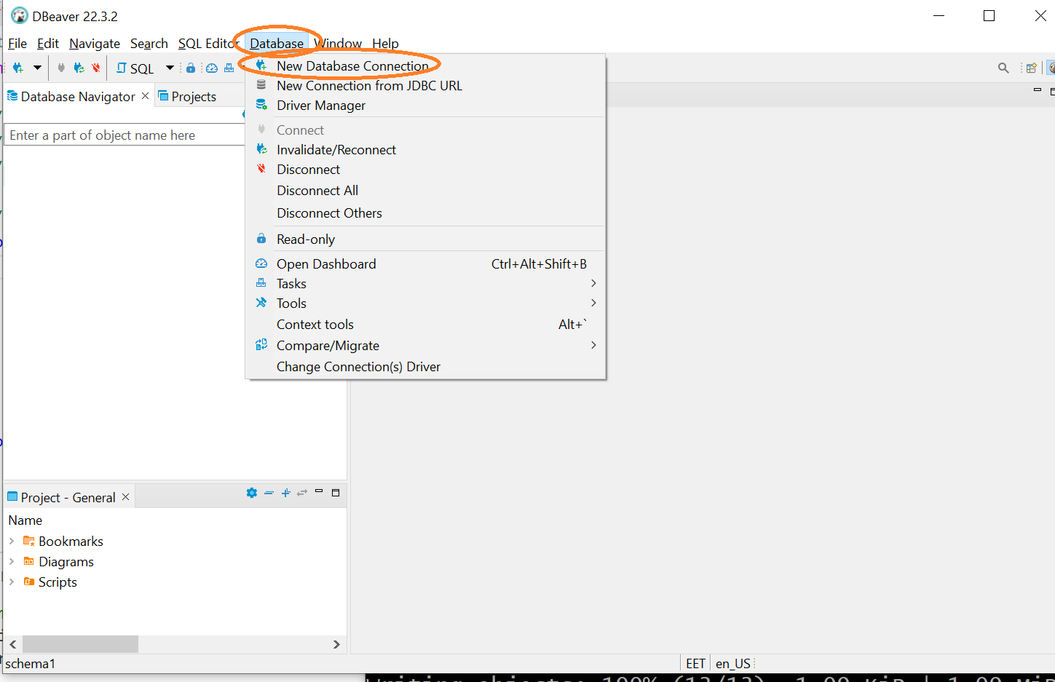
3.1.1 Use DBeaver according to the pictures to create and test the connection

Slide 11
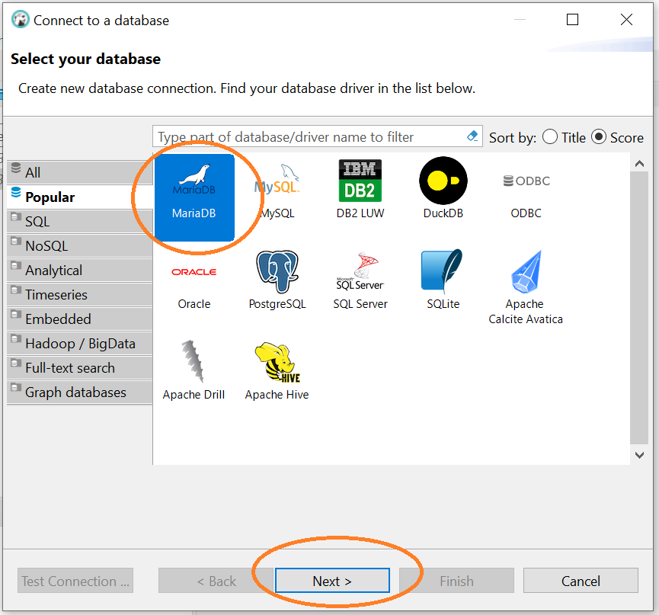
3.1.2 Use DBeaver according to the pictures to create and test the connection

Slide 12
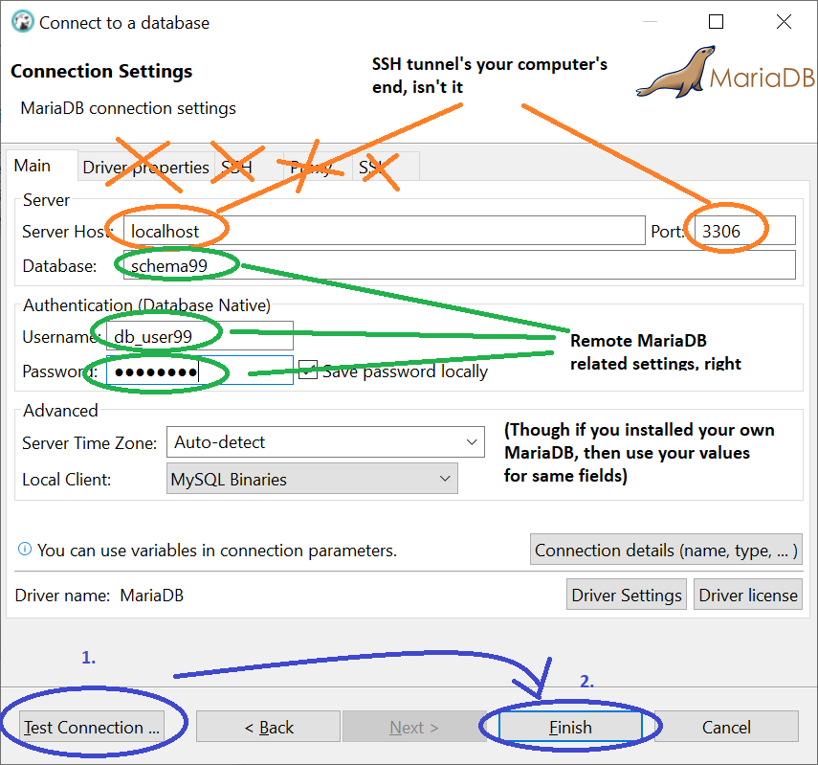
3.1.3 Use DBeaver according to the pictures to create and test the connection

Slide 13
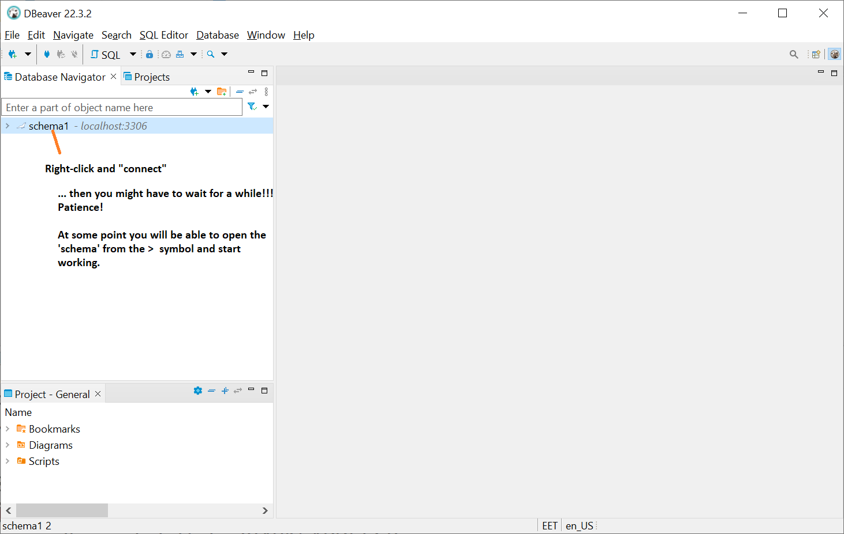
3.1.4 Use DBeaver according to the pictures to create and test the connection

Slide 14
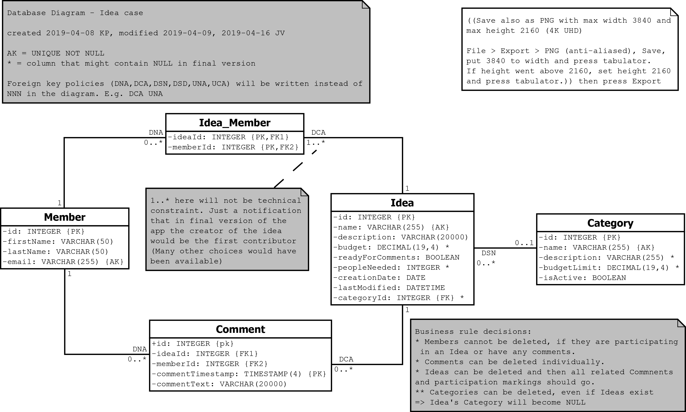
Here is how the database will look like:

Slide 15
Download the SQL script for creating the database
Now download at least the https://github.com/valju/idea-case-backend/blob/master/Database/SQL_Scripts/000_drop_create_insert.sql this file to some known folder.
Or just clone the repo
It drops, creates and populates the needed tables.

Slide 16
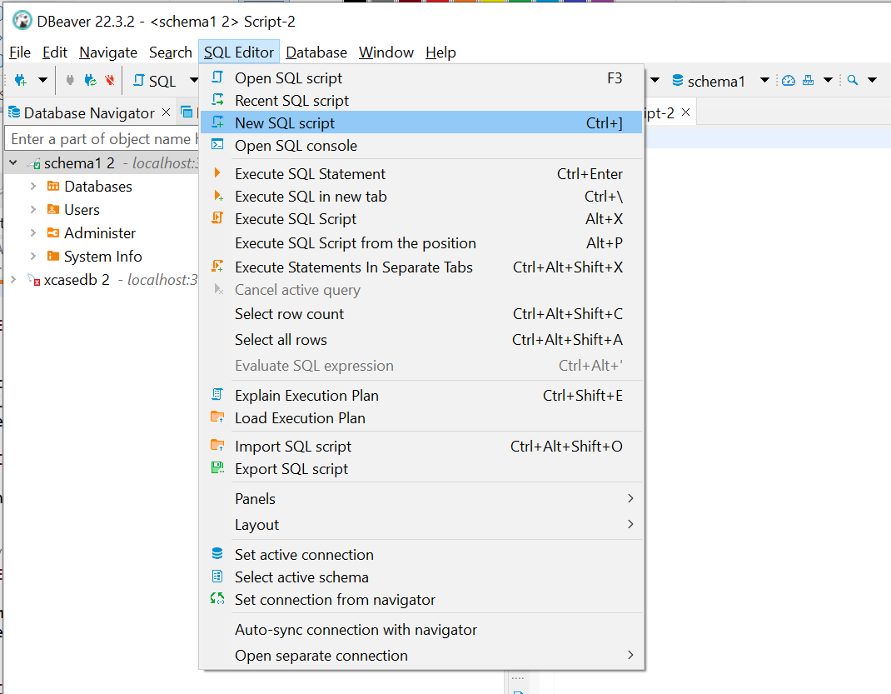
3.2.1 Use DBeaver to run SQL to create the tables and populate with test data

Slide 17
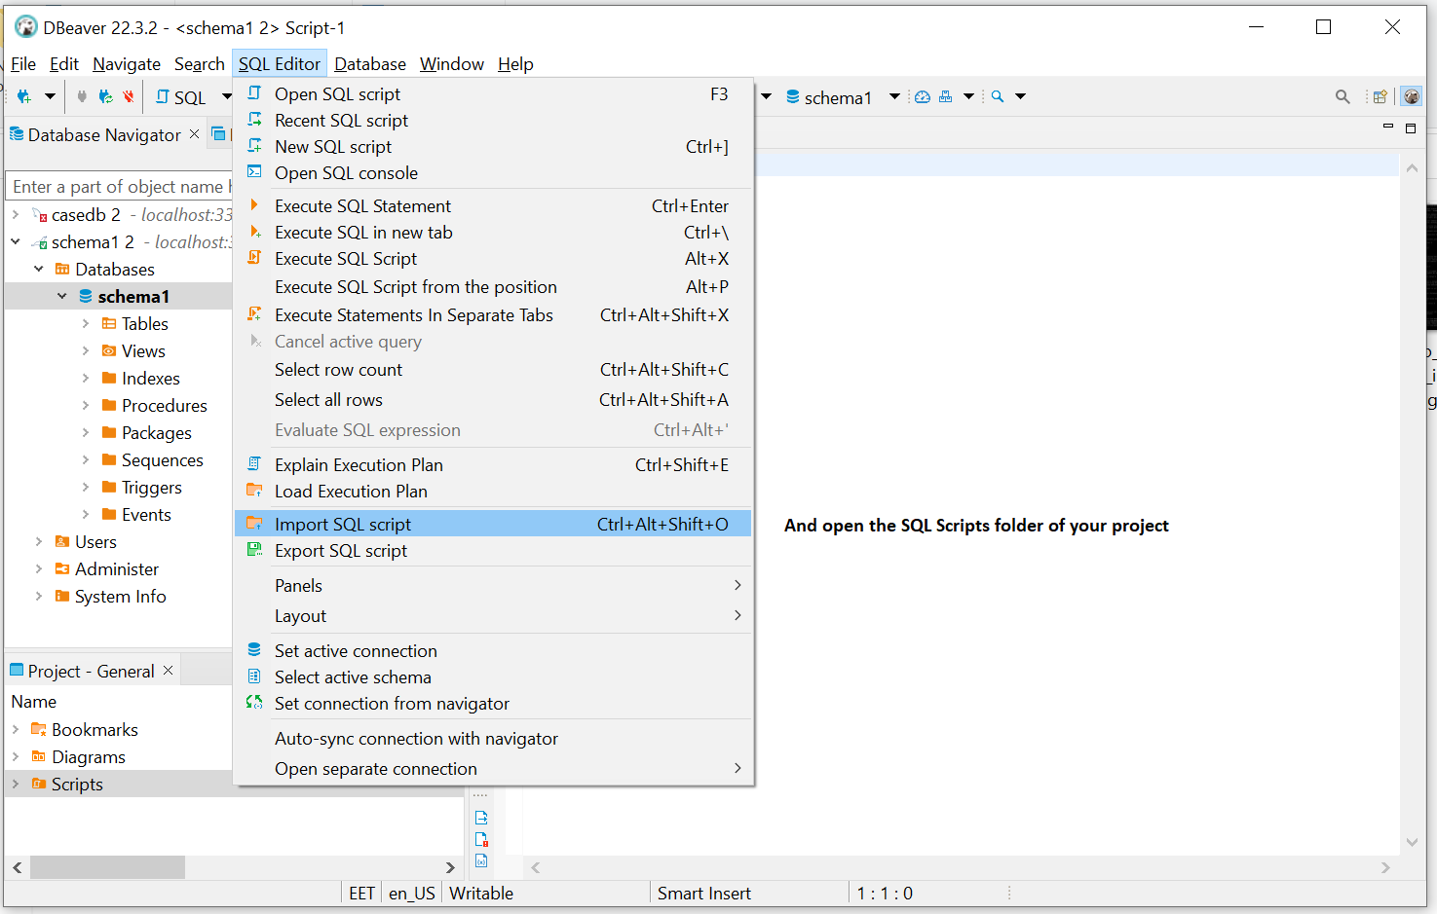
3.2.2 Use DBeaver to run SQL to create the tables and populate with test data

Slide 18
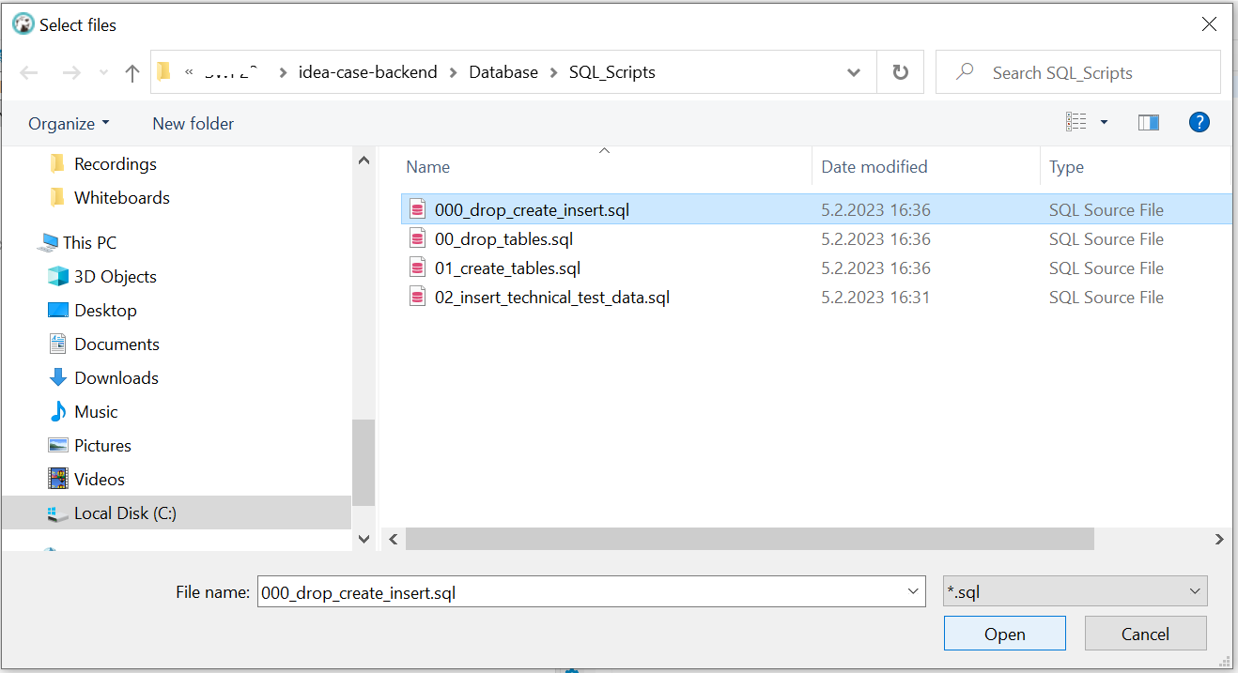
3.2.3 Use DBeaver to run SQL to create the tables and populate with test data

Slide 19
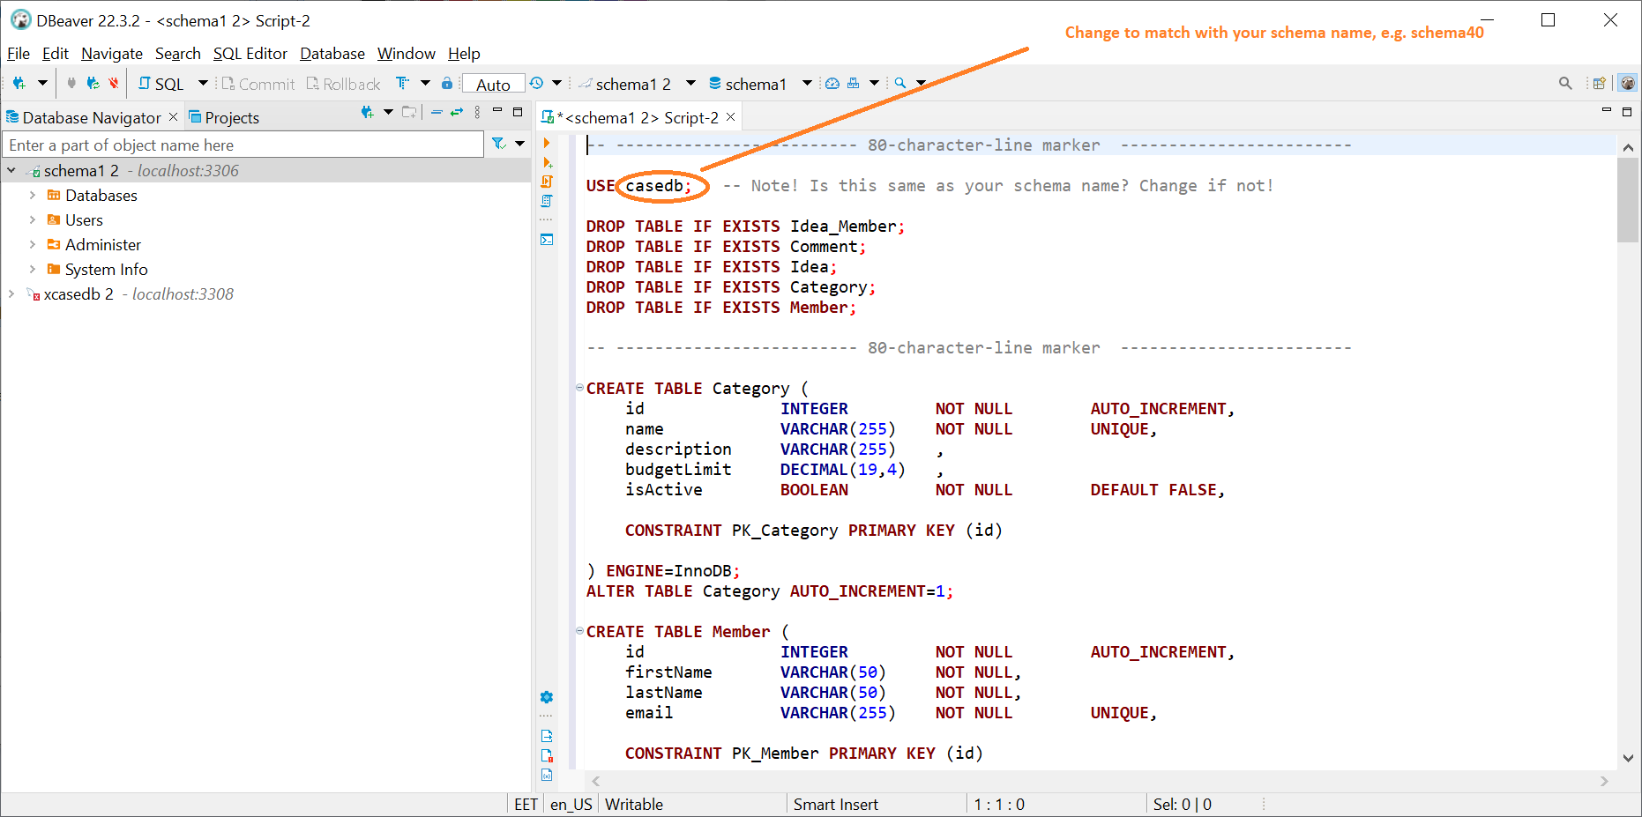
3.2.4 Use DBeaver to run SQL to create the tables and populate with test data

Slide 20
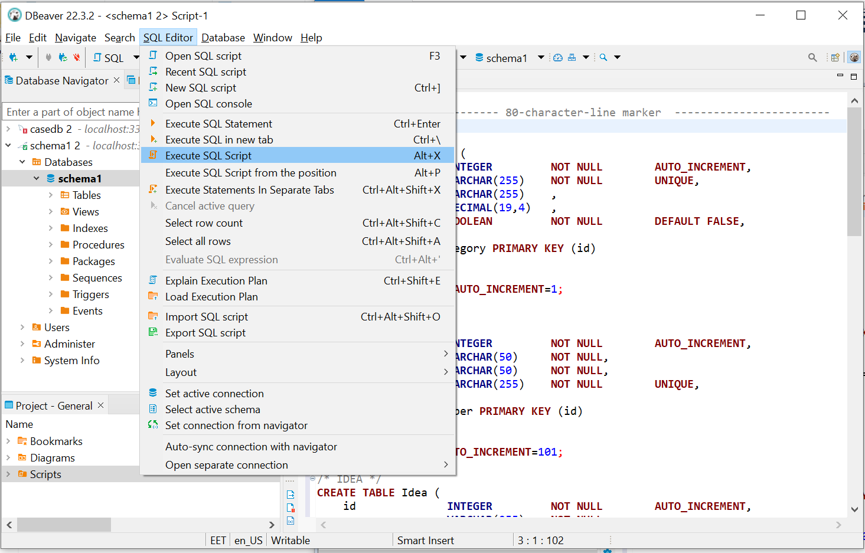
3.2.5 Use DBeaver to run SQL to create the tables and populate with test data

Slide 21
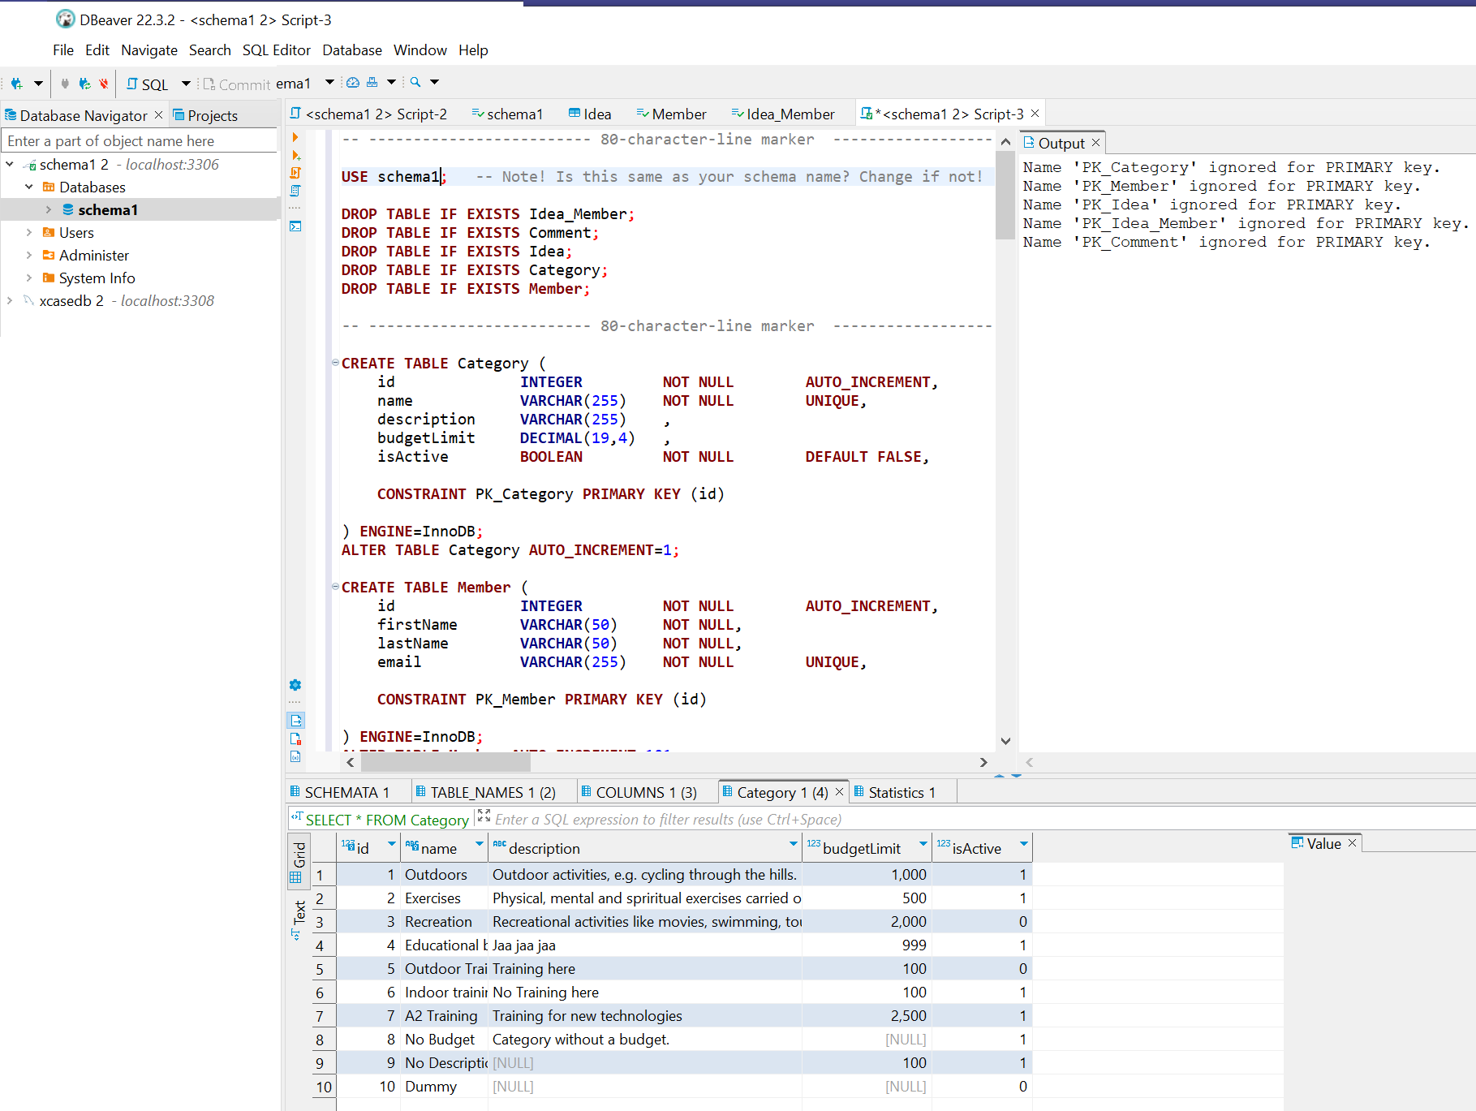
3.2.6 Use DBeaver to run SQL to create the tables and populate with test data – Success?

