Slide 1
Database creation for Idea-case
idea-case-backend – Juhani Välimäki

Slide 2
0. Teacher created a Virtual machine, database and there sandboxes (=schemas) for 70 DB users
To the Finnish CSC’s cloud, cPouta machine. Here are the installation notes / steps if someone is interested: (extra information)
https://github.com/haagahelia/linux-servers-etc/
https://github.com/haagahelia/linux-servers-etc/blob/main/CSC_virtual_machine_and_user_creation.md (Linux and its 2 users)
And here are the steps used to create the MariaDB, and 70 schemas and users to that database.
https://github.com/haagahelia/linux-servers-etc/blob/main/mariadb_installation.md

Slide 3
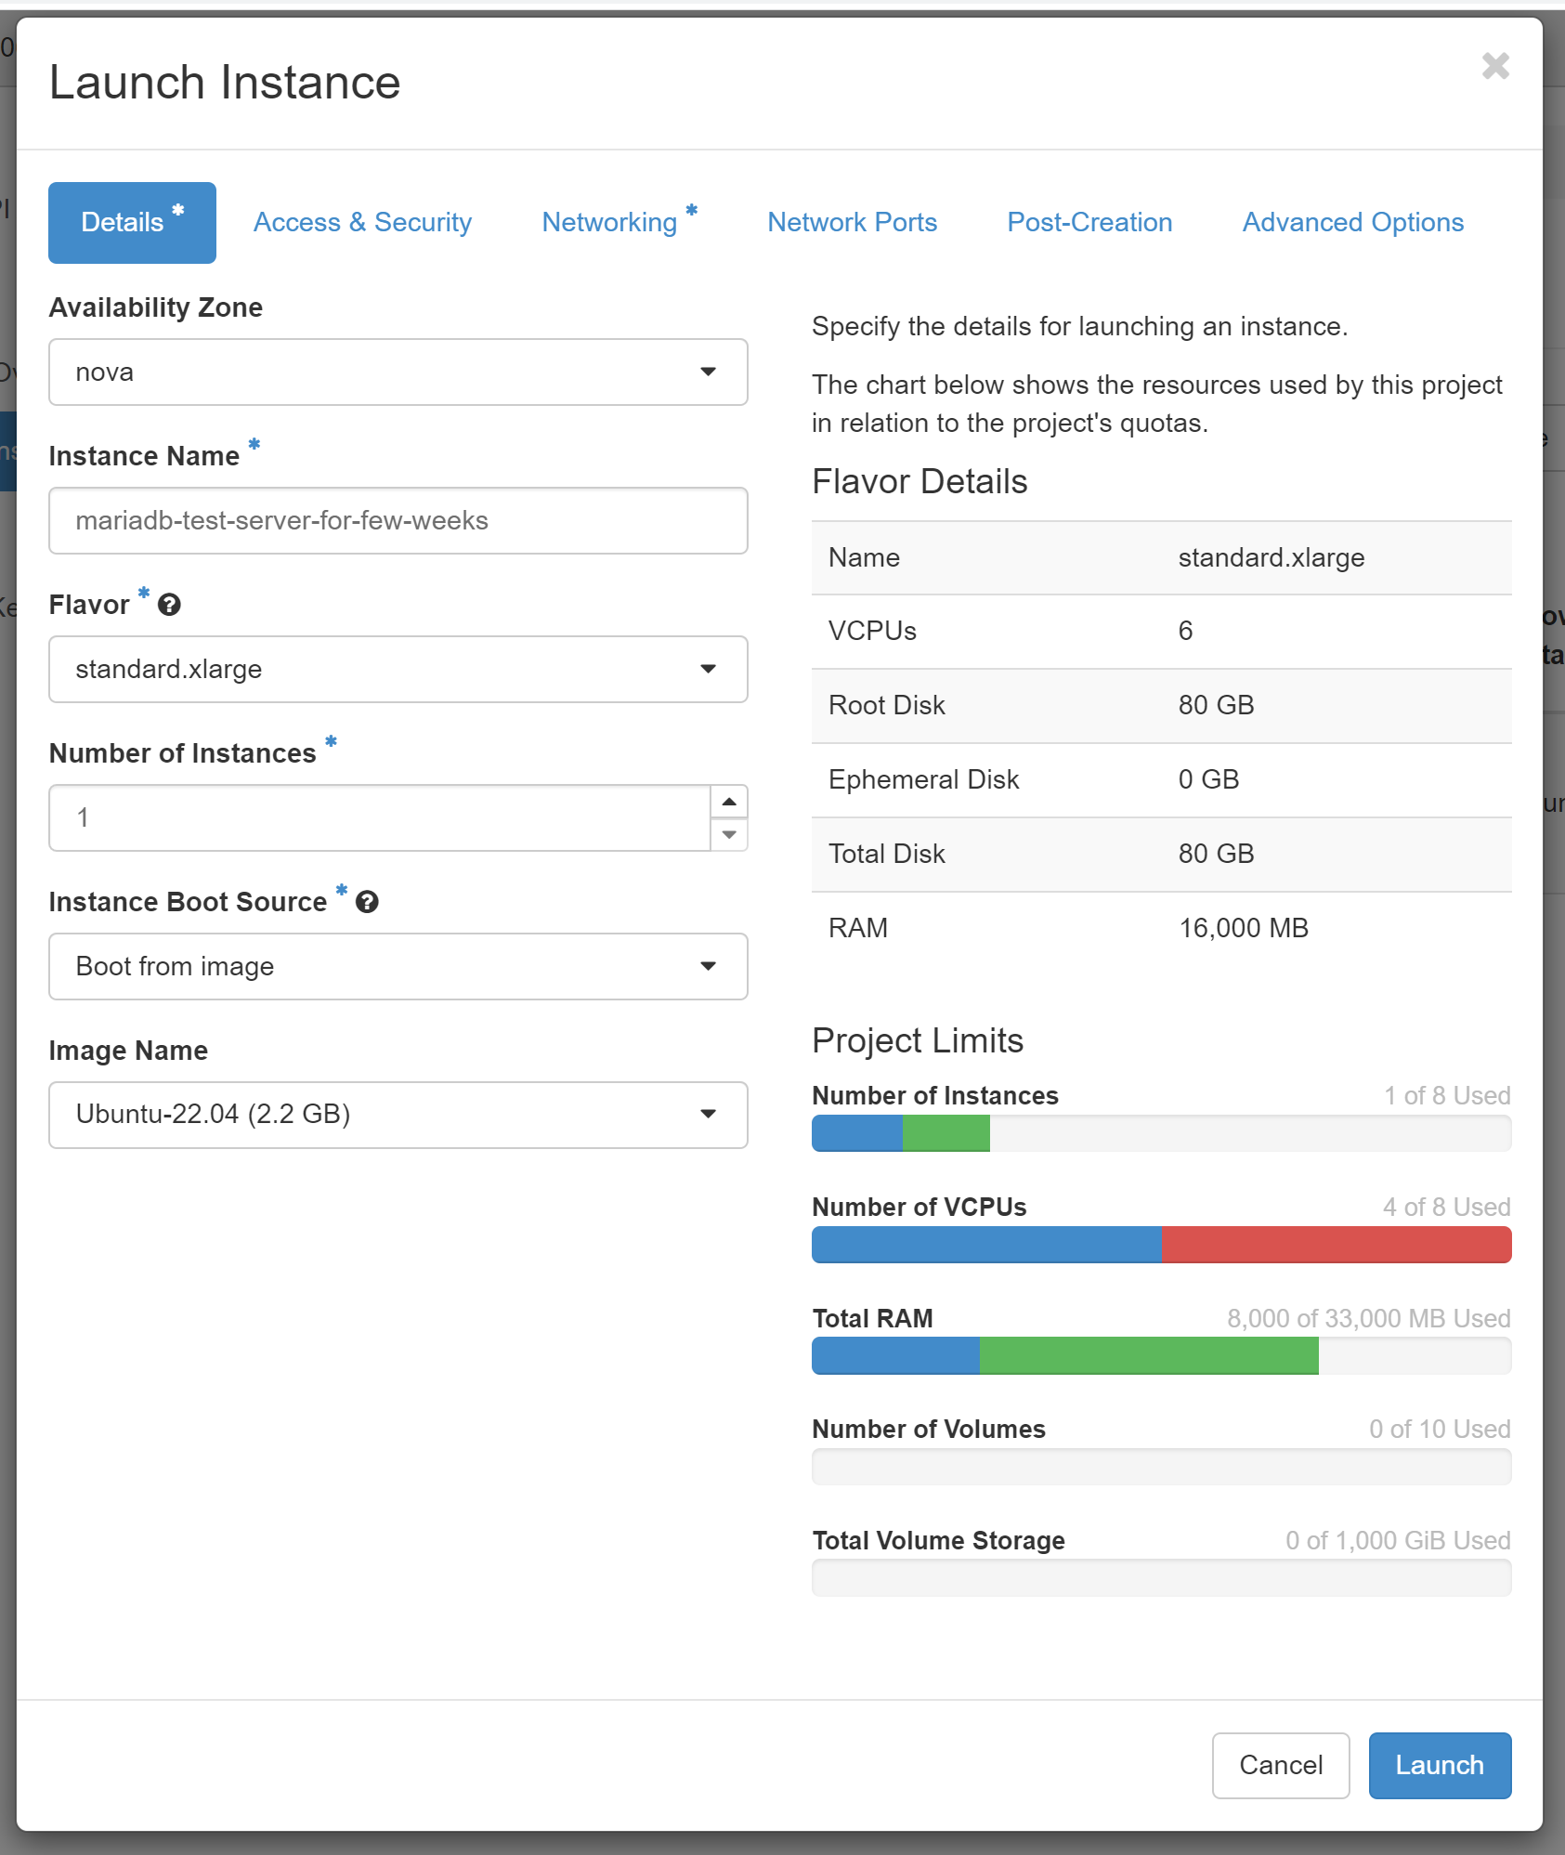
View to some of the creation steps in the cloud… Here the Virtual Machine resources selected. And the Ubuntu base image.

Slide 4
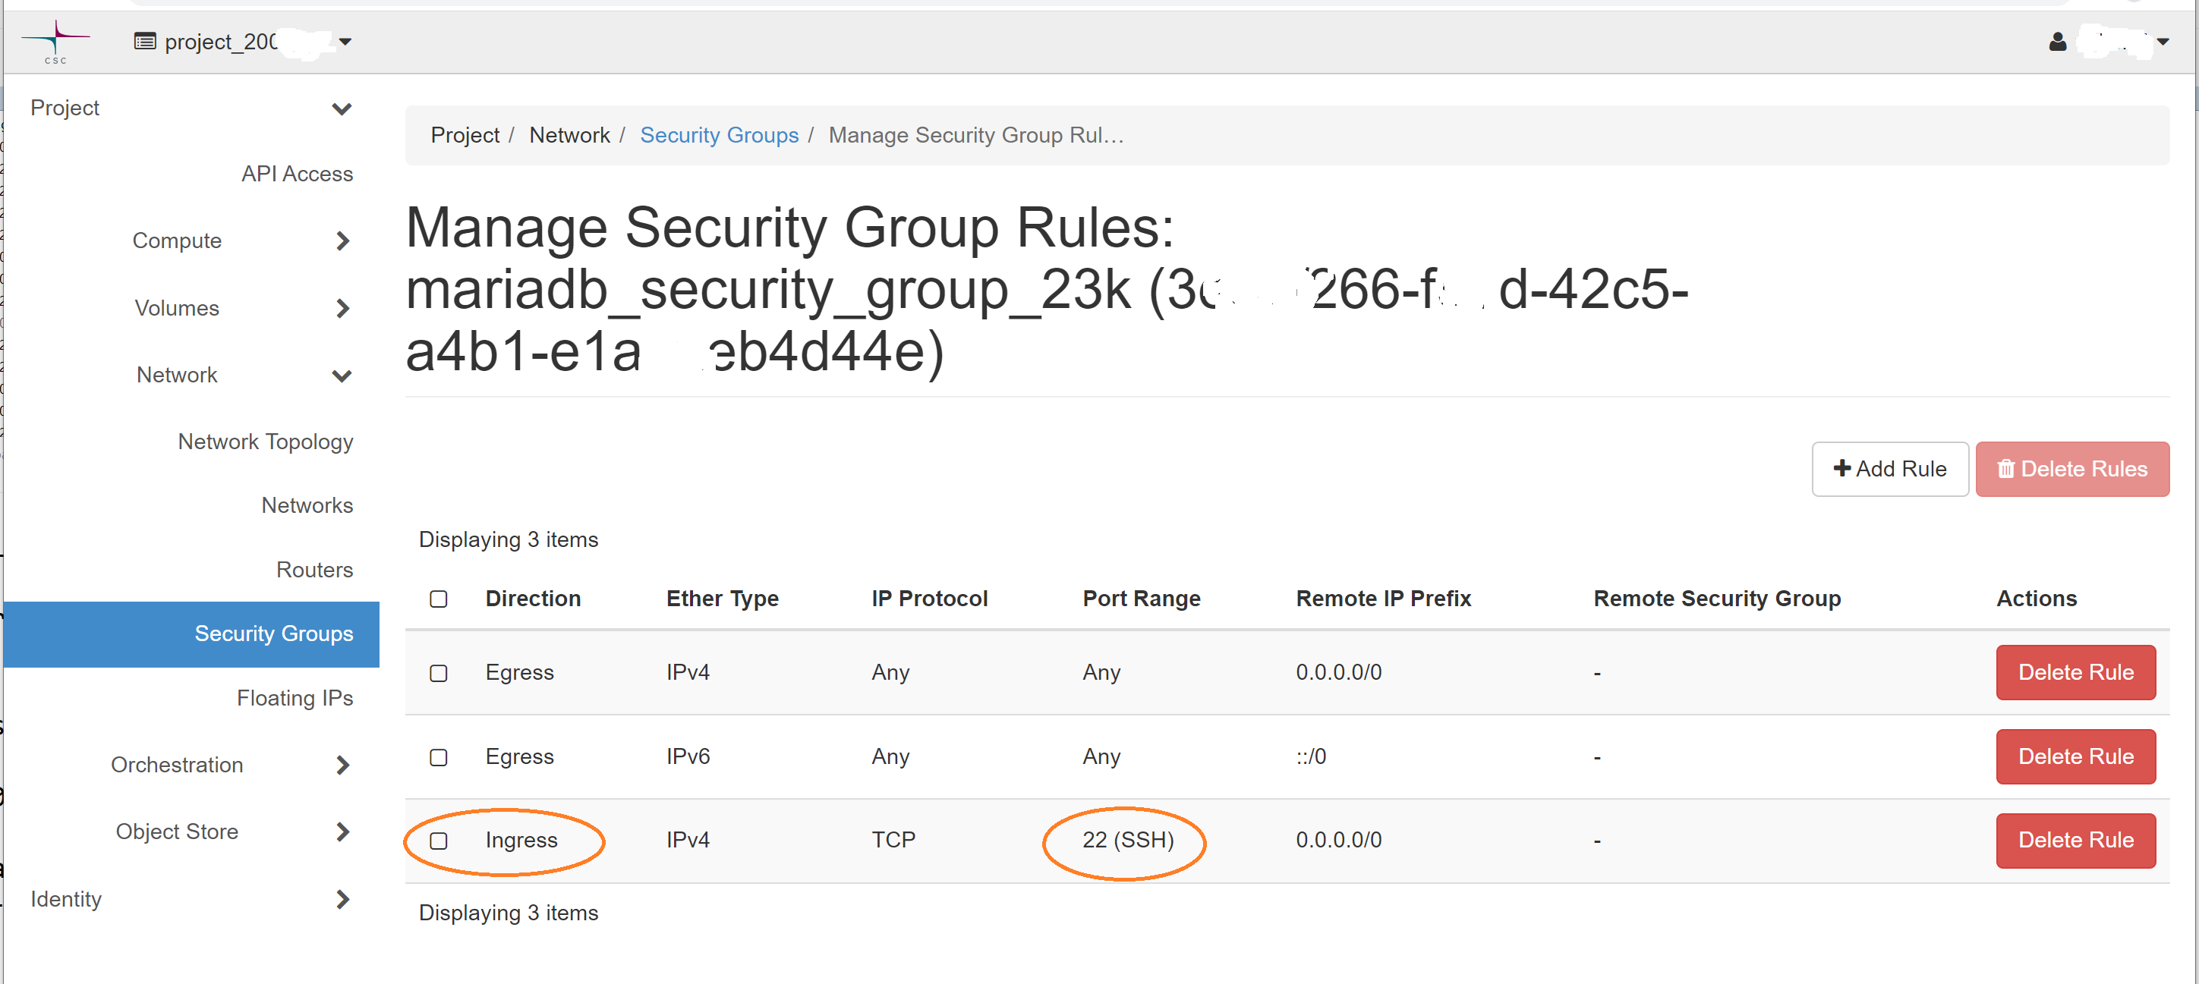
View to some of the creation steps – strictish Firewall

Slide 5
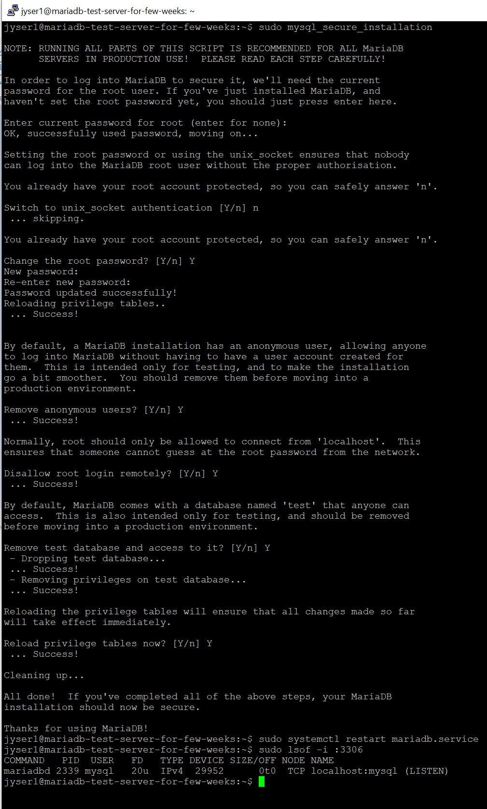
View to some of the creation steps in the cloud… Here running the mysql_secure_installation hardening script or wizard against installed and started MariaDB server

Slide 6
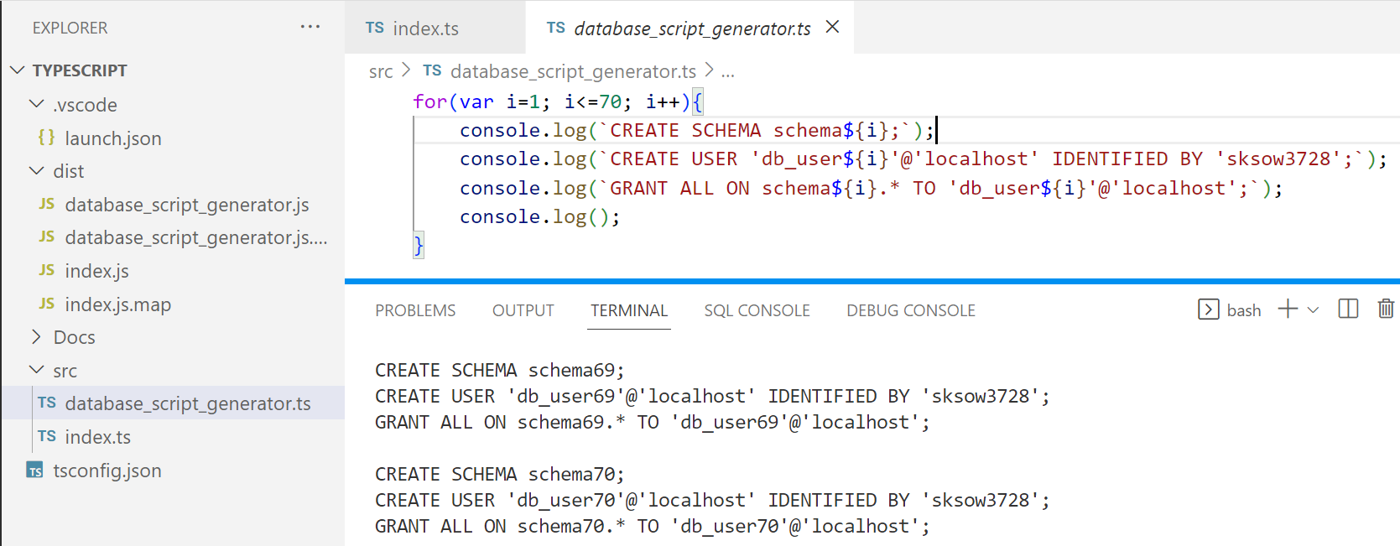
View to some of creation steps. 70 DB users and schema for each. Granting rights to that schema

Slide 7
YOUR PART STARTS HERE

Slide 8
1. You need to install the needed tools…
For database connection etc. these are needed:
(MariaDB or MySQL, if you want to install your own, instead of using my cloud DB)
ssh – for tunnel creation. E.g. GitBash should have this. Maybe Powershell too.
Putty could also be used to create the tunnel.
DBeaver – Community Edition. testing the tunnel connection, creating and filling the tables, and possibly creating ER diagrams, looking at the table data while testing, etc.

Slide 9
2. … and use ssh to create the tunnel (SSH port forwarding)
The server only has 2 Linux users. You can only use the normal user who has just normal rights
Only port :22 open, thus you’ll need to use the tunnel to connect to this remote MariaDB,
cannot access :3306 directly, but need to create a tunnel to it.
ssh -f jyser2@86.50.229.46 -L 3306:localhost:3306 -N (Password given by teacher in Teams>Files)
Red- and blue-marked parts might change from case to case. E.g. If some other process has already taken port 3306 in your computer, you can use 3308 as the first number.
Note! Your project .env and such setting must match with the created tunnel. In this case tunnel starts at localhost and 3306 (or 3308)
In a true Linux program style the tunnel creation doesn’t show anything if no problems ☺
lsof -i :3306 (Linux) or netstat -aof | findstr :3306 (Windows) might help you check if tunnel process stil there

Slide 10
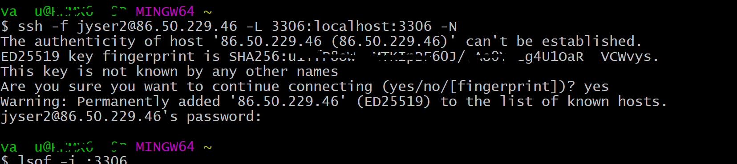
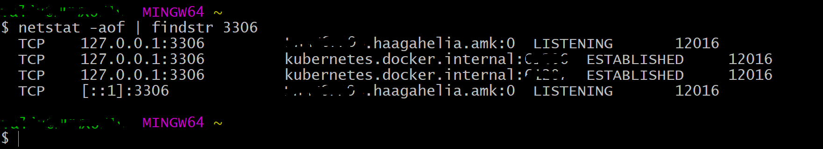
2. … and use ssh to create the tunnel
netstat -aof in Windows might take some time to produce results. Reason unknown.

Slide 11
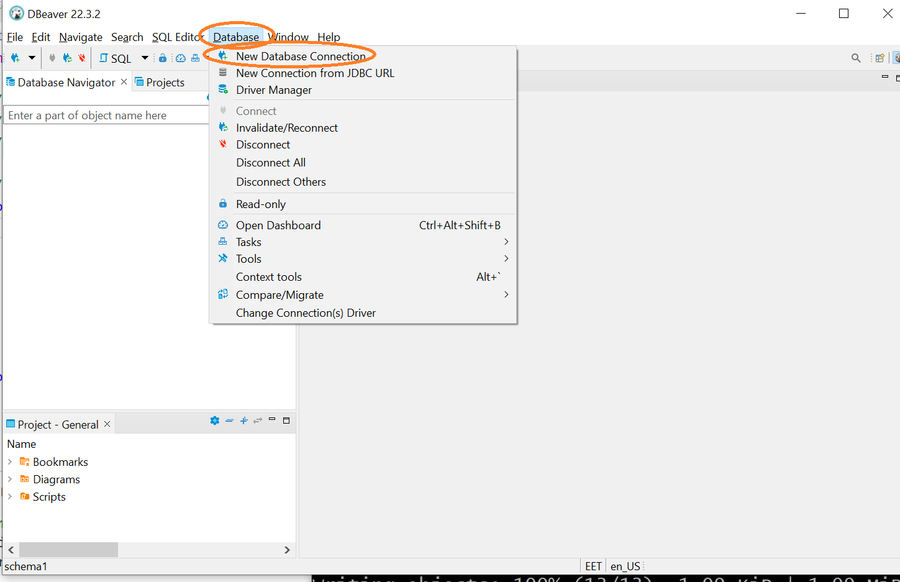
3.1.1 Use DBeaver according to the pictures to create and test the connection

Slide 12
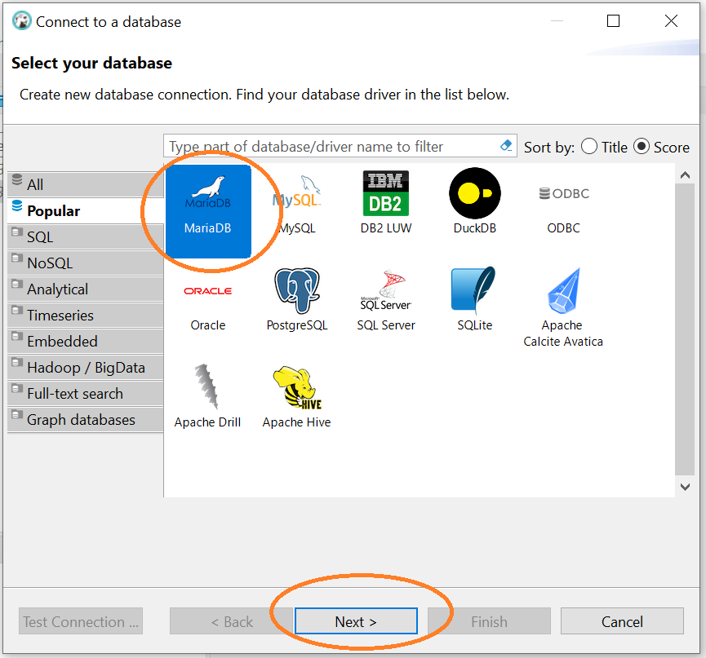
3.1.2 Use DBeaver according to the pictures to create and test the connection

Slide 13
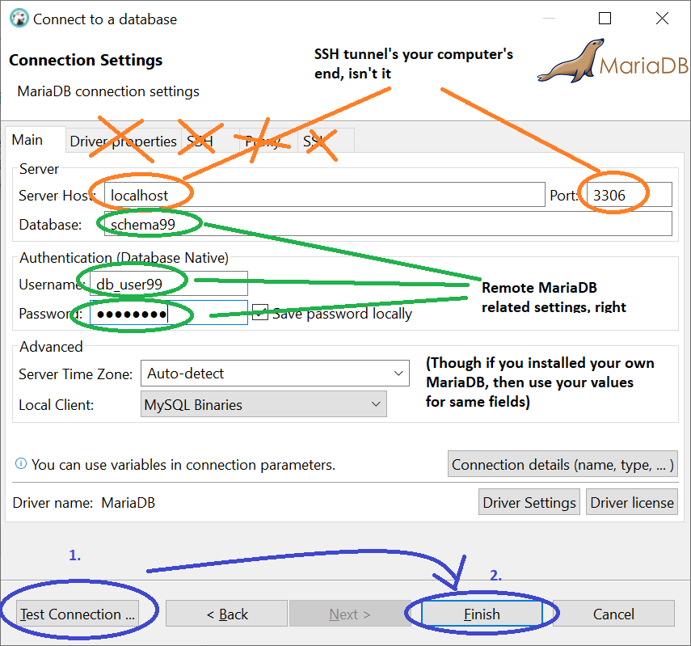
3.1.3 Use DBeaver according to the pictures to create and test the connection

Slide 14
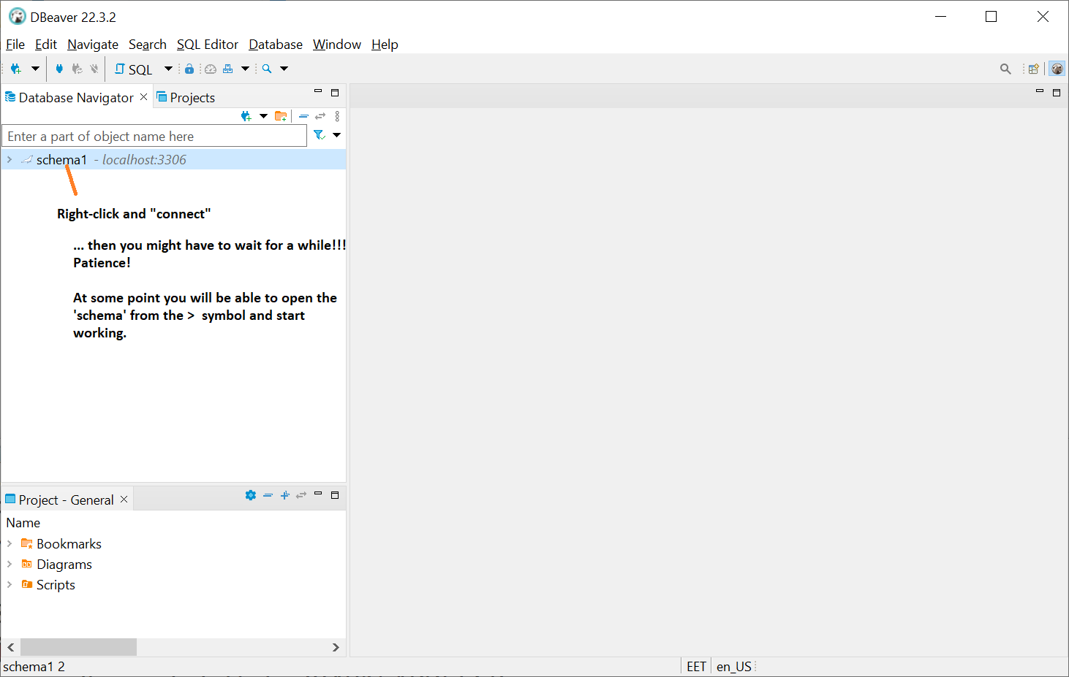
3.1.4 Use DBeaver according to the pictures to create and test the connection

Slide 15
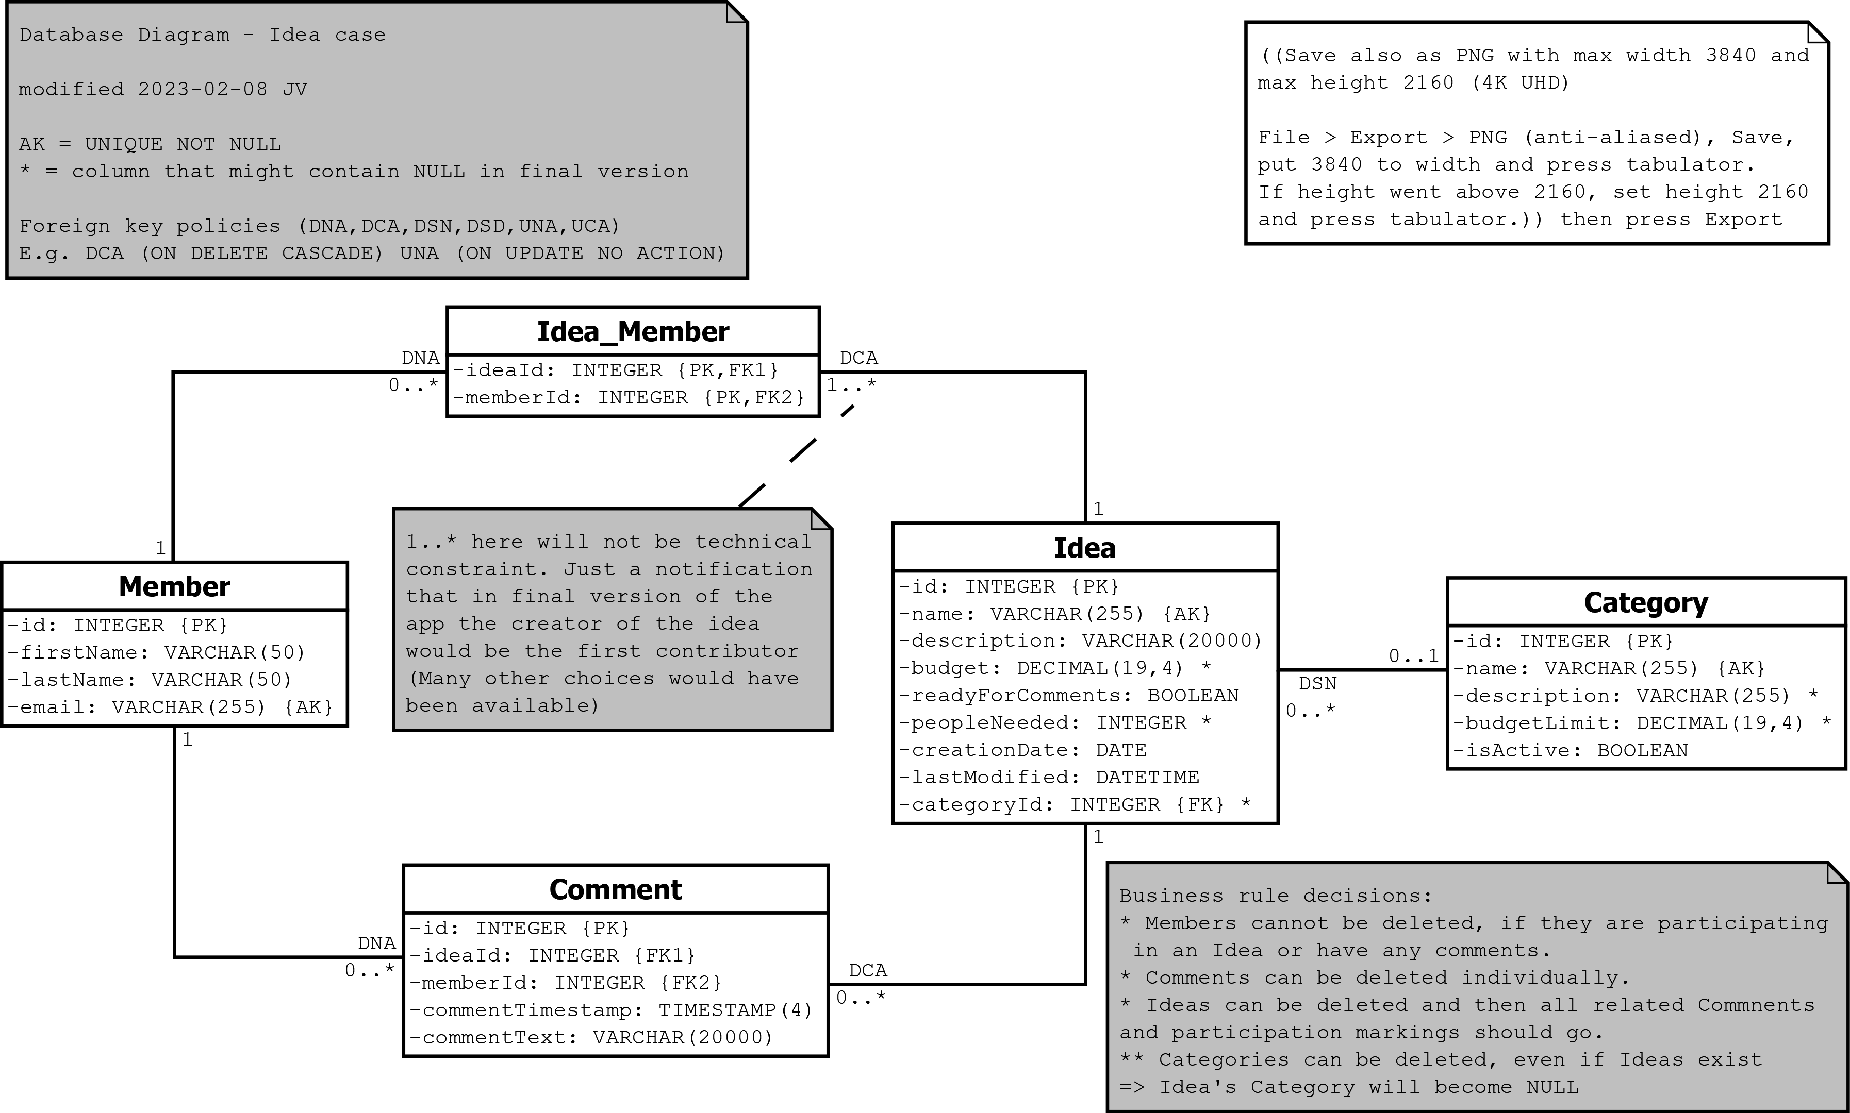
Here is how the database will look like:

Slide 16
Download the SQL script for creating the database
Now download at least the https://github.com/valju/idea-case-backend/blob/master/Database/SQL_Scripts/000_drop_create_insert.sql this file to some known folder.
Or just clone the repo
It drops, creates and populates the needed tables.

Slide 17
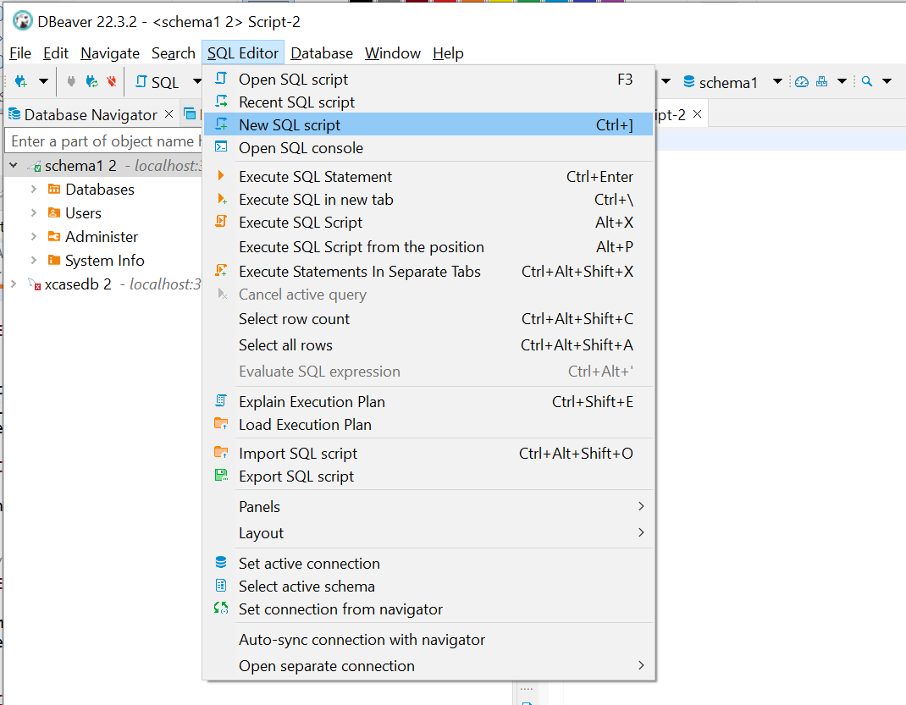
3.2.1 Use DBeaver to run SQL to create the tables and populate with test data

Slide 18
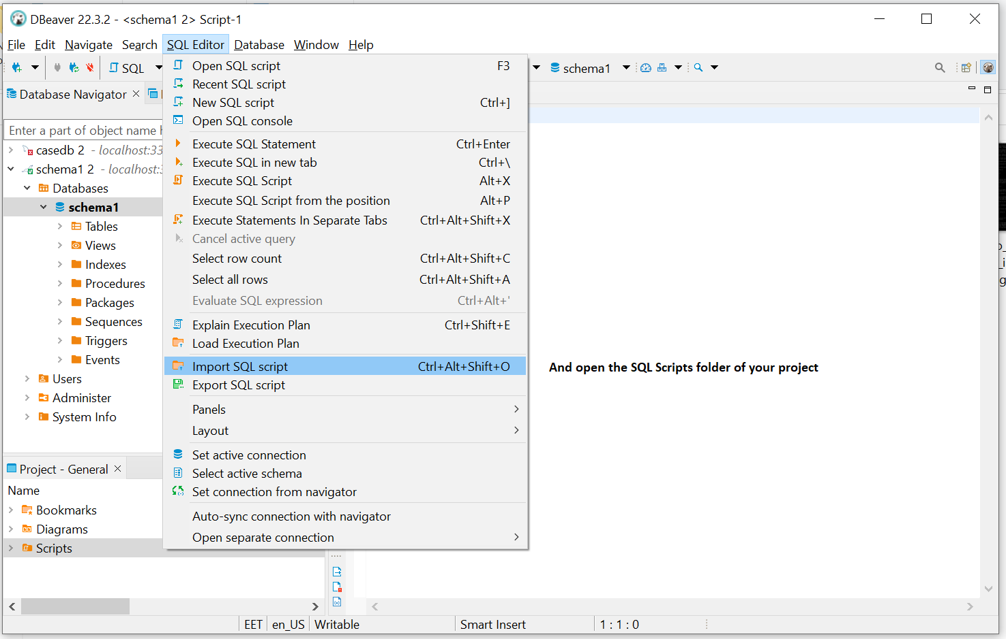
3.2.2 Use DBeaver to run SQL to create the tables and populate with test data

Slide 19
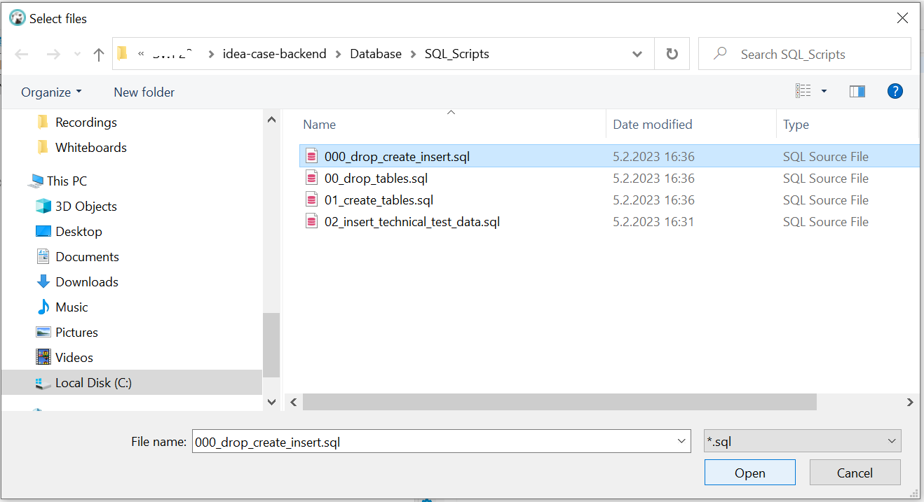
3.2.3 Use DBeaver to run SQL to create the tables and populate with test data

Slide 20
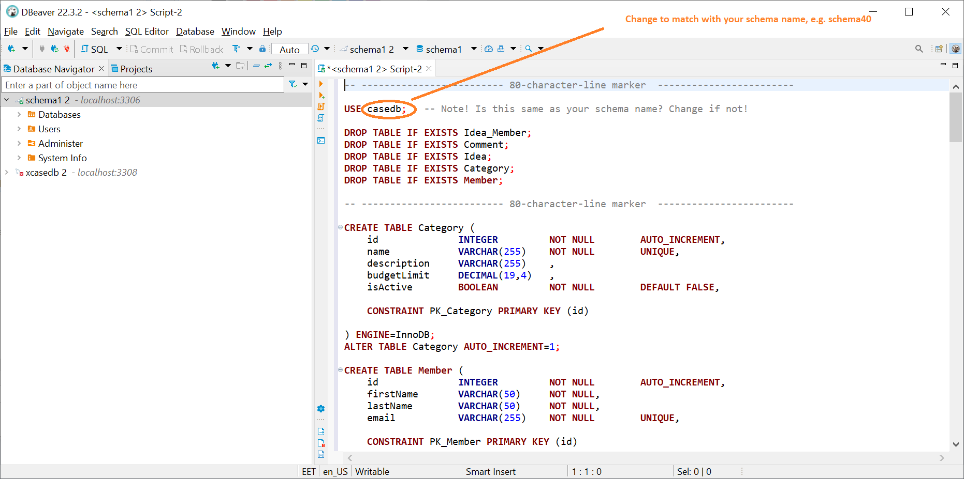
3.2.4 Use DBeaver to run SQL to create the tables and populate with test data

Slide 21
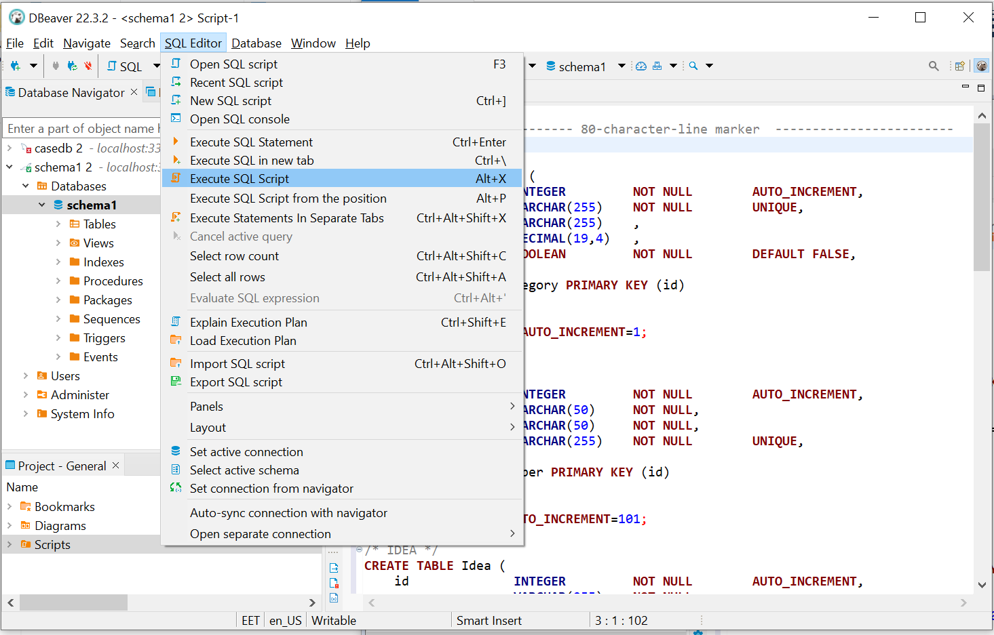
3.2.5 Use DBeaver to run SQL to create the tables and populate with test data

Slide 22
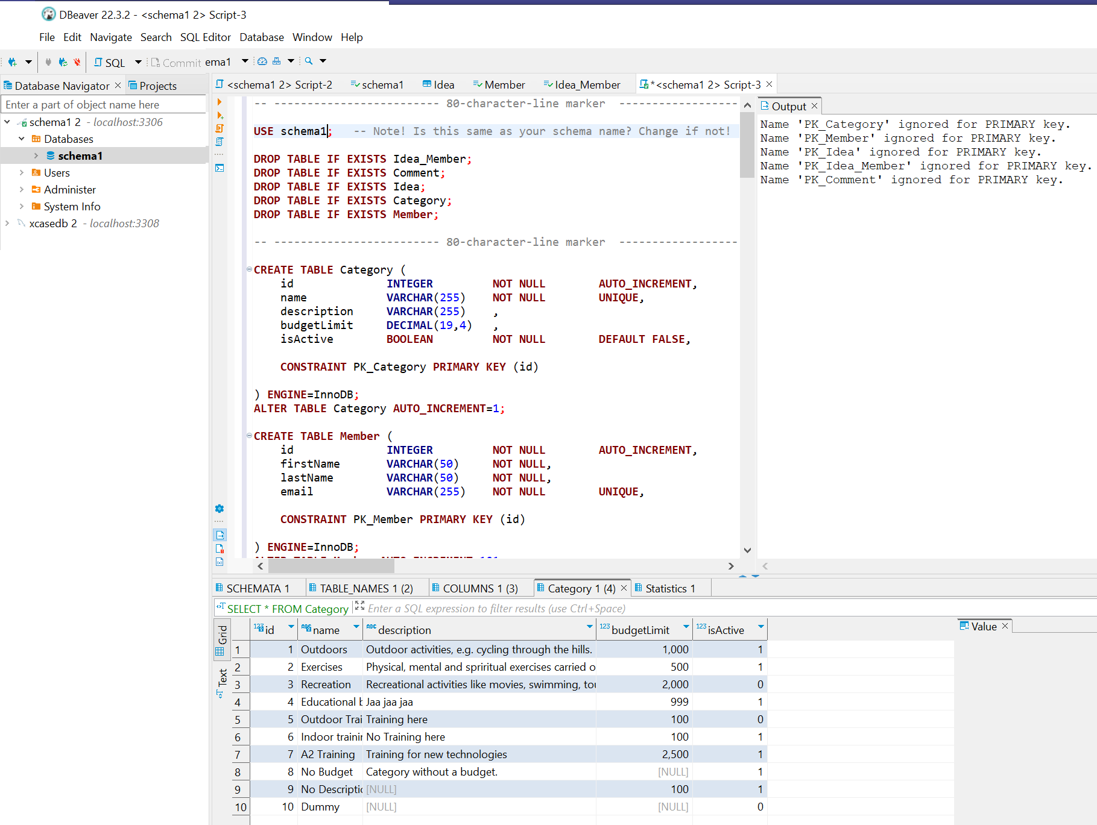
3.2.6 Use DBeaver to run SQL to create the tables and populate with test data – Success?

