Slide 1
The Different Stages To Learning How To Deploy A Laravel Application
https://github.com/haakco
tim@haak.co
Tim Haak

Slide 2

Why are people struggling with this?
Complexity
Not knowing where to start
What is enough
How hard is it actually

Slide 3
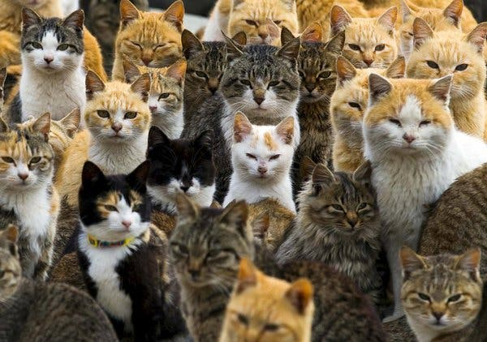
Why?
Complexity
People are overwhelmed
Where do you start
To many options and experts
What is enough
If I don’t get it perfect I’m a bad developer
How hard is it actually
Is it going to take me days and days to get it done

Slide 4

Why deploy yourself?
Control
Can make it work exactly how you want
Cost
Not having to pay for an extra service

Slide 5

Some tips
Don’t start with the latest fad
Even if it is actually better
Remember the people you read or watch are normally at the top of their fields.
It’s ok if you aren’t there yet.
Don’t worry about having to redo things.
If you try and learn a million things at one time you will fail
Start simple and then add

Slide 6

Different stages
Stage 0
Simplest
Each stage thereafter adds a tool to improve the deployment
Can learn each piece in context.
Feel free to jump ahead or mix and match
None of these are perfect or the way you have to do it
Only a suggested path

Slide 7

Examples
Every stage has a complete example.
They also have
Just replace things like example.com with your domain.
Each stage builds on the previous stage.
If you don’t understand something, just go back a stage
The example are not perfect and are a general case.

Slide 8
Examples
Examples for every stage can be found at the link bellow.
Not all stages are complete yet ☹
But should be in the next couple weeks ☺
https://github.com/haakco/the-different-stages-to-learning-how-to-deploy-a-laravel-application
https://git.io/J3t1E

Slide 9
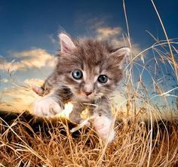
Stage 0
Just start a server and install what you need
Keep it simple
Example
https://github.com/haakco/the-different-stages-to-learning-how-to-deploy-a-laravel-application/tree/main/Stage_0
https://git.io/J3t1n

Slide 10
Stage 0
Literally just get a server up
Do everything manually
And install the software you need.
Save the commands and steps into a text file
Done
Either follow the guide in the git repository or follow the millions of examples online

Slide 11
Stage 0
Literally just get a single server up
Do everything manually
And install the software you need.
Save the commands and steps into a text file
Connect to the DB via IP and not socket
Done
Either follow the guide in the git repository or follow the millions of examples online

Slide 12
Stage 0
But it’s not using x technology that I heard you must have a use.
For now, it doesn’t matter
More sites are run this way than you would ever believe
Ignore the people who tell you that you are wrong.
Haters are going to hate

Slide 13
Stage 0
But if the serve goes down it will be offline.
Yes and?
Once again this happens more often than you realize for larger sites.

Slide 14
Stage 0
Following this you will learn what you need and how the config files and services you need work.
Without that knowledge you will be in for a painful time trying to automate.
Everything you learn can and will be use later.

Slide 15
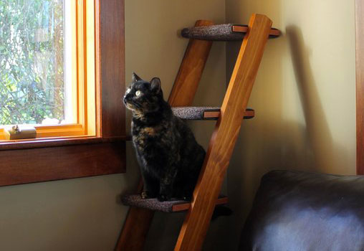
Stage 1
You now know what needs to be installed on the server and how to do it.
Now take the files with your steps and automate it.
You did save your steps into a file ☺

Slide 16

Stage 1
Here I would recommend Ansible.
It’s simple
Very close to the commands

Slide 17
Stage 1
Once again there is a complete example on how to do this here
https://git.io/J3tQN
https://github.com/haakco/the-different-stages-to-learning-how-to-deploy-a-laravel-application/tree/main/Stage_1

Slide 18
Stage 1
Main reasons for this change are
Repeatability
You will forget how you did things in a year
Documentation
Your sick someone else can see how things were put together
Speed of new server setup

Slide 19
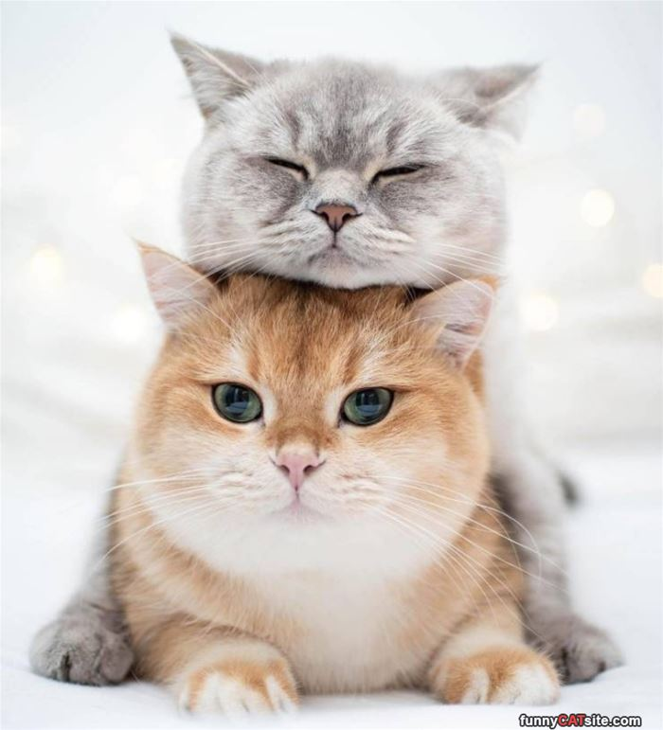
Stage 2
Well why stop at only automating the server install
Let's automate everything else.
Let’s have two servers while we are at it
And let’s split off the DB and Redis

Slide 20

Stage 2
Here I would recommend terraform
Really simple to learn
Will work with most cloud providers

Slide 21
Stage 2
Links for the working example
https://git.io/J3tdn
https://github.com/haakco/the-different-stages-to-learning-how-to-deploy-a-laravel-application/tree/main/Stage_2

Slide 22
Stage 2
Main reasons
Everything is now automated
Simple to scale up
Failover for at least the web servers is done
Simple to create a staging environment.

Slide 23

Stage 3
Nothing here yet ☹
Things planned for future stages
Start using Docker
Setting up automatic deployments
Complete local development environments using Docker
Kubernetes

Slide 24
Any questions?
https://github.com/haakco
tim@haak.co
Tim Haak

