Slide 1
Taking the pain out of application deployment
with Kubernetes automation
https://github.com/haakco
tim@haak.co
Tim Haak

Slide 2

Why are people struggling with this?
Complexity
Not knowing where to start
Example don’t work in the real world
Need to take a couple steps back first

Slide 3

Complete working working example
https://bit.ly/3A0ZxCM
Most of the pieces that you will need
Replace with your own pieces
Everything working together
…..
Profit?

Slide 4

Plan of attach
Go through what is needed to deploy an application
Talk about each piece of software as needed
Very high level
Links to software also in GitHub repository

Slide 5

Plan of attach
Start demo now
Go over actual code at the end
Depending on time

Slide 6

Server Provider
Digital Ocean
Could be any other cloud provider
Very high level
For your own servers can look at https://k3s.io/

Slide 7

DNS Provider
CloudFlare
Not using all the features
Simple to switch out

Slide 8
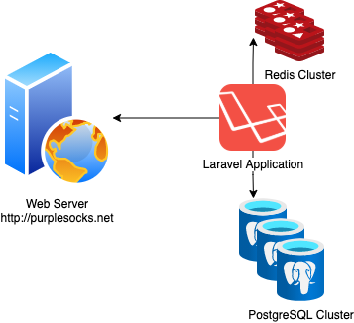

Application overview
https://devdojo.com/wave

Slide 9

Setup Kubernetes cluster
Terraform
Infrastructure as code
Committable to git
Digital Ocean provider
At least 3 nodes just to be safe

Slide 10

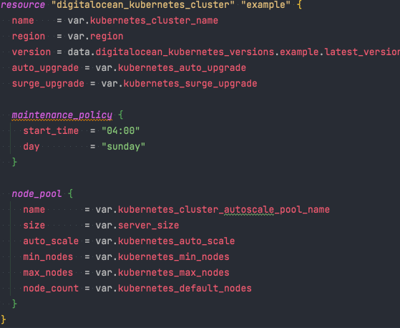
Quick example of code

Slide 11

Databases
Application needs PostgreSQL and Redis
Would be great to have High Availability (HA)
That sounds complicated

Slide 12

Helm
Helm to the rescue
https://helm.sh/
Helm is a package manager for Kubernetes that allows developers and operators to more easily package, configure, and deploy applications and services onto Kubernetes clusters
Configuration via YAML file

Slide 13

Helm
Britani Helm scripts handle everything
Including HA
https://bitnami.com/stack/postgresql/helm
https://bitnami.com/stack/redis/helm
Most help scripts don’t work on ARM ☹

Slide 14

Helm
Only application not using Helm
Helm used for all other applications
See git repository for code

Slide 15
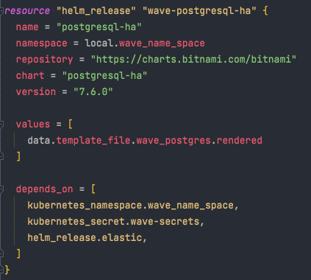
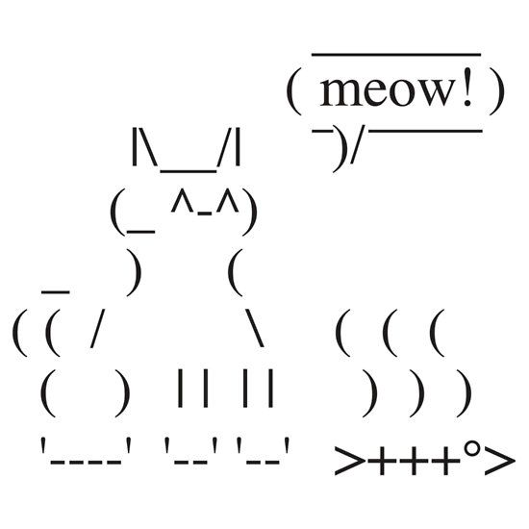
Terraform and helm
But I thought you said single run
Terraform can run helm scripts

Slide 16
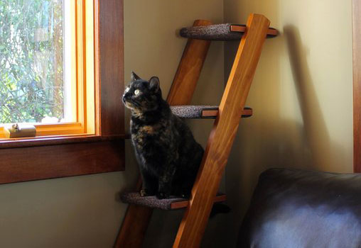
Deploy Application
Terraform can also run normal Kubernetes files
Only deployment not using Helm
Application is built as a Docker Image
Once again everything on GitHub
Base Image
https://bit.ly/3l5kuIs
With wave
https://bit.ly/2YjPR9u

Slide 17

DNS
How do we get the URL Mapped to the cluster
External DNS
https://github.com/kubernetes-sigs/external-dns
Automatically updates DNS provider via annotations
See git for configuration
Once configured just needs a line like the following

Slide 18

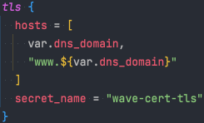
SSL Cert
How do we get the SSL cert?
There’s an app for that
https://cert-manager.io/
Configuration in ingress controller
Uses lets-encrypt

Slide 19

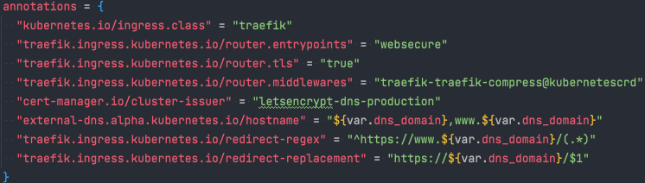
Load-Balance HTTP Routing
How does traffic get to the application
https://traefik.io/
Annotation in ingress config

Slide 20

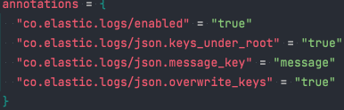
Application Logging
ELK stack
https://www.elastic.co
Logs configured via annotation

Slide 21
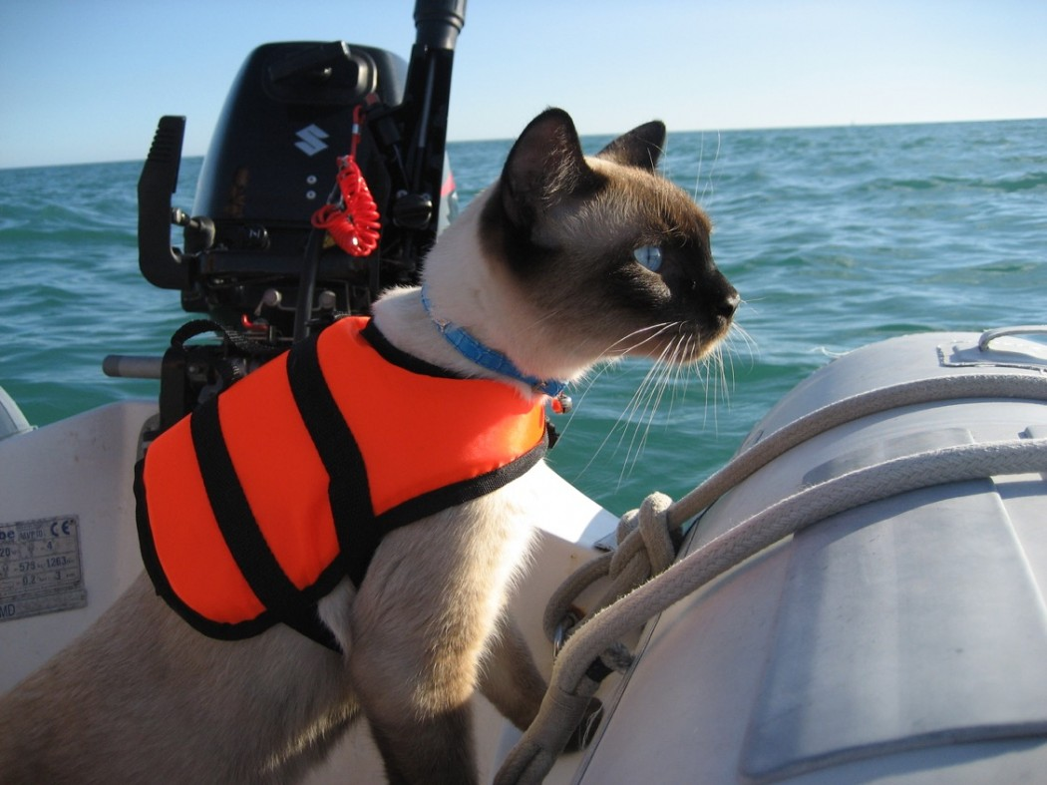
Auto update
https://keel.sh
Configured via annotation
To many to methods to check for update to mention
Currently using if newer image available

Slide 22

Demo

Slide 23
Any questions?
https://github.com/haakco
tim@haak.co
Tim Haak

